Slide 1
Faster
Dave Ward
dward@cisco.com

Slide 2
Fast Community Growth

Slide 3
Active Community – Launched 2016-02-11
545 commits from 52 contributors
Well attended Weekly Community Calls:
VPP – 8am PST Tuesdays
TSC – 8am PST Thursdays
New Projects:
Continuous System Integration Test (CSIT) – approved 3/17
Honeycomb – approved 3/24
NSH SFC – approved 3/24
Overlay Network Engine – approved 3/24
More under discussion
Netlink agent

Slide 4
Upcoming Release
Vpp project began discussing Release Plan in its weekly call
Targeting 2016-06-17 Release (16.06)
Themes:
Use dpdk 16.04
IP fib cleanups
Packaging/Consumability
Testing (CSIT/CPL/Performance)

Slide 5
Touchpoints with other communities
OpenDaylight
Honeycomb Virtual Bridge Domain project approved
ODL app using fd.io for virtual bridge domains
OpNFV
Fast Data Stacks Project Proposed
OpNFV project to integrate OpenStack/ODL/fd.io

Slide 6
Events
Fd.io @ ONS – occurred week of 3/14
“fd.io is the future” – business track talk
“Fd.io intro” – developer track talk
“fd.io meetup”
Fd.io IETF Hackfest – 3/2 Buenos Areas
Fd.io Training/Hackfest – this event

Slide 7
Fast(er) Data

Slide 8
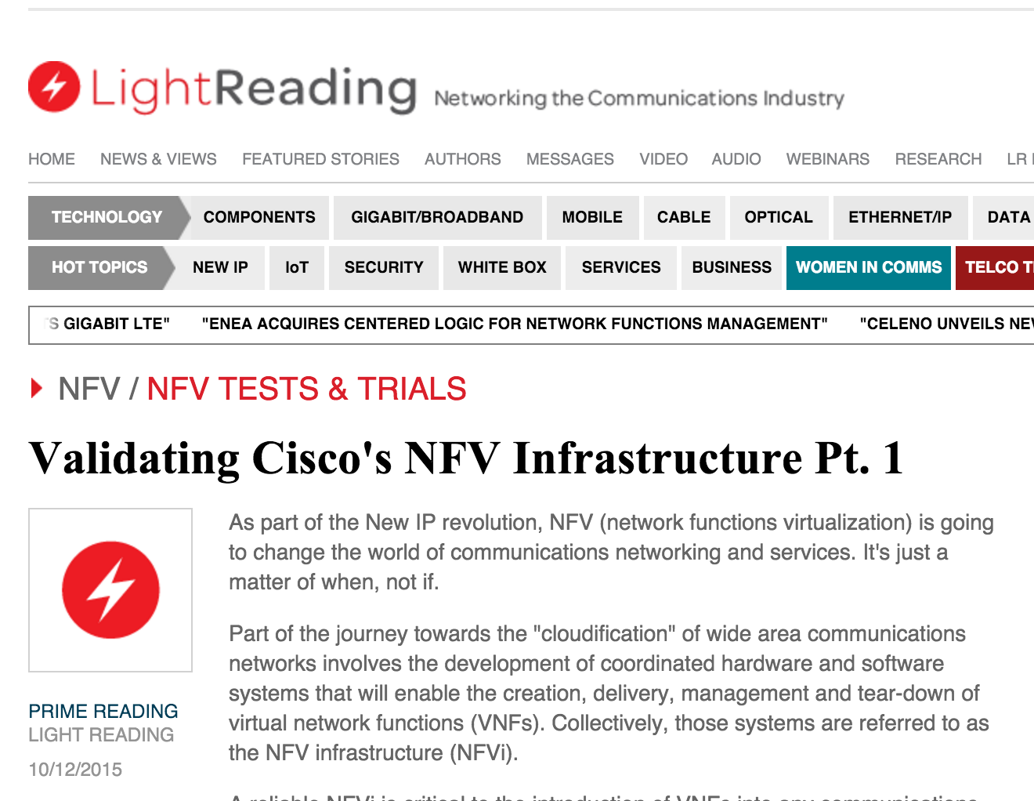
NDR rates for 2p10GE, 1 core, L2 NIC-to-NIC
[IMIX Gbps]
NDR rates for 12 port 10GE, 12 cores, IPv4
[IMIX Gbps]
VPP technology in a nutshell
VPP data plane throughput not impacted by large FIB size
OVSDPDK data plane throughput heavily impacted by FIB size
VPP and OVSDPDK tested on Haswell x86 platform with E5-2698v3 2x16C 2.3GHz (Ubuntu 14.04 trusty)
not tested

Slide 9
vNet-SLA benchmarking at scale: L2 MAC VPP-based vSwitch
Phy-VS-Phy
Zero-packet-loss Throughput for 12 port 40GE, 24 cores L2 MAC
Zero-packet-loss Throughput for 12 port 40GE, 24 cores, L2 MAC
[Gbps]
[Mpps]
FD.io VPP data plane throughput not impacted by large L2 MAC FIB size
VPP tested on UCS 4-CPU-socket server with 4 of Intel “Haswell" x86-64 processors E7-8890v3 18C 2.5GHz
24 Cores used – Another 48 cores can be used for other network services!
VPP vSwitch IPv4 routed forwarding FIB with 2 million L2 MAC entries 12x40GE (480GE) 64B frames
200Mpps zero frame loss
NIC and PCIe is the limit not VPP
VPP vSwitch IPv4 routed forwarding FIB with 2 million L2 MAC entries
12x40GE (480GE) IMIX frames
480Gbps zero frame loss
“Sky” is the limit not VPP

Slide 10
vNet-SLA benchmarking at scale: IPv6 VPP-based vSwitch
Phy-VS-Phy
Zero-packet-loss Throughput for 12 port 40GE, 24 cores, IPv6
Zero-packet-loss Throughput for 12 port 40GE, 24 cores, IPv6
[Gbps]
[Mpps]
FD.io VPP data plane throughput not impacted by large size of IPv6 FIB
VPP tested on UCS 4-CPU-socket server with 4 of Intel “Haswell" x86-64 processors E7-8890v3 18C 2.5GHz
24 Cores used – Another 48 cores can be used for other network services!
VPP vSwitch IPv4 routed forwarding FIB with 2 milion IPv6 entries 12x40GE (480GE) 64B frames
200Mpps zero frame loss
NIC and PCIe is the limit not VPP
VPP vSwitch IPv4 routed forwarding FIB with 2 milion IPv6 entries
12x40GE (480GE) IMIX frames
480Gbps zero frame loss
“Sky” is the limit not VPP

Slide 11
vNet benchmarking at scale: IPv4 on VPP vSwitch
Zero-Packet-Loss Throughput for 18 port 40GE, 36 cores, IPv4
[Gbps]
[Mpps]
FD.io VPP data plane throughput not impacted by large size of IPv4 FIB
VPP tested on UCS 4-CPU server with 4x Intel E7-8890v3 (18C 2.5GHz)
36 Core used – NIC RSS=2 to drive NIC performance, VPP cores not busy!
Another 36 cores available for other services!
VPP vSwitch IPv4 routed forwarding, FIB up to 8M IPv4
Zero Packet Loss Measurements
IMIX => 342 Gbps
1518B => 462 Gbps
“Sky” is the limit not VPP
64B => 297 Mpps
NIC and PCIe is the limit not VPP

Slide 12
vNet benchmarking at scale: IPv4+SEcurity
Zero-Packet-Loss Throughput for 18 port 40GE, 36 cores, IPv4
[Gbps]
[Mpps]
That is Right – No Impact on IMIX and 1518B Performance
FD.io VPP data plane throughput not impacted by large size of IPv4 FIB
VPP tested on UCS 4-CPU server with 4x Intel E7-8890v3 (18C 2.5GHz)
36 Core used – NIC RSS=2 to drive NIC performance, VPP cores not busy!
Another 36 cores available for other services!
VPP vSwitch IPv4 rtd fwding, FIB up to 8M IPv4, 2k white-list
Zero Packet Loss Measurements
IMIX => 342 Gbps
1518B => 462 Gbps
“Sky” is the limit not VPP
64B => 238 Mpps
NIC and PCIe is the limit not VPP

Slide 13
VPP Cores Not Completely Busy
VPP Vectors Have Space For More Services and More Packets!!
PCIe 3.0 and NICs Are The Limit
And How Do We Know This?
Simples – A Well Engineered Telemetry
In Linux and VPP Tells Us So
========
TC5 120ge.vpp.24t24pc.ip4.cop
TC5.0 120ge.2pnic.6nic.rss2.vpp.24t24pc.ip4.cop
d. testcase-vpp-ip4-cop-scale
120ge.2pnic.6nic.rss2.vpp.24t24pc.ip4.2m.cop.2.copip4dst.2k.match.100
64B, 138.000Mpps, 92,736Gbps
IMIX, 40.124832Mpps, 120.000Gbps
1518, 9.752925Mpps, 120.000Gbps
---------------
Thread 1 vpp_wk_0 (lcore 2)
Time 45.1, average vectors/node 23.44, last 128 main loops 1.44 per node 23.00
vector rates in 4.6791e6, out 4.6791e6, drop 0.0000e0, punt 0.0000e0
Name State Calls Vectors Suspends Clocks Vectors/Call
TenGigabitEtherneta/0/1-output active 9003498 211054648 0 1.63e1 23.44
TenGigabitEtherneta/0/1-tx active 9003498 211054648 0 7.94e1 23.44
cop-input active 9003498 211054648 0 2.23e1 23.44
dpdk-input polling 45658750 211054648 0 1.52e2 4.62
ip4-cop-whitelist active 9003498 211054648 0 4.34e1 23.44
ip4-input active 9003498 211054648 0 4.98e1 23.44
ip4-lookup active 9003498 211054648 0 6.25e1 23.44
ip4-rewrite-transit active 9003498 211054648 0 3.43e1 23.44
---------------
Thread 24 vpp_wk_23 (lcore 29)
Time 45.1, average vectors/node 27.04, last 128 main loops 1.75 per node 28.00
vector rates in 4.6791e6, out 4.6791e6, drop 0.0000e0, punt 0.0000e0
Name State Calls Vectors Suspends Clocks Vectors/Call
TenGigabitEthernet88/0/0-outpu active 7805705 211055503 0 1.54e1 27.04
TenGigabitEthernet88/0/0-tx active 7805705 211055503 0 7.75e1 27.04
cop-input active 7805705 211055503 0 2.12e1 27.04
dpdk-input polling 46628961 211055503 0 1.60e2 4.53
ip4-cop-whitelist active 7805705 211055503 0 4.35e1 27.04
ip4-input active 7805705 211055503 0 4.86e1 27.04
ip4-lookup active 7805705 211055503 0 6.02e1 27.04
ip4-rewrite-transit active 7805705 211055503 0 3.36e1 27.04

Slide 14
VPP Cores Not Completely Busy
VPP Vectors Have Space For More Services and More Packets!!
PCIe 3.0 and NICs Are The Limit
And How Do We Know This?
Simples – A Well Engineered Telemetry
In Linux and VPP Tells Us So
VPP average vector size below shows 23-to-27
This indicates VPP program worker threads are not busy
Busy VPP worker threads should be showing 255
This means that VPP worker threads operate at 10% capacity
It’s like driving 1,000hp car at 100hp power – lots of space
for adding (service) acceleration and (sevice) speed.
========
TC5 120ge.vpp.24t24pc.ip4.cop
TC5.0 120ge.2pnic.6nic.rss2.vpp.24t24pc.ip4.cop
d. testcase-vpp-ip4-cop-scale
120ge.2pnic.6nic.rss2.vpp.24t24pc.ip4.2m.cop.2.copip4dst.2k.match.100
64B, 138.000Mpps, 92,736Gbps
IMIX, 40.124832Mpps, 120.000Gbps
1518, 9.752925Mpps, 120.000Gbps
---------------
Thread 1 vpp_wk_0 (lcore 2)
Time 45.1, average vectors/node 23.44, last 128 main loops 1.44 per node 23.00
vector rates in 4.6791e6, out 4.6791e6, drop 0.0000e0, punt 0.0000e0
Name State Calls Vectors Suspends Clocks Vectors/Call
TenGigabitEtherneta/0/1-output active 9003498 211054648 0 1.63e1 23.44
TenGigabitEtherneta/0/1-tx active 9003498 211054648 0 7.94e1 23.44
cop-input active 9003498 211054648 0 2.23e1 23.44
dpdk-input polling 45658750 211054648 0 1.52e2 4.62
ip4-cop-whitelist active 9003498 211054648 0 4.34e1 23.44
ip4-input active 9003498 211054648 0 4.98e1 23.44
ip4-lookup active 9003498 211054648 0 6.25e1 23.44
ip4-rewrite-transit active 9003498 211054648 0 3.43e1 23.44
---------------
Thread 24 vpp_wk_23 (lcore 29)
Time 45.1, average vectors/node 27.04, last 128 main loops 1.75 per node 28.00
vector rates in 4.6791e6, out 4.6791e6, drop 0.0000e0, punt 0.0000e0
Name State Calls Vectors Suspends Clocks Vectors/Call
TenGigabitEthernet88/0/0-outpu active 7805705 211055503 0 1.54e1 27.04
TenGigabitEthernet88/0/0-tx active 7805705 211055503 0 7.75e1 27.04
cop-input active 7805705 211055503 0 2.12e1 27.04
dpdk-input polling 46628961 211055503 0 1.60e2 4.53
ip4-cop-whitelist active 7805705 211055503 0 4.35e1 27.04
ip4-input active 7805705 211055503 0 4.86e1 27.04
ip4-lookup active 7805705 211055503 0 6.02e1 27.04
ip4-rewrite-transit active 7805705 211055503 0 3.36e1 27.04

Slide 15
VPP Cores Not Completely Busy
VPP Vectors Have Space For More Services and More Packets!!
PCIe 3.0 and NICs Are The Limit
And How Do We Know This?
Simples – A Well Engineered Telemetry
In Linux and VPP Tells Us So
VPP average vector size below shows 23-to-27
This indicates VPP program worker threads are not busy
Busy VPP worker threads should be showing 255
This means that VPP worker threads operate at 10% capacity
It’s like driving 1,000bhp car at 100bhp power – lots of space
for adding (service) acceleration and (sevice) speed.
========
TC5 120ge.vpp.24t24pc.ip4.cop
TC5.0 120ge.2pnic.6nic.rss2.vpp.24t24pc.ip4.cop
d. testcase-vpp-ip4-cop-scale
120ge.2pnic.6nic.rss2.vpp.24t24pc.ip4.2m.cop.2.copip4dst.2k.match.100
64B, 138.000Mpps, 92,736Gbps
IMIX, 40.124832Mpps, 120.000Gbps
1518, 9.752925Mpps, 120.000Gbps
---------------
Thread 1 vpp_wk_0 (lcore 2)
Time 45.1, average vectors/node 23.44, last 128 main loops 1.44 per node 23.00
vector rates in 4.6791e6, out 4.6791e6, drop 0.0000e0, punt 0.0000e0
Name State Calls Vectors Suspends Clocks Vectors/Call
TenGigabitEtherneta/0/1-output active 9003498 211054648 0 1.63e1 23.44
TenGigabitEtherneta/0/1-tx active 9003498 211054648 0 7.94e1 23.44
cop-input active 9003498 211054648 0 2.23e1 23.44
dpdk-input polling 45658750 211054648 0 1.52e2 4.62
ip4-cop-whitelist active 9003498 211054648 0 4.34e1 23.44
ip4-input active 9003498 211054648 0 4.98e1 23.44
ip4-lookup active 9003498 211054648 0 6.25e1 23.44
ip4-rewrite-transit active 9003498 211054648 0 3.43e1 23.44
---------------
Thread 24 vpp_wk_23 (lcore 29)
Time 45.1, average vectors/node 27.04, last 128 main loops 1.75 per node 28.00
vector rates in 4.6791e6, out 4.6791e6, drop 0.0000e0, punt 0.0000e0
Name State Calls Vectors Suspends Clocks Vectors/Call
TenGigabitEthernet88/0/0-outpu active 7805705 211055503 0 1.54e1 27.04
TenGigabitEthernet88/0/0-tx active 7805705 211055503 0 7.75e1 27.04
cop-input active 7805705 211055503 0 2.12e1 27.04
dpdk-input polling 46628961 211055503 0 1.60e2 4.53
ip4-cop-whitelist active 7805705 211055503 0 4.35e1 27.04
ip4-input active 7805705 211055503 0 4.86e1 27.04
ip4-lookup active 7805705 211055503 0 6.02e1 27.04
ip4-rewrite-transit active 7805705 211055503 0 3.36e1 27.04
VPP is also counting the cycles-per-packet (CPP)
We know exactly what feature, service, packet processing activity is using the CPU cores
We can engineer, we can capacity plan, we can automate service placement
We can scale across many many CPU cores and computers
And AUTOMATE it easily – as it is after all just SOFTWARE

Slide 16
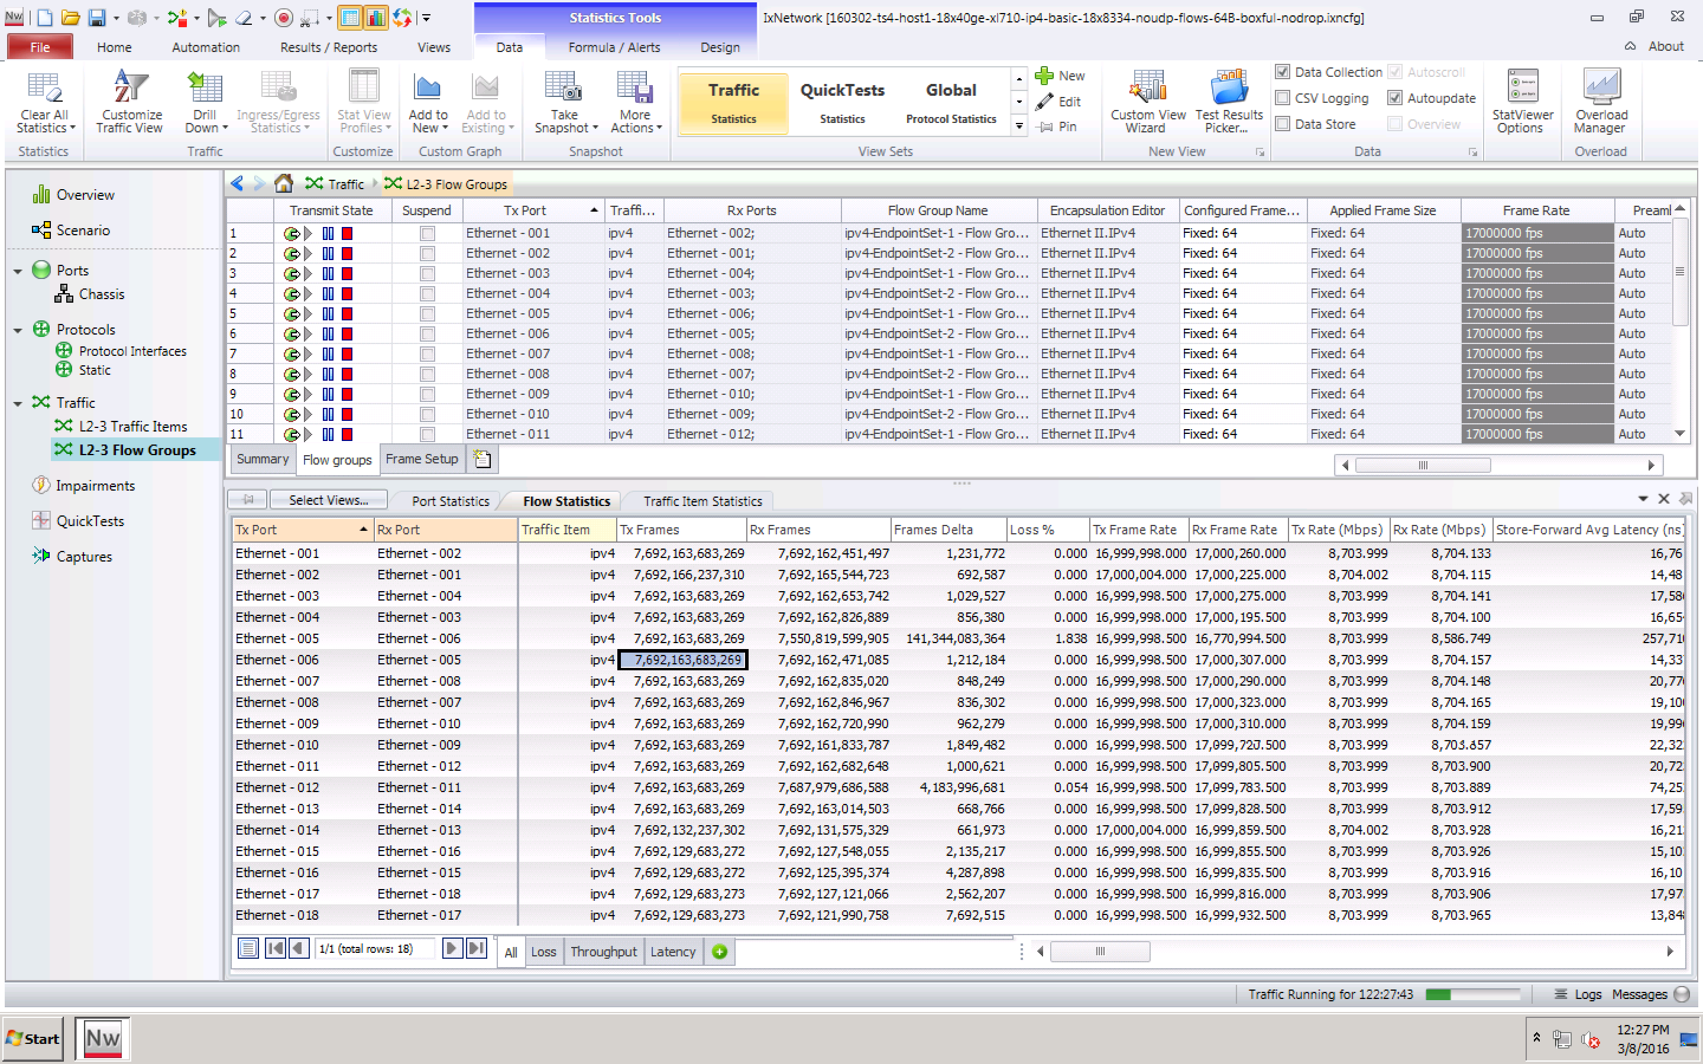
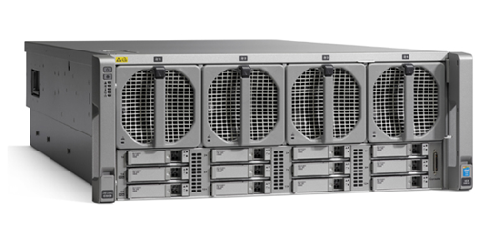
ONE MORE THING – THE LONG TERM MAX DELAY
Low long-term max packet delay with FD.io VPP
>>120 msec long-term max packet delay measured by others for other vSwitches
But it is just not not there with VPP and stock Ubuntu 14.04 (no Linux tuning!)
The Fast Data Project (FD.io)
The Soak Test Proof:
18 x 7.7trillion packets forwarded.
Compute Node Software | Version
Host Operating System | Ubuntu 14.04.3 LTS Kernel version: 3.13.0-63-generic
DPDK | DPDK 2.2.0
FD.io VPP | vpp v1.0.0-174~g57a90e5
Compute Node Hardware | Cisco UCS C460 M4
Chipset | Intel® C610 series chipset
CPU | 4 x Intel® Xeon® Processor E7-8890 v3 (18 cores, 2.5GHz, 45MB Cache)
Memory | 2133 MHz, 512 GB Total
NICs | 9 x 2p40GE Intel XL710 18 x 40GE = 720GE !!
18x

Slide 17
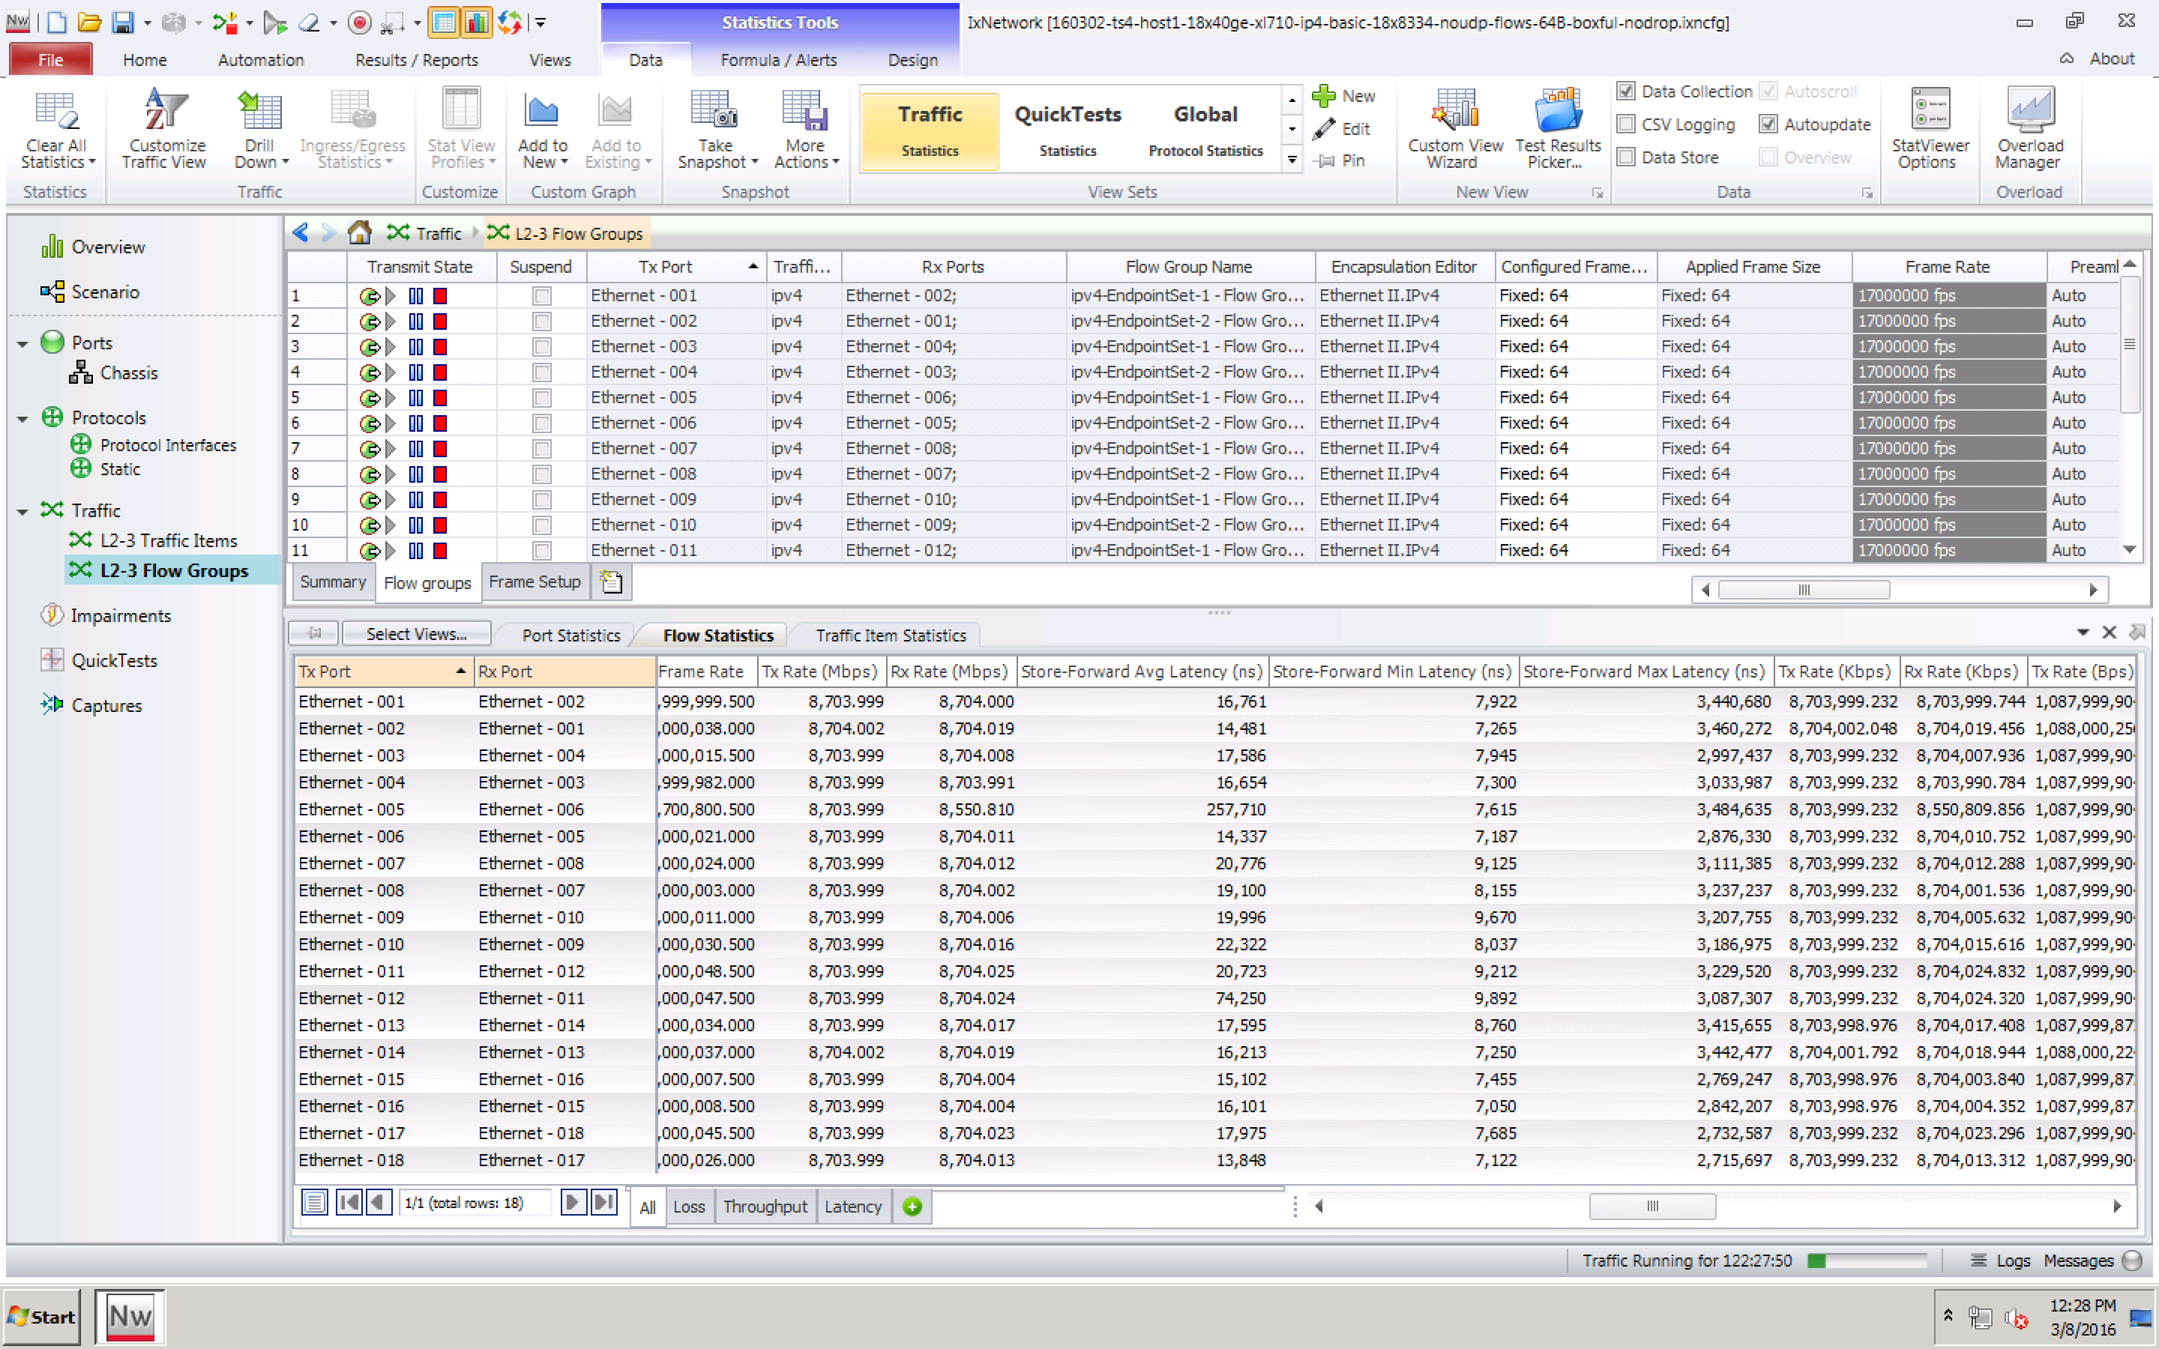
ONE MORE THING – THE LONG TERM MAX DELAY
Low long-term max packet delay with FD.io VPP
>>120 msec long-term max packet delay measured by others for other vSwitches
But it is just not not there with VPP and stock Ubuntu 14.04 (no Linux tuning!)
The Fast Data Project (FD.io)
The Soak Test Proof:
18 x 7.7trillion packets forwarded.
VPP: 3.5msec Max Packet Delay incl. the outliers!!
Compute Node Software | Version
Host Operating System | Ubuntu 14.04.3 LTS Kernel version: 3.13.0-63-generic
DPDK | DPDK 2.2.0
FD.io VPP | vpp v1.0.0-174~g57a90e5
Compute Node Hardware | Cisco UCS C460 M4
Chipset | Intel® C610 series chipset
CPU | 4 x Intel® Xeon® Processor E7-8890 v3 (18 cores, 2.5GHz, 45MB Cache)
Memory | 2133 MHz, 512 GB Total
NICs | 9 x 2p40GE Intel XL710 18 x 40GE = 720GE !!
<3.5 msec

Slide 18
Next steps in benchmarking: VPP and CPU systems
Here is a teaser of a few things we are testing and exploring with VPP running the servers and computers, running them hard, sweating on processing packets:
PCIe3.0 sub-system benchmarking of 8x and 16x lanes, switching and DMA, DCA.
CPU microarchitectures efficiency, core and uncore subsystems.
CPU cache and memory coherence.
Multi-core x86_64, AArch64, other - for L/M/S/XS deployments (Large/Medium/Small/eXtraSmall).

Slide 19
Fast Innovation

Slide 20
VPP Architecture - Modularity Enabling Flexible Plugins
Packet vector
…
Plugins == Subprojects
Plugins can:
Introduce new graph nodes
Rearrange packet processing graph
Can be built independently of VPP source tree
Can be added at runtime (drop into plugin directory)
All in user space
Enabling:
Ability to take advantage of diverse hardware when present
Support for multiple processor architectures (x86, ARM, PPC)
Few dependencies on the OS (clib) allowing easier ports to other Oses/Env
ethernet-input
Plug-in to enable new HW input Nodes
mpls-ethernet-input
ip4input
llc-input
ip6-input
arp-input
…
ip6-lookup
Plug-in to create new nodes
ip6-rewrite-transmit
ip6-local
Custom-A
Custom-B

Slide 21
VPP Feature Summary
IPv4/IPv6
IPv4
L2
14+ MPPS, single core
Multimillion entry FIBs
Source RPF
Thousands of VRFs
Controlled cross-VRF lookups
Multipath – ECMP and Unequal Cost
Multiple million Classifiers –
Arbitrary N-tuple
VLAN Support – Single/Double tag
Counters for everything
Mandatory Input Checks:
TTL expiration
header checksum
L2 length < IP length
ARP resolution/snooping
ARP proxy
GRE, MPLS-GRE, NSH-GRE,
VXLAN
IPSEC
DHCP client/proxy
CG NAT
VLAN Support
Single/ Double tag
L2 forwarding with EFP/BridgeDomain concepts
VTR – push/pop/Translate (1:1,1:2, 2:1,2:2)
Mac Learning – default limit of 50k addresses
Bridging – Split-horizon group support/EFP Filtering
Proxy Arp
Arp termination
IRB – BVI Support with RouterMac assignment
Flooding
Input ACLs
Interface cross-connect
IPv6
Neighbor discovery
Router Advertisement
DHCPv6 Proxy
L2TPv3
Segment Routing
MAP/LW46 – IPv4aas
iOAM
MPLS
MPLS-o-Ethernet –
Deep label stacks supported
Notes:
The input checks included by VPP include mandatory networking checks.
Some solutions today either don’t perform these or don’t have them leading to questionable performance numbers

Slide 22
Examples of Other possible subprojects
Loadbalancer
Firewall
IDS
Host Stack
Hardware Accelerators
RFC Support
BFD
OAM
Control plane – support your favorite SDN Protocol Agent
Spanning Tree
DPI
Test tools
Cloud Foundry Integration
Container Integration
Packaging
Testing

Slide 23
Fast Forward

Slide 24
OpenStack Integration
Working on installer changes needed to add ODL & VPP as the networking stack for Openstack
Provides a programmable interface to include ‘edge’ network programming into a virtual environment
Allows for multiple data plane forwarders to be active
Openstack
Neutron
ODL
Plugin
Control Plane
HC
Data Plane
VPP

Slide 25
Container Integration
Netlink Server to ‘intercept’ netlink calls from existing container control planes
Netlink Server then programs VPP as appropriate
Container control planes can evolve to interfacing directly with VPP at their own pace
Control Plane
…
cni
libnetwork
calico
weave
flannel
Netlink Server
Data Plane
VPP

Slide 26
NFV - SFCs
NSH_SFC support in VPP to support NSH enabled SFCs
Expose NSH_SFC Programmability via Honeycomb
Program global SFCs from OpenDaylight SFC using IETF SFC model
Control Plane
SFC
HC
Data Plane
VPP
NSH_SFC

Slide 27
NFV - VNFs
Build VNFs using VPP Framework
High performance
Can focus only on new functionality
Existing graph provides switching/routing
Control VNFs via Honeycomb
HC
Data Plane
VPP
VNF

Slide 28
Ubiquity
Packaging – debs, rpms
Support all uarchs via one binary package
Upstream to distributions
Configuration - Puppet/Chef modules
Upstream

Slide 29
Fast Validation

Slide 30
Continuous Performance Lab (CPL)
Submit Patch
Automated Testing
Deploy
Develop
Fully automated testing infrastructure
Covers both programmability and data planes
Continuous verification of code/feature
Functionality and performance
Code breakage and performance degradations identified before patch review
Review, commit and release resource protected
Fully open sourced test framework to be included at launch

Slide 31
Continuous Performance Lab (CPL)
Submit Patch
Automated Testing
Deploy
Develop
Continuous Functional Testing
VM based virtual testbeds (3-node/3-VM topologies)
Continuous verification of feature conformance
Highly parallel test execution
Membership dues can donate VMs …. to the CPL
Continuous Benchmark Testing
Server based hardware testbeds (3-node/3-server topologies)
Continuous integration process with real hardware verification
Server models, CPU models, NIC models
Platinum Members can donate hardware to the CPL

Slide 32
Next Steps – Get Involved
We invite you to Participate in fd.io
Get the Code, Build the Code, Run the Code
Read/Watch the Tutorials
Join the Mailing Lists
Join the IRC Channels
Explore the wiki

