Slide 1
Fd.io: The Universal Dataplane

Slide 2
FD.io: The Universal Dataplane
Project at Linux Foundation
Multi-party
Multi-project
Software Dataplane
High throughput
Low Latency
Feature Rich
Resource Efficient
Bare Metal/VM/Container
Multiplatform
Fd.io Scope:
Network IO - NIC/vNIC <-> cores/threads
Packet Processing – Classify/Transform/Prioritize/Forward/Terminate
Dataplane Management Agents - ControlPlane
Bare Metal/VM/Container
Dataplane Management Agent
Packet Processing
Network IO

Slide 3
Fd.io in the overall stack
Application Layer/App Server
Orchestration
Network Controller
Data Plane Services
Dataplane Management Agent
Packet Processing
Network IO
Operation System
Hardware

Slide 4
Multiparty: Broad Membership
Chip Vendors
Service Providers
Network Vendors
Integrators

Slide 5
Multiparty: Broad Contribution
Qiniu
Yandex
Universitat Politècnica de Catalunya (UPC)

Slide 6
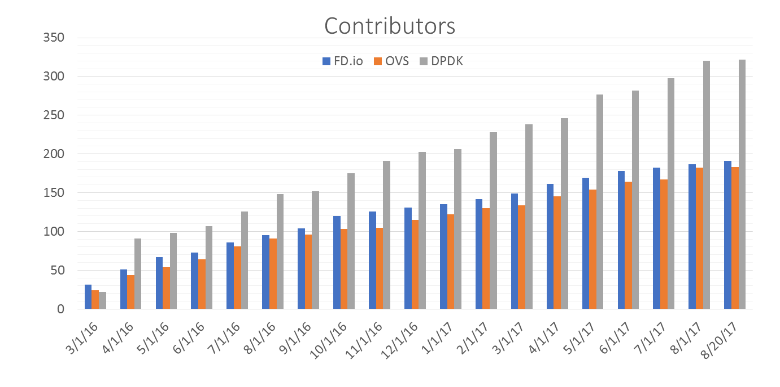
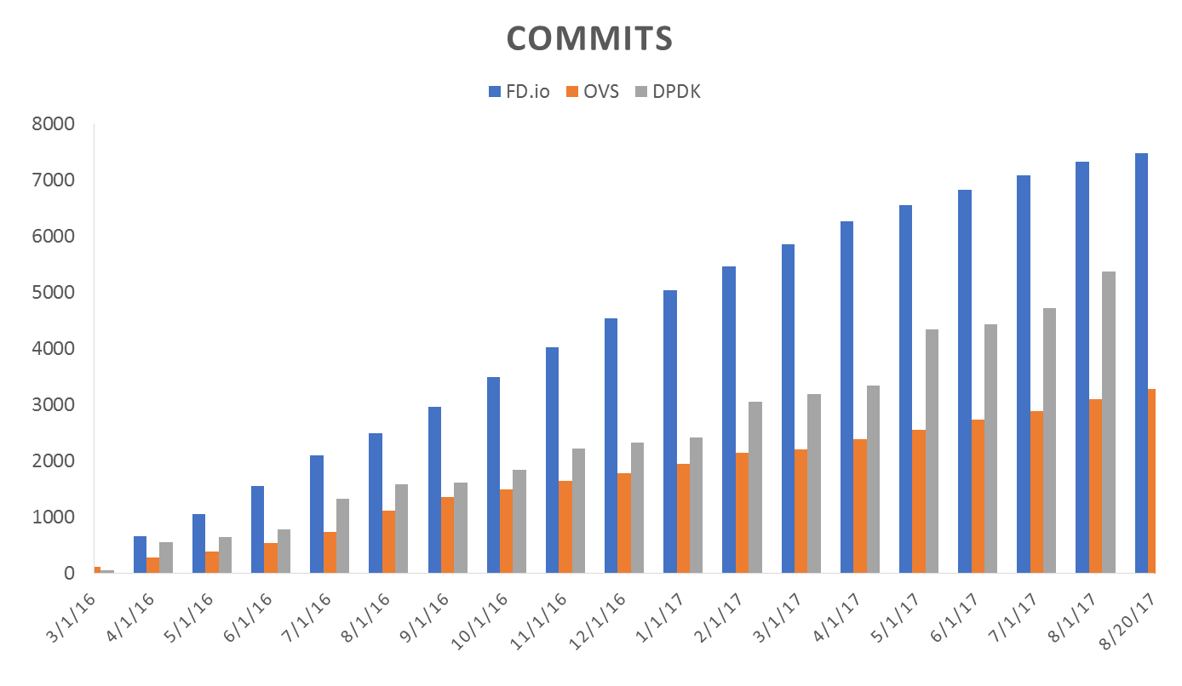
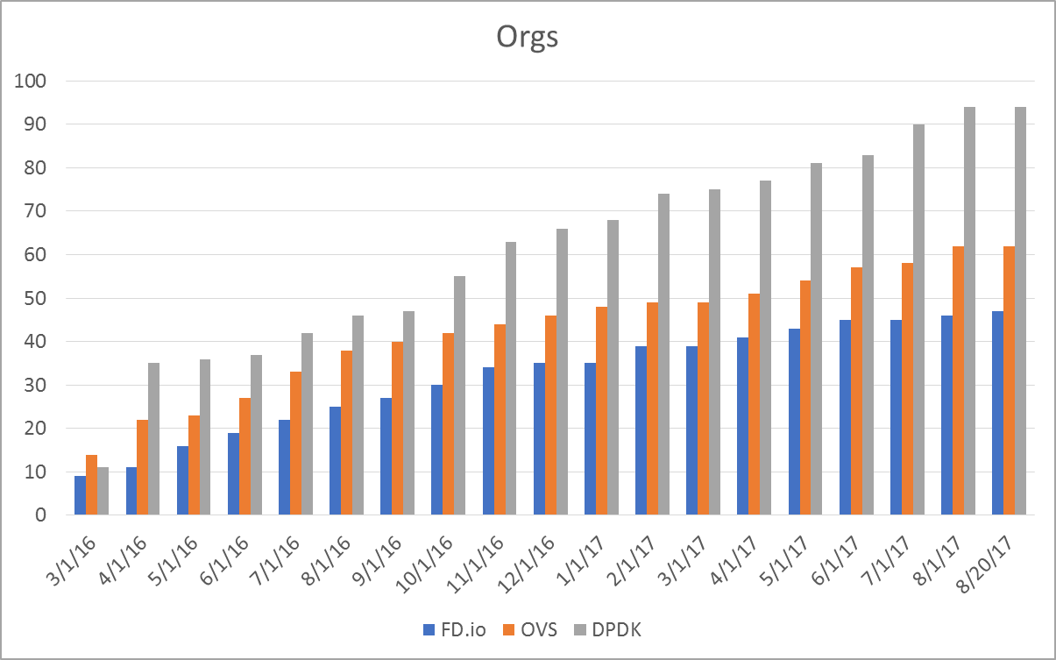
Code Activity

Slide 7
Multiproject: Fd.io Projects
Dataplane Management Agent
Testing/Support
Honeycomb
hc2vpp
CSIT
Packet Processing
P4VPP
GoVPP
puppet-fdio
NSH_SFC
ONE
TLDK
trex
CICN
odp4vpp
VPP Sandbox
VPP
Network IO
deb_dpdk
rpm_dpdk

Slide 8
VPP – Vector Packet Processing Compute Optimized SW Network Platform
Bare-metal / VM / Container
Packet Processing Software Platform
High performance
Linux user space
Runs on compute CPUs:
And “knows” how to run them well !
Shipping at volume in server & embedded products
Dataplane Management Agent
Packet Processing
Network IO
8
Notes:
Should we add “Commodity HW”?

Slide 9
VPP – How does it work?
Compute Optimized SW Network Platform
1
Packet processing is decomposed
into a directed graph of nodes …
2
… packets move through graph nodes in vector …
3
… graph nodes are optimized to fit inside the instruction cache …
vhost-user-
input
af-packet-
input
dpdk-input
Packet 0
Packet 1
Microprocessor
ethernet-
input
Packet 2
Instruction Cache
Packet 3
3
cdp-input
l2-input
ip4-input
ip6-input
Packet 4
arp-input
lldp-input
...-no-
checksum
Packet 5
Data Cache
mpls-input
4
Packet 6
ip4-lookup-
mulitcast
ip4-lookup*
Packet 7
Packet 8
mpls-policy-
encap
ip4-load-
balance
ip4-rewrite-
transit
ip4-
midchain
Packet 9
… packets are pre-fetched into the data cache.
4
Packet 10
interface-
output
* Each graph node implements a “micro-NF”, a “micro-NetworkFunction” processing packets.
Makes use of modern Intel® Xeon® Processor micro-architectures. Instruction cache & data cache always hot ➔ Minimized memory latency and usage.

Slide 10
VPP Architecture: Packet Processing
Packet
…
0
1
2
3
n
Vector of n packets
dpdk-input
vhost-user-input
…
af-packet-input
Packet Processing
Graph
Input Graph Node
ethernet-input
Graph Node
ip6-input
ip4-input
mpls-input
…
arp-input
ip6-lookup
ip4-lookup
ip6-rewrite
ip6-local
ip4-local
ip4-rewrite

Slide 11
VPP Architecture: Splitting the Vector
Packet
…
0
1
2
3
n
Vector of n packets
dpdk-input
vhost-user-input
…
af-packet-input
Packet Processing
Graph
Input Graph Node
ethernet-input
Graph Node
ip6-input
ip4-input
mpls-input
…
arp-input
ip6-lookup
ip4-lookup
ip6-rewrite
ip6-local
ip4-local
ip4-rewrite

Slide 12
VPP Architecture: Plugins
Packet
…
0
1
2
3
n
Hardware Plugin
Vector of n packets
hw-accel-input
dpdk-input
vhost-user-input
…
af-packet-input
Packet Processing
Graph
Input Graph Node
ethernet-input
Graph Node
Skip sftw nodes
where work is done by
hardware already
ip6-input
ip4-input
mpls-input
…
arp-input
Plugin
Plugins are:
First class citizens
That can:
Add graph nodes
Add API
Rearrange the graph
/usr/lib/vpp_plugins/foo.so
ip6-lookup
ip4-lookup
custom-1
ip6-rewrite
ip6-local
ip4-local
ip4-rewrite
custom-2
custom-3
Can be built independently
of VPP source tree

Slide 13
VPP Architecture: Programmability
Architecture
Example: Honeycomb
Control Plane Protocol
Request Message
900k request/s
Netconf/Restconf/Yang
Request Message
Linux Hosts
Linux Hosts
Shared Memory
Shared Memory
Agent
…
VPP
Honeycomb
Agent
…
VPP
Request Queue
Request Queue
…
…
Response Queue
Response Queue
Can use C/Java/Python/or Lua
Language bindings
Async Response Message
Async Response Message

Slide 14
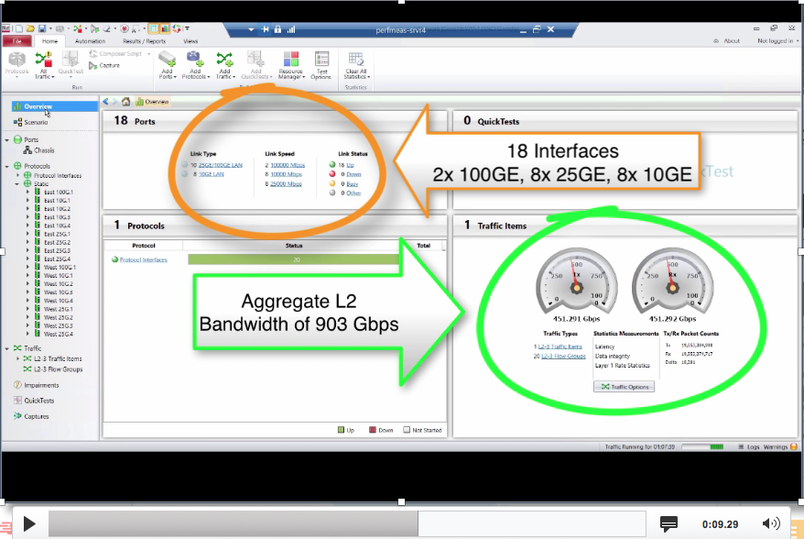
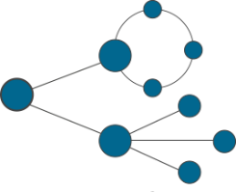
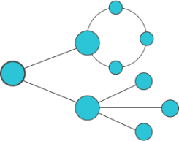
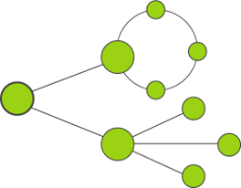
Fast Virtual Network Services
With Universal Terabit* Network Data Plane
FD.io Fast Network Data Plane
Software Defined Network – Cloud Network Services, IPVPN and Internet Security
vNF Services
Sites 1..N
IPVPN and L2VPN Overlays*, IPSec/SSL Crypto
Enterprise1
vRouter vNF
SERVICE VIEW
vNF Services
Sites 1..N
IPVPN and L2VPN Overlays*, IPSec/SSL Crypto
Enterprise2
vRouter vNF
vNF Services
Sites 1..N
IPVPN and L2VPN Overlays*, IPSec/SSL Crypto
Enterprise3
vRouter vNF
Host-1 – Server-SKL
Host-2 – Server-SKL
2CPU
Network I/O 480 Gbps
Crypto I/O 100 Gbps
2CPU
Network I/O 480 Gbps
Crypto I/O 100 Gbps
4x
25GE
25GE
x4
IP Network
Private or Public
4x
4x
1x
100GE
100GE
4x
4x
1x
10GE
25GE
100GE
2x
x2
10GE
25GE
100GE
PHYSICAL VIEW
10GE
1-4
25GE
5-8
100GE
9
10GE
1-4
25GE
5-8
100GE
9
IPVPN Service Traffic Simulator
Traffic Generator
IPv4/v6
IPv4/v6
IPv4/v6
IPv4/v6
IPv4/v6
IPv4/v6
Sites 1..N
Sites 1..N
Sites 1..N
Services
Services
Services

Slide 16
Universal Dataplane: Features
Hardware Platforms
Routing
Switching
Network Services
Pure Userspace - X86,ARM 32/64,Power
Raspberry Pi
IPv4/IPv6
14+ MPPS, single core
Hierarchical FIBs
Multimillion FIB entries
Source RPF
Thousands of VRFs
Controlled cross-VRF lookups
Multipath – ECMP and Unequal Cost
VLAN Support
Single/ Double tag
L2 forwd w/EFP/BridgeDomain concepts
VTR – push/pop/Translate (1:1,1:2, 2:1,2:2)
Mac Learning – default limit of 50k addr
Bridging
Split-horizon group support/EFP Filtering
Proxy Arp
Arp termination
IRB - BVI Support with RouterMac assigmt
Flooding
Input ACLs
Interface cross-connect
L2 GRE over IPSec tunnels
DHCPv4 client/proxy
DHCPv6 Proxy
MAP/LW46 – IPv4aas
MagLev-like Load
Identifier Locator Addressing
NSH SFC SFF’s & NSH Proxy
LLDP
BFD
Policer
Multiple million Classifiers –
Arbitrary N-tuple
Interfaces
DPDK/Netmap/AF_Packet/TunTap
Vhost-user - multi-queue, reconnect,
Jumbo Frame Support
Language Bindings
Segment Routing
C/Java/Python/Lua
SR MPLS/IPv6
Including Multicast
Inband iOAM
Telemetry export infra (raw IPFIX)
iOAM for VXLAN-GPE (NGENA)
SRv6 and iOAM co-existence
iOAM proxy mode / caching
iOAM probe and responder
Tunnels/Encaps
LISP
Security
GRE/VXLAN/VXLAN-GPE/LISP-GPE/NSH
IPSEC
Including HW offload when available
LISP xTR/RTR
L2 Overlays over LISP and GRE encaps
Multitenancy
Multihome
Map/Resolver Failover
Source/Dest control plane support
Map-Register/Map-Notify/RLOC-probing
Mandatory Input Checks:
TTL expiration
header checksum
L2 length < IP length
ARP resolution/snooping
ARP proxy
SNAT
Ingress Port Range Filtering
Per interface whitelists
Policy/Security Groups/GBP (Classifier)
Monitoring
MPLS
Simple Port Analyzer (SPAN)
IP Flow Export (IPFIX)
Counters for everything
Lawful Intercept
MPLS over Ethernet/GRE
Deep label stacks supported

Slide 17
Rapid Release Cadence – ~3 months
17-01
Release:
VPP, Honeycomb, NSH_SFC, ONE
17-04
Release:
VPP, Honeycomb, NSH_SFC, ONE…
17-07
Release:
VPP, Honeycomb, NSH_SFC, ONE
16-09
Release:
VPP, Honeycomb, NSH_SFC, ONE
17-01 New Features
17-04 New Features
17-07 New Features
16-09 New Features
Enhanced LISP support for
L2 overlays
Multitenancy
Multihoming
Re-encapsulating Tunnel Routers (RTR) support
Map-Resolver failover algorithm
New plugins for
SNAT
MagLev-like Load
Identifier Locator Addressing
NSH SFC SFF’s & NSH Proxy
Port range ingress filtering
Dynamically ordered subgraphs
Hierarchical FIB
Performance Improvements
DPDK input and output nodes
L2 Path
IPv4 lookup node
IPSEC Performance
SW and HW Crypto Support
HQoS support
Simple Port Analyzer (SPAN)
BFD, ACL, IPFIX, SNAT
L2 GRE over IPSec tunnels
LLDP
LISP Enhancements
Source/Dest control plane
L2 over LISP and GRE
Map-Register/Map-Notify
RLOC-probing
Flow Per Packet
VPP Userspace Host Stack
TCP stack
DHCPv4 & DHCPv6 relay/proxy
ND Proxy
SNAT
CGN: port allocation & address pool
CPE: External interface
NAT64, LW46
Segment Routing
SRv6 Network Programming
SR Traffic Engineering
SR LocalSIDs
Framework to expand LocalSIDs w/ plugins
iOAM
UDP Pinger
IOAM as type 2 metadata in NSH
Anycast active server selection
IPFIX Improvements (IPv6)
VPP Userspace Host Stack
Improved Linux Host Stack Compatibility
Improved loss recovery (RFC5681, RFC6582, RF6675)
Basic implementation of Eifel detection algorithm (RFC3522)
Interfaces
memif: IP mode, jumbo frames, multi queue
Network Features
MPLS Multicast FIB
BFD FIB integration
NAT64 support
GRE over IPv6
LISP
- NSH support
- L2 ARP
ACL multi-core suuport
GTP-U support

Slide 18
Continuous Quality, Performance, Usability Built into the development process – patch by patch
Submit
Automated
Verify
Code Review
Merge
Publish Artifacts
Build/Unit Testing
120 Tests/Patch
System Functional Testing
252 Tests/Patch
Performance Testing
144 Tests/Patch, 841 Tests
Usability
Build binary packaging for
Ubuntu 14.04
Ubuntu 16.04
Centos 7
Automated Style Checking
Unit test :
IPFIX
BFD
Classifier
DHCP
FIB
GRE
IPv4
IPv4 IRB
IPv4 multi-VRF
DHCP – Client and Proxy
GRE Overlay Tunnels
L2BD Ethernet Switching
L2 Cross Connect Ethernet Switching
LISP Overlay Tunnels
IPv4-in-IPv6 Softwire Tunnels
Cop Address Security
IPSec
IPv6 Routing – NS/ND, RA, ICMPv6
uRPF Security
Tap Interface
Telemetry – IPFIX and Span
VRF Routed Forwarding
iACL Security – Ingress – IPv6/IPv6/Mac
IPv4 Routing
QoS Policer Metering
VLAN Tag Translation
VXLAN Overlay Tunnels
L2 Cross Connect
L2 Bridging
IPv4 Routing
IPv6 Routing
IPv4 Scale – 20k,200k,2M FIB Entries
IPv4 Scale - 20k,200k,2M FIB Entries
VM with vhost-userr
PHYS-VPP-VM-VPP-PHYS
L2 Cross Connect/Bridge
VXLAN w/L2 Bridge Domain
IPv4 Routing
COP – IPv4/IPv6 whiteless
iACL – ingress IPv4/IPv6 ACLs
LISP – IPv4-o-IPv6/IPv6-o-IPv4
VXLAN
QoS Policer
L2 Cross over
L2 Bridging
Merge-by-merge:
apt installable deb packaging
yum installable rpm packaging
autogenerated code documentation
autogenerated cli documentation
Per release:
autogenerated testing reports
report perf improvements
Puppet modules
Training/Tutorial videos
Hands-on-usecase documentation
IPv6
IP Multicast
L2 FIB
L2 Bridge Domain
MPLS
SNAT
SPAN
VXLAN
Merge-by-merge packaging feeds
Downstream consumer CI pipelines
Run on real hardware in FD.io Performance Lab

Slide 19
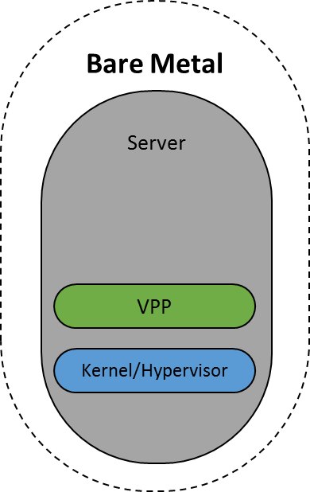
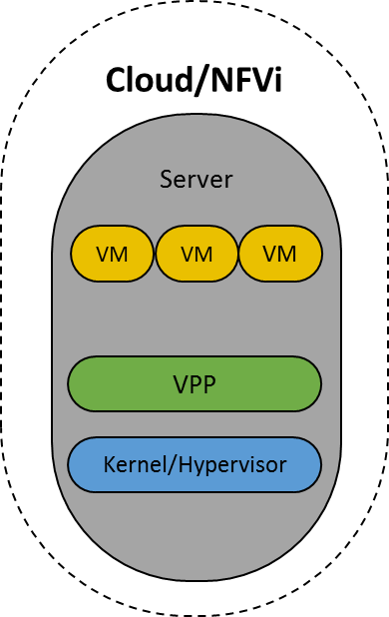
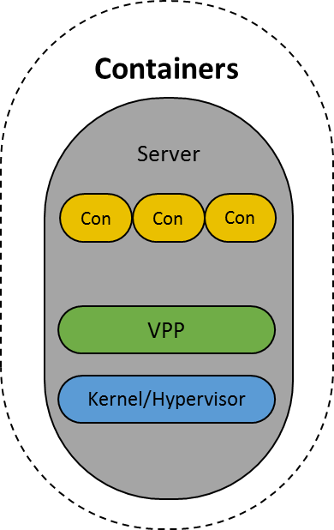
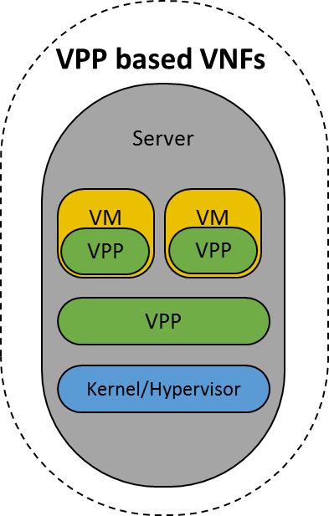
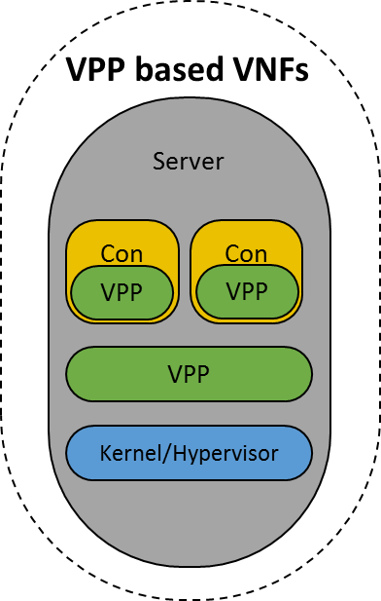
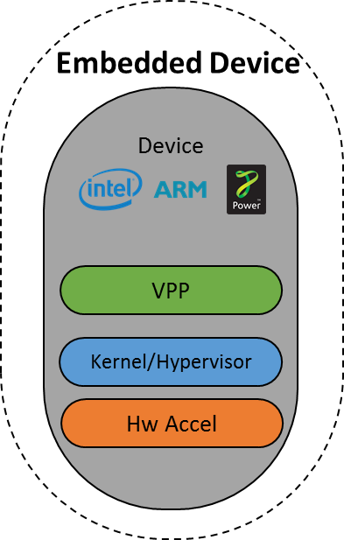
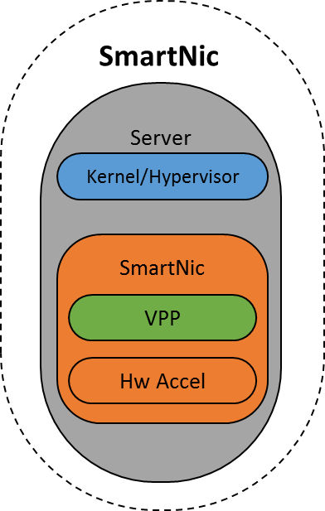
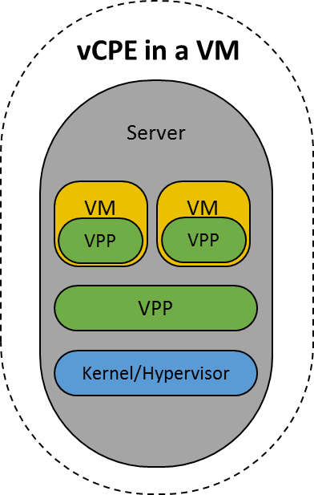
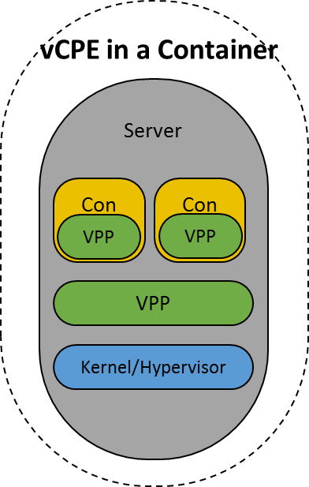
Deployment Models
Notes:
- VPP allows the use of the same dataplane across a wide variety of deployments:
- Physical hardware
- Cloud/NFVi
- Containers networking
- VPP is pure user space, you can write a VNF once and deploy it:
- In VMs
- In Containers
- On Physical devices
An example of the utility of this would b a CPE use case, where the same CPE code could be run in VM based vCPEs, container based vCPEs, and on actual physical CPEs, greatly simplifying deployment of NFV solutions.
- VPP brings intelligence to hardware acceleration, allowing consistent behavior across different kinds of hardware acceleration, including running *in* SmartNICs.

Slide 20
Networking as a Microservice
FD.io Provides vSwitch Functions as MicroService
Pure Userspace
Talks directly to NIC using DPDK drivers
Faster
More scalable
More feature rich
Faster evolution
More innovation
Communicates with Pods
Via veth for ’legacy’ statically linked worklads
Via VPP Userspace Host Stack
Via LD_PRELOAD shim
No code changes in Pod
Or via higher performance VCL API
Would require code changes
Server
vSwitch Microservice Pod
Pod
FD.io
Pod
Kernel
NIC

Slide 21
Opportunities to Contribute
Firewall
IDS
Hardware Accelerators
Integration with OpenCache
Control plane – support your favorite SDN Protocol Agent
Spanning Tree
DPI
Test tools
Cloud Foundry Integration
Container Integration
Packaging
Testing
We invite you to Participate in FD.io
Get the Code, Build the Code, Run the Code
Try the vpp user demo
Install vpp from binary packages (yum/apt)
Install Honeycomb from binary packages
Read/Watch the Tutorials
Join the Mailing Lists
Join the IRC Channels
Explore the wiki
Join FD.io as a member

Slide 22
Backup

Slide 23
VPP: How does it work?
1
vhost-user-
input
af-packet-
input
dpdk-input
… graph nodes are optimized to fit inside the instruction cache …
2
ethernet-
input
Microprocessor
mpls-input
lldp-input
arp-input
cdp-input
l2-input
ip4-input
ip6-input
Packet 0
Packet 1
Packet 2
Packet 3
Packet 4
Packet 5
Packet 6
Packet 7
Packet 8
Packet 9
Packet 10
...-no-
checksum
Instruction Cache
3
ip4-lookup
ip4-lookup-
mulitcast
Data Cache
4
mpls-policy-
encap
ip4-load-
balance
ip4-rewrite-
transit
ip4-
midchain
interface-
output
… packets moved through graph nodes in vector …
… packets are pre-fetched, into the data cache …
Packet processing is decomposed into a directed graph node …
* approx. 173 nodes in default deployment

Slide 24
VPP: How does it work?
6
dispatch fn()
… instruction cache is warm with the instructions from a single graph node …
while packets in vector
Get pointer to vector
while 4 or more packets
Microprocessor
PREFETCH #3 and #4
ethernet-input
PROCESS #1 and #2
4
ASSUME next_node same as last packet
5
Update counters, advance buffers
Packet 1
Packet 2
Enqueue the packet to next_node
while any packets
<as above but single packet>
… data cache is warm with a small number of packets ..
… packets are processed in groups of four, any remaining packets are processed on by one …

Slide 25
VPP: How does it work?
dispatch fn()
while packets in vector
7
Get pointer to vector
while 4 or more packets
Microprocessor
PREFETCH #1 and #2
ethernet-input
PROCESS #1 and #2
ASSUME next_node same as last packet
Update counters, advance buffers
Packet 1
Packet 2
Enqueue the packet to next_node
while any packets
<as above but single packet>
… prefetch packets #1 and #2 …

Slide 26
VPP: How does it work?
dispatch fn()
while packets in vector
8
Get pointer to vector
while 4 or more packets
Microprocessor
PREFETCH #3 and #4
ethernet-input
PROCESS #1 and #2
ASSUME next_node same as last packet
Update counters, advance buffers
Packet 1
Packet 2
Enqueue the packet to next_node
Packet 3
while any packets
Packet 4
<as above but single packet>
… process packet #3 and #4 … … update counters, enqueue packets to the next node …

Slide 27
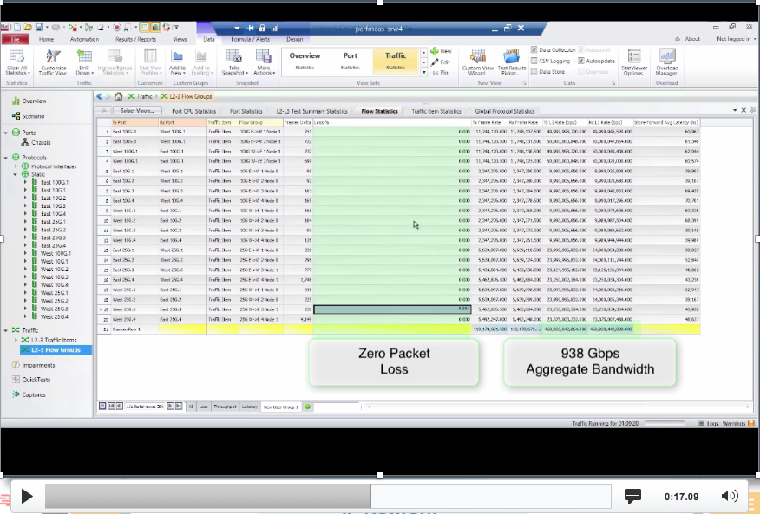
Fast Virtual Network Services
With Universal Terabit* Network Data Plane
FD.io Fast Network Data Plane
Software Defined Network – Cloud Network Services, IPVPN and Internet Security
vNF Services
Sites 1..N
IPVPN and L2VPN Overlays*, IPSec/SSL Crypto
Enterprise1
vRouter vNF
SERVICE VIEW
vNF Services
Sites 1..N
IPVPN and L2VPN Overlays*, IPSec/SSL Crypto
Enterprise2
vRouter vNF
vNF Services
Sites 1..N
IPVPN and L2VPN Overlays*, IPSec/SSL Crypto
Enterprise3
vRouter vNF
Host-1 – Server-SKL
Host-2 – Server-SKL
2CPU
Network I/O 480 Gbps
Crypto I/O 100 Gbps
2CPU
Network I/O 480 Gbps
Crypto I/O 100 Gbps
4x
25GE
25GE
x4
IP Network
Private or Public
4x
4x
1x
100GE
100GE
4x
4x
1x
10GE
25GE
100GE
2x
x2
10GE
25GE
100GE
PHYSICAL VIEW
10GE
1-4
25GE
5-8
100GE
9
10GE
1-4
25GE
5-8
100GE
9
IPVPN Service Traffic Simulator
Traffic Generator
IPv4/v6
IPv4/v6
IPv4/v6
IPv4/v6
IPv4/v6
IPv4/v6
Sites 1..N
Sites 1..N
Sites 1..N
Services
Services
Services

Slide 28
Code Activity

Slide 29
Code Activity

Slide 30
Code Activity

