Slide 1
ODL SFC and VPP Integration
Yi Yang @ Intel
Keith Burns @ CISCO
Hongjun Ni @ Intel

Slide 2
Agenda
SFC Introduction
FD.io Work for SFC Support
ODL SFC VPP Renderer
NSH_SFC (Keith Burns)
ODL SFC and VPP Integration Architecture
ODL SFC and VPP Integration Demo Overview
DEMO
Q & A
Future Work to Do

Slide 3
SFC (Service Function Chaining) Introduction
SF1
(Firewall)
SF2
(DPI)
Client1
Classifier1
SFF1
SFF2
Classifier2
Client2
Server
Client3
Legend
SFC Component
SFF: Service Function Forwarder NSI: Network Service Index
SF : Service Function NSP: Network Service Path
RSP: Rendered Service Path, SFC Instance
NSH: Network Service Header
Service Function Chain

Slide 4
Work in VPP and NSH_SFC and Honeycomb
VPP: VxLAN-gpe (Keith Burns@CISCO)
VPP: Plugin Infrastructure, JVPP core for VxLAN-gpe, JVPP NSH for NSH_SFC (Marek@CISCO)
NSH_SFC: NSH implementation (Keith Burns@CISCO, Hongjun Ni@Intel)
Honeycomb: REST and Netconf interface to ODL SFC (VxLAN-gpe v3po YANG, NSH Yang Model, Hongjun Ni@Intel)
Honeycomb: Plugin Infrastructure (Maros@CISCO) and NSH_SFC plugin (Hongjun Ni@Intel)

Slide 5
VPP Renderer in ODL SFC Architecture
SFC UI
RESTCONF
SFC Provider
SFC
Data Store
ODL
OpenFlow Renderer
SFCOVS
IOS XE Renderer
VPP Renderer
SBI
Openflowplugin
OVSDB
Netconf
Devices
Switch (OVS)
Netconf Device (VPP node)

Slide 6
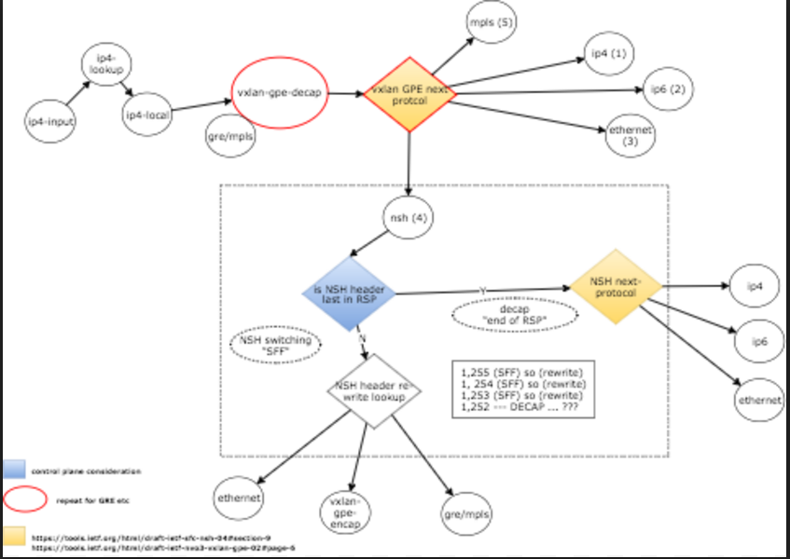
NSH_SFC

Slide 7
ODL SFC and VPP Integration Architecture
OpenDaylight SFC
VPP Renderer
VxLAN-GPE
Netconf/YANG
NSH Entry and NSH Map
Honeycomb
Data Broker
Config Data Tree
Operational Data Tree
Translation Layer
HC Core
HC NSH Plugin
JVPP APIs
JVPP APIs
VPP
JVPP Core
JVPP NSH Plugin
JVPP Registry
VPP Connection
Core Binary APIs
NSH Binary APIs
VPP Core
NSH_SFC plugin

Slide 8
ODL SFC and VPP Integration Demo Topology
Classifier1
SF 1
VPP1/SFF1
VPP2/SFF2
SF 2
Classifier2
Web Client
BridgeDomain:SFCVPP
BridgeDomain:SFCVPP
Web Server
VxLANgpe0
VxLANgpe1
VxLANgpe0
VxLANgpe1
veth1
10.0.100.9
VxLANgpe2
veth1
10.0.100.14
VxLANgpe2
Eth1
192.168.10.11
Eth1
192.168.10.12
Eth2
192.168.20.9
Eth2
192.168.20.10
GigabitEthernet0/9/0
192.168.20.11
GigabitEthernet0/9/0
192.168.20.12
Eth2
192.168.20.13
Eth2
192.168.20.14
Data Plane
Control Plane
vboxnet2
192.168.10.1
ODL SFC

Slide 9
ODL SFC and VPP Integration Demo Topology (cont’d)
Classifier1
SF 1
VPP1/SFF1
VPP2/SFF2
SF 2
Classifier2
Web Client
BridgeDomain:SFCVPP
BridgeDomain:SFCVPP
Web Server
VxLANgpe0
VxLANgpe1
VxLANgpe0
VxLANgpe1
veth1
10.0.100.9
VxLANgpe2
veth1
10.0.100.14
VxLANgpe2
Eth2
192.168.20.9
Eth2
192.168.20.10
GigabitEthernet0/9/0
192.168.20.11
GigabitEthernet0/9/0
192.168.20.12
Eth2
192.168.20.13
Eth2
192.168.20.14
Data Plane
Forward RSP: webclient → Classifier1 → VPP1 → SF1 → VPP1 → VPP2 → SF2 → VPP2 → Classifier2 → webserver
Reverse RSP: webserver → Classifier2 → VPP2 → SF2 → VPP2 → VPP1 → SF1 → VPP1 → Classifier1 → webclient

Slide 10
ODL SFC and VPP Integration Demo
DEMO

Slide 11
Q & A

Slide 12
Future Work to Do
VPP Classifier to support SFC
SFC VPP Classifier
VPP NSH Proxy
SFC NSH Proxy
VPP to support Ethernet + NSH
NSH_SFC to support MD Type 2

Slide 13
References
OVS NSH version: https://github.com/yyang13/ovs_nsh_patches
ODL SFC: https://git.opendaylight.org/gerrit/gitweb?p=sfc.git;a=summary
vxlan-tool.py: python-based NSH-aware service function, https://git.opendaylight.org/gerrit/gitweb?p=sfc.git;a=blob_plain;f=sfc-test/nsh-tools/vxlan_tool.py;h=d7b75316f0e29c1dc09ec63b17a054c2fcdf20af;hb=HEAD
nsh_sfc: https://gerrit.fd.io/r/gitweb?p=nsh_sfc.git;a=summary
Honeycomb overview: https://wiki.fd.io/view/File:Honeycomb_overview.pptx
nsh_sfc and VxLAN-gpe Design: https://drive.google.com/file/d/0B_RDwdFu5VJDRzlZZ1ozRW9faFE/view

Slide 14
Build & Start Instructions
VPP Build
$ git clone https://gerrit.fd.io/r/p/vpp.git
$ cd vpp/build-root
$ make distclean && ./bootstrap.sh && make V=0 PLATFORM=vpp TAG=vpp install-deb
$ sudo dpkg -i *.deb
$ cd build-vpp-native/vpp-api/java/
$ mvn install:install-file -Dfile=jvpp-registry-16.12.jar -DgroupId=io.fd.vpp -DartifactId=jvpp-registry -Dversion=16.12-SNAPSHOT -Dpackaging=jar
$ mvn install:install-file -Dfile=jvpp-core-16.12.jar -DgroupId=io.fd.vpp -DartifactId=jvpp-core -Dversion=16.12-SNAPSHOT -Dpackaging=jar
$ cd ../../../../..
NSH_SFC Build
$ git clone https://gerrit.fd.io/r/p/nsh_sfc.git
$ cd nsh_sfc/nsh-plugin
$ ./build.sh
$ cd build/java/jvpp
$ mvn package
$ mvn install:install-file -Dfile=./target/nsh-sfc-16.12-SNAPSHOT.jar -DgroupId=io.fd.vpp -DartifactId=nsh-sfc -Dversion=16.12-SNAPSHOT -Dpackaging=jar
$ cd ../../../../..

Slide 15
Build & Start Instructions (cont.)
Copy nsh_sfc plugin to vpp plugin directory
$ cd nsh_sfc/nsh-plugin
$ sudo cp ./build/.libs/nsh_plugin.so /usr/lib/vpp_plugins/
$ sudo cp ./build/.libs/nsh_test_plugin.so /usr/lib/vpp_api_test_plugins/
$ cd ../..
honeycomb Build
$ git clone https://gerrit.fd.io/r/p/honeycomb.git
$ cd honeycomb
$ mvn clean install -nsu -DskipTests -Dmaven.javadoc.skip=true

Slide 16
Build & Start Instructions (cont.)
Start VPP
$ sudo start vpp
$ sudo status vpp
Start honeycomb
$ sudo rm -f /var/lib/honeycomb/persist/config/data.json
$ sudo rm -f /var/lib/honeycomb/persist/context/data.json
$ cd honeycomb
$ sudo sh ./nsh/minimal-distribution/target/minimal-distribution-1.16.12-SNAPSHOT-hc/minimal-distribution-1.16.12-SNAPSHOT/honeycomb

Slide 17
Build & Start Instructions (cont.)
Build ODL SFC
$ git clone https://git.opendaylight.org/gerrit/p/sfc.git
$ mvn clean install -DskipTests
Start ODL SFC
$ export JAVA_HOME=/usr/lib/jvm/java-1.8.0/jre/
$ cd sfc-karaf/target/assembly
$ ./bin/karaf
In karaf console, install the below features
opendaylight-user@root> feature:install odl-sfc-vpp-renderer odl-sfc-ui
curl -v -u admin:admin http://localhost:8181/restconf/streams
Or
http://localhost:8181/index.html
Or
Postman
Can check if ODL SFC is started normally

Slide 18
Appendix
vagrant@vpp1:~/vpp$ sudo vppctl show vxlan-gpe
[0] local: 192.168.20.11 remote: 192.168.20.10 vxlan VNI 0 next-protocol nsh fibs: (encap 0, decap 0)
[1] local: 192.168.20.11 remote: 192.168.20.12 vxlan VNI 0 next-protocol nsh fibs: (encap 0, decap 0)
[2] local: 192.168.20.11 remote: 192.168.20.9 vxlan VNI 0 next-protocol nsh fibs: (encap 0, decap 0)
vagrant@vpp1:~/vpp$

Slide 19
Appendix (cont.)
vagrant@vpp1:~/vpp$ sudo vppctl show nsh entry
nsh ver 0 len 6 (24 bytes) md_type 1 next_protocol 3
service path 29 service index 255
c1 0 c2 0 c3 0 c4 0
nsh ver 0 len 6 (24 bytes) md_type 1 next_protocol 3
service path 29 service index 254
c1 0 c2 0 c3 0 c4 0
nsh ver 0 len 6 (24 bytes) md_type 1 next_protocol 3
service path 8388637 service index 254
c1 0 c2 0 c3 0 c4 0
nsh ver 0 len 6 (24 bytes) md_type 1 next_protocol 3
service path 8388637 service index 253
c1 0 c2 0 c3 0 c4 0
vagrant@vpp1:~/vpp$

Slide 20
Appendix (cont.)
vagrant@vpp1:~/vpp$ sudo vppctl show nsh map
nsh entry nsp: 29 nsi: 255 maps to nsp: 29 nsi: 255 encapped by VXLAN GPE intf: 3
nsh entry nsp: 29 nsi: 254 maps to nsp: 29 nsi: 254 encapped by VXLAN GPE intf: 4
nsh entry nsp: 8388637 nsi: 254 maps to nsp: 8388637 nsi: 254 encapped by VXLAN GPE intf: 3
nsh entry nsp: 8388637 nsi: 253 maps to nsp: 8388637 nsi: 253 encapped by VXLAN GPE intf: 5
vagrant@vpp1:~/vpp$

Slide 21
Appendix (cont.)
vagrant@classifier1:~$ cat test-flows-odl.txt
table=0,ip,nw_dst=192.168.20.9 actions=NORMAL
table=0,ip,nw_dst=192.168.20.11 actions=output:1
table=0,icmp,in_port=4,nw_src=10.0.100.9,nw_dst=10.0.100.14 actions=push_nsh,
load:0x1->NXM_NX_NSH_MDTYPE[],load:0x3->NXM_NX_NSH_NP[],load:29->NXM_NX_NSP[0..23],
load:0xff->NXM_NX_NSI[],load:0x1->NXM_NX_NSH_C1[],load:0x9->NXM_NX_NSH_C2[],
load:0x3->NXM_NX_NSH_C3[],load:0x4->NXM_NX_NSH_C4[],load:0x4->NXM_NX_TUN_GPE_NP[],
load:9->NXM_NX_TUN_ID[0..31],load:0xc0a8140b->NXM_NX_TUN_IPV4_DST[],output:2
table=0,tcp,in_port=4,nw_src=10.0.100.9,nw_dst=10.0.100.14 actions=push_nsh,
load:0x1->NXM_NX_NSH_MDTYPE[],load:0x3->NXM_NX_NSH_NP[],load:29->NXM_NX_NSP[0..23],
load:0xff->NXM_NX_NSI[],load:0x1->NXM_NX_NSH_C1[],load:0x9->NXM_NX_NSH_C2[],
load:0x3->NXM_NX_NSH_C3[],load:0x4->NXM_NX_NSH_C4[],load:0x4->NXM_NX_TUN_GPE_NP[],
load:9->NXM_NX_TUN_ID[0..31],load:0xc0a8140b->NXM_NX_TUN_IPV4_DST[],output:2
table=0,nsp=8388637,nsi=253 actions=pop_nsh,
set_field:00:00:10:00:64:14->eth_src,set_field:00:00:10:00:64:09->eth_dst,output:4
table=0 actions=NORMAL
vagrant@classifier1:~$

