Slide 1
The Universal Fast Dataplane

Slide 2










A Fast Data Network Platform For Native Cloud Network Services
EFFICIENCY
Most Efficient on the Planet
The most efficient software packet
Processing on the planet
Superior Performance
PERFORMANCE
FD.io on x86 servers outperforms specialized packet processing HW
Flexible and Extensible
SOFTWARE DEFINED NETWORKING
Software programmable, extendable and flexible
Cloud Native
CLOUD NETWORK SERVICES
Foundation for cloud native network services
Open Source
LINUX FOUNDATION
Open source collaborative project in Linux Foundation
Breaking the Barrier of Software Defined Network Services
1 Terabit Services on a Single Intel® Xeon® Server !!!
2

Slide 3



FD.io: The Universal Fast Dataplane
Project at Linux Foundation
  Multi-party
  Multi-project
Software Dataplane
  High throughput
  Low Latency
  Feature Rich
  Resource Efficient
  Bare Metal/VM/Container
  Multiplatform
FD.io Scope
  Network IO – NIC/vNIC <-> cores/threads
  Packet Processing – Classify / Transform / Prioritize / Forward / Terminate
  Dataplane Management Agents – Control Plane
Bare Metal/VM/Container
Dataplane Management Agent
Packet Processing
Network IO

Slide 4








Fd.io in the overall stack
Application Layer/App Server
Orchestration
Network Controller
Data Plane Services
Dataplane Management Agent
Packet Processing
Network IO
Operating System
Hardware

Slide 5











Multiparty: Broad Membership
Service Providers
Network Vendors
Chip Vendors
Integrators

Slide 6















Multiparty: Broad Contribution
Qiniu
Yandex
Universitat Politècnica de Catalunya (UPC)

Slide 7
Code Activity
In the period since its inception, fd.io has more commits than OVS and DPDK combined, and more contributors than OVS
2016-02-11 to 2017-04-03 | Fd.io | OVS | DPDK
Commits | 6283 | 2395 | 3289
Contributors | 163 | 146 | 245
Organizations | 42 | 52 | 78

Slide 8
Multiproject: Fd.io Projects
Dataplane Management Agent
Testing/Support
Honeycomb
hc2vpp
CSIT
Packet Processing
puppet-fdio
NSH_SFC
ONE
TLDK
trex
CICN
odp4vpp
VPP Sandbox
VPP
Network IO
deb_dpdk
rpm_dpdk

Slide 9

Fd.io Integrations
Openstack
Neutron
Integration work done at
ODL
Plugin
Fd.io
Plugin
GBP app
Control Plane
Lispflowmapping app
SFC
VBD app
LISP Mapping Protocol
Netconf/Yang
Netconf/yang
REST
Honeycomb
Fd.io ML2 Agent
Data Plane
VPP

Slide 10
Vector Packet Processor - VPP
Bare Metal/VM/Container
Packet Processing Platform
  High performance
  Linux User space
  Run’s on commodity CPUs: / /
  Shipping at volume in server & embedded products since 2004.
Dataplane Management Agent
Packet Processing
Network IO

Slide 11
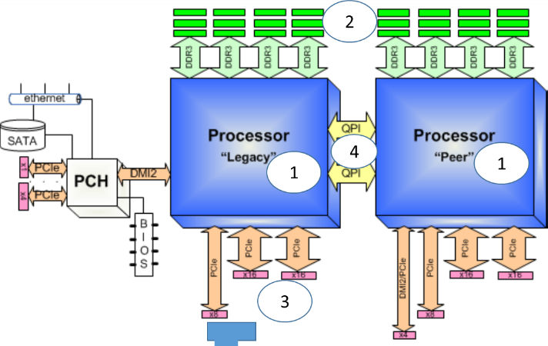
Aside [1/4]: Computer Evolution For Packet Processing
It started with ALU …
(2) Became universal and faster …
(1) It started simple …
A simple generic purpose computer
An Arithmetic Logic Unit (ALU)
(3) Then it got much faster …
(4) … but far from simple !
A modern two CPU socket server
The pipeline of a modern high-performance XEON CPU*
B
D
A
A
C
* Intel Top-Down Microarchitecture Analysis Method for tuning applications, https://software.intel.com/en-us/top-down-microarchitecture-analysis-method-win

Slide 12
Aside [2/4]: Computer Evolution For Packet Processing
… and we arrived to modern multi-socket COTS server …
(2) Became universal and faster …
(1) It started simple …
A simple generic purpose computer
An Arithmetic Logic Unit (ALU)
(3) Then it got much faster …
(4) … but far from simple !
A modern two CPU socket server
The pipeline of a modern high-performance XEON CPU*
B
D
A
A
C
* Intel Top-Down Microarchitecture Analysis Method for tuning applications, https://software.intel.com/en-us/top-down-microarchitecture-analysis-method-win

Slide 13
Aside [2/4]: Computer Evolution For Packet Processing
… and we arrived to modern multi-socket COTS server …
(2) Became universal and faster …
(1) It started simple …
Four main functional dimensions important for processing packets:
A simple generic purpose computer
An Arithmetic Logic Unit (ALU)
CPUs executing the program(s):
  Minimize Instructions per Packet – Efficient software logic to perform needed packet operations.
  Maximize Instructions per CPU core clock cycle – Execution efficiency of an underlying CPU micro-architecture.
Memory bandwidth: Minimize memory bandwidth utilization – Memory access is slow.
Network I/O bandwidth: Make efficient use of PCIe I/O bandwidth – It is a limited resource.
Inter-socket transactions: Minimize cross-NUMA connection utilization – It slows things down.
Hint: Start with optimizing the use of CPU micro-architecture => Use vectors !
(3) Then it got much faster …
(4) … but far from simple !
A modern two CPU socket server
The pipeline of a modern high-performance XEON CPU*
B
D
A
A
C
* Intel Top-Down Microarchitecture Analysis Method for tuning applications, https://software.intel.com/en-us/top-down-microarchitecture-analysis-method-win

Slide 14
VPP Architecture: Vector Packet Processing
Packet
0
1
2
3
…
n
Vector of n packets
dpdk-input
vhost-user-input
…
af-packet-input
Packet Processing
Graph
ethernet-input
Input Graph Node
Graph Node
ip6-input
ip4-input
mpls-input
…
arp-input
ip6-lookup
ip4-lookup
ip6-rewrite
ip6-local
ip4-local
ip4-rewrite

Slide 15
VPP Architecture: Splitting the Vector
Packet
0
1
2
3
…
n
Vector of n packets
dpdk-input
vhost-user-input
…
af-packet-input
Packet Processing
Graph
ethernet-input
Input Graph Node
Graph Node
ip6-input
ip4-input
mpls-input
…
arp-input
ip6-lookup
ip4-lookup
ip6-rewrite
ip6-local
ip4-local
ip4-rewrite

Slide 16
VPP Architecture: Plugins
Packet
0
1
2
3
…
n
Hardware Plugin
Vector of n packets
hw-accel-input
dpdk-input
vhost-user-input
…
af-packet-input
Packet Processing
Graph
ethernet-input
Input Graph Node
Graph Node
Skip software nodes
where work is done by
hardware already
ip6-input
ip4-input
mpls-input
…
arp-input
Plugin
Plugins are:
First class citizens
That can:
Add graph nodes
Add API
Rearrange the graph
/usr/lib/vpp_plugins/foo.so
ip6-lookup
ip4-lookup
custom-1
ip6-rewrite
ip6-local
ip4-local
ip4-rewrite
custom-2
custom-3
Can be built independently
of VPP source tree

Slide 17
Aside [3/4]: Computer Evolution For Packet Processing
… we then optimize software for network workloads ...
(2) Became universal and faster …
(1) It started simple …
A simple generic purpose computer
An Arithmetic Logic Unit (ALU)
(3) Then it got much faster …
(4) … but far from simple !
A modern two CPU socket server
The pipeline of a modern high-performance XEON CPU*
B
D
A
A
C
* Intel Top-Down Microarchitecture Analysis Method for tuning applications, https://software.intel.com/en-us/top-down-microarchitecture-analysis-method-win

Slide 18
Aside [3/4]: Computer Evolution For Packet Processing
… we then optimize software for network workloads ...
(2) Became universal and faster …
(1) It started simple …
Network workloads are very different from compute ones
  They are all about processing packets, at rate.
  At 10GE, 64B packets can arrive at 14.88Mpps => 67 nsec per packet.
  With 2GHz CPU core clock cycle is 0.5nsec => 134 clock cycles per packet.
  To access memory it takes ~70nsec => too slow to do it per packet !
  Packet processing efficiency is essential
  Moving packets
    Packets arrive on physical interfaces (NICs) and virtual interfaces (VNFs) - need CPU optimized drivers for both.
    Drivers and buffer management software must not rely on memory access – see time budget above, MUST use CPU core caching hierarchy well.
  Processing packets
    Need packet processing optimized for CPU platforms.
    Header manipulation, encaps/decaps, lookups, classifiers, counters.
A simple generic purpose computer
An Arithmetic Logic Unit (ALU)
(3) Then it got much faster …
(4) … but far from simple !
A modern two CPU socket server
The pipeline of a modern high-performance XEON CPU*
B
D
A
A
C
* Intel Top-Down Microarchitecture Analysis Method for tuning applications, https://software.intel.com/en-us/top-down-microarchitecture-analysis-method-win

Slide 19
Aside [3/4]: Computer Evolution For Packet Processing
… we then optimize software for network workloads ...
(2) Became universal and faster …
(1) It started simple …
Network workloads are very different from compute ones
  They are all about processing packets, at rate.
  At 10GE, 64B packets can arrive at 14.88Mpps => 67 nsec per packet.
  With 2GHz CPU core clock cycle is 0.5nsec => 134 clock cycles per packet.
  To access memory it takes ~70nsec => too slow to do it per packet !
  Packet processing efficiency is essential
  Moving packets
    Packets arrive on physical interfaces (NICs) and virtual interfaces (VNFs) - need CPU optimized drivers for both.
    Drivers and buffer management software must not rely on memory access – see time budget above, MUST use CPU core caching hierarchy well.
  Processing packets
    Need packet processing optimized for CPU platforms.
    Header manipulation, encaps/decaps, lookups, classifiers, counters.
A simple generic purpose computer
An Arithmetic Logic Unit (ALU)
(3) Then it got much faster …
AND =>
(4a) … let’s make it Simple Again!
A modern two CPU socket server
CPU Socket
B
DDR SDRAM
CPU Cores
Memory
Channels
7
8
6
Memory Controller
D
1
5
9
10
A
A
rxd
LLC
packet
txd
3
12
No-to-Minimal memory
bandwidth per packet.
2
4
13
11
PCIe
C
Core operations
NIC packet operations
NIC descriptor operations
NICs

Slide 20
Aside [4/4]: Computer Evolution For Packet Processing
… and use FD.io VPP to make them fast for packets.
(2) Became universal and faster …
(1) It started simple …
Vector Packet Processing
software worker thread
Core writes Rx descriptor in preparation for receiving a packet.
NIC reads Rx descriptor to get ctrl flags and buffer address.
NIC writes the packet.
NIC writes Rx descriptor.
Core reads Rx descriptor (polling or irq or coalesced irq).
Core reads packet header to determine action.
Core performs action on packet header.
Core writes packet header (MAC swap, TTL, tunnel, foobar..)
Core reads Tx descriptor.
Core writes Tx descriptor and writes Tx tail pointer.
NIC reads Tx descriptor.
NIC reads the packet.
NIC writes Tx descriptor.
A simple generic purpose computer
An Arithmetic Logic Unit (ALU)
(3) Then it got much faster …
AND =>
(4a) … let’s make it Simple Again!
A modern two CPU socket server
CPU Socket
B
DDR SDRAM
CPU Cores
Memory
Channels
7
8
6
Memory Controller
D
1
5
9
10
A
A
rxd
LLC
packet
txd
3
12
No-to-Minimal memory
bandwidth per packet.
2
4
13
11
PCIe
C
Core operations
NIC packet operations
NIC descriptor operations
NICs

Slide 21
Aside [4/4]: Computer Evolution For Packet Processing
… and use FD.io VPP to make them fast for packets.
(2) Became universal and faster …
(1) It started simple …
Vector Packet Processing
software worker thread
Core writes Rx descriptor in preparation for receiving a packet.
NIC reads Rx descriptor to get ctrl flags and buffer address.
NIC writes the packet.
NIC writes Rx descriptor.
Core reads Rx descriptor (polling or irq or coalesced irq).
Core reads packet header to determine action.
Core performs action on packet header.
Core writes packet header (MAC swap, TTL, tunnel, foobar..)
Core reads Tx descriptor.
Core writes Tx descriptor and writes Tx tail pointer.
NIC reads Tx descriptor.
NIC reads the packet.
NIC writes Tx descriptor.
Steps 1-to-13 in a Nutshell:
VPP software worker threads run on CPU cores.
Use local caching with No-to-Minimal memory bandwidth per packet.
Get speed with predictive prefetching and smart algos.
And make CPU cache hierarchy always “Hot” => Packet processing at rate.
Making VPP simply tick the A-B-C-D server optimization points !
A simple generic purpose computer
An Arithmetic Logic Unit (ALU)
(3) Then it got much faster …
AND =>
(4a) … let’s make it Simple Again!
A modern two CPU socket server
CPU Socket
B
DDR SDRAM
CPU Cores
Memory
Channels
7
8
6
Memory Controller
D
1
5
9
10
A
A
rxd
LLC
packet
txd
3
12
No-to-Minimal memory
bandwidth per packet.
2
4
13
11
PCIe
C
Core operations
NIC packet operations
NIC descriptor operations
NICs

Slide 22
Let’s look at performance data at scale
Packet throughput for
  IPv4 routing,
  IPv6 routing,
  L2 switching,
  L2 switching with VXLAN tunnelling.

Slide 23
VPP Universal Fast Dataplane: Performance at Scale [1/2]
Per CPU core throughput with linear multi-thread(-core) scaling
Topology:
Phy-VS-Phy
Hardware: Cisco UCS C240 M4
Intel® C610 series chipset
2 x Intel® Xeon® Processor E5-2698 v3 (16 cores, 2.3GHz, 40MB Cache)
2133 MHz, 256 GB Total
6 x 2p40GE Intel XL710=12x40GE
Software
Linux: Ubuntu 16.04.1 LTS Kernel: ver. 4.4.0-45-generic
FD.io VPP: VPP v17.01-5~ge234726 (DPDK 16.11)
Resources
1 physical CPU core per 40GE port
Other CPU cores available for other services and other work
20 physical CPU cores available in 12x40GE seupt
Lots of Headroom for much more throughput and features

Slide 24
VPP Universal Fast Dataplane: Performance at Scale [2/2]
Per CPU core throughput with linear multi-thread(-core) scaling
Topology:
Phy-VS-Phy
Hardware: Cisco UCS C240 M4
Intel® C610 series chipset
2 x Intel® Xeon® Processor E5-2698 v3 (16 cores, 2.3GHz, 40MB Cache)
2133 MHz, 256 GB Total
6 x 2p40GE Intel XL710=12x40GE
Software
Linux: Ubuntu 16.04.1 LTS Kernel: ver. 4.4.0-45-generic
FD.io VPP: VPP v17.01-5~ge234726 (DPDK 16.11)
Resources
1 physical CPU core per 40GE port
Other CPU cores available for other services and other work
20 physical CPU cores available in 12x40GE seupt
Lots of Headroom for much more throughput and features

Slide 25





Native Cloud Network Services – Sample Use Cases
Based on supported FD.io VPP functionality
SECURE PRIVATE NETWORKING
SD-WAN and DC Overlays
IPVPN, L2VPN, IPSec/SSL encryption
Scaleable L2 switching and IPv4/IPv6 routing vNFs
Million Routes Scale and Service Features
Performance at Max Network I/O of Intel® Xeon® Server
PRODUCTION
GRADE
SECURE PRIVATE
NETWORKING
SUBSCRIBER MANAGEMENT
CG-NAT and Softwires
Carrier Grade NAT for Subscriber IPv4 Addressing Control
Softwires for Subscriber IPv4 over IPv6 Transport
Million of Subscribers and Service Features
Performance at Max Network I/O of Intel® Xeon® Server
SUBSCRIBER
MANAGEMENT
Substantial Performance and Efficiency Gains vs. Alternatives

Slide 26


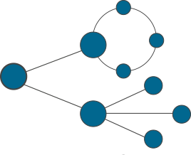


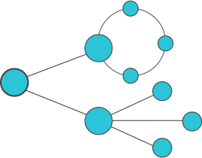


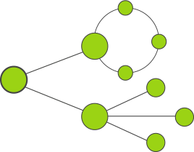


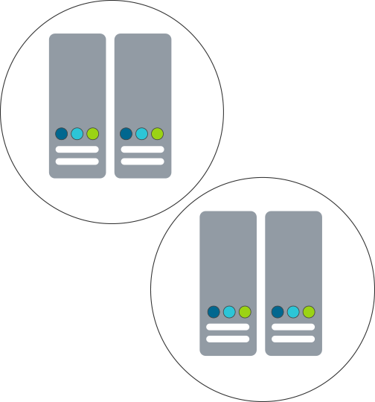






SD-WAN – with FD.io Universal Fast Data Plane
FD.io Fast Network Data Plane
Software Defined – WAN
Sites 1..N
IPVPN and L2VPN Overlays*, IPSec/SSL Crypto
vNF Services
Enterprise1
vRouter vNF
SERVICE VIEW
vNF Services
Sites 1..N
IPVPN and L2VPN Overlays*, IPSec/SSL Crypto
Enterprise2
vRouter vNF
Sites 1..N
IPVPN and L2VPN Overlays*, IPSec/SSL Crypto
vNF Services
Enterprise3
vRouter vNF
HQ-to-HQ
Branch-to-HQ
Branch-to-Branch
Secure and Fast Private Networking
HQ-to-PrivateCloud
Branch-to-PrivateCloud
HomeUser-to-PrivateCloud
Server
CPUs
Net I/O
Crypto I/O
Server
CPUs
Net I/O
Crypto I/O
Site 1
Enterprise1
Site N
PHYSICAL VIEW
IP Network
Private or Public
SD-WAN Hub
Site 1
Enterprise2
Site N
Data Center1
Server
CPUs
Net I/O
Crypto I/O
Server
CPUs
Net I/O
Crypto I/O
FD.io SD-WAN Service Properties:
Native cloud network data plane
Fast and Efficient
Over 20GE of net I/O per CPU core
Site 1
Enterprise3
Site N
SD-WAN Hub
*Overlay encapsulations: VXLAN, LISP GPE
Data Center2

Slide 27
SD-WAN – with FD.io Universal Fast Data Plane
FD.io Fast Network Data Plane
Software Defined – WAN
Sites 1..N
IPVPN and L2VPN Overlays*, IPSec/SSL Crypto
vNF Services
Enterprise1
vRouter vNF
SERVICE VIEW
vNF Services
Sites 1..N
IPVPN and L2VPN Overlays*, IPSec/SSL Crypto
Enterprise2
vRouter vNF
Sites 1..N
IPVPN and L2VPN Overlays*, IPSec/SSL Crypto
vNF Services
Enterprise3
vRouter vNF
Host-1 – Server-SKL
Host-2 – Server-SKL
2CPU
Network I/O 480 Gbps
Crypto I/O 100 Gbps
2CPU
Network I/O 480 Gbps
Crypto I/O 100 Gbps
2x
25GE
IP Network
Private or Public
25GE
x2
4x
4x
1x
100GE
100GE
4x
4x
1x
10GE
25GE
100GE
2x
x2
10GE
25GE
100GE
PHYSICAL VIEW
10GE
1-4
25GE
5-8
100GE
9
10GE
1-4
25GE
5-8
100GE
9
IPVPN Service Traffic Simulator
Traffic Generator
IPv4/v6
IPv4/v6
IPv4/v6
IPv4/v6
IPv4/v6
IPv4/v6
Sites 1..N
Sites 1..N
Sites 1..N
Services
Services
Services
*Overlay encapsulations: VXLAN, LISP GPE

Slide 28
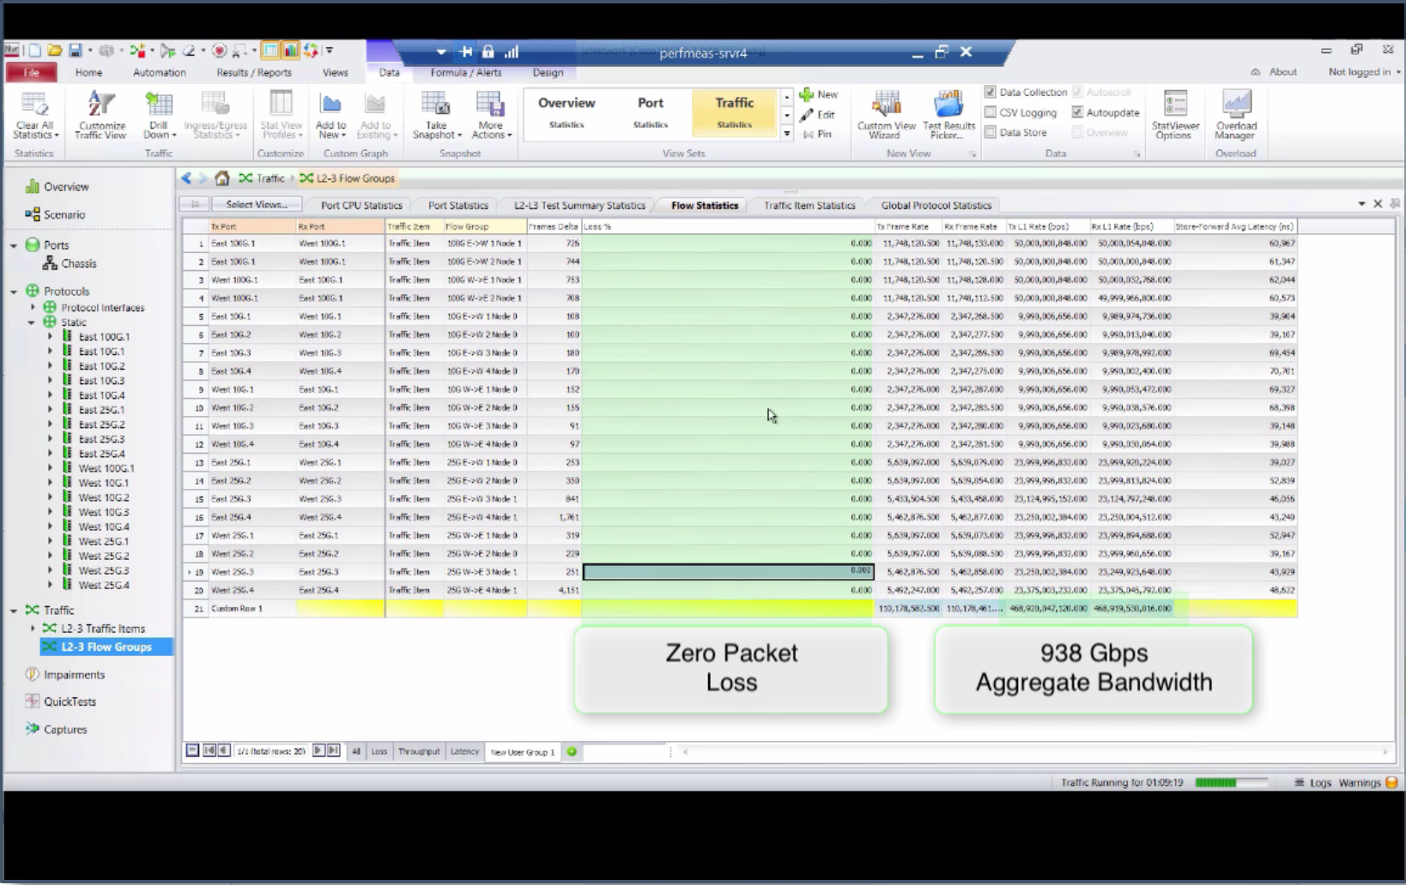
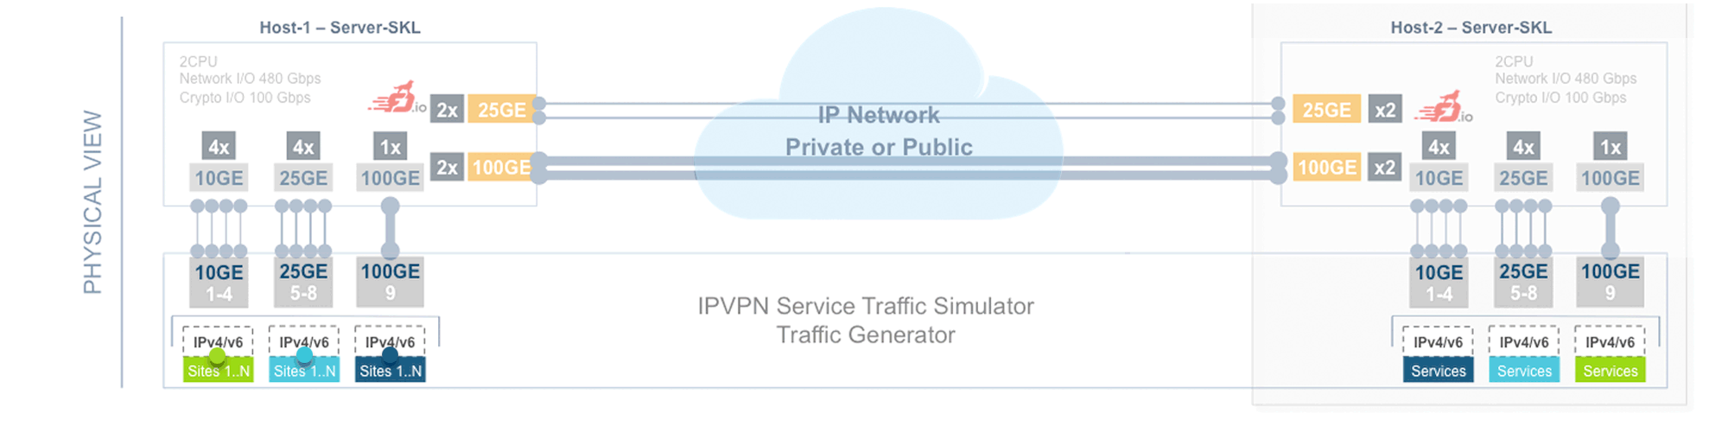
SD-WAN – with FD.io Universal Fast Data Plane
Fast SD-WAN Services – with FD.io Fast Network Data Plane
FD.io Fast Network Data Plane
Software Defined – WAN
Sites 1..N
IPVPN and L2VPN Overlays*, IPSec/SSL Crypto
vNF Services
Enterprise1
vRouter vNF
SERVICE VIEW
vNF Services
Sites 1..N
IPVPN and L2VPN Overlays*, IPSec/SSL Crypto
Enterprise2
vRouter vNF
Sites 1..N
IPVPN and L2VPN Overlays*, IPSec/SSL Crypto
vNF Services
Enterprise3
vRouter vNF
Host-1 – Server-SKL
Host-2 – Server-SKL
2CPU
Network I/O 480 Gbps
Crypto I/O 100 Gbps
2CPU
Network I/O 480 Gbps
Crypto I/O 100 Gbps
4x
25GE
IP Network
Private or Public
25GE
x4
4x
4x
1x
100GE
100GE
4x
4x
1x
10GE
25GE
100GE
2x
x2
10GE
25GE
100GE
PHYSICAL VIEW
10GE
1-4
25GE
5-8
100GE
9
10GE
1-4
25GE
5-8
100GE
9
IPVPN Service Traffic Simulator
Traffic Generator
IPv4/v6
IPv4/v6
IPv4/v6
IPv4/v6
IPv4/v6
IPv4/v6
Sites 1..N
Sites 1..N
Sites 1..N
Services
Services
Services
*Overlay encapsulations: VXLAN, LISP GPE
Breaking the Barrier of Software Defined Network Services
1 Terabit Services on a Single Intel® Xeon® Server !!!
28

Slide 29
Scaling Up The Packet Throughput with FD.io VPP
Can we squeeze more from a single 2RU server ?
Today’s Intel® XEON® CPUs (E5 v3/v4):
  Per socket have 40 lanes of PCIe Gen3
  2x 160Gbps of packet I/O per socket
Tomorrow’s Intel® XEON® CPUs:
  Per socket support More lanes of PCIe Gen3
  2x 280Gbps of packet I/O per socket
VPP enables linear multi-thread(-core) scaling
up to the packet I/O limit per CPU => on a path to one terabit software router (1TFR).
Breaking the Barrier of Software Defined Network Services
1 Terabit Services on a Single Intel® Xeon® Server !!!
29

Slide 30
VPP Architecture: Programmability
Architecture
Example: Honeycomb
Control Plane Protocol
Request Message
900k request/s
Netconf/Restconf/Yang
Request Message
Linux Hosts
Linux Hosts
Shared Memory
Shared Memory
Agent
…
VPP
Honeycomb
Agent
…
VPP
Request Queue
Request Queue
…
…
Response Queue
Response Queue
Can use C/Java/Python/or Lua
Language bindings
Async Response Message
Async Response Message

Slide 31
Universal Fast Dataplane: Features
Hardware Platforms
Routing
Switching
Network Services
  IPv4/IPv6
  14+ MPPS, single core
  Hierarchical FIBs
  Multimillion FIB entries
  Source RPF
  Thousands of VRFs
  Controlled cross-VRF lookups
  Multipath – ECMP and Unequal Cost
  IP Multicast
  VLAN Support
  Single/ Double tag
  L2 forwd w/EFP/BridgeDomain concepts
  VTR – push/pop/Translate (1:1,1:2, 2:1,2:2)
  Mac Learning – default limit of 50k addr
  Bridging
  Split-horizon group support/EFP Filtering
  Proxy Arp
  Arp termination
  IRB - BVI Support with RouterMac assigmt
  Flooding
  Input ACLs
  Interface cross-connect
  L2 GRE over IPSec tunnels
  DHCPv4 client/proxy
  DHCPv6 Proxy
  MAP/LW46 – IPv4aas
  CGNAT
  MagLev-like Load Balancer
  Identifier Locator Addressing
  NSH SFC SFF’s & NSH Proxy
  LLDP
  BFD
  QoS Policer 1R2C, 2R3C
  Multiple million Classifiers –
  Arbitrary N-tuple
  Pure Userspace - X86,ARM 32/64,Power
  Raspberry Pi
Interfaces
  DPDK/Netmap/AF_Packet/TunTap
  Vhost-user - multi-queue, reconnect,
  Jumbo Frame Support
Language Bindings
Segment Routing
  C/Java/Python/Lua
  SR MPLS/IPv6
  Including Multicast
Inband iOAM
  Telemetry export infra (raw IPFIX)
  iOAM for VXLAN-GPE (NGENA)
  SRv6 and iOAM co-existence
  iOAM proxy mode / caching
  iOAM probe and responder
Tunnels/Encaps
LISP
Security
  GRE/VXLAN/VXLAN-GPE/LISP-GPE
  NSH, L2TPv3, SRv6
  IPSec Tunnel, Transport
  Including HW offload if present
  LISP xTR/RTR
  L2 Overlays over LISP and GRE encaps
  Multitenancy
  Multihome
  Map/Resolver Failover
  Source/Dest control plane support
  Map-Register/Map-Notify/RLOC-probing
  IPSec transport mode
  Mandatory Input Checks:
  TTL expiration
  header checksum
  L2 length < IP length
  ARP resolution/snooping
  ARP proxy
  NAT
  Ingress Port Range Filtering
  Per interface whitelists
  Policy/Security Groups/GBP (Classifier)
MPLS
Monitoring
  MPLS over Ethernet/GRE
  Deep label stacks supported
  Simple Port Analyzer (SPAN)
  IP Flow Export (IPFIX)
  Counters for everything
  Lawful Intercept

Slide 32
Rapid Release Cadence – ~3 months
16-09
Release:
VPP, Honeycomb, NSH_SFC, ONE
17-01
Release:
VPP, Honeycomb, NSH_SFC, ONE
16-02
Fd.io launch
16-06
Release- VPP
16-06 New Features
16-09 New Features
17-01 New Features
  Enhanced Switching & Routing
  IPv6 SR multicast support
  LISP xTR support
  VXLAN over IPv6 underlay
  per interface whitelists
  shared adjacencies in FIB
  Improves interface support
  vhost-user – jumbo frames
  Netmap interface support
  AF_Packet interface support
  Improved programmability
  Python API bindings
  Enhanced JVPP Java API bindings
  Enhanced debugging cli
  Hardware and Software Support
  Support for ARM 32 targets
  Support for Raspberry Pi
  Support for DPDK 16.04
  Enhanced LISP support for
  L2 overlays
  Multitenancy
  Multihoming
  Re-encapsulating Tunnel Routers
  (RTR) support
  Map-Resolver failover algorithm
  New plugins for
  SNAT
  MagLev-like Load
  Identifier Locator Addressing
  NSH SFC SFF’s & NSH Proxy
  Port range ingress filtering
  Dynamically ordered subgraphs
  Hierarchical FIB
  Performance Improvements
  DPDK input and output nodes
  L2 Path
  IPv4 lookup node
  IPSEC
  Softwand HWCrypto Support
  HQoS support
  Simple Port Analyzer (SPAN)
  BFD
  IPFIX Improvements
  L2 GRE over IPSec tunnels
  LLDP
  LISP Enhancements
  Source/Dest control plane
  L2 over LISP and GRE
  Map-Register/Map-Notify
  RLOC-probing
  ACL
  Flow Per Packet
  SNAT – Multithread, Flow Export
  LUA API Bindings

Slide 33
New in 17.04 – Released Apr 19
VPP Userspace Host Stack
Stateful Security Groups
Segment Routing v6
  TCP stack
  DHCPv4 relay multi-destination
  DHCPv4 option 82
  DHCPv6 relay multi-destination
  DHPCv6 relay remote-id
  ND Proxy
  Routed interface support
  L4 filters with IPv6 Extension Headers
  SR policies with weighted SID lists
  Binding SID
  SR steering policies
  SR LocalSIDs
  Framework to expand local SIDs w/plugins
API
  Move to CFFI for Python binding
  Python Packaging improvements
  CLI over API
  Improved C/C++ language binding
iOAM
NAT
  UDP Pinger w/path fault isolation
  IOAM as type 2 metadata in NSH
  IOAM raw IPFIX collector and analyzer
  Anycast active server selection
  CGN: Configurable port allocation
  CGN: Configurable Address pooling
  CPE: External interface
  DHCP support
  NAT44, NAT64, LW46
IPFIX
  Collect IPv6 information
  Per flow state
Release notes: https://docs.fd.io/vpp/17.04/release_notes_1704.html
Images at: https://nexus.fd.io/

Slide 34
Continuous Quality, Performance, Usability
Built into the development process – patch by patch
Submit
Automated
Verify
Code Review
Merge
Publish Artifacts
Build/Unit Testing
120 Tests/Patch
System Functional Testing
252 Tests/Patch
Performance Testing
144 Tests/Patch, 841 Tests
Usability
  Build binary packaging for
  Ubuntu 14.04
  Ubuntu 16.04
  Centos 7
  Automated Style Checking
  Unit test :
  IPFIX
  BFD
  Classifier
  DHCP
  FIB
  GRE
  IPv4
  IPv4 IRB
  IPv4 multi-VRF
  DHCP – Client and Proxy
  GRE Overlay Tunnels
  L2BD Ethernet Switching
  L2 Cross Connect Ethernet Switching
  LISP Overlay Tunnels
  IPv4-in-IPv6 Softwire Tunnels
  Cop Address Security
  IPSec
  IPv6 Routing – NS/ND, RA, ICMPv6
  uRPF Security
  Tap Interface
  Telemetry – IPFIX and Span
  VRF Routed Forwarding
  iACL Security – Ingress – IPv6/IPv6/Mac
  IPv4 Routing
  QoS Policer Metering
  VLAN Tag Translation
  VXLAN Overlay Tunnels
  L2 Cross Connect
  L2 Bridging
  IPv4 Routing
  IPv6 Routing
  IPv4 Scale – 20k,200k,2M FIB Entries
  IPv4 Scale - 20k,200k,2M FIB Entries
  VM with vhost-userr
  PHYS-VPP-VM-VPP-PHYS
  L2 Cross Connect/Bridge
  VXLAN w/L2 Bridge Domain
  IPv4 Routing
  COP – IPv4/IPv6 whiteless
  iACL – ingress IPv4/IPv6 ACLs
  LISP – IPv4-o-IPv6/IPv6-o-IPv4
  VXLAN
  QoS Policer
  L2 Cross over
  L2 Bridging
  Merge-by-merge:
  apt installable deb packaging
  yum installable rpm packaging
  autogenerated code documentation
  autogenerated cli documentation
  Per release:
  autogenerated testing reports
  report perf improvements
  Puppet modules
  Training/Tutorial videos
  Hands-on-usecase documentation
  IPv6
  IP Multicast
  L2 FIB
  L2 Bridge Domain
  MPLS
  SNAT
  SPAN
  VXLAN
Merge-by-merge packaging feeds
Downstream consumer CI pipelines
Run on real hardware in fd.io Performance Lab

Slide 35
Universal Fast Dataplane: Infrastructure
Cloud/NFVi
Container Infra
Bare Metal
Server
Server
Server
VM
VM
VM
Con
Con
Con
FD.io
FD.io
FD.io
Kernel/Hypervisor
Kernel
Kernel/Hypervisor

Slide 36
Universal Fast Dataplane: xNFs
FD.io based vNFs
FD.io based cNFs
Server
Server
VM
VM
Con
Con
FD.io
FD.io
FD.io
FD.io
FD.io
FD.io
Kernel/Hypervisor
Kernel/Hypervisor

Slide 37
Universal Fast Dataplane: Embedded
Embedded Device
SmartNic
Device
Server
Kernel/Hypervisor
FD.io
SmartNic
FD.io
Kernel/Hypervisor
Hw Accel
Hw Accel

Slide 38
Universal Fast Dataplane: CPE Example
Physical CPE
vCPE in a VM
vCPE in a Container
Device
Server
Server
VM
VM
Con
Con
FD.io
FD.io
FD.io
FD.io
FD.io
FD.io
FD.io
Kernel/Hypervisor
Kernel/Hypervisor
Kernel/Hypervisor
Hw Accel

Slide 39
A Fast Data Network Platform For Native Cloud Network Services
EFFICIENCY
Most Efficient on the Planet
The most efficient software packet
Processing on the planet
Superior Performance
PERFORMANCE
FD.io on x86 servers outperforms specialized packet processing HW
Flexible and Extensible
SOFTWARE DEFINED NETWORKING
Software programmable, extendable and flexible
Cloud Native
CLOUD NETWORK SERVICES
Foundation for cloud native network services
Open Source
LINUX FOUNDATION
Open source collaborative project in Linux Foundation
Breaking the Barrier of Software Defined Network Services
1 Terabit Services on a Single Intel® Xeon® Server !!!
39

Slide 40
Opportunities to Contribute
Firewall
IDS
DPI
Flow and user telemetry
Hardware Accelerators
Container Integration
Integration with OpenCache
Control plane – support your favorite SDN Protocol Agent
Test tools
Cloud Foundry Integration
Packaging
Testing
We invite you to Participate in fd.io
Get the Code, Build the Code, Run the Code
Try the vpp user demo
Install vpp from binary packages (yum/apt)
Install Honeycomb from binary packages
Read/Watch the Tutorials
Join the Mailing Lists
Join the IRC Channels
Explore the wiki
Join fd.io as a member
FD.io git repos:
https://git.fd.io/
https://git.fd.io/vpp/
https://git.fd.io/csit/
FD.io project wiki pages:
https://wiki.fd.io/view/Main_Page
https://wiki.fd.io/view/VPP
https://wiki.fd.io/view/CSIT

Slide 41
Q&A

Slide 42
Thank You !

