Slide 1



fd.io vpp and containers
Keith Burns
@alagalah
alagalah@gmail.com
github.com/alagalah

Slide 2
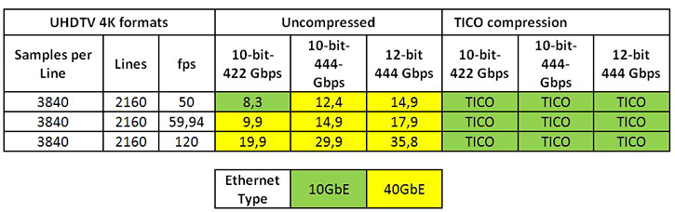
video
Uncompressed data rate = color depths * vertical resolution * horizontal resolution * refresh frequency
August 27, 2015, TVTechnology

Slide 3
“Encoding in multiple formats in parallel including raw uncompressed per camera”
BBC: IP Studio project
… “Destination-timed switching is probably the simplest way to switch video on commodity Ethernet switches, but it generally requires twice the bandwidth of a single video signal to be reserved.”
Thomas Edwards of Fox, June 10, 2015, TVTechnology.com

Slide 4
Implications of reality...
100Gbps NICs are reality
Use cases exist today for 100Gbps per workload
3D XPoint and Memristor technology is reality
Machine learning algorithms being held back by lack of real-time streaming instrumentation

Slide 5


Slide 6
Implications of containers
Containers are small

Slide 7
Implications of containers
Quicker to start/stop on demand
Containers are small
Can afford to have more of them
Easier to develop with

Slide 8
Implications of containers
Quicker to start/stop on demand
New ways of designing applications
Can afford to have more of them
New deployment models
Easier to develop with

Slide 9
Implications of containers
New ways of designing applications
New deployment models

Slide 10
Implications of containers
Microservices
New ways of designing applications
New deployment models

Slide 11
Implications of containers
Microservices
New ways of designing applications
Application components run in own process
Simpler API - REST
New deployment models

Slide 12
Implications of containers
New ways of designing applications
New deployment models

Slide 13
Implications of containers
New ways of designing applications
Described by container metadata
New deployment models
Horizontally scaled

Slide 14
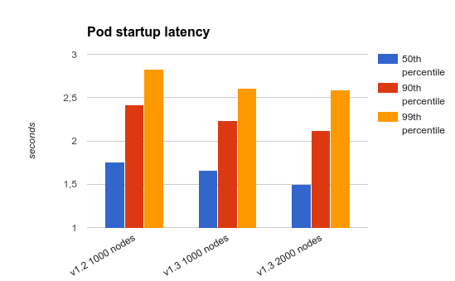
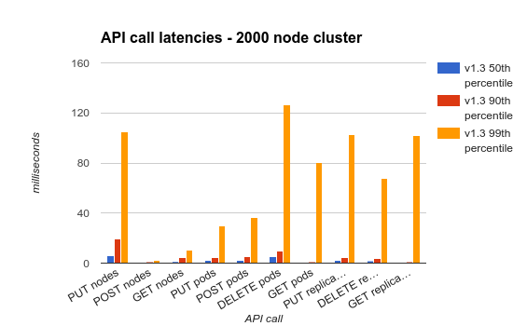
Kubernetes 1.3 - 2,000 node 60,000 pod clusters
http://blog.kubernetes.io/2016/07/kubernetes-updates-to-performance-and-scalability-in-1.3.html

Slide 15
Implications of containers
Lots of individually addressed elements to manage
Lots of TCP sessions to scale
Predictable performance under load
Instrumentation - Do you know who is talking to who? How much?

Slide 16
If REST is the new SOAP….
… TCP becomes even more important.

Slide 17
How is container networking done today?

Slide 18
How is container networking done today?

Slide 19
Why not this?

Slide 20

control plane

Slide 21
Project Calico – key Principles
BGP
Distribute routes using proven Border Gateway Protocol*, with route reflectors for scale
IP
Perform layer 3 forwarding at each compute node
Separate policy decisions from routing information
Translate global policy into distributed firewall on each host, enabling tenant isolation & more

Slide 22
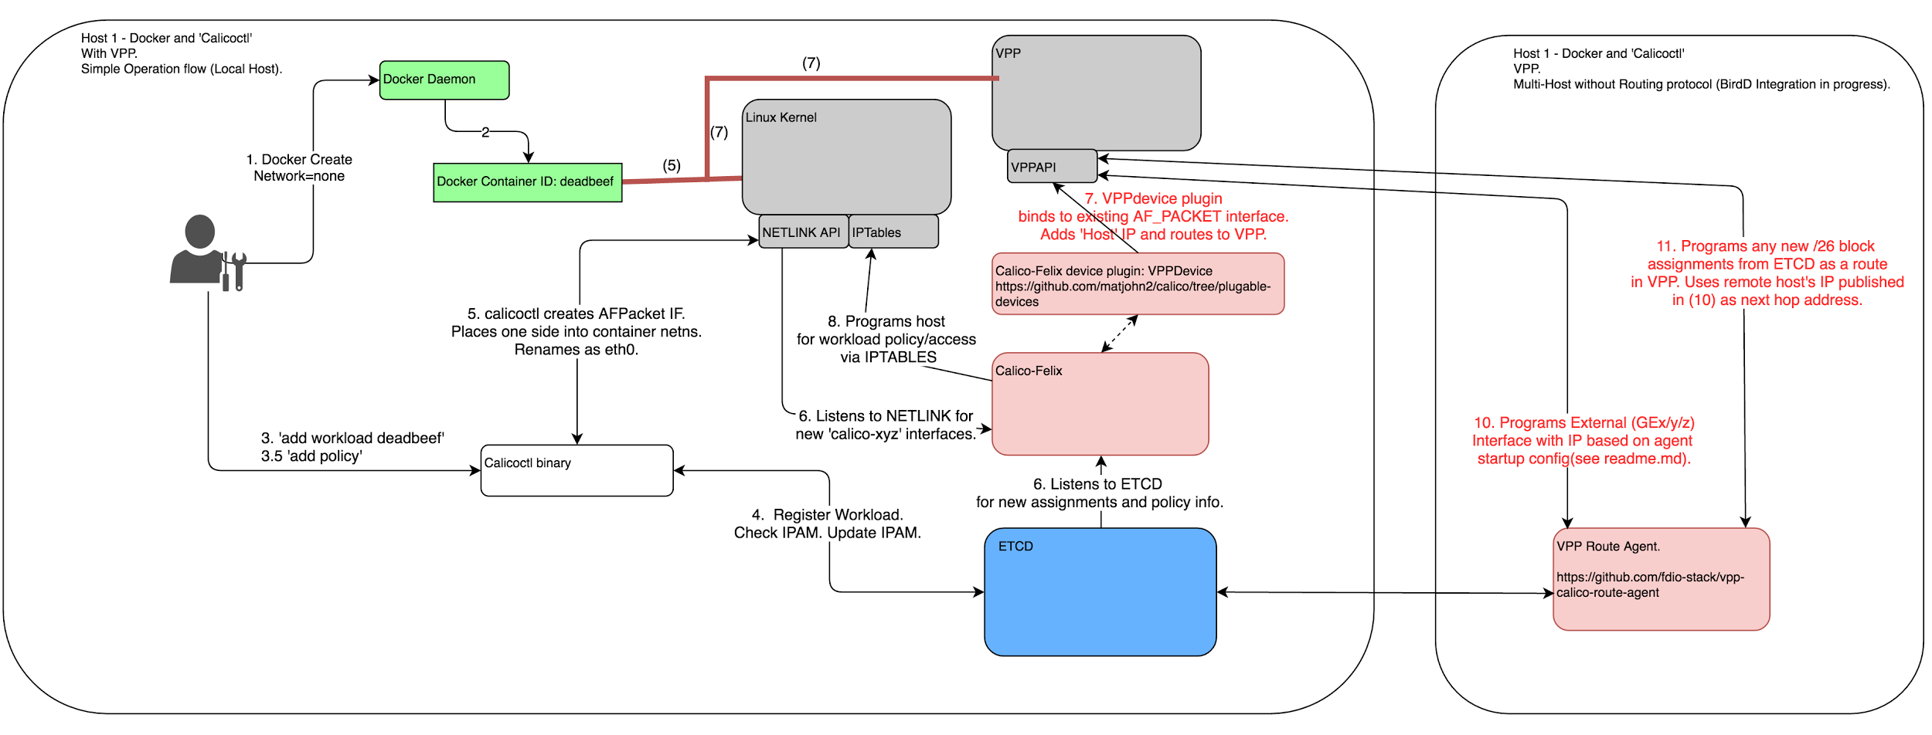
How do I provision it?

Slide 23
How do I provision it?
calicoctl pool add 192.168.0.0/16 docker run --net=none --name workload-A -tid busybox
sudo calicoctl container add workload-A 192.168.0.1 calicoctl profile add PROF_A
calicoctl container workload-A profile append PROF_A

Slide 24

Calico Network Policy
Workload
Workload
container, VM, bare metal
Endpoint
Endpoint
Endpoint
(virtual) network interface
…
Profile
Profile
Profile
reusable policy
…
Rules
Tag
Tag
…

Slide 26
Putting it all together

Slide 27
Where are we going?

Slide 28
Progress thus far...
Currently:
Calico integration being upstreamed in phases
Experimental code for FIFO ~ 2Mpps per
Experimental: LD_PRELOAD/kernel module

Slide 29


Slide 30
Thanks.
Keith Burns
@alagalah
alagalah@gmail.com
github.com/alagalah

Slide 31
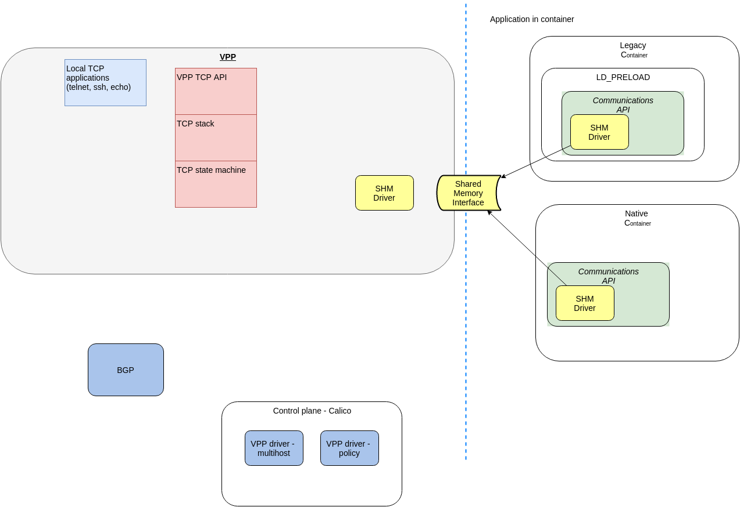
Simplified architecture

