Slide 1
SDN Controller/
Orchestration/
FastDataStacks
Joel Halpern (Ericsson)
Frank Brockners (Cisco)

Slide 2
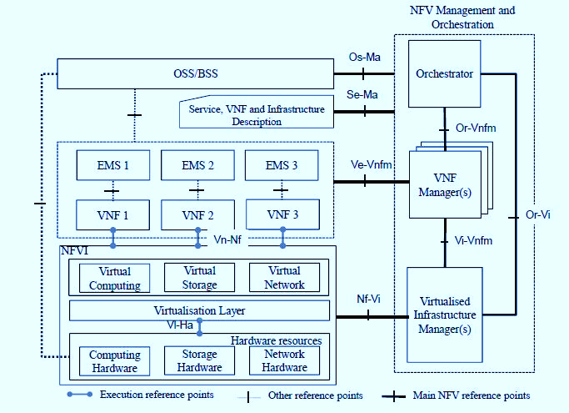
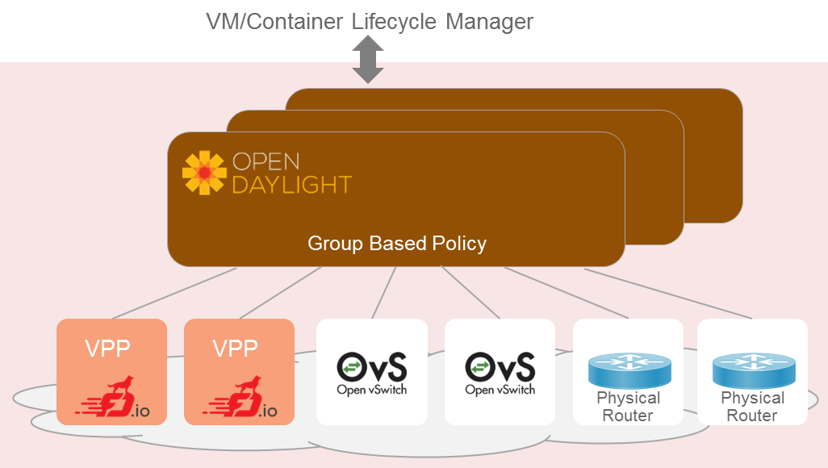
Building Blocks
Service
Model
WorkFlow Topology
App Intent
Service/WF Life Cycle Manager
Virtual Machine/Container
Life Cycle Manager
Network Controller
Forwarder – Switch/Router

Slide 3
What are these
ETSI Defines an overall architecture and components for designing NFV solutions
OPNFV is building a solution to realize the ETSI NFV Architecture
ODL is building a controller to enable multiple entities to work with underlying infrastructure
So where does that leave forwarding?

Slide 4
Controllers
NFV is intended to be deployable in data centers and smaller facilities
In all of these, one needs to coordinate a lot of elements to deliver an NFV solution
There are a range of pieces used for that coordination
  Element and Network Management
  Orchestration
  SDN Controllers

Slide 5
NFV and SDN controllers
SDN controllers provide means to work with the network
This includes both real hardware forwarders, and many flavors of software forwarders
In order to create the needed state to operate NFVi
  This can include both Overlay and Underlay technologies
  Which may be separate or combined

Slide 6
About those forwarders
Any facility will have hardware that provides interconnect
  Sorry, it appears very unlikely we will use plain PCs for all forwarding
At the same time, NFV and SDN technologies require many specialized pieces of forwarding
  Which may be delivered in hardware or software
And we likely need to create overlay forwarding logic on demand, for tenants and other interesting cases

Slide 7
Fast Data I/O - Software
We need the ability to create fast, flexible, extensible, user space packet handling
It has to be able to take advantage of performance features
  For example, DPDK
  And CPU capabilities such as Single-Instruction Multiple-Data
  And very efficient cache interaction

Slide 8
FD.IO - Uses
If we have that software forwarder…
We can create virtual switches for tenants wherever they are need
We can create scalable software based specialized software forwarders
  NAT, Firewall, Service Chaining NSH SFF
And we can enable high performance applications
  Content Transcoding, DPI, Charging, …

Slide 9
FastDataStacks
VPP as part of NFV Solution Stacks

Slide 10
Foundational Assets For NFV Infrastructure
A stack is only as good as its foundation
Virtual Forwarder
  Feature rich, high performance,
  highly scale virtual switch-router
  Leverages hardware accelerators
  Runs in user space
  Modular and easy extensible
Forwarder Diversity: Hardware and Software
  Virtual Domains link and interact with physical domains
Domains and Policy
  Connectivity should reflect business logic instead of physical L2/L3 constructs
Service
Model
WorkFlow Topology
App Intent
Service/WF Life Cycle Manager
Virtual Machine/Container
Life Cycle Manager
Network Controller
Forwarder – Switch/Router

Slide 11
Networking Foundation for NFV Infrastructure
Choices
VPP
  Highly scalable, high
  performance, extensible virtual
  forwarder
OpenDaylight
  Extensible controller platform
  Group Based Policy to separate
  business logic from network
  constructs
  Support for a diverse set of network devices
  Clustering for HA

Slide 12

Evolving The OPNFV Scenario Set
Category
Components in
OPNFV
OPNFV performs system integration as an open community effort:
  Create Components (in lock-step with Upstream Communities)
  Compose / Deploy / Test
  Interate (in a distributed, multi-vendor CI/CD system)
OPNFV scenarios in the Brahmaputra release were focused on OVS as virtual forwarder
Create a new stack which significantly evolves networking for NFV: Introduce
Scenarios with VPP for OPNFV Colorado
Install Tools
Apex, Compass,
Fuel, Juju
VM Control
OpenStack
Network Control
OpenDaylight,
ONOS, OpenContrail
Hypervisor
KVM, KVM4NFV
+ VPP
Forwarder
OVS, OVS-DPDK

Slide 13





OPNFV FastDataStacks (FDS)
Integrate VPP into existing
OPNFV scenarios
Initial scenarios
  OpenStack – ODL (Layer2) – VPP
  OpenStack – ODL (Layer3) – VPP
  OpenStack – VPP
  ...
Diverse set of contributors:
https://wiki.opnfv.org/display/fds
Install Tools
Apex
Apex
Apex
VM Control
OpenStack
OpenStack
OpenStack
Network Control
OpenDaylight
L2
OpenDaylight
L3
Hypervisor
KVM
KVM
KVM
Forwarder
VPP
VPP
VPP

Slide 14



FDS Development
...
Component development, Systems Integration, Testing
Neutron
OpenDaylight
  GBP Neutron Mapper
  GBP Renderer Manager enhancements
  VPP Renderer
  Virtual Bridge Domain Mgr / Topology Manager
FD.io
  HoneyComb – Enhancements
  VPP – Enhancements
  CSIT – VPP component tests
OPNFV
  Installer: Integration of VPP into APEX
  System Test: FuncTest and Yardstick system test application to FDS
REST
Neutron NorthBound
GBP Neutron Mapper
GBP Renderer Manager
VPP renderer
Topology Mgr vBD
OpenDaylight
Netconf/YANG
Honeycomb (Dataplane Agent)
VPP
DPDK
System Install
System Test
See also:
FDS Architecture: https://wiki.opnfv.org/display/fds/OpenStack-ODL-VPP+integration+design+and+architecture

Slide 15


Example: Creating a Neutron vhostuser port on VPP
POST PORT
(id=uuid, host_id=vpp, vif_type=vhostuser)
Neutron
Update Port
Neutron NorthBound
Map Port to GBP Endpoint
(Neutron specifics to Generic Endpoint mapping)
GBP Neutron Mapper
Update/Create GBP Endpoint (L2 context, MAC,...)
Apply Policy
GBP Renderer Manager
Update device end point
Update node(s), bridge-domain
VPP Renderer
Topology Manager (vBD)
Netconf/
YANG
Netconf Commit
(vhostuser i/f config,
bridge config)
Netconf/
YANG
Netconf Commit
(bridge config, tunnel config)
VM
Honeycomb
Honeycomb
vhostuser
VPP 1
VXLAN Tunnel
VPP 2

Slide 16
FDS Project Schedule – Near Term
July 2016: CiscoLive Las Vegas
Base O/S-ODL-VPP stack
(Infra complete: Neutron – GBP Mapper – GBP Renderer – Topology Mgr – Honeycomb – VPP)
  Automatic Install
  Basic system-level testing
  Basic L2 Networking (no NAT/floating IPs, no Security Groups)
  Overlays: VXLAN, VLAN
September 2016: OPNFV Colorado Release
O/S-ODL-VPP stack
(Infra complete: Neutron – GBP Mapper – GBP Renderer – Topology Mgr – Honeycomb – VPP)
  Automatic Install
  Ongoing OPNFV system-level testing (FuncTest, Yardstick testsuites) – part of OPNFV CI/CD pipeline
  Complete L2-L3 Networking (NAT/floating IPs, Security Groups)
  HA
  Overlays: VXLAN, VLAN, NSH
Detailed development plan: https://wiki.opnfv.org/display/fds/FastDataStacks+Work+Areas#FastDataStacksWorkAreas-Plan

