Slide 1
TLV Parsing in VPP
Hongjun Ni @ Intel
Danny Zhou @ Intel
Keith Burns @ Cisco
Vengada Prasad Govindan @ Cisco

Slide 2
NSH Header
Length: total length, in 4-byte words, of NSH including the Base Header, the Service Path Header and the optional variable TLVs.
The Length MUST be of value 0x6 for MD Type = 0x1,
and MUST be of value 0x2 or higher for MD Type = 0x2.
The NSH header length MUST be an integer number of 4 bytes.

Slide 3
NSH MD-type 2
TLV Class: describes the scope of the "Type" field. The TLV Class will identify a specific vendor, or specific standards body allocated types. A new IANA registry will be created for TLV Class type.
Type: the specific type of information being carried, within the scope of a given TLV Class. Value allocation is the responsibility of the TLV Class owner.
C bit: Encoding the criticality of the TLV within the Type field, and is consistent with IPv6 option types: the most significant bit of the Type field indicates whether the TLV is mandatory for the receiver to understand/process.
Reserved bits: three reserved bit are present for future use. The reserved bits MUST be set to 0x0.
Length: Length of the variable metadata, in 4-byte words. A value of 0x0 or higher can be used. A value of 0x0 denotes a TLV header without a Variable Metadata field.

Slide 4
NSH MD-type 2 Option Mapping Table
Add an option mapping table:
Key: TLV Class + Type
Entry:
Option Size (in 4-Byte unit)
Function pointer to option handling routine
Function pointer to add option handling routine
Function pointer to pop option handling routine
Function pointer to trace option handling routine

Slide 5
NSH MD-type 2 Support in VPP
Add NSH MD-type 2 Option Mapping Table.
Allocate an array to store each packets’ TLVs, and store array address to nsh_header->tlvs[0].
Augment command “create nsh entry” to support TLVs.
Augment nsh_mapping_by_key with TLVs.
Augment nsh_add_del_entry in nsh.api to support TLVs.
Augment Honeycomb to support NSH TLVs.

Slide 6
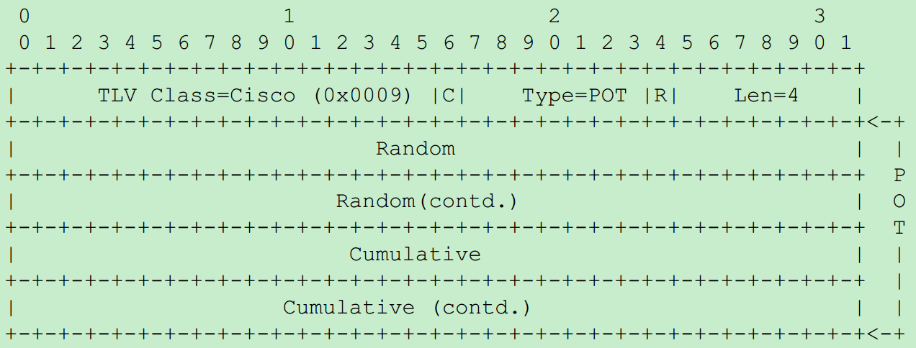
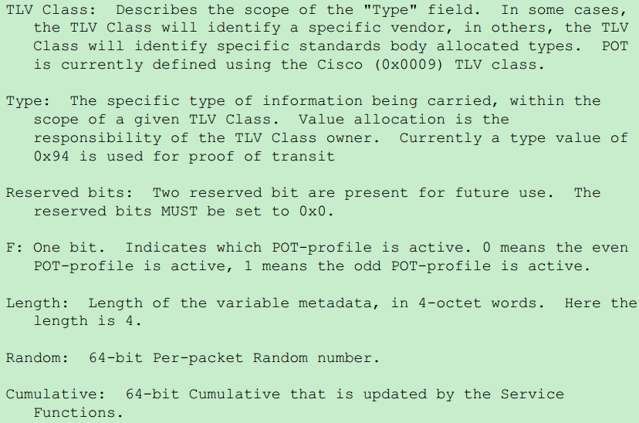
iOAM over NSH: POT Option

Slide 7
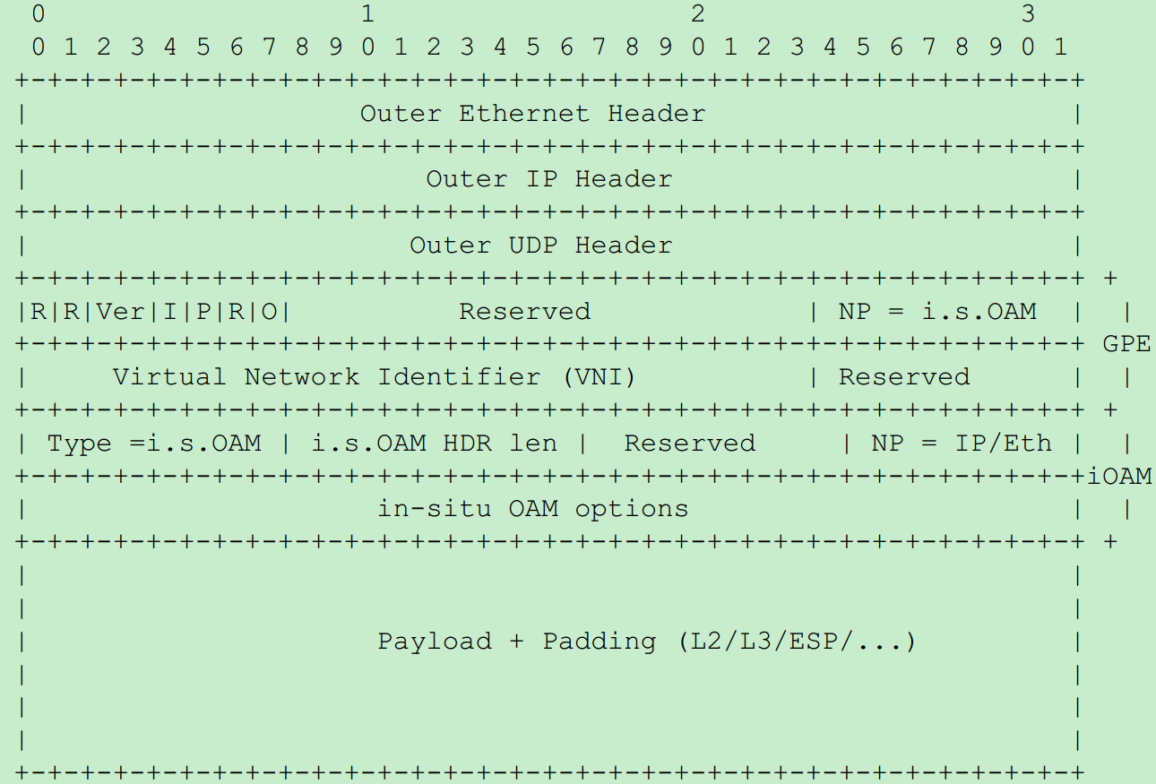
iOAM over VxLAN-GPE: Header and Option

Slide 8
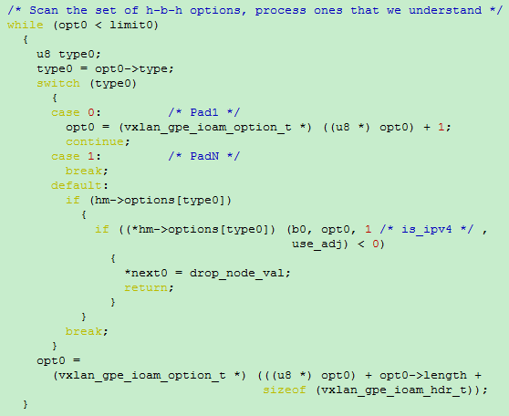
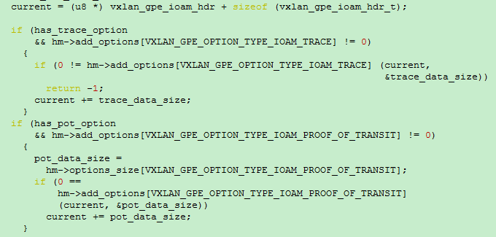
iOAM over VxLAN-GPE: Option Process
vxlan_gpe_encap_decap_ioam_v4_one_inline
vxlan_gpe_ioam_set_rewrite

Slide 9
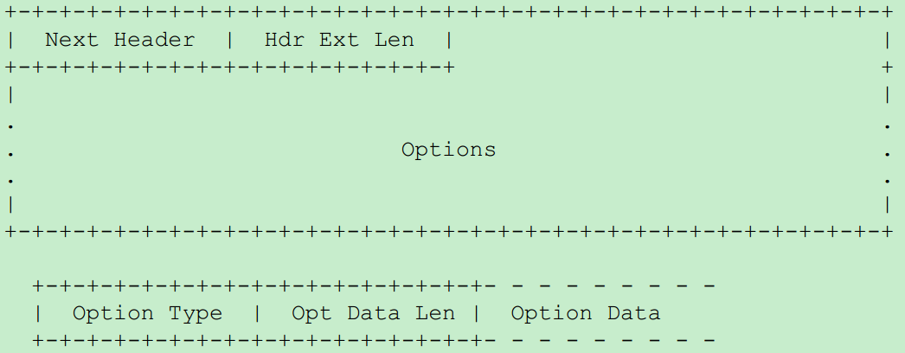
iOAM over IPv6: Header and Option

Slide 10
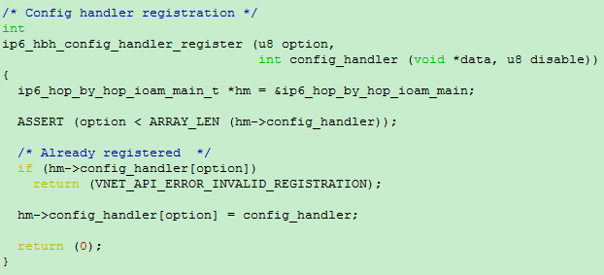
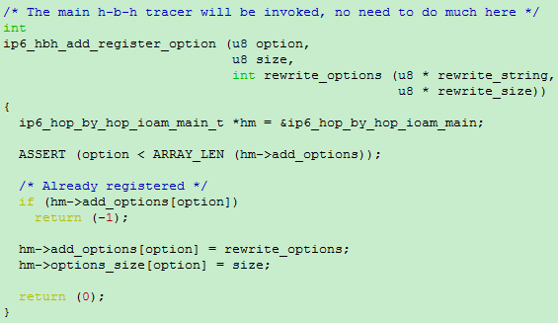
iOAM over IPv6: Option Process

Slide 11
Problems to discuss
Use generic TLV parser APIs or Graph node in IPv6, iOAM and NSH_SFC plugins?
Decouple VxLAN-GPE and iOAM components?

