Slide 1
Improve Performance of Kube-proxy and GTP-U using VPP
Hongjun Ni (hongjun.ni@intel.com)
Danny Zhou (danny.zhou@intel.com)
Johnson Li (johnson.li@intel.com)
Network Platform Group, DCG, Intel
Acknowledgement: Jianfeng Tan

Slide 2
Agenda
  Enabling high performance kube-proxy
  Six ways to improve performance of GTP-U
  Key takeaway

Slide 3
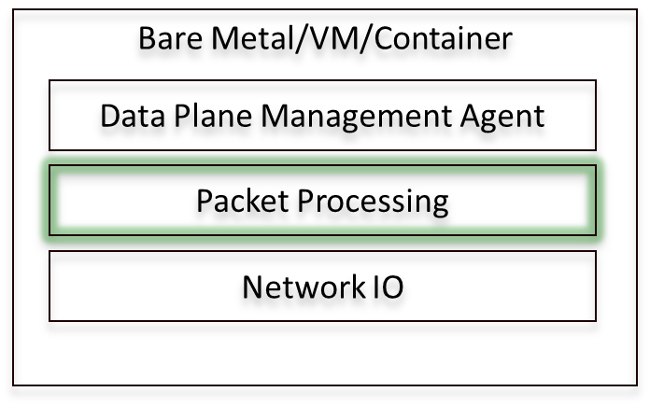
Introducing Vector Packet Processor
Packet processing development platform
Runs on commodity CPUs and leverages DPDK
Runs as a Linux user-space application

Slide 4
VPP Graph Node and Plugin Framework
dpdk-input
…
Packet Vector
ethernet-input
mpls-ethernet-input
arp-input
ip4-input
ip6-input
ip4-lookup
ip4-local
ip4-udp-lookup
ip4-load-balance
Kube-proxy
ip4-rewrite
GTP-U
ethernet-output

Slide 5
Enabling high performance kube-proxy
  Introducing kube-proxy
  Current pain point
  Proposed kube-proxy solution
  Kube-proxy dataplane
  GoVPP
  Performance

Slide 6
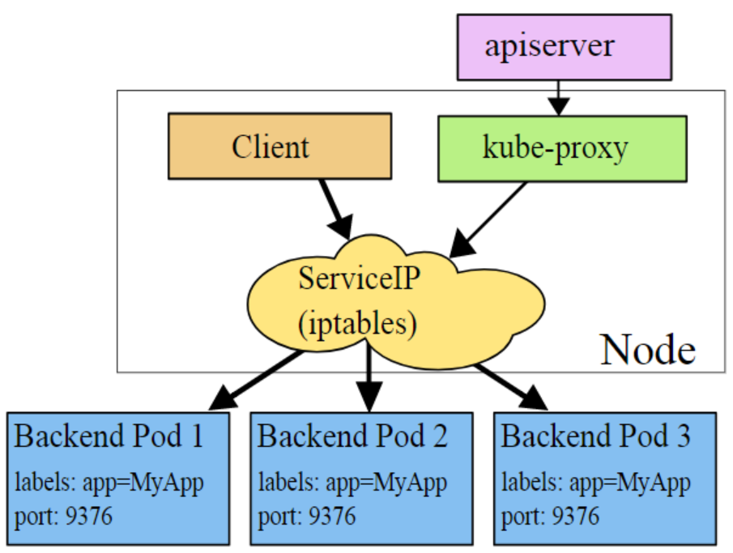
Introducing kube-proxy
Watches addition and removal of Service and Endpoints.
Installs iptables rules
Captures traffic and select Pod
Redirects traffic
Reference: https://kubernetes.io/docs/concepts/services-networking/service/

Slide 7
Current Pain Point
  Supports userspace and iptables
  Uses kernel iptables NAT
  Performance degrades when service/endpoint pairs increase

Slide 8
Proposed kube-proxy solution
CP: Control Plane
DP: Data Plane

Slide 9
Kube-proxy Data Plane
Distribute traffic evenly
Per flow stick to a Pod
Three service types:
(1). ClusterIP: Port
(2). NodeIP: NodePort
(3). External LoadBalancer

Slide 10
Kube-proxy Data Plane Internals
Supported Graph Nodes
kp4-nat4
kp4-nat6
kp6-nat4
udp-lookup
kp6-nat6
kp4-nodeport
kp6-nodeport
ip4
-lookup
input
Other
Graph nodes
ip-lookup
input
Other
Graph nodes
VIP->Pod Table
ip6
-lookup
Stores VIP->Pod session

Slide 11
Kube-proxy: External LoadBalancer

Slide 12
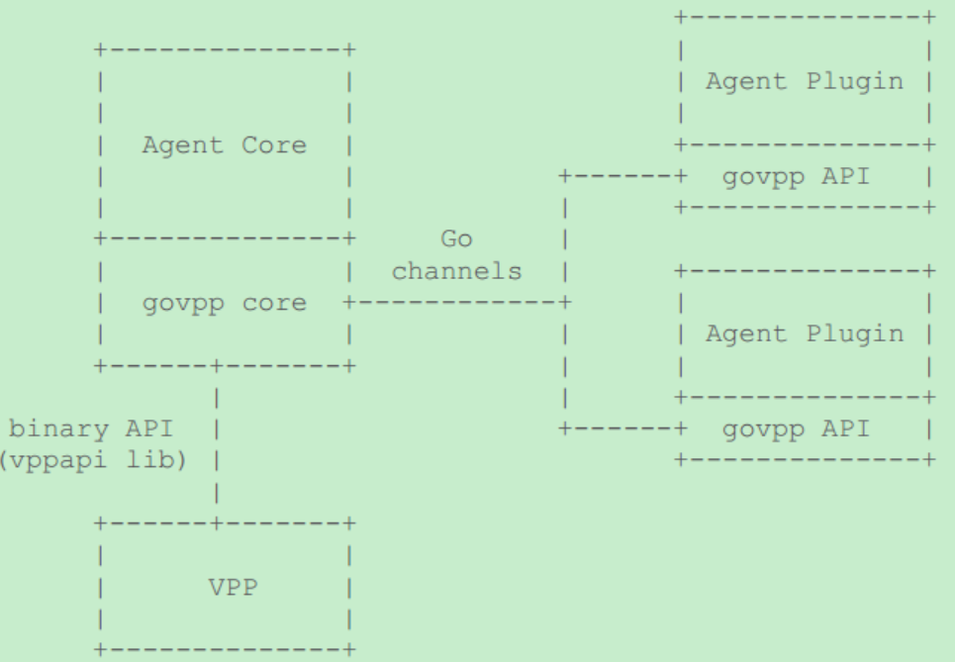
GoVPP
Golang toolset for VPP management
VPP binary API (JSON) → Go Structure
Handle 250,000 binary API requests per second
Reference: https://wiki.fd.io/images/f/fa/GoVPP-intro.pdf

Slide 13
Performance
Linux iptables perf:
< 400 kpps
Scaling
Test Case | Input packet size (bytes) | Output packet size (bytes)
Load balance + DNAT + Routing | 64 | 64
Reference: https://people.netfilter.org/kadlec/nftest.pdf

Slide 14
Six Ways to Improve Performance of GTP-U
  Cache table lookup result
  Bypass second ip-input
  Bypass first route lookup
  Dual-loop and Quad-loop
  Packet prefetching
  Bypass second route lookup

Slide 15
GTP-U Plugin Internals
Typical GTP-U packet processed by VPP and GTP-U plugin
Outer MAC
header
Outer
IP header
UDP header
GTP-U
header
Inner
IP header
L4 header
Payload
GTP-U Plugin
GTP-U Plugin
Supported Graph Nodes
ip-lookup
udp-lookup
gtpu-input
gtpu-encap
IP4
-input
input
Other
Graph nodes
gtpu-bypass
input
Other
Graph nodes
GTP-U tunnel
IP6
-input
Stores PDP context

Slide 16
BIOS Configuration
Device Under Test for Performance
Network Topology
Hardware Configuration
Traffic Gen
(Trex)
CPU | Intel(R) Xeon(R) CPU E5-2699 v3 @ 2.30GHz
DIMM | 2133 MHz, 64GB Total
NIC | 2x 82599ES 10-Gigabit SFI/SFP+ Network Connection
PacketGen | Ixia* 10 Gigabit Ethernet Traffic Generator
Enhanced Intel Speedstep | Enabled
Turbo Boost | Enabled
Processor C3 | Disabled
Processor C6 | Disabled
Hyper-Threading | Disabled
Intel VT-d | Enabled
CPU Power and Performance Policy | Performance
Memory Freq. | 2133 MHz
Total Memory Size | 64 GB
Memory RAS and Performance Configuration -> NUMA Optimized | ENABLED
QPI B/W | 9.6 GT/s
MLC Streamer | ENABLED
MLC Spatial Prefetcher | ENABLED
DCU Data Prefetcher | ENABLED
DCU Instruction Prefetcher | ENABLED
Direct Cache Access (DCA) | ENABLED
Port A
Port B
Software Configuration
Port A
Port B
DUT
(VPP + GTP-U)
OS | Ubuntu 16.04.2 LTS
Kernel | Linux version 4.4.0-62-generic
DPDK | 17.08
VPP | 17.10-rc0
GTP-U | 17.10-rc0
Core 0
Legend
Flow A
Flow B

Slide 17
Cache table lookup result

Slide 18
Bypass second ip-input
dpdk-input
…
Packet Vector
ethernet-input
Pros:
Boost performance
Cons :
Security issue
ip4-input
ip6-input
arp-input
ip4-lookup
ip4-local
ip4-udp-lookup
ip4-load-balance
gtpu-decap
ip4-rewrite
ip4-lookup
ip4-input
ethernet-output

Slide 19
Bypass first route lookup
dpdk-input
…
gtpu packet:
accelerate decap processing
none-gtpu packet:
an overhead with about
13 clocks per packet
Packet Vector
ethernet-input
ip4-input
ip6-input
arp-input
none-gtpu
packet
gtpu-bypss
ip4-lookup
ip4-local
ip4-udp-lookup
gtpu packet
ip4-load-balance
gtpu-decap
ip4-rewrite
ip4-lookup
ip4-input
ethernet-output

Slide 20
GTPU-Decap Performance and Analysis
Test Case | Input packet size (bytes) | Output packet size (bytes)
Transport IP Routing + GTPU-Decap + Inner IP Routing | 98 | 64

Slide 21
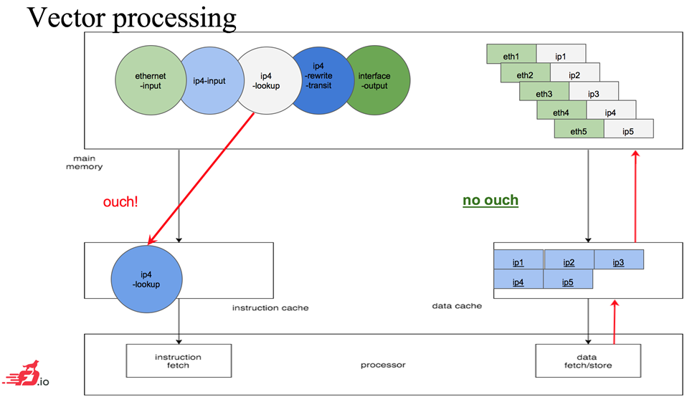
Dual-loop and Quad-loop, Packet Prefetching
Reduce read latency
Process packets in parallel

Slide 22
Bypass second route lookup
dpdk-input
…
Packet Vector
ethernet-input
ip4-input
ip6-input
arp-input
ip4-lookup
ip4-rewrite
ip4-load-balance
gtpu-encap
ip4-rewrite
ip4-lookup
ethernet-output

Slide 23
GTPU-Encap Performance and Analysis
Test Case | Input packet size (bytes) | Output packet size (bytes)
Inner IP Routing + GTPU-Encap + Transport Routing | 64 | 114

Slide 24
Key Takeaway
  Easy-to-use and flexible VPP plugin framework
  Kube-proxy plugin to boost DP’s performance in Cloud environment
  Combination of a set of ways to optimize data plane performance
  Better platform for developing open source dataplane ingredients

Slide 25
Q&A

