Slide 1
An introduction to vICN
Simple and efficient ICN testbed creation and orchestration
Marcel Enguehard
July 18th 2017 – ICN2020 Pmeeting
Prague, Czech Republic

Slide 2
Quick introduction to vICN

Slide 3
Why vICN?
A unified open-source framework for:
Research | Demonstrations | Production networks
Handle network changes Retrieve meaningful data Automate experiments Focus on specific feature | Reliability Interactivity Display | Scalability Error handling
Different requirements but same underlying basic need: deploy virtualized networks

Slide 4
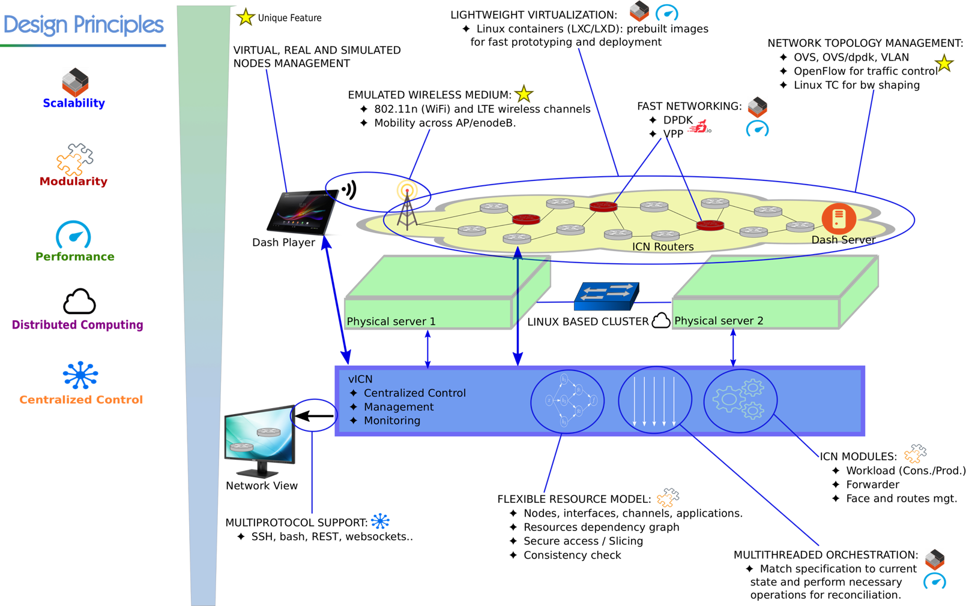
vICN at a glance

Slide 5
Underlying technologies
CICN suite
Linux Containers
Virtual networking

Slide 6
An example vICN topology
Cons
Relay
Prod
consumer
producer
forwarder
forwarder
forwarder
veth
veth
veth
veth
LXD hypervisor

Slide 7
vICN resources
Class
Virtual representation of deployment element
Node, forwarder, application, link, etc.
Described by attributes
Class members

Slide 8
Example resource: Forwarder
Represents an ICN forwarder
Attributes:
  node
  cache_size
  cache_policy (e.g., LRU)
  log_file
  etc.

Slide 9
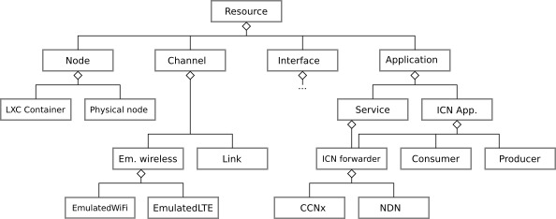
vICN resources dependencies

Slide 10
vICN topology declaration - JSON
“resources”: {
{
"type": "Physical",
"name": "server",
"hostname": "localhost"
},
{
"type": "LxcContainer",
"image": "ubuntu1604-cicnsuite-rc2",
"name": "core1",
"node": "server »
},
{
"type": "MetisForwarder",
"node": "core1"
}
...
...
{
“type”: “Link”,
“src_node”: “core1”,
“dst_node”: “core2”
},
{
"type": "LxcContainer",
"image": "ubuntu1604-cicnsuite-rc2",
"name": "prod1",
"node": "server »
},
{
"type": "MetisForwarder",
"node": "prod1"
}
...

Slide 11
Topology declaration tutorial

Slide 12
Topology declaration
JSON file
List of resources

Slide 13
Topology creation – Physical deployment
{
"type": "Physical",
"name": "server",
"hostname": "localhost"
},
{
"type": "LxcImage",
"name": "cicn-image",
"node": "server",
"image": "ubuntu1604-cicnsuite-rc3 »
}

Slide 14
Topology creation – Virtual nodes
{
"type" : "LxcContainer",
"image": "cicn-image",
"name" : "cons",
"groups": [ "virtual" ],
"node" : "server"
},
{
"type" : "LxcContainer",
"image": "cicn-image",
"name" : "prod",
"groups": [ "virtual" ],
"node" : "server"
},
{
"type" : "LxcContainer",
"image": "cicn-image",
"name" : "relay",
"groups": [ "virtual" ],
"node" : "server"
},
Part of our virtual network
I want:
a container
using the CICN image
on the machine “server”

Slide 15
Topology creation – Network links
{
"type": "Link",
"src_node": "cons",
"dst_node": "relay",
"groups": [ "virtual" ]
},
{
"type": "Link",
"src_node": "relay",
"dst_node": "prod",
"groups": [ "virtual" ]
},
Cons
Relay
Prod

Slide 16
IP networking on topology
{
"type": "CentralIP",
"ip4_data_prefix": "192.168.19.0/24",
"ip6_data_prefix": "9001::/16",
"ip_routing_strategy": "spt",
"groups": [
"virtual"
]
}
IPv6 addresses are attributed by /64
Defines objects on which to act
CentralIP is similar to an SDN controller that assigns addresses and sets up the routing in the network:
CentralIP = (Ipv4Assignment | Ipv6Assignment) > IPRoutes

Slide 17
ICN Applications
{
"type": "MetisForwarder",
"cache_size": 0,
"node": "cons"
},
{
"type": "MetisForwarder",
"cache_size": 2000,
"node": "relay"
},
{
"type": "MetisForwarder",
"cache_size": 0,
"node": "prod"
},
{
"type": "WebServer",
"prefixes": [
"/webserver"
],
"node": "prod"
},
{
"type": "CentralICN",
"groups": [ "virtual" ],
"face_protocol": "udp4"
}
Like CentralIP
ether, udp4, udp6,
tcp4, tcp6

Slide 18
GUI
{
"type": "GUI",
"groups": ["virtual"]
},

Slide 19
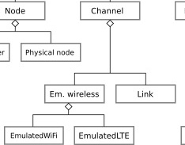
What about emulators?
vICN can emulate wireless links

Slide 20
Let’s use LTE
Cons
Relay
Prod
Cons
Relay
Emulator
veth
veth
Virtual bridge
veth
TAP
TAP
veth

Slide 21
The EmulatedLteChannel resource
{
"type": "Link",
"src_node": "cons",
"dst_node": "relay",
"groups": [ "virtual" ]
},
{
"type": "EmulatedLteChannel",
"name": "lch",
"ap": "relay",
"stations": [
"cons"
],
"control_port": 30002,
"node": "server",
"groups": [ "virtual" ]
},
More information (including EmulatedWifiChannel):
https://wiki.fd.io/view/VICN/Tutorial/HetnetLoadBalancing

Slide 22
Other capabilities
VPP-based forwarder
Deploy on cluster
Attach real nodes to network
etc.

Slide 23
Understanding the vICN code

Slide 24
Resources and attributes
Relational Object Model
  Resources ~ Classes
  Attributes ~ Class members
  Relations between objects:
    Object a must be created after object attribute b:
    a.__key__ = Key(b)
    Object A must be created after all instances of resource B:
    a.__after__ = (B,)

Slide 25
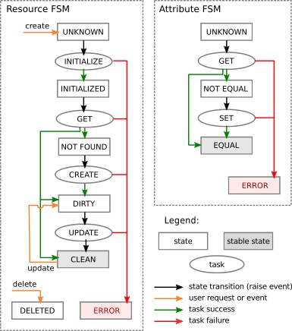
Resource lifecycle
Handled by FSM
3 main steps:
  Initialization: r.__init__()
  Retrieval: r.__get__()
  Creation: r.__create__()

Slide 26
Attribute lifecycle
Handled by FSM
2 main steps:
  Retrieval: r._get_attr()
  Creation: r._set_attr()

Slide 27
Example: TextFile class skeleton
class TextFile(Resource):
filename = Attribute(String, description = 'Path to the file')
node = Attribute(Node, description = 'Node on which the file is created’)
content = Attribute(String, description=‘File content’)
#Resource FSM
def __create__(self): #touch {file.filename}
def __get__(self): #test -f {file.filename} && readlink -e {file.filename}
#attribute FSM
def _set_content(self): #echo {file.content} > {file.filename}
def _get_content(self): #cat {file.filename}

Slide 28
Example relation – key
src_node
dst_node
class Link:
[...]
src_node = Attribute(Node)
dst_node = Attribute(Node)
__key__ = Key(src_node, dst_node)
veth
veth
src_node and dst_node must be up before we can create the veth pair

Slide 29
Example relation – after
class IPRoutes(Resource):
def __after__(self):
return ("IPAssignment",)
Must be a python tuple
IP Routing can only be computed after all interfaces have been attributed IP addresses

Slide 30
Resources / References
code source:
git clone -b vicn/master https://gerrit.fd.io/r/cicn vicn
Technical report: https://wiki.fd.io/view/File:VICN_technical_report.pdf
vICN wiki: https://wiki.fd.io/view/Vicn
Mailing list: cicn-dev@lists.fd.io

Slide 31
Tutorials
VPP: https://wiki.fd.io/view/Dumbbell-vicn
HetNets: https://wiki.fd.io/view/VICN/Tutorial/HetnetLoadBalancing
Load-balancing and caching: https://wiki.fd.io/view/VICN/Tutorial/Internet2GlobalSummit2017

