Slide 1
Honeycomb design and architecture

Slide 2
Initial design
Standard ODL application
Binding aware
Relying on
MD-SAL
global datastore
NETCONF northbound for MD-SAL

Slide 3
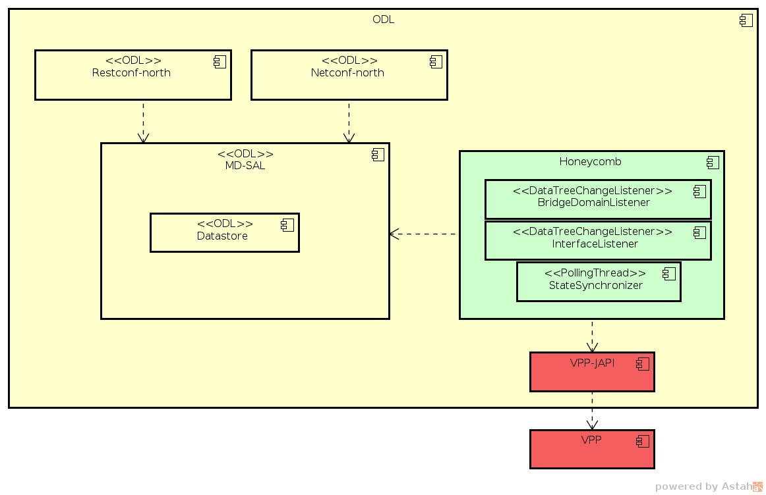

Slide 4
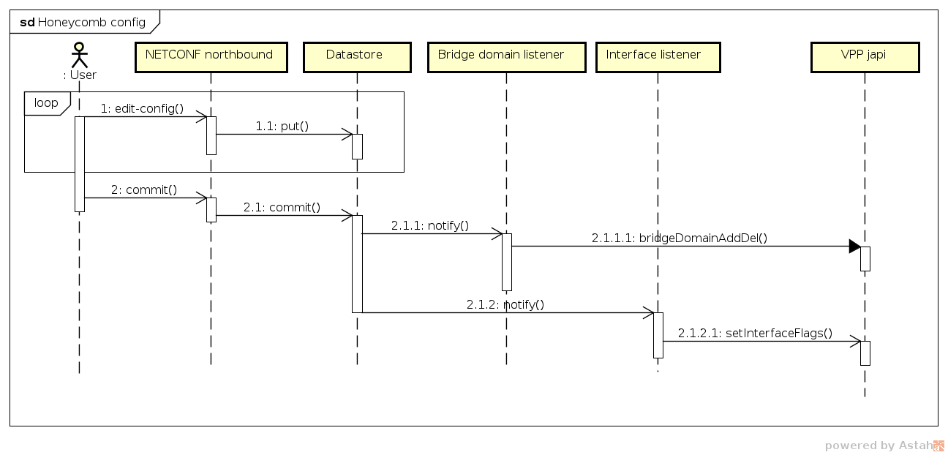
Honeycomb config

Slide 5
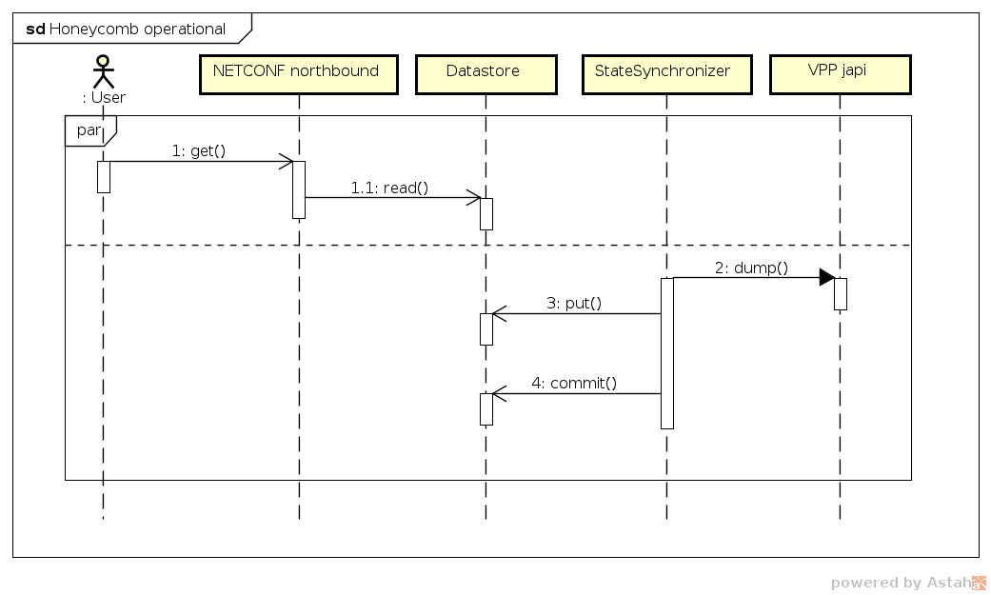
Honeycomb operational

Slide 6
Issues
Unable to reject committed data
Silent failures when committing configuration
Out-of-sync between VPP and Honeycomb data in ODL
Config data handling order out of control
Operational data out of date

Slide 7
Distribution
Regular karaf distribution with ODL

Slide 8
Re-design
New pipeline
Custom DataBroker with dedicated in-memory DataTree for configuration
Dedicated NETCONF and RESTCONF northbounds
Operational data polled and translated on demand
Rewired to serve only Honeycomb
Generic agent infrastructure
VPP specific plugins

Slide 9
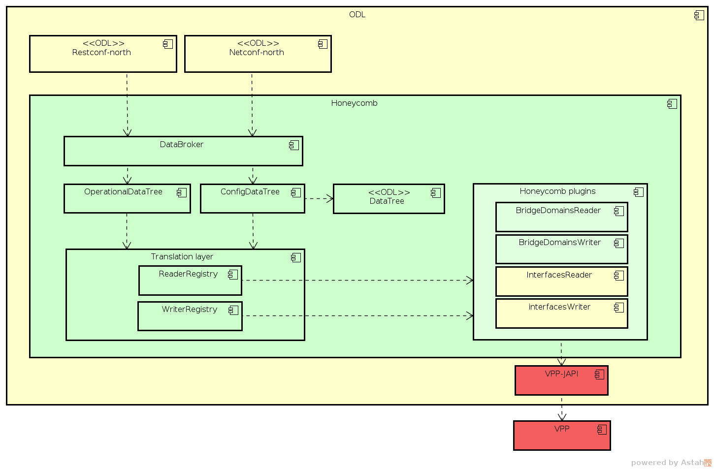

Slide 10
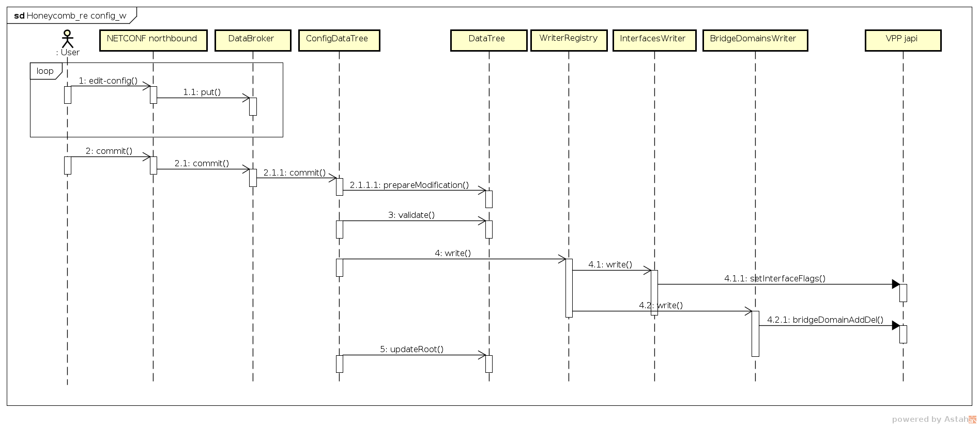
Honeycomb config

Slide 11
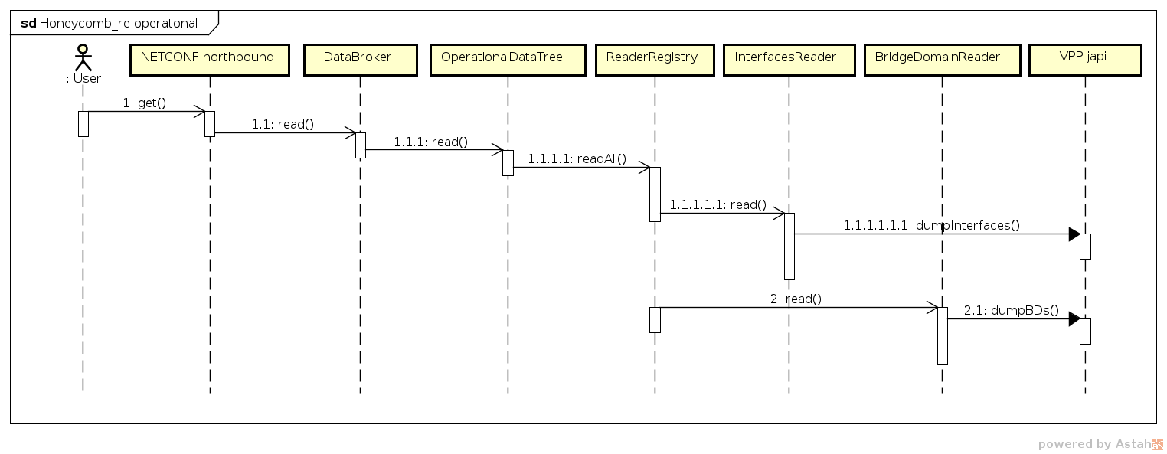
Honeycomb operational

Slide 12
What’s missing
Notification service
RPC service
Initial sync between VPP and Honeycomb config DataTree
Persistence
Tooling (Honeycomb plugin archetype)
VPP japi improvements

Slide 13
Distribution
Regular karaf distribution with ODL (at the moment)
Minimal non-karaf non-config-subsystem distribution with only necessary components (in the future)

Slide 14
Translation layer
Composite
Recursive
Extensible
Readers – responsible for reading operational data subtrees from e.g. VPP
Writers – responsible for writing config data subtrees into e.g. VPP
Config data are read straight from DataTree instance

