Slide 1
Chinac's USN Project -- Experience of Building VPP-based Applications for OpenStack Networks
Shaopeng, Ho Architect of Chinac Group
heshaopeng@chinac.com

Slide 2
Contents
Chinac Cloud Products Introduction
Ultra Speed Network Project Overview: new VPP applications not pure OpenStack-integration of existing standard L2/L3 VPP functions; co-operate with OVS
Restructure OpenStack Data Plane
Networking from Kernel to User Space
A/S(Active/Standby) HA(High Availability ) to Cluster
Simplify and offload Compute Node network functions to VPP cluster
Summary: user-perspective view on VPP in datacenter

Slide 3
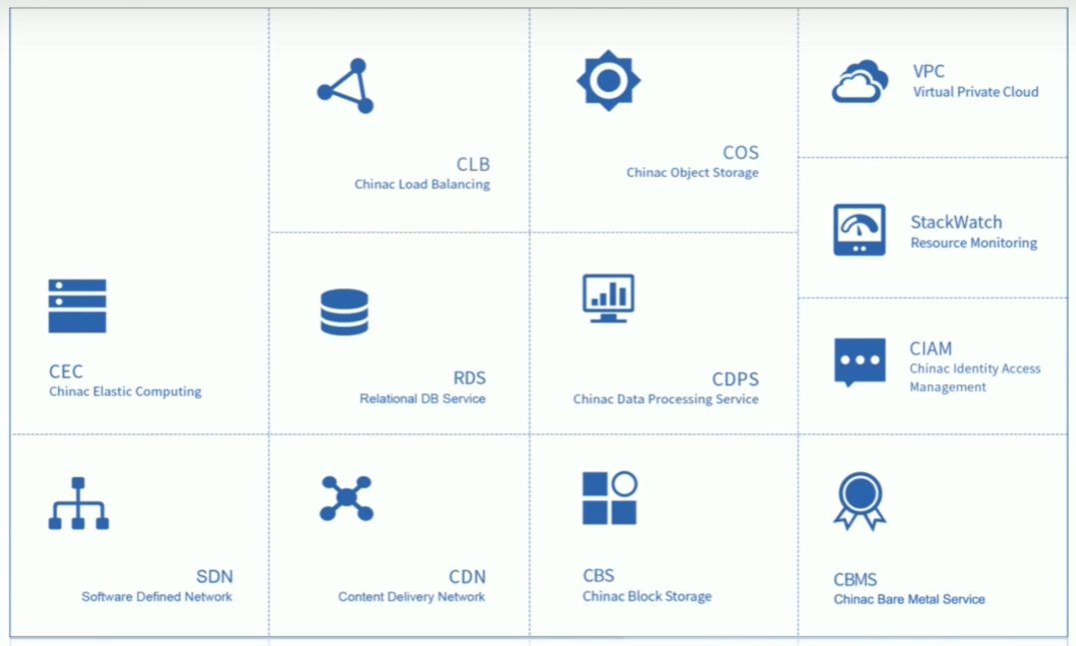
Chinac Cloud Products
Released public cloud in 2010
21 datacenters totally today
15,000+ physical servers
Focus on Public, Private and Hybrid cloud
Complete Portfolios
Using OpenStack since 2013

Slide 4
Ultra Speed Network Project
Project Target
Improve the networks performance for public, private and hybrid cloud, to meet some customers which need the most fast network experience.
Directions: Restructure OpenStack Data Plane by
Scale Up: Move heavy load network functions from kernel space to user space or hardware offloading
Scale Out: Build active/active network service cluster like google Meglev. Never single point of failure, never performance bottleneck.
Simplify: simplify network functions in compute node --- 80% problems in compute node are caused by network; separate different functions in network node to different servers. Each focuses on own job, i.e.. compute node on compute task etc., and work together to achieve a whole fast network experience.

Slide 5
Kernel to User Space Networking
Network Node L2 + L3 :
fd.io/vpp
Compute Node L2 Switch:
Ovs-dpdk
This is typical OpenStack deployment: three kinds of node and three kinds of networks. VM and networks services are connected to different networks by ovs bridges(br-int, br-eth1, br-ex etc.).
Linux kernel networking is slow, especially for the small packets. Moving to user space applications is one direction to resolve this problem. DPDK is the key part of those solutions by providing fast User Space Network IO. VPP adds a packet processing platform on DPDK.
Original OpenStack supports Ovs-dpdk for L2 Switch. For L3 routing, only kernel Iptables and IP route are used officially in open source solution now, VPP is a good candidate.

Slide 6
A/S HA to Cluster
Internet
Internet
SNAT
ECMP
Vpp/
VR
Vpp/VR
Vpp/VR
Vpp/
LB
Vpp/
LB
Vpp/
LB
Active
Network Node
Standby
Network Node
ECMP
Compute Node
…
Compute Node
Compute Node
…
Compute Node
3 types of network node traffic: internal between different subnet , DNAT(Destination NAT) from Internet, SNAT(Source Network Address Translation) to Internet.
Internal traffic via vpp-based VR(Virtual Router) , DNAT to vpp-based LB(load balancer)
SNAT is normally shared by different VMs to access internet, which needs connection tracking to remember the status. It is hard to do the sync between cluster nodes, so still in A/S HA mode.
Configuration are distributed to all cluster nodes via files, which are generated from OpenStack database, and have all the information about the network. Openstack does not see the cluster directly.

Slide 7
Simplify Compute Node
DVR is most complex network function in compute node, uses kernel route. After network node functions are scaled up and out using VR/VPP and LB/VPP, compute node could get rid of kernel route, and still have direct communication between different subnet using new fast DVR approach.
Fast DVR has the default route using VR/VPP, and can setup L2 forward rules for special cases e.g. very heavy traffic load or high QoS requirement between specific VMs.
Later, we plan to move more network functions from computer node to VR/VPP, e.g. ARP responder
In the long term, we hope the network function in compute node could be simple enough to be offloaded in hardware smartNIC, and host CPU could focus on compute task.

Slide 8
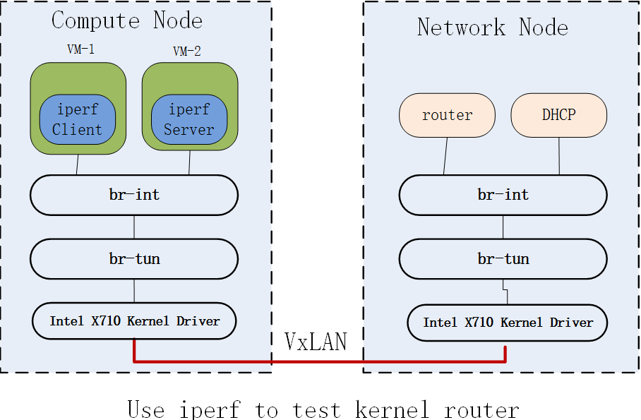
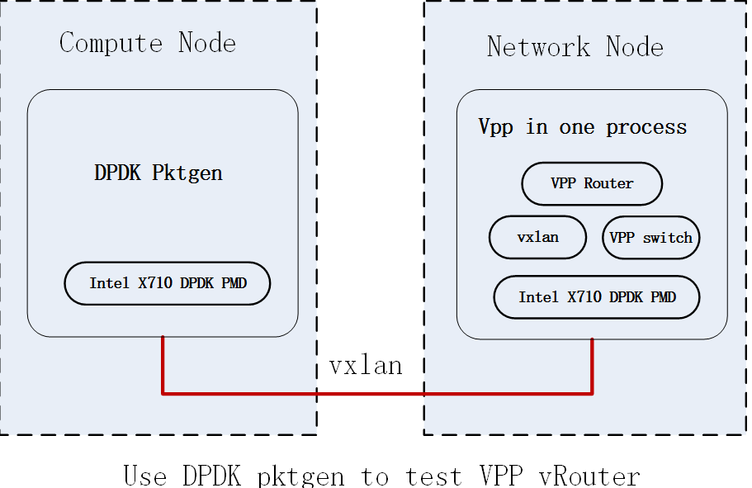
POC Performance Data
Test ENV：
NIC： Intel 10G X710 NIC
Server： R730XD CPU 2640 V3
One Core and One HW queue
A test case：
test traffic throughput via VPP virtual router in network node.
Single Node Performance Improvement ：> 8X
16 Node Cluster Improvement: > 16 * 8 = 128X
Logic topology for test

Slide 9
Summary
VPP/DPDK is a fantastic network development platform. Graph Node and Plugin mechanism provide great flexibility for different network applications. New use cases for these new capabilities, re-arrangement network functionalities in datacenter.
There are several projects working on openstack-vpp integration, e.g. Openstack + OpenDayLight + HoneyComb + VPP and networking-vpp; mostly focus on L2 functionality now, similar as OVS did. Ovs-dpdk has better community support, more mature and works well for L2 switch.
Stateless cluster like Meglev is good way of scale-out not only for Load Balance but also for other network applications.
Different solutions for different situations, looking forward to co-operations with community on these innovation opportunities VPP brings to reality

Slide 10
Thank You !

