Slide 1


VPP overview
Shwetha Bhandari
Developer@Cisco

Slide 2
Scalar Packet Processing
A fancy name for processing one packet at a time
Traditional, straightforward implementation scheme
Interrupt, a calls b calls c … return return return
Issues:
thrashing the I-cache (when code path length exceeds the primary I-cache size)
Dependent read latency (packet headers, forwarding tables, stack, other data structures)
Each packet incurs an identical set of I-cache and D-Cache misses

Slide 3
Packet Processing Budget
14 Mpps on 3.5 GHz CPU = 250 cycles per packet

Slide 4
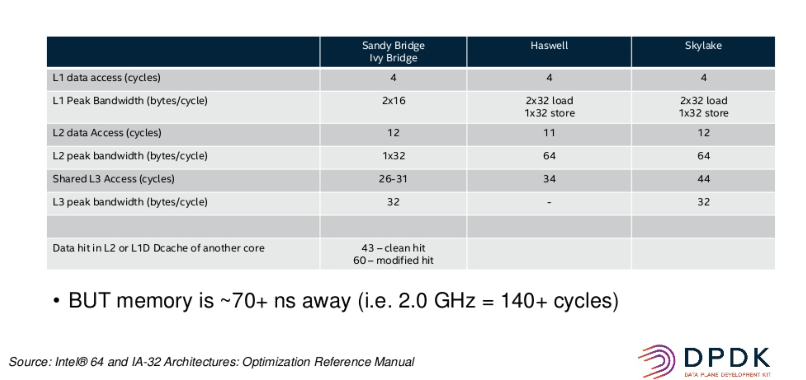
Memory Read/Write latency

Slide 5
Introducing VPP: the vector packet processor

Slide 6
Introducing VPP
Accelerating the dataplane since 2002
Fast, Scalable and consistent
14+ Mpps per core
Tested to 1TB
Scalable FIB: supporting millions of entries
0 packet drops, ~15µs latency
Optimized
DPDK for fast I/O
ISA: SSE, AVX, AVX2, NEON ..
IPC: Batching, no mode switching, no context switches, non-blocking
Multi-core: Cache and memory efficient
Netconf/Yang
REST
...
Management Agent
Packet Processing: VPP
Network I/O

Slide 7
Introducing VPP
Netconf/Yang
REST
...
Extensible and Flexible modular design
Implement as a directed graph of nodes
Extensible with plugins, plugins are equal citizens.
Configurable via CP and CLI
Developer friendly
Deep introspection with counters and tracing facilities.
Runtime counters with IPC and errors information.
Pipeline tracing facilities, life-of-a-packet.
Developed using standard toolchains.
Management Agent
Packet Processing: VPP
Network I/O

Slide 8
Introducing VPP
Netconf/Yang
REST
...
Fully featured
L2: VLan, Q-in-Q, Bridge Domains, LLDP ...
L3: IPv4, GRE, VXLAN, DHCP, IPSEC …
L3: IPv6, Discovery, Segment Routing …
CP: CLI, IKEv2 …
Integrated
Language bindings
Open Stack/ODL (Netconf/Yang)
Kubernetes/Flanel (Python API)
OSV Packaging
Management Agent
Packet Processing: VPP
Network I/O
Notes:
https://docs.fd.io/vpp/17.04/release_notes_1704.html

Slide 9

VPP in the Overall Stack
Application Layer / App Server
VM/VIM Management Systems
Orchestration
Network Controller
Operating Systems
Data Plane Services
VPP
Packet Processing
Network IO
Hardware

Slide 10
VPP: Dipping into internals..

Slide 11
VPP Graph Scheduler
Always process as many packets as possible
As vector size increases, processing cost per packet decreases
Amortize I-cache misses
Native support for interrupt and polling modes
Node types:
Internal
Process
Input

Slide 12
Sample Graph
dpdk-input
mpls-gre
-input
ethernet
-input
ip6-input
ip4-input
ip4-input-no-checksum
mpls
-ethernet
-input
ip4-lookup
ip4-lookup-multicast
ip4-local
ip4-classify
ip4-rewrite
-transit

Slide 13
How does it work?
1
vhost-user-
input
af-packet-
input
dpdk-input
… graph nodes are optimized to fit inside the instruction cache …
2
ethernet-
input
Microprocessor
mpls-input
lldp-input
arp-input
cdp-input
l2-input
ip4-input
ip6-input
Packet 0
Packet 1
Packet 2
Packet 3
Packet 4
Packet 5
Packet 6
Packet 7
Packet 8
Packet 9
Packet 10
...-no-
checksum
Instruction Cache
3
ip4-lookup
ip4-lookup-
mulitcast
Data Cache
4
mpls-policy-
encap
ip4-load-
balance
ip4-rewrite-
transit
ip4-
midchain
interface-
output
… packets moved through graph nodes in vector …
… packets are pre-fetched, into the data cache …
Packet processing is decomposed into a directed graph node …
* approx. 173 nodes in default deployment

Slide 14
How does it work?
6
dispatch fn()
… instruction cache is warm with the instructions from a single graph node …
while packets in vector
Get pointer to vector
while 4 or more packets
Microprocessor
PREFETCH #3 and #4
ethernet-input
PROCESS #1 and #2
4
ASSUME next_node same as last packet
5
Update counters, advance buffers
Packet 1
Packet 2
Enqueue the packet to next_node
while any packets
<as above but single packet>
… data cache is warm with a small number of packets ..
… packets are processed in groups of four, any remaining packets are processed on by one …

Slide 15
How does it work?
dispatch fn()
while packets in vector
7
Get pointer to vector
while 4 or more packets
Microprocessor
PREFETCH #1 and #2
ethernet-input
PROCESS #1 and #2
ASSUME next_node same as last packet
Update counters, advance buffers
Packet 1
Packet 2
Enqueue the packet to next_node
while any packets
<as above but single packet>
… prefetch packets #1 and #2 …

Slide 16
How does it work?
dispatch fn()
while packets in vector
8
Get pointer to vector
while 4 or more packets
Microprocessor
PREFETCH #3 and #4
ethernet-input
PROCESS #1 and #2
ASSUME next_node same as last packet
Update counters, advance buffers
Packet 1
Packet 2
Enqueue the packet to next_node
Packet 3
while any packets
Packet 4
<as above but single packet>
… process packet #3 and #4 … … update counters, enqueue packets to the next node …

Slide 17
Modularity Enabling Flexible Plugins
Packet vector
…
Plugins can:
Introduce new graph nodes
Rearrange packet processing graph
Can be built independently of VPP source tree
Can be added at runtime (drop into plugin directory)
All in user space
Enabling:
Ability to take advantage of diverse hardware when present
Support for multiple processor architectures (x86, ARM, PPC)
Few dependencies on the OS (clib) allowing easier ports to other Oses/Env
ethernet-input
Plug-in to enable new HW input Nodes
mpls-ethernet-input
ip4input
llc-input
ip6-input
arp-input
…
ip6-lookup
Plug-in to create new nodes
ip6-rewrite-transmit
ip6-local
Custom-A
Custom-B

Slide 18
VPP: performance

Slide 19
VPP Performance at Scale
Phy-VS-Phy
IPv6, 24 of 72 cores
IPv4+ 2k Whitelist, 36 of 72 cores
Zero-packet-loss Throughput
for 12 port 40GE
[Gbps]]
[Gbps]]
Hardware: Cisco UCS C460 M4
Intel® C610 series chipset
4 x Intel® Xeon® Processor E7-8890 v3 (18 cores, 2.5GHz, 45MB Cache)
2133 MHz, 512 GB Total
9 x 2p40GE Intel XL710 18 x 40GE = 720GE !!
480Gbps zero frame loss
IMIX => 342 Gbps,1518B => 462 Gbps
Latency
18 x 7.7trillion packets soak test
Average latency: <23 usec
Min Latency: 7…10 usec
Max Latency: 3.5 ms
[Mpps]
[Mpps]
Headroom
Average vector size ~24-27
Max vector size 255
Headroom for much more throughput/features
NIC/PCI bus is the limit not vpp
200Mpps zero frame loss
64B => 238 Mpps

Slide 20
VPP: integrations

Slide 21


FD.io Integrations
Openstack
Neutron
Integration work done at
ODL
Plugin
FD.io
Plugin
GBP app
Control Plane
Lispflowmapping app
SFC
VBD app
LISP Mapping Protocol
Netconf/Yang
Netconf/yang
REST
Honeycomb
FD.io ML2 Agent
Felixv2 (Calico Agent)
Data Plane
VPP

Slide 22
Summary
VPP is a fast, scalable and low latency network stack in user space.
VPP is trace-able, debug-able and fully featured layer 2, 3 ,4 implementation.
VPP is easy to integrate with your data-centre environment for both NFV and Cloud use cases.
VPP is always growing, innovating and getting faster.
VPP is a fast growing community of fellow travellers.
ML: vpp-dev@lists.fd.io Wiki: wiki.fd.io/view/VPP
Join us in FD.io & VPP - fellow travellers are always welcome.
Please reuse and contribute!

Slide 23























Contributors…
Qiniu
Yandex
Universitat Politècnica de Catalunya (UPC)

Slide 24
