Slide 1
Honeycomb
VPP management agent

Slide 2
What is Honeycomb?
Management agent for VPP providing northbound interfaces:
RESTCONF
NETCONF
Connected to a custom translation layer handling
Accepting configuration request described in YANG on one end and invoking VPP API calls on the other
Accepting operational data requests and invoking VPP API calls transforming the result into YANG described data
Notes:
Operational data are handled similarly just in the opposite direction: invoking VPP API calls transforming the result into YANG described data

Slide 3
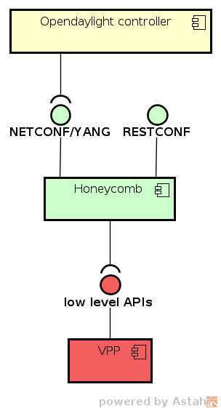
Honeycomb and VPP
VPP’s low level, high performance, shared memory APIs
Exposed as high level NETCONF/YANG or RESTCONF APIs
Easily consumable by e.g. Opendaylight controller
Bare Metal/
VM/Container
Data Plane
Management Agent
Data Plane
Packet Processing
Notes:
Honeycomb is on top of VPP, using its low level high performance shared memory APIs. Exposing them as high level NETCONF or RESTCONF APIs using YANG models, which are easily consumable by e.g. Opendaylight controller. Demo of an ODL based application talking to VPP through Honeycomb’s NETCONF is linked at the end of presentation (virtual bridge domain application).

Slide 4
Honeycomb - Building on existing components
Honeycomb (HC) Builds on existing Opendaylight components and tools:
Yangtools – YANG language parser, data tree
Md-sal – BA and BI* representation of YANG structures, APIs
Netconf – Netconf northbound server
Restconf – Restconf northbound server
Wired into a special data processing pipeline
It is not just an Opendaylight application
* BA and BI - Binding Aware and Binding Independent java code representation on YANG structures.
Notes:
Yangtools for:
yang language parser
Data tree (tree like collection optimized for storing YANG structures) as in-memory database
Md-sal for
BA (java code) representation of YANG structures. In ODL there are 2 forms of data described by YANG (In HC, both forms are used):
BI – binding independent – generated code is not used and only DOM like structures represent the data.
BA – binding aware – instantiated generated code
and MD-SAL APIs (which are implemented by Honeycomb in order to wire with NETCONF, RESTCONF)
Netconf for
NETCONF northbound server optimized to work with MD-SAL APIs (used completely as is)
Restconf for
REST northbound server optimized to work with MD-SAL APIs (used completely as is)
NOT just an ODL application, it is a different distribution of ODL components + custom implementation for MD-SAL components + wiring to provide special way of data handling (not possible in a regular ODL application)

Slide 5
Generic design approach
Data processing pipeline is completely generic
Translation layer is generic and extensible
=> Making Honeycomb not just VPP specific agent
VPP specific translation is a “Honeycomb plugin”
Notes:
We tried to design/develop Honeycomb as generic as possible making it not just VPP specific agent but in the future a framework for Java based agents providing NETCONF/RESTCONF/BGP(maybe) northbounds.
All the specific translation functionality is self-contained in plugins for translation layer + their YANG models.

Slide 6
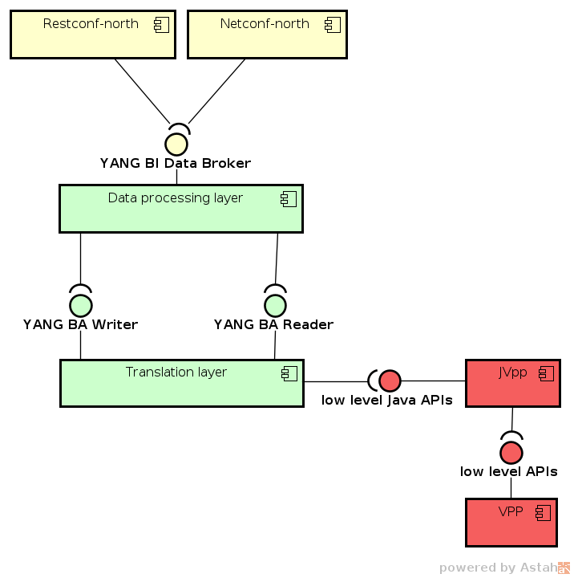
Honeycomb architecture
Honeycomb components and their APIs
Honeycomb core functionality is split into 2 layers:
Data processing layer
Pipeline processing data from northbound interfaces down to translation layer
Translation layer
Invoked by above layer to handle configuration updates or when polling operational state from VPP
Specific translation code lives in this layer in a form of extensions/plugins
Next slides zoom in on each layer..
Notes:
Data processing layer implements OLD’s API called DataBroker (DataBroker is an interface for transactional manipulation of data, exposing CRUD operations). It is BI (binding independent) (generated code is NOT used) and uses just DOM like representation of YANG structures. This makes it generic, since it does not depend on generated code for YANG models. Plus it also enables it to easily wire with existing implementations of NETCONF and RESTCONF northbound servers from Opendaylight.
Translation layer exposes Honeycomb’s custom APIs. They are utilizing BA (binding aware) representation of YANG structures (instances of generated Java code from YANG). It is still generic, since the models are brought in with the plugins (implementations of Readers and Writers). Readers and writers APIs are split in terms of APIs, to provide the freedom for plugins in case their YANG models are asymetrical (Config and Operational data are too different).
VPP is exposing its standard low level shared memory APIs and JVpp on top of VPP is exposing the same APIs, just available for Java code.

Slide 7
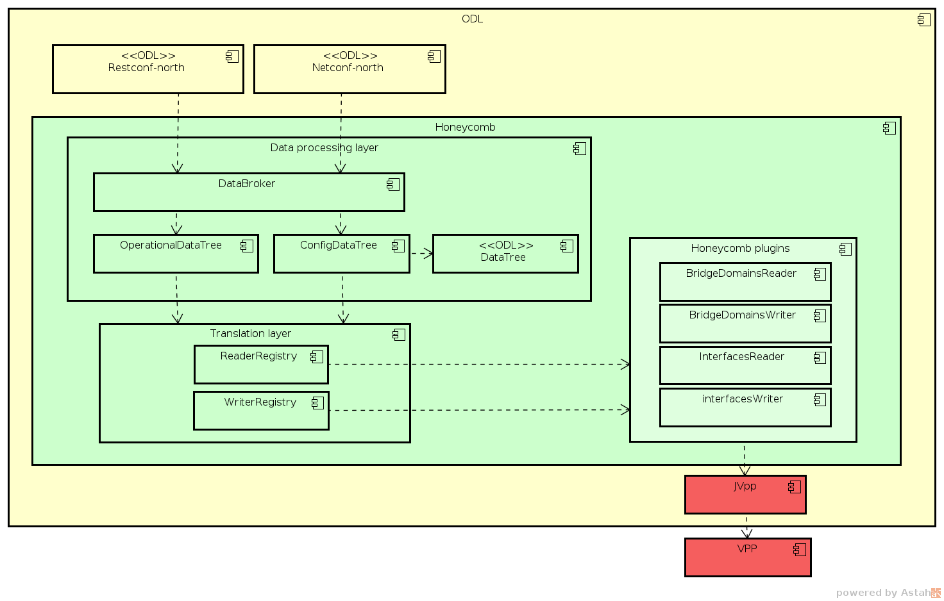
Notes:
This diagram shows Honeycomb’s layer with their major components
Also shows how VPP specific translations are in a self contained translation layer extension

Slide 8
Data processing layer
Custom DataBroker implementation
Config/Operational data trees provide abstraction on top of Translation layer for DataBroker
Config data flowing through DataTree storage to the translation layer
Operational data polled and translated on demand from the translation layer
Context DataTree
In addition to configuration, Honeycomb needs to provide a storage for mapping contexts (non deriveable information about YANG <-> VPP mapping)
Notes:
Data processing pipeline is the pipeline from NETCONF/RESTCONF northbounds down to translation layer
DataBroker is MD-SAL API that handles all data processing operations. Honeycomb implements a custom one.
This isn’t on the diagrams, but: Context DataTree is a special storage provided to translation layer so that plugins can store any non-config information required for their translations e.g. interface name from YANG -> Interface ID in VPP

Slide 9
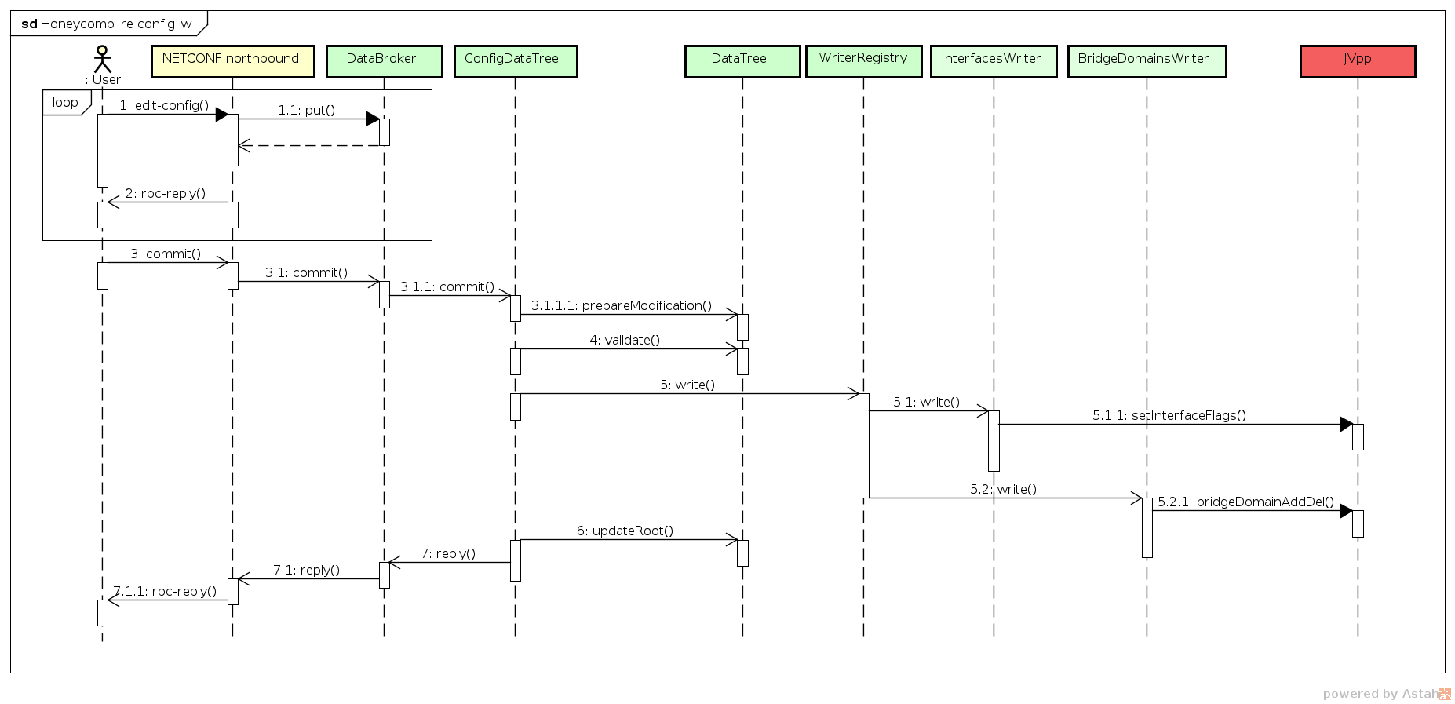
Notes:
Honeycomb config write sequence
Basically, data are applied to data tree for initial validation
Only after they are valid they are passed to translation layer
And after translation layer succeeds, data tree root is updated and OK response is sent to user

Slide 10
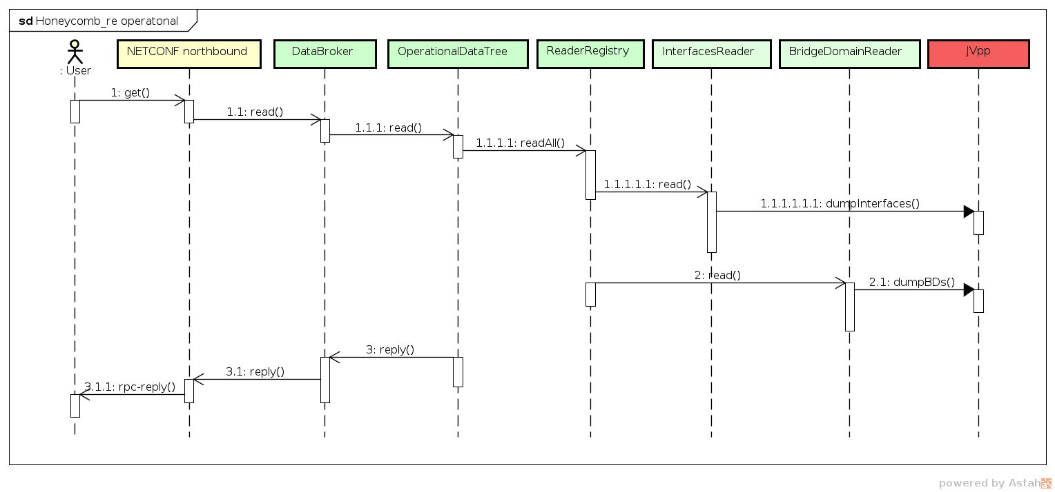
Notes:
Honeycomb operational read sequence
Bassically, it goes straight to VPP for data and returns to user performing transformations on the fly

Slide 11
Translation layer
Composite/tree-like implementation
Extensible
Separates readers and writers:
Readers - responsible for reading operational data subtrees
Writers – responsible for writing configuration data subtrees
Plugins provide a set of readers and/or writers
Readers and writers receive/provide data in BA format
Notes:
Translation layer shelters all the translation code (packaged in plugins) and invokes whatever necessary whenever it is necessary.
Translation layer uses separate registries for config and operational. These registries hold all the readers and writers provided by plugins and are called by the data processing layer.
For writes, plugins literally just receive data in BA format (instances of Java code generated for yang by yangtools + mdsal + maven plugin) and invoke appropriate VPP calls. For Reads, plugins return data in BA format constructed from whatever VPP returned.
Translation layer provides basic framework for readers/writers + lots of utilities, base implementations etc. to make the plugin development easier.

Slide 12
Adding features to Honeycomb
Make sure VPP binary APIs exist
Define a YANG model for them
Often models already exist e.g. ietf models
Generate Java bindings for YANG model
Write relatively small translation code for translation layer framework
”Wire” the new translation code into HC translation layer
Notes:
This is how Honeycomb features are currently developed…
If VPP already provides the APIs, you just need a model then write small code for the translation fitting into Honeycomb’s framework
And after updating wiring configuration, Honeycomb has new features
Currently all VPP related features live in Honeycomb project, but we would like to get them into dedicated projects later

Slide 13
VPP Java APIs
Auto-generated Java APIs for VPP
Supports all functionality available via low level VPP APIs
Component JVpp is part of VPP build
Uses JNI (Java Native interface)
Asynchronous
Generators
vpe.api definition as input
Python
Notes:
Honeycomb needs an interface to VPP to actually invoke the calls. That’s where JVpp comes in … it’s JNI based, fully-generated Java code working on top of VPP’s shared memory APIs, making it possible for any JVM application to manage&monitor VPP

Slide 14
Current features - Infrastructure
RESTCONF
Direct and simple management or monitoring of VPP
NETCONF
Similar to RESTCONF, but more suitable for controllers e.g. Opendaylight
Configuration data to VPP
Updating current configuration in VPP
Operational data from VPP
Reading current state from VPP on demand
Persistence & restoration of configuration
Covers VPP crashes, Honeycomb crashes or both
Notes:
This is changing “rapidly” but in the time of writing this ppt.
NETCONF is more suitable for controllers since its faster and transaction based + ODL does not have RESTCONF southbound plugin at the moment.

Slide 15
Current features – VPP configuration
Basic interface management
Vhost user interface
Tap interface
Bridge domain
Vxlan tunneling
Vlan management
Notes:
This is changing “rapidly” but in the time of writing this ppt
Each supports both config and operational data. Enabling full management (CRUD operations) of VPP for these features.
Basic interface management
enable/disable
IP settings
Vlan management
Subinterface management
Tag matching
Tag rewrite

Slide 16
What’s next
Infrastructure
Vpp features
Notifications support
Minimal distribution (with minimal code footprint)
BGP
L2 ACLs
LISP
Routes management
NSH
Vxlan-gpe
Notes:
Some of the items in our backlog we would like to work on in the near future

Slide 17
Links and pointers for Honeycomb
Wiki - https://wiki.fd.io/view/Honeycomb
POSTMAN request collection - https://wiki.fd.io/view/Honeycomb/Running_Honeycomb#Using_RESTCONF_northbound
JIRA - https://jira.fd.io/projects/HONEYCOMB
Gerrit - https://gerrit.fd.io/r/#/admin/projects/honeycomb
Mailing-list – honeycomb-dev@lists.fd.io
IRC channel - #fdio-honeycomb at freenode
Virtual bridge domain application demo - https://www.youtube.com/watch?v=vs1XzOOpaCo&feature=youtu.be
Notes:
Wiki provides general information, how to setup and run guides

