Slide 1
CICN
Community
Information-Centric Networking
Tutorial at ACM SIGCOMM ICN, Berlin, Germany
26th of September 2017

Slide 2
Tutorial agenda
Project overview
Vector Packet Processing
vICN: automation of virtual ICN network deployment
The consumer/producer socket API with applications to HTTP

Slide 3
CICN project overview
CCNx Internet documents are specified at the ICNRG define the architecture.
The rest is just software development, testing and experimentation.
Focus on VPP and application development:
Vector Packet Processing as the Universal Data Plane for vRouting and vSwitching
vICN automation of virtual networks deployment
The Consumer/Producer Socket API and HTTP

Slide 4
What is FD.io (pronounced “fido”)?

Slide 5
FD.io: The Universal Dataplane
Project at Linux Foundation
Multi-party
Multi-project
Software Dataplane
High throughput
Low Latency
Feature Rich
Resource Efficient
Bare Metal/VM/Container
Multiplatform
Fd.io Scope:
Network IO - NIC/vNIC <-> cores/threads
Packet Processing – Classify/Transform/Prioritize/Forward/Terminate
Dataplane Management Agents - ControlPlane
Bare Metal/VM/Container
Dataplane Management Agent
Packet Processing
Network IO

Slide 6
Fd.io in the overall stack
Application Layer/App Server
Orchestration
vICN
Network Controller
Data Plane Services
Dataplane Management Agent
Packet Processing
Network IO
Operation System
Hardware

Slide 7
Multiparty: Broad Membership
Service Providers
Network Vendors
Chip Vendors
Integrators

Slide 8
Multiparty: Broad Contribution
Qiniu
Yandex
Universitat Politècnica de Catalunya (UPC)

Slide 9
Code Activity
In the period since its inception, fd.io has more commits than OVS and DPDK combined, and more contributors than OVS
2016-02-11 to 2017-04-03 | Fd.io | OVS | DPDK
Commits | 6283 | 2395 | 3289
Contributors | 163 | 146 | 245
Organizations | 42 | 52 | 78

Slide 10
Multiproject: Fd.io Projects
Dataplane Management Agent
Testing/Support
vICN
hc2vpp
Honeycomb
CSIT
Packet Processing
puppet-fdio
ICNET
ONE
TLDK
trex
CICN
odp4vpp
VPP Sandbox
VPP
Network IO
deb_dpdk
rpm_dpdk

Slide 11
Fd.io Integrations
Openstack
Neutron
Integration work done at
ODL
Plugin
Fd.io
Plugin
GBP app
Control Plane
Lispflowmapping app
SFC
VBD app
LISP Mapping Protocol
Netconf/Yang
Netconf/yang
REST
Honeycomb
Fd.io ML2 Agent
Data Plane
VPP

Slide 12
Continuous Quality, Performance, Usability Built into the development process – patch by patch
Submit
Automated
Verify
Code Review
Merge
Publish Artifacts
Build/Unit Testing
120 Tests/Patch
System Functional Testing
252 Tests/Patch
Performance Testing
144 Tests/Patch, 841 Tests
Usability
Build binary packaging for
Ubuntu 14.04
Ubuntu 16.04
Centos 7
Automated Style Checking
Unit test :
IPFIX
BFD
Classifier
DHCP
FIB
GRE
IPv4
IPv4 IRB
IPv4 multi-VRF
DHCP – Client and Proxy
GRE Overlay Tunnels
L2BD Ethernet Switching
L2 Cross Connect Ethernet Switching
LISP Overlay Tunnels
IPv4-in-IPv6 Softwire Tunnels
Cop Address Security
IPSec
IPv6 Routing – NS/ND, RA, ICMPv6
uRPF Security
Tap Interface
Telemetry – IPFIX and Span
VRF Routed Forwarding
iACL Security – Ingress – IPv6/IPv6/Mac
IPv4 Routing
QoS Policer Metering
VLAN Tag Translation
VXLAN Overlay Tunnels
L2 Cross Connect
L2 Bridging
IPv4 Routing
IPv6 Routing
IPv4 Scale – 20k,200k,2M FIB Entries
IPv4 Scale - 20k,200k,2M FIB Entries
VM with vhost-userr
PHYS-VPP-VM-VPP-PHYS
L2 Cross Connect/Bridge
VXLAN w/L2 Bridge Domain
IPv4 Routing
COP – IPv4/IPv6 whiteless
iACL – ingress IPv4/IPv6 ACLs
LISP – IPv4-o-IPv6/IPv6-o-IPv4
VXLAN
QoS Policer
L2 Cross over
L2 Bridging
Merge-by-merge:
apt installable deb packaging
yum installable rpm packaging
autogenerated code documentation
autogenerated cli documentation
Per release:
autogenerated testing reports
report perf improvements
Puppet modules
Training/Tutorial videos
Hands-on-usecase documentation
IPv6
IP Multicast
L2 FIB
L2 Bridge Domain
MPLS
SNAT
SPAN
VXLAN
Merge-by-merge packaging feeds
Downstream consumer CI pipelines
Run on real hardware in fd.io Performance Lab

Slide 13
Universal Dataplane: Infrastructure
Cloud/NFVi
Container Infra
Bare Metal
Server
Server
Server
VM
VM
VM
Con
Con
Con
FD.io
FD.io
FD.io
Kernel/Hypervisor
Kernel
Kernel/Hypervisor

Slide 14
Universal Dataplane: VNFs
FD.io based VNFs
FD.io based VNFs
Server
Server
VM
VM
Con
Con
FD.io
FD.io
FD.io
FD.io
FD.io
FD.io
Kernel/Hypervisor
Kernel/Hypervisor

Slide 15
Universal Dataplane: Embedded
Embedded Device
SmartNic
Device
Server
Kernel/Hypervisor
SmartNic
FD.io
FD.io
Kernel/Hypervisor
Hw Accel
Hw Accel

Slide 16
Universal Dataplane: CICN Example
Physical CICN router
CICN in a VM
CICN in a Container
Device
Server
Server
VM
VM
docker
LXC
FD.io
FD.io
FD.io
FD.io
FD.io
FD.io
FD.io
Kernel/Hypervisor
Kernel/Hypervisor
Kernel/Hypervisor
Hw Accel

Slide 17
Universal Dataplane: communication/API
Server
Consumer/Producer Socket API
LXC
Segmentation/Naming
Manifest management
Reassembly
Flow and Congestion Control
LXD
app
Socket API
LXC
VCL
FD.io
MEMIF
FD.io
Existing drivers for links
AF-PACKET
DPDK
AF-PACKET
MEMIF (SHARED MEMORY)
Kernel/Hypervisor
DPDK
Nic

Slide 18
What is Vector Packet Processing?
An open-source software that provides out-of-the-box production quality switch/router functionality running under commodity CPUs
High Throughput
14+ Mpps per core
Multiplatform
Feature rich
L2, L3, L4, local and remote programmability
Modular and Extensible
Through plugins
Bare Metal/VM/Container
Data Plane Management Agent
Packet Processing
Network IO

Slide 19
Why VPP?
NFV goals
Software flexibility without giving up to hardware level performance
What about existing solutions?
Linux Kernel
Too slow for high throughput
Evolve slowly
Click
In principle similar to VPP, no V(ector)

Slide 20
CICN distribution
Core libraries
Consumer/Producer Socket API, CCNx libs, PARC C libraries
Server and Router
VPP cicn plugin for Ubuntu 16, CentOS 7
HTTP video server, Apache Traffic Server Plugin coming soon
Client
Metis Forwarder
VIPER MPEG-DASH video player
Android 7/8, MacOS X 10.12, iOS 10/11, Ubuntu 16, CentOS 7
Soon Apple Store and Google Play
vICN
intent-based networking
model driven programmable framework
monitoring and streaming for BigData support (PNDA.io)

Slide 21
Opportunities to Contribute
We invite you to Participate in fd.io
Get the Code, Build the Code, Run the Code, install from binaries
from binary packages
Read/Watch the Tutorials
Join the Mailing Lists
Join the IRC Channels
Explore the wiki
Join fd.io as a member
https://wiki.fd.io/view/cicn
https://wiki.fd.io/view/vicn
https://fd.io/
Forwarding strategies
Mobility management
Hardware Accelerators
vICN, configuration/management/control
Consumer/Producer Socket API
Reliable Transport
Instrumentation tools
HTTP integration

Slide 23
Vector Packet Processing for ICN
Alberto Compagno
Tutorial at ACM SIGCOMM ICN, Berlin, Germany
26th of September 2017

Slide 24
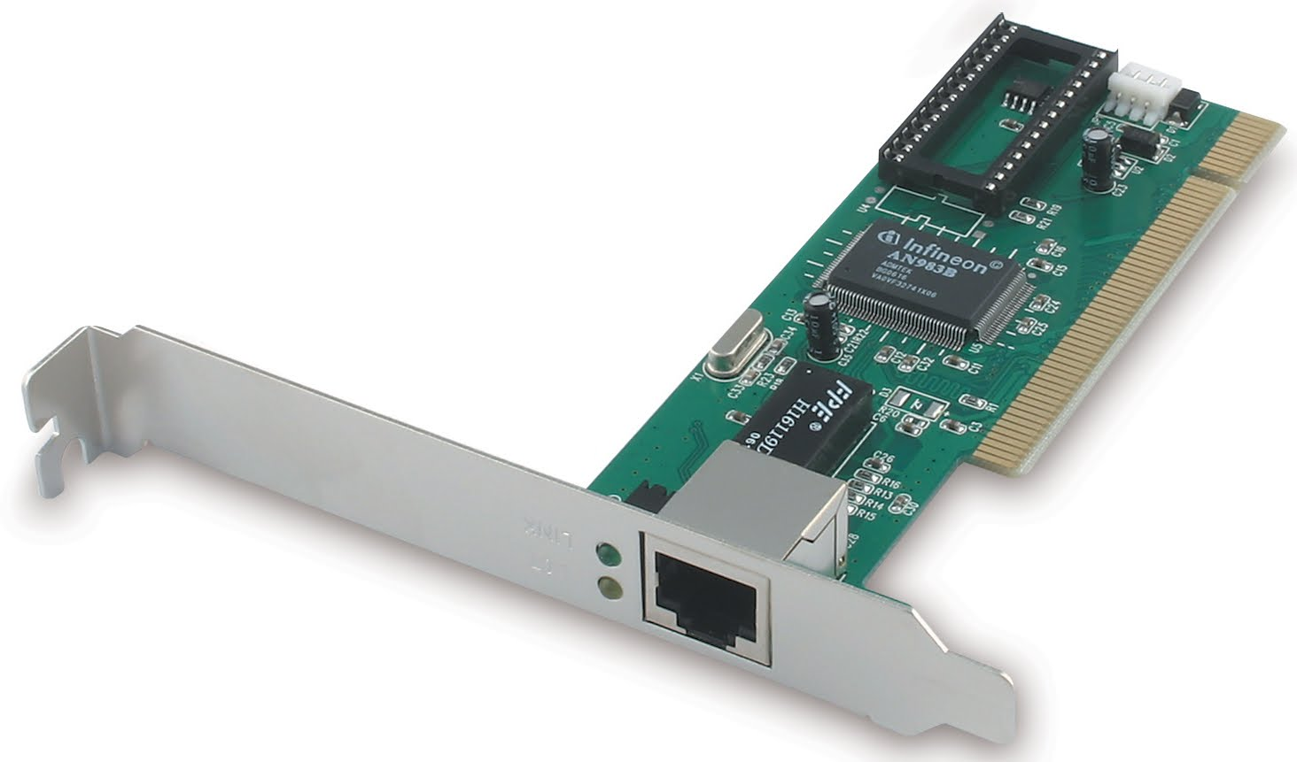
How does VPP work?
Packet vector
…
VPP is a ‘packet processing graph’
Nodes are
Small
Loosely coupled
VPP processes vectors of packets
Passed from node to node
dpdk-input
netmap-input
…
mpls-input
arp-input
ip6-input
ip4-input
ip6-lookup
ip6-rewrite
ip6-local

Slide 25
How does VPP work?
Each node has its vector(s)
Packets are “passed” from vector to vector
dpdk-input
netmap-input
Packet vector
…
…
mpls-input
arp-input
ip6-input
ip4-input
…
…
…
Packet vector
Packet vector
ip6-lookup
Packet vector
ip6-rewrite
ip6-local

Slide 26
How does VPP work?
Packet vector
…
Three types of nodes
Input
Internal
Process
dpdk-input
netmap-input
…
mpls-input
arp-input
ip6-input
ip4-input
ip6-lookup
ip6-rewrite
ip6-local

Slide 27
How does VPP work?
Packet vector
…
Input nodes
Read packets from RX buffer
Create the packet vector
dpdk-input
netmap-input
…
mpls-input
arp-input
Internal nodes
Process packets
Called from other nodes
Can be leaf (drop or TX)
ip6-input
ip4-input
ip6-lookup
ip6-rewrite
ip6-local

Slide 28
How does VPP work?
Packet vector
…
Process nodes
Not part of the processing graph
Run in background
React to timer/event
dpdk-input
netmap-input
…
mpls-input
arp-input
ip6-input
ip4-input
ip6-lookup
ip6-rewrite
ip6-local

Slide 29
Extend VPP with plugins?
Packet vector
…
new-input
dpdk-input
netmap-input
Plugins are first class citizen
They can:
Add nodes
Add api
Rearrange the graph
…
mpls-input
arp-input
ip6-input
ip4-input
ip6-lookup
icn-forwarder
ip6-rewrite
ip6-local

Slide 30
How does VPP accelerate packet processing?

Slide 31
Accelerating packet processing
Kernel bypass
Code Design (Multi-loop, Branch prediction, Function flattening, Lock-free structures, Numa aware)
Reduce cache misses

Slide 32
Kernel bypass
Packet processing in Linux
DPDK/Netmap
NIC
Main Memory
Operating System
NIC
Main Memory
Vpp
Registers
Ring
Buffers
mbuf/sk_buff
Registers
Ring
Buffers
vlib_buf
Head
Tail
Head
Tail
Application
Copy

Slide 33
Reduce cache misses – Why?
14 Mpps on 3.5GHz CPU = 250 cycles/packet
Cache hit:
~2-30 cycles
Cache miss (main memory)
~140 cycles

Slide 34
Reduce cache misses
Main memory
Packets
ip6-input
ip6-lookup
ip6-rewrite
…
Expensive
Processor
I-cache
D-cache

Slide 35
Reduce cache misses – I-cache
Let’s compare scalar processing with vector processing
Main memory
Packets
ip6-input
ip6-lookup
ip6-rewrite
…
Expensive
Processor
I-cache
D-cache

Slide 36
Scalar Packet Processing
Process one packet at a time
Main memory
Packets
ip6-input
ip6-lookup
ip6-rewrite
…
Processor
I-cache
D-cache

Slide 37
Scalar Packet Processing
Process one packet at a time
Main memory
Packets
ip6-input
ip6-lookup
ip6-rewrite
…
miss
miss
Processor
I cache
D-cache
ip6-input

Slide 38
Scalar Packet Processing
Process one packet at a time
Main memory
Packets
ip6-input
ip6-lookup
ip6-rewrite
…
miss
Processor
I cache
D-cache
ip6-lookup

Slide 39
Scalar Packet Processing
Process one packet at a time
Main memory
Packets
ip6-input
ip6-lookup
ip6-rewrite
…
miss
Processor
I cache
D-cache
ip6-rewrite

Slide 40
Scalar Packet Processing
Process one packet at a time
Main memory
Packets
ip6-input
ip6-lookup
ip6-rewrite
…
miss
miss
Processor
I cache
D-cache
ip6-input

Slide 41
Scalar Packet Processing
Process one packet at a time
Many I-cache misses per packet
Main memory
Packets
ip6-input
ip6-lookup
ip6-rewrite
…
miss
Processor
I cache
D-cache
ip6-lookup

Slide 42
Vector Packet Processing
Every node process the full packet vector
Main memory
Packets
ip6-input
ip6-lookup
ip6-rewrite
…
Processor
I-cache
D-cache

Slide 43
Vector Packet Processing
Every node process the full packet vector
Main memory
Packets
ip6-input
ip6-lookup
ip6-rewrite
…
miss
miss
Processor
I cache
D-cache
ip6-input

Slide 44
Vector Packet Processing
Every node process the full packet vector
Main memory
Packets
ip6-input
ip6-lookup
ip6-rewrite
…
miss
Processor
I cache
D-cache
ip6-input

Slide 45
Vector Packet Processing
Every node process the full packet vector
Main memory
Packets
ip6-input
ip6-lookup
ip6-rewrite
…
miss
Processor
I cache
D-cache
ip6-input

Slide 46
Vector Packet Processing
Every node process the full packet vector
Processing the full vector amortizes the cost of the first I-cache miss
… at the cost of increasing D-cache misses
Main memory
Packets
ip6-input
ip6-lookup
ip6-rewrite
…
miss
Processor
I cache
D-cache
ip6-input

Slide 47
Reduce cache miss – D-cache
VPP pre-fetches data into D-cache
Main memory
Packets
ip6-input
ip6-lookup
ip6-rewrite
…
Expensive
Processor
I-cache
D-cache

Slide 48
Reduce cache miss – D-cache
Example: Processing packet 1 & 2
VPP node pseudocode
Might have a cache miss for packet 1 & 2
while packets in vector
Packets
Main memory
ip6-input
while 4 or more packets
ip6-lookup
1
2
3
4
5
…
ip6-rewrite
PREFETCH #3 and #4
PROCESS #1 and #2
Processor
I-cache
D-cache
while any packets
ip6-input
1
2
3
4
<as above but single packet>

Slide 49
Reduce cache miss – D-cache
Example: Processing packet 3 & 4
The cost of the first D-cache miss is amortized by the subsequent D-cache hits.
VPP node code snippet
Cache hit!
while packets in vector
Packets
Main memory
ip6-input
while 4 or more packets
ip6-lookup
1
2
3
4
5
…
ip6-rewrite
PREFETCH #5 and #6
PROCESS #3 and #4
Processor
I-cache
D-cache
while any packets
ip6-input
5
6
3
4
<as above but single packet>

Slide 50
Hands on VPP!

Slide 51
VPP documentation
Wiki
https://wiki.fd.io/view/VPP
Doxygen
https://docs.fd.io/vpp/17.04/

Slide 52
Download VPP (v17.04)
Clone the source code from git
git clone https://gerrit.fd.io/r/vpp
Or install it from .deb pkg (rpm for Centos available too)
… see wiki

Slide 53
Configure and Start VPP
VPP configuration file
# emacs /etc/vpp/startup.conf
Start vpp
# sudo vpp -c /etc/vpp/startup.conf

Slide 54
VPP Command Line Interface
To start a shell:
# vppctl
To run one command:
# vppctl <command>

Slide 55
VPP Command Line Interface
A bunch of useful commands:
?
show
set

Slide 56
Create your own plugin

Slide 57
Outline
VPP structures
Design & Implement your node(s)
Insert your node(s) in the vlib_graph
Compile and install your plugin

Slide 58
VPP structures
vlib_buffer_t
The vector of packets is called FRAME
….
u8 data[0];
…
Pointer to packet data (DMA memory)
Each element is called VECTOR
A vector is an index to a vlib_buffer_t
Memory holding vlib_buffer_t objects

Slide 59
Outline
VPP structures
Design & Implement your node(s)
Inserting your node(s) in the vlib_graph
Compiling and installing your plugin

Slide 60
Design & Implement your node(s)
Your node should follow VPP style
Multi-loop, Branch prediction, Function flattening, Lock-free structures
A node must implement a processing function that
“Moves vectors” from your node’s frame to the next node’s frame
Processes packets as YOU want
Add whatever else you need
Supporting Functions, macros, variables, etc.. (C code)

Slide 61
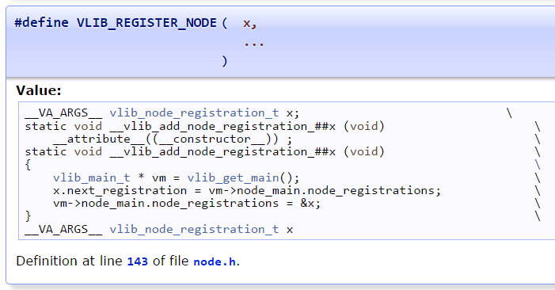
Register your node(s) to VPP
Each node must be registered to VPP through VLIB_REGISTER_NODE macro

Slide 62
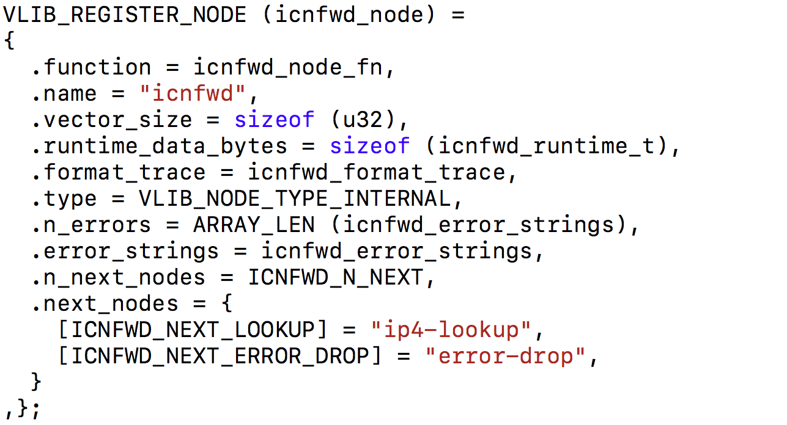
Example: Cicn plugin
Node processing function
Name of the node
Runtime structure
You need to initialize it by yourself
Type of node
Next nodes in the Vpp graph
Let’s take a look to icnfwd_node_fn

Slide 63
icnfwd node
from
icnfwd
…
n_left_from
to_next
ip4-lookup
error
…
…
n_left_to_next
next_index
Hold the actual next node id
next0=?

Slide 64
icnfwd node
vlib_buffer_t objects
b0
from
icnfwd
bi0=
…
n_left_from
to_next
ip4-lookup
error
…
…
n_left_to_next
next_index
next0=?

Slide 65
icnfwd node
vlib_buffer_t objects
b0
from
icnfwd
bi0=
…
n_left_from
to_next
ip4-lookup
error
…
…
n_left_to_next
next_index
next0=?

Slide 66
Wrong speculation
vlib_buffer_t objects
b0
from
icnfwd
bi0=
…
n_left_from
to_next
ip4-lookup
error
to_next
…
…
n_left_to_next
n_left_to_next
next_index
next0=?

Slide 67
Example: Cicn plugin
Errors handling (counters)

Slide 68
Other important macros
VPP_INIT_FUNCTION
Function that is called during VPP initialization
VPP_REGISTER_PLUGIN
Required to guarantee that your plugin is actually a VPP plugin …and not a library copied by mistake in /usr/lib/vpp_plugins

Slide 69
Outline
VPP structures
Design & Implement your node(s)
Insert your node(s) in the vlib_graph
Compile and install your plugin

Slide 70
Insert your node to VPP graph
direct all the packets from one interface
vnet_hw_interface_rx_redirect_to_node (vnet_main, hw_if_index, my_graph_node.index /* redirect to my_graph_node */);
capture packets with a particular ethertype
ethernet_register_input_type (vm, ETHERNET_TYPE_CDP, cdp_input_node.index);
for-us packet for new protocol on top of IP
ip4_register_protocol (IP_PROTOCOL_GRE, gre_input_node.index);

Slide 71
Insert your node to VPP graph
ip-for-us packet sent to a specific UDP port
udp_register_dst_port (vm, UDP_DST_PORT_vxlan, vxlan_input_node.index, 1 /* is_ip4 */);
direct all packets from one ip prefix
Create your own Data Path Object (i.e. result of a FIB lookup)

Slide 72
Outline
VPP structures
Design & Implement your node(s)
Insert your node(s) in the vlib_graph
Compile and install your plugin

Slide 73
Compiling your plugin
VPP provides Automake/Autoconf examples
Install vpp-dev and move to /usr/share/doc/vpp/examples
Adapting Makefile.am and sample.am is trivial
Compile cicn-plugin:

Slide 74
vICN: configuration, management and control of an virtual ICN network
Marcel Enguehard
ACM ICN Conference – CICN tutorial
September 26th 2017

Slide 75
What is vICN
Unified framework for network deployment, management and monitoring
Integrates all the tools of the CICN fd.io suite
Provides an API to easily to bootstrap ICN deployments and get meaningful telemetry out of it

Slide 76
vICN at a glance
I want to deploy and monitor a network model
I know how things work
User intent
I have some infrastructure you can use
vICN
Resource
description
Infrastructure
description
Notes:
Programmability: User express intent, not path
Developers only describe resources
Example

Slide 77
Example vICN topology
Linux Containers
Cons
Relay
Prod
consumer
producer
forwarder
forwarder
forwarder
veth
veth
veth
veth
Data plane
veth
veth
veth
Control plane
Bridge

Slide 78
vICN resources
Class
Virtual representation of deployment element
Node, forwarder, application, link, etc.
Described by attributes
Members

Slide 79
Example resource: forwarder
Represents an ICN forwarder
Attributes:
node
cache_size
cache_policy (e.g., LRU)
log_file
etc.

Slide 80
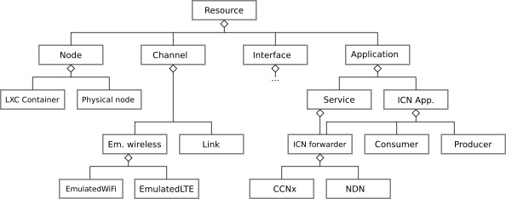
Resource hierarchy

Slide 81
How does it work?
Intent based-framework
Object-based model
State reconciliation between model and deployment
cons = LxcContainer()
prod = LxcContainer()
link = Link(src=cons, dst=prod)
tasks
monitoring
cons
prod

Slide 82
vICN functionalities
Multithreaded deployment of network models
SDN controller for IPv4, IPv6, and ICN
Wireless links emulation
Connection of real devices
Built-in monitoring through Python model

Slide 83
Our example deployment
cons
core1
core2
prod
Notes:
Add server + cloud to design “virtual” topology

Slide 84
Network model deployment

Slide 85
Network model declaration
JSON file containing list of resources
Resources complemented with “key” attributes
Intent-based declaration: descriptive approach (not imperative)

Slide 86
Physical resources
{
"type": "Physical",
"name": "server",
"hostname": "localhost"
},
{
"type": "LxcImage",
"name": "cicn-image",
"node": "server",
"image": "ubuntu1604-cicnsuite-rc3"
}

Slide 87
Nodes
Virtual topology
References to previous
resources
{
"type" : "LxcContainer",
"image": "cicn-image",
"name" : "cons",
"groups": [ "virtual" ],
"node" : "server"
},
{
"type" : "LxcContainer",
"image": "cicn-image",
"name" : "prod",
"groups": [ "virtual" ],
"node" : "server"
},
{
"type" : "LxcContainer",
"image": "cicn-image",
"name" : "core1",
"groups": [ "virtual" ],
"node" : "server"
},
{
"type" : "LxcContainer",
"image": "cicn-image",
"name" : "core2",
"groups": [ "virtual" ],
"node" : "server"
},
Notes:
Add animation to point out “virtual” group, + icons of the nodes

Slide 88
Links
{
"type": "Link",
"src_node": "cons",
"dst_node": "core1",
"groups": [ "virtual" ]
},
{
"type": "Link",
"src_node": "core1",
"dst_node": "core2",
"groups": [ "virtual" ]
},
{
"type": "Link",
"src_node": "core2",
"dst_node": "prod",
"groups": [ "virtual" ]
},

Slide 89
IP networking on topology
{
"type": "CentralIP",
"ip4_data_prefix": "192.168.19.0/24",
"ip6_data_prefix": "9001::/16",
"ip_routing_strategy": "spt",
"groups": [
"virtual"
]
}
IPv6 addresses are attributed by /64
Defines objects on which to act
CentralIP is similar to an SDN controller that assigns addresses and sets up the routing in the network:
CentralIP = (Ipv4Assignment | Ipv6Assignment) > IPRoutes

Slide 90
ICN forwarders
{
"type": "MetisForwarder",
"cache_size": 0,
"node": "cons"
},
{
"type": "MetisForwarder",
"cache_size": 2000,
"node": "core1"
},
{
"type": "MetisForwarder",
"cache_size": 0,
"node": "core2"
},
{
"type": "MetisForwarder",
"cache_size": 0,
"node": "prod"
},
{
"type": "WebServer",
"prefixes": [
"/webserver"
],
"node": "prod"
},
{
"type": "CentralICN",
"groups": [ "virtual" ],
"face_protocol": "udp4"
}
Like CentralIP
ether, udp4, udp6,
tcp4, tcp6

Slide 91
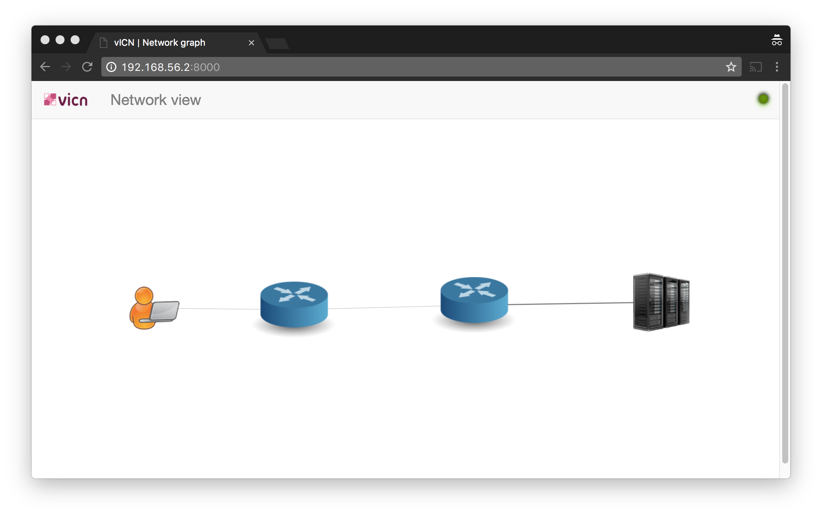
GUI
{
"type": "GUI",
"groups": ["virtual"]
},

Slide 92
Launching vicn
cicn@cicn-VirtualBox:~/vicn$ sudo vicn/bin/vicn.py -s examples/tutorial/tutorial06-acm-icn17.json
[…]
2017-09-21 17:48:15,023 - vicn.core.task - INFO - Scheduling task <Task[apy] partial<_task_resource_update>> for resource <UUID MetisForwarder-MPDRB>
2017-09-21 17:48:15,024 - vicn.core.resource_mgr - INFO - Resource <UUID MetisForwarder-MPDRB> is marked as CLEAN (99/104)
2017-09-21 17:48:15,146 - vicn.core.task - INFO - Scheduling task <Task[apy] partial<_task_resource_update>> for resource <UUID MetisForwarder-NC33W>
2017-09-21 17:48:15,148 - vicn.core.resource_mgr - INFO - Resource <UUID MetisForwarder-NC33W> is marked as CLEAN (100/104)

Slide 93
Traffic creation
Producer setup:
producer-test
producer-test -D ccnx:/webserver
Webserver
http-server -p $server_folder -l http://webserver
Consumer setup
consumer-test
consumer-test -D ccnx:/webserver
iget
iget http://webserver/$filename

Slide 94
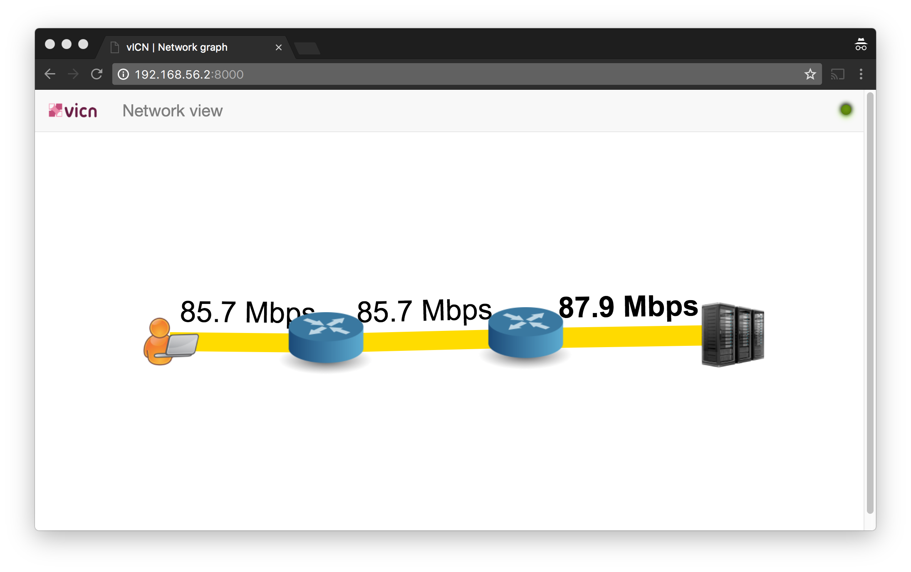
Traffic visualization on the GUI

Slide 95
Network teardown
cicn@cicn-VirtualBox:~/vicn$ sudo ./scripts/topo_cleanup.sh examples/tutorial/tutorial06-acm-icn17.json
wifi_emulator: no process found
lte_emulator: no process found
kill: usage: kill [-s sigspec | -n signum | -sigspec] pid | jobspec ... or kill -l [sigspec]
Removing bridge...
Removing interface...
Removing stale routes

Slide 96
VPP in vICN
Objective: learn to setup vICN to use your Intel interfaces
VPP running in container
Uses DPDK and ZC-forwarding

Slide 97
Setup
VPP
cons
core1
core2
prod
enp0s9
enp0s10
DPDK-compatible
interfaces

Slide 98
Identifying the DPDK interfaces
Compare:
sudo lshw -c network -businfo
with http://dpdk.org/doc/nics

Slide 99
Declaring the DPDK Interfaces
{
"type": "DpdkDevice",
"name": "core1-dpdk1",
"mac_address": "08:00:27:44:9a:38",
"node": "core1",
"device_name": "enp0s9",
"pci_address": "0000:00:09.0"
},
{
"type": "DpdkDevice",
"name": "core2-dpdk1",
"mac_address": "08:00:27:18:42:f2",
"node": "core2",
"device_name": "enp0s10",
"pci_address": "0000:00:0a.0"
},

Slide 100
Changes to resources
{
"type": "PhyLink",
"src": "core1-dpdk1",
"dst": "core2-dpdk1",
"groups": [ "virtual" ]
},
{
"type": "VPP", "node": "core1", "name": "vpp_core1"
},
{
"type": "CICNPlugin", "node": "core1",
"name": "vpp-fwd"
},
{
"type": "VPP", "node": "core2", "name": "vpp_core2"
},
{
"type": "CICNPlugin", "node": "core1",
"name": "vpp-fwd"
},
{
"type": "Link",
"src_node": "core1",
"dst_node": "core2",
"groups": [ "virtual" ]
},
{
"type": "MetisForwarder",
"cache_size": 2000,
"node": "core1"
},
{
"type": "MetisForwarder",
"cache_size": 0,
"node": "core2"
},

Slide 101
What is vICN actually doing?
VPP-ready host
Install (if necessary) the DPDK driver and load it in the host kernel
Change driver for DPDK-compatible devices
Change number of hugepages for VPP
VPP-ready container
Create a privileged container by changing its apparmor profile
Add DPDK-enabled interfaces to the container

Slide 102
What is vICN actually doing? (cont’d)
Start VPP on the container
Create configuration file for VPP in the container
Start VPP
Set up IP forwarding
Start CICN plugin in VPP
Enable CICN plugin
Set up ICN faces and routes

Slide 103
Launching vicn
cicn@cicn-VirtualBox:~/vicn$ sudo vicn/bin/vicn.py -s examples/tutorial/tutorial06-acm-icn17-vpp.json
[…]
2017-09-21 17:48:15,023 - vicn.core.task - INFO - Scheduling task <Task[apy] partial<_task_resource_update>> for resource <UUID MetisForwarder-MPDRB>
2017-09-21 17:48:15,024 - vicn.core.resource_mgr - INFO - Resource <UUID MetisForwarder-MPDRB> is marked as CLEAN (99/104)
2017-09-21 17:48:15,146 - vicn.core.task - INFO - Scheduling task <Task[apy] partial<_task_resource_update>> for resource <UUID MetisForwarder-NC33W>
2017-09-21 17:48:15,148 - vicn.core.resource_mgr - INFO - Resource <UUID MetisForwarder-NC33W> is marked as CLEAN (100/104)

Slide 104
Traffic creation
Producer setup:
producer-test
producer-test -D ccnx:/webserver
Webserver
http-server -p $server_folder -l http://webserver
Consumer setup
consumer-test
consumer-test -D ccnx:/webserver
iget
iget http://webserver/$filename

Slide 105
Traffic visualization on the GUI

Slide 106
Toward a new Python API
Use python objects instead of static JSON file
cons = LxcContainer()
prod = LxcContainer()
link = Link(src=cons, dst=prod)
tasks
monitoring
cons
prod

Slide 107
More on vICN
Demonstration session: new dynamic python API
Thursday 10:50am: vICN paper presentation

Slide 108
Available tutorials
In examples/tutorial/:
tutorial01.json → Simple topology
tutorial02-dumbell → VPP
tutorial03-hetnets.json → Wireless emulators
tutorial06-acm-icn17* → Today’s tutorial (soon)
https://wiki.fd.io/view/Vicn#Tutorials_overview

Slide 109
References
vICN wiki: https://wiki.fd.io/View/Vicn
vICN paper: http://conferences.sigcomm.org/acm-icn/2017/proceedings/icn17-26.pdf
vICN code: git clone -b vicn/master https://gerrit.fd.io/r/cicn vicn

Slide 110
Libicnet: transport layer library for ICN Mauro Sardara
Tutorial at ACM SIGCOMM ICN, Berlin, Germany
26th of September 2017

Slide 111
What is Libicnet?
Library implementing a transport layer and exposing socket API to applications willing to communicate through an ICN protocol stack
Relieves applications from the task of managing layer 4 problems, such as segmentation and congestion control
Enhances the separation between Application Data Unit (ADU) and Protocol Data Unit (PDU) processing
Notes:
Example: an HTTP server want to deal just with HTTP Replies and HTTP responses

Slide 112
Core Elements
ProducerSocket
ADU Segmentation and Naming → Layer 4 PDU (ICN Content Object)
L4 PDU Signature
L4 PDU Publication
ConsumerSocket
Congestion control
L4 PDU Fetching
Signature verification
L4 PDU reassembly → ADU

Slide 113
ProducerSocket
ProducerSocket
Application
Produce(Name)
Segmentation + Naming
ADU
Signature
Publication

Slide 114
ProducerSocket
ProducerSocket
Application
Produce(Name)
Segmentation + Naming
ADU
Signature
Publication

Slide 115
ProducerSocket
ProducerSocket
Application
Produce(Name)
Segmentation + Naming
PDU = ICN Content Object
PDU
PDU
PDU
Signature
ICN Name + Signature
PDU
=
ADU
Publication

Slide 116
ProducerSocket
ProducerSocket
Application
Produce(Name)
Segmentation + Naming
Signature
PDU
PDU
PDU
Publication

Slide 117
ProducerSocket
ProducerSocket
Application
Produce()
Segmentation + Naming
Signature
Interest
Publication
PDU
PDU
PDU
Content Object

Slide 118
ProducerSocket
Signature
The application has to provide the library with the information for signing the content objects
Signing every content object is computationally expensive: we provide support for manifest
CO1
ContentObject1Hash ContentObject2hash ContentObject3Hash …..
Signed Manifest
CO2
CO3

Slide 119
ConsumerSocket
ConsumerSocket
Application
Consume(Name)
Congestion Control
Signature verification
PDU Reassembly

Slide 120
ConsumerSocket
ConsumerSocket
Application
Consume(Name)
Interest
Congestion Control
Content Object
PDU
PDU
PDU
Signature verification
PDU Reassembly

Slide 121
ConsumerSocket
ConsumerSocket
Application
Consume(Name)
Interest
Congestion Control
Content Object
Signature verification
PDU
PDU
PDU
PDU Reassembly

Slide 122
ConsumerSocket
ConsumerSocket
Application
Consume(Name)
Interest
Congestion Control
Content Object
Signature verification
PDU Reassembly
ADU

Slide 123
ConsumerSocket
ConsumerSocket
Application
Consume(Name)
Interest
Congestion Control
ADU
Content Object
Signature verification
PDU Reassembly

Slide 124
ConsumerSocket
Congestion Control
Application can choose among a set of algorithms: VEGAS, RAAQM¹, FIXED_WINDOW
Extension with new algorithms possible
Signature
The application has to provide the library with the information for verifying the signature of the received content objects
As the producer case, verifying every content object is expensive: we verify just the manifest signature
¹ G. Carofiglio et al. "Multipath congestion control in content-centric networks,”
2013 IEEE Conference on Computer Communications Workshops (INFOCOM WKSHPS)

Slide 125
Hands on Libicnet!

Slide 126
Where to find Libicnet?
Wiki page
https://wiki.fd.io/view/Libicnet
Code
https://git.fd.io/cicn/log/?h=libicnet/master

Slide 127
Hello World Applications
We will see how building two trivial applications against Libicnet:
Hello world Producer
It will produce a content of a certain size
Hello world Consumer
It will pull the content published by the producer

Slide 128
Topology
Metis Forwarder
Hello World Consumer
Hello World Producer

Slide 129
Hello World Producer
#include <icnet/icnet_transport_socket_producer.h>
…
Name n("ccnx://helloworld");
ProducerSocket p_(n);
std::string content(10000, 'A');
p_.produce(n, (uint8_t *)content.data(), content.size());
p_.attach();
p_.serveForever();
Routable prefix
Naming, Segmentation,
Signature, Publication
Local face forwarder-producer
establishment

Slide 130
Hello World Consumer
Congestion control algorithm
#include <icnet/icnet_transport_socket_consumer.h>
…
Consumer c_(Name(), TransportProtocolAlgorithms::RAAQM);
c_.setSocketOption(GeneralTransportOptions::INTEREST_LIFETIME, 1001);
c_.setSocketOption(GeneralTransportOptions::MAX_INTEREST_RETX, 25);
c_.setSocketOption(ConsumerCallbacksOptions::CONTENT_RETRIEVED,
(ConsumerContentCallback) std::bind(&processContent,
std::placeholders::_1,
std::placeholders::_2));
Name name("ccnx://helloworld");
c_.consume(name);
Callback called after whole ADU will be pulled and reassembled
Content Pull + Signature Verification + Reassembly

Slide 131
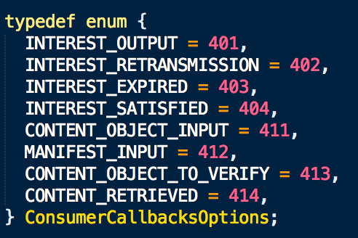
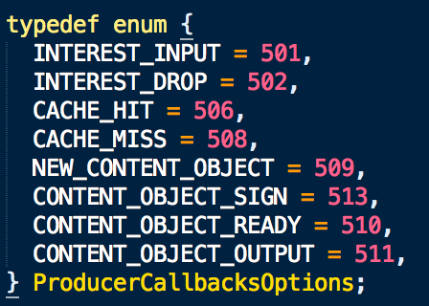
Callbacks
The application can register into the library a set of callback allowing to directly handle events during the download/publication.

Slide 132
Advanced Example: HTTP support
HTTP Client
HTTP Server
HTTP request reply
HTTP reply request
libicnet
locator = getlocator()
name = resourceName()
send(locator) recv(name)
libicnet
locator = getlocator()
name = resourceName()
send(name) recv(locator)
Send Buffer
Recv Buffer
Send Buffer
Recv Buffer
Producer Socket
Interest
Consumer
Socket
Producer Socket
Interest
Consumer
Socket
Manifest
Manifest
Data
Interest
Interest
Data
Data
Interest
Interest
Data
Network (ICN)
Network (ICN)

Slide 133
Thank You!

