Slide 1
OpenStack’s networking-vpp
Jérôme Tollet

Slide 2
Agenda
Goals
Design principles
Main components
Performance benchmarks
Supported features
Next steps

Slide 3
Networking-vpp: Goals
FD.io / VPP is a fast software dataplane that can be used to speed up communications for any kind of VM or VNF.
VPP can speed-up both East-West and North-South communications
Networking-vpp is a project aiming at providing a simple, robust, production grade integration of VPP in OpenStack using ml2 interface
Goal is to make VPP a first class citizen component in OpenStack for NFV and Cloud applications

Slide 4
Networking-vpp: Design Principles
Main design goals are: scalability, simplicity and availability
Efficient management communications
All communication are asynchronous
All communications are REST based
Availability
All state information are maintained in a highly scalable KV store cluster (etcd)
All modules are unit and system tested
Code is small and easy to understand (no spaghetti/legacy code)
Project plays with OpenStack rules
Blueprint, code reviews, …

Slide 5
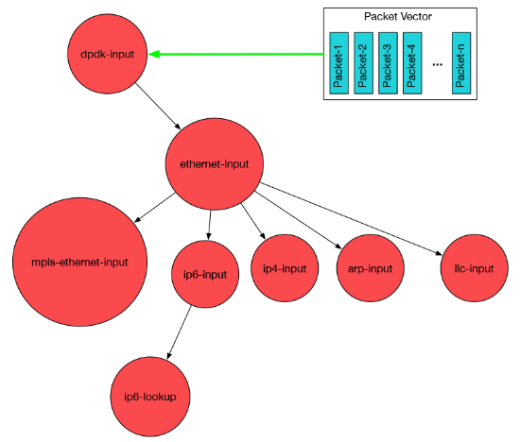
Introducing Vector Packet Processor - VPP
NC/Y
REST
...
VPP is a rapid packet processing development platform for highly performing network applications
14+ MPPS, single core
Multimillion entry FIBs
Runs on commodity CPUs and leverages DPDK
Creates a vector of packet indices and processes them using a directed graph of nodes – resulting in a highly performant solution.
Runs as a Linux user-space application
Ships as part of both embedded & server products, in volume; Active development since 2002
See also: FD.IO (The Fast Data Project)
Management Agent
Packet Processing: VPP
Network IO

Slide 6
Networking-vpp: Current Performances
16.09 Results
Lossless 10Mpps per CPU
2 hyperthreads
5Mpps TX + 5Mpps RX (64B packets)
Hardware / software testbed
Intel E5-2643v3@3.4GHz
Intel NIC 82599ES 2x10Gbps
VPP 16.09 running on 1 core (2 threads)
Qemu 2.7
Testpmd DPDK patched version (indirect buffer)
VNF
DPDK testpmd
5Mpps + 5Mpps
VPP
** more detailed results at 4:25pm today ! **

Slide 7
Networking-vpp: Main Components
networking-vpp ML2 driver
Implements the Neutron ML2 mechanism driver APIs.
runs on the controller node.
VPP agent
Runs on each compute node and programs the VPP data plane.
etcd (version >= 3.0.x)
stores agent state and enables communication between the driver and agents
etcd instance(s) run wherever you want (controller node(s) or anywhere else)

Slide 8
Networking-vpp: Overall Architecture
Neutron Server
ML2 VPP
Mechanical Driver
journaling
Compute Node
Compute Node
VM
VM
VM
VM
VM
VM
HTTP/json
ML2 Agent
vhostuser
vhostuser
VPP
VPP
ML2 Agent
dpdk
dpdk
vlan / flat network

Slide 9
Networking-vpp: etcd KV store
etcd
etcd is a distributed key value store
Tolerate machine failure
Applications can read and write data into etcd using REST / JSON
Values can be watched
etcdctl watch --recursive --forever / to see “behind the curtain”(e.g. ports added / deleted)
Networking-vpp etcd data structure
networking-vpp/nodes
Subdirs are compute nodes
networking-vpp/state/nodes/X/alive
heartbeat back
networking-vpp/state/nodes/X/ports
return port state
networking-vpp/state/nodes/X/physnets
physnets present on the hypervisor

Slide 10
Networking-vpp: etcd sample JSON entry (1/2)
Sample JSON node entries in etcd for a vhostuser port type created on a compute node named "server-2"
{ "action": "get" "node": {
"key": "/networking-vpp/nodes", "dir": true,
"nodes": [ {
"key": "/networking-vpp/nodes/server-2", "dir": true,
"nodes": [ {
"key": "/networking-vpp/nodes/server-2/ports", "dir": true,
"nodes": [ {
"key": "/networking-vpp/nodes/server-2/ports/fd07aa8f-4572-4eba-af75-16c7c59e544c",
"value": "{\"network_id\": \"04016a26-b571-458d-9f2e-524aee598a37\", \"segmentation_id\": 2070, \"mtu\": 1500, \"binding_type\": \"vhostuser\", \"mac_address\": \"fa:16:3e:bd:5d:c8\", \"network_type\": \"vlan\", \"physnet\": \"physnet1\"}",
"modifiedIndex": 458419, "createdIndex": 458419 }, ],
"modifiedIndex": 36, "createdIndex": 36 } ],
"modifiedIndex": 36, "createdIndex": 36 } ],
"modifiedIndex": 36, "createdIndex": 36 } }

Slide 11
Networking-vpp: etcd sample JSON entry (2/2)
JSON value under networking-vpp/nodes/server-2/ports/fd07aa8f-4572-4eba-af75-16c7c59e544c
key | value
network_id | 04016a26-b571-458d-9f2e-524aee598a37
segmentation_id | 2070
mtu | 1500
binding_type | vhostuser
mac_address | fa:16:3e:bd:5d:c8
network_type | vlan
physnet | physnet1

Slide 12
Networking-vpp: Supported Features
Network Types: Flat, VLANs
Port connectivity:
vhostuser ports for Virtual Machines
Tap port for ”service connectivity”: DHCP (q-dhcp), Router (q-router)
DB Journaling
Used for logging in the driver “pre_commit” phase. Based on the existing Neutron MariaDB Database
to it 'to keep etcd in sync with Neutron's internal state in the face of intermittent problems'
Supported HA scenario
VPP agent restart
resets VPP to a clean state
fetches any existing port data from etcd and programs the VPP state.
ml2 driver restart
retrieves information from etcd
uses the journal to push as yet unpublished data to etcd
Public distro and Installers
Redhat, TripleO, APEX (based on TripleO), DevStack

Slide 13
Networking-vpp: Draft Dev Roadmap
Plan of Records (POR)
Security Groups / Anti Spoofing
Requires enhanced classifier in VPP
MAC / IP restrictions, blocks gratuitous ARP, DHCP servers, …
Tap-as-a-Service
Requires enhanced port mirroring capability in VPP
Enhanced automated testplan / testbed for unit testing
Plan of Intents (POI)
Integration with Telemetry systems
Support for VXLan

Slide 14
Useful pointers
networking-vpp OpenStack Repository
https://git.openstack.org/cgit/openstack/networking-vpp/
networking-VPP Launchpad
https://launchpad.net/networking-vpp
Colorado automated testing
https://build.opnfv.org/ci/job/apex-deploy-baremetal-os-nosdn-fdio-noha-colorado/

Slide 15
Questions ?

