Slide 1

/csit
CSIT Readout to LF OPNFV Project
01 February 2017
Maciek Konstantynowicz | Project Lead
FD.io CSIT Project

Slide 2
FD.io CSIT
Readout
FD.io CSIT Background
FD.io CSIT Project
Going forward
Agenda

Slide 3
FD.io Continuous Performance Lab (CPL)
Submit Patch
Automated Testing
Deploy
Develop
Fully automated testing infrastructure
  Covers both programmability and data planes
Continuous verification of code/feature
  Functionality and performance
Code breakage and performance degradations identified before patch review
  Review, commit and release resource protected
Fully open sourced test framework to be included at launch
Slide from Linux Foundation FD.io Pre-Launch Event
Presented by DWard on 12th January 2016 In San Jose, CA, US.

Slide 4
CSIT⁽⁴⁾ Project Scope
Fully automated testing of LF⁽¹⁾ FD.io⁽²⁾ systems
  FD.io VPP⁽³⁾ and related sub-systems (e.g. DPDK⁽⁵⁾ Testpmd⁽⁶⁾, Honeycomb⁽⁷⁾, ...)
  Functionality, performance, regression and new functions.
Functionality tests - against functional specifications
  VPP data plane, network control plane, management plane.
Performance tests - limits discovery and benchmark against established reference
  VPP data plane incl. non-drop-rate and partial-drop-rate packet throughput and latency.
  Network control plane, management plane.
Test definitions driven by FD.io VPP functionality, interfaces and performance
  Uni-dimensional tests: data plane, network control plane, management plane.
  Multi-dimensional tests: Use case driven.
Integration with LF VPP test execution environment
  Performance tests execute in physical compute environment hosted by LF.
  Functional tests execute in virtualized VM VIRL⁽⁹⁾ environment hosted by LF.
Integration with LF FD.io CI⁽⁸⁾ system including FD.io Gerrit and Jenkins
  Test auto-execution triggered by VPP verify jobs, periodic CSIT jobs, and other FD.io jobs.
(1) LF - Linux Foundation.
(2) FD.io - Fast Data I/O - project in LF.
(3) VPP - Vector Packet Processing - sub-project in FD.io.
(4) CSIT – Continuous System Integration and Testing - sub-project in FD.io.
(5) DPDK - Data Plane Development Kit.
(6) Testpmd - DPDK example application for baseline DPDK testing.
(7) Honeycomb - Model-driven management agent for VPP - project in FD.io.
(8) CI - Continuous Integration.
(9) VIRL - Virtual Internet Routing Lab, SW platform donated by Cisco..

Slide 5
FD.io Continuous Performance Lab a.k.a. The CSIT Project (Continuous System Integration and Testing)
What it is all about – CSIT aspirations
  FD.io VPP benchmarking
    VPP functionality per specifications (RFCs¹)
    VPP performance and efficiency (PPS², CPP³)
      Network data plane - throughput Non-Drop Rate, bandwidth, PPS, packet delay
      Network Control Plane, Management Plane Interactions (memory leaks!)
    Performance baseline references for HW + SW stack (PPS², CPP³)
    Range of deterministic operation for HW + SW stack (SLA⁴)
  Provide testing platform and tools to FD.io VPP dev and usr community
    Automated functional and performance tests
    Automated telemetry feedback with conformance, performance and efficiency metrics
  Help to drive good practice and engineering discipline into FD.io dev community
    Drive innovative optimizations into the source code – verify they work
    Enable innovative functional, performance and efficiency additions & extensions
    Make progress faster
    Prevent unnecessary code “harm”
Legend:
¹ RFC – Request For Comments – IETF Specs basically
² PPS – Packets Per Second
³ CPP – Cycles Per Packet (metric of packet processing efficiency)
⁴ SLA – Service Level Agreement

Slide 6
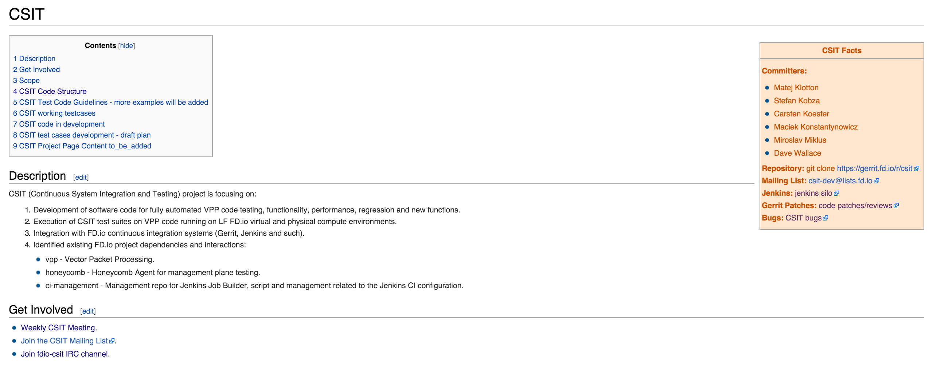
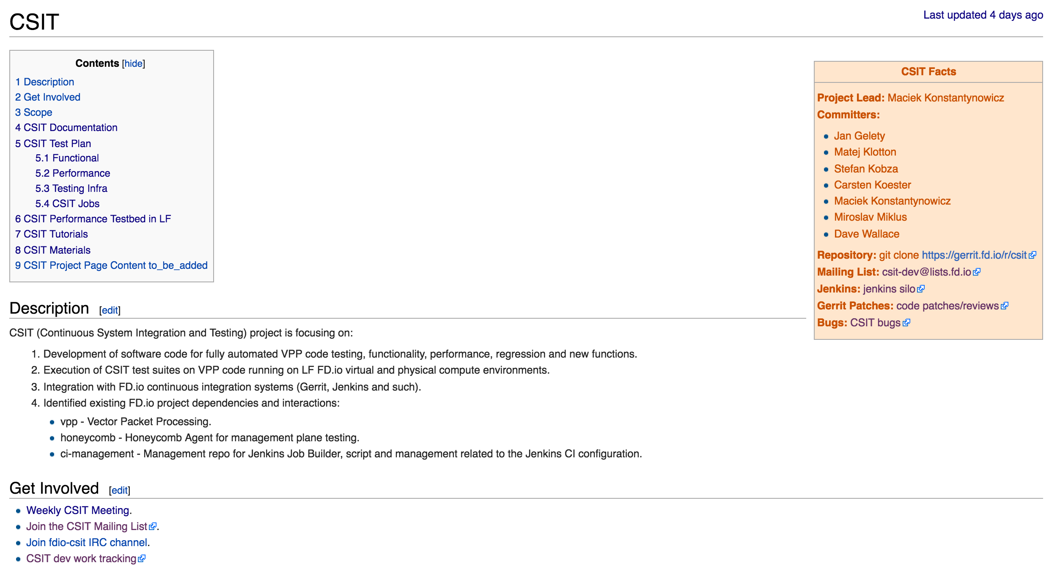
CSIT Project wiki
https://wiki.fd.io/view/CSIT

Slide 7
Network Workloads vs. Compute Workloads
They are just a little BIT different
  They are all about processing packets
  At 10GE, 64B frames can arrive at 14.88Mfps – that’s 67nsec per frame.
  With 2GHz CPU core each clock cycle is 0.5nsec – that’s 134 clock cycles per frame.
  BUT it takes ~70nsec to access memory – not much time to do work if waiting for memory access.
  Efficiency of dealing with packets within the computer is essential
  Moving packets:
    Packets arrive on physical interfaces (NICs) and virtual interfaces (VNFs) - need CPU optimized drivers for both.
    Drivers and buffer management software must not rely on memory access – see time budget above.
  Processing packets:
    Header manipulation, encaps/decaps, lookups, classifiers, counters.
    Need packet processing optimized for CPU platforms
CONCLUSION - Need to pay attention to Computer efficiency for Network workloads
  Computer efficiency for x86-64 = close to optimal use of x86-64 uarchitectures: core and uncore resources

Slide 8
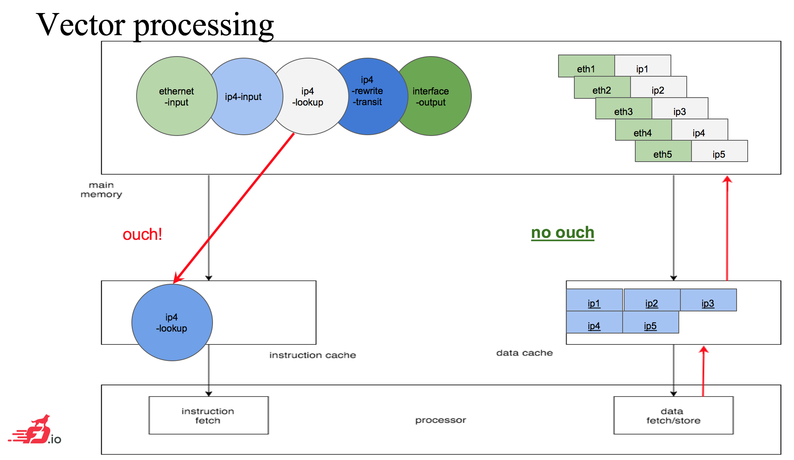
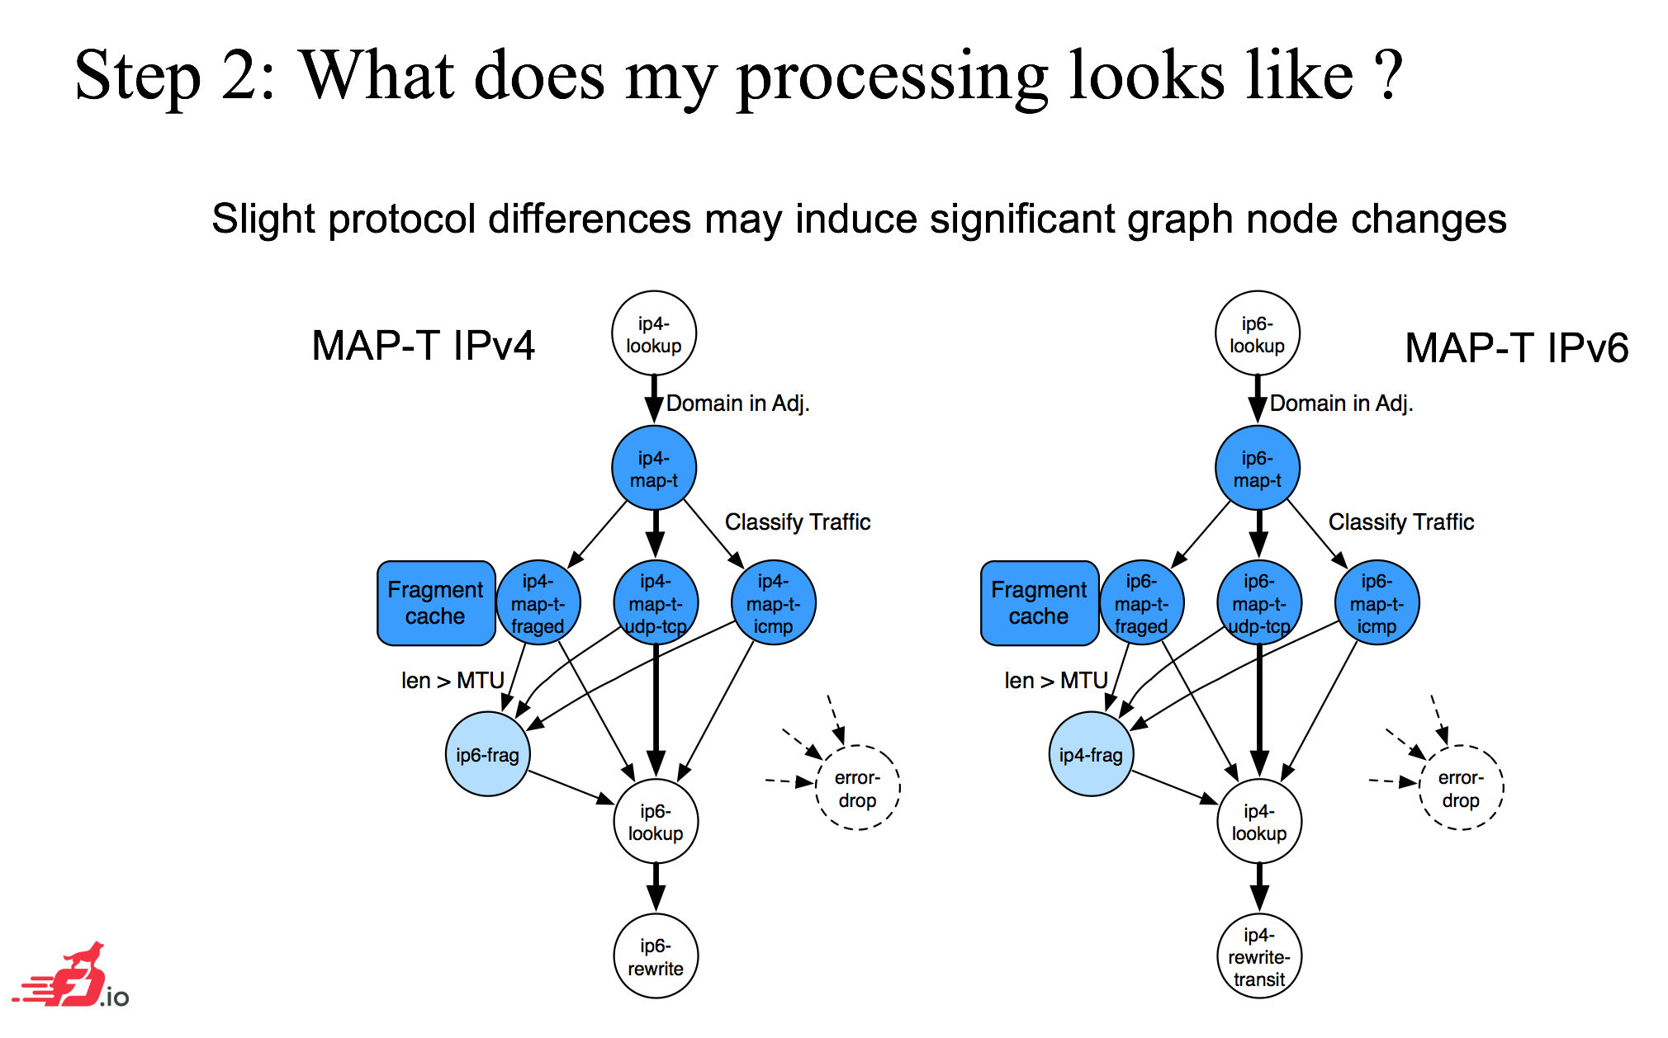
How does CSIT system see VPP code
A black box
  Test against: functional specifications (RFCs), reference performance (PPS), reference efficiency (CPP), and then also discover NDR and PDR (PPS, CPP).
A white box
  Test the paths thru VPP graph nodes
    Leverage VPP CPP telemetry
  Example - testing use cases
    E.g. VPP IP4-over-IP6 softwire MAP implementation

Slide 9
CSIT - Where We Got So Far …
CSIT Latest Report – CSIT rls1701
  http://docs.fd.io

Slide 10
CSIT - Where We Want To Go … (1/2)
System-level improvements
  Goal: Easier replicability, consumability, extensibility
  Model-driven test definitions and analytics
  More telemetry
    Know exactly what's happening on machines: collectd
    Periodic HW system baselinining: pcm, mlc, sys_info scripts
    CPU uarch: pmu-tools, CPU jitter measurement tools
    Baseline instruction/cycle efficiency: Skylake packet trace
  Continue to automate analytics
  Better exception handling
  More coding discipline :)
More HW for performance tests
  More HW offload
  Latest XEONs in 1- and 2-socket servers
  100GE NICs
  SmartNICs
Use case focus
  VM vhost virtual interfaces
  LXC shared-memory virtual interfaces
  Network Function chaining

Slide 11
CSIT - Where We Want To Go … (2/2)
Providing feedback to directly associated projects
  FD.io VPP
  FD.io Honeycomb
  DPDK Testpmd
Making Test-verified Use Recommendations for FD.io
Providing feedback to technology stack owners:
  HW CPU: CPU technologies e.g. Intel
  HW NICs: HW offload, driver costs, ...
  OS: kernel related e.g. CFS
  Virtualization: QEMU, libvirt, ...
  Orchestration integration: OpenStack, ...
Asking technology stack owners for optimizations

Slide 12
Network system performance – reference network device benchmarking specs
IETF
  RFC 2544, https://tools.ietf.org/html/rfc2544
  RFC 1242, https://tools.ietf.org/html/rfc1242
opnfv/vsperf – vsperf.ltd
  draft-vsperf-bmwg-vswitch-opnfv-01
  https://tools.ietf.org/html/draft-vsperf-bmwg-vswitch-opnfv-01
Derivatives
  vnet-sla, http://events.linuxfoundation.org/sites/events/files/slides/OPNFV_VSPERF_v10.pdf

Slide 13
CSIT Latest Report – CSIT rls1701
http://docs.fd.io

Slide 14
FD.io CSIT
Readout
Some other slides

Slide 15
Evolution of Programmable Networking
CLOUD
NFV
SDN
Many industries are transitioning to a more dynamic model to deliver network services
The great unsolved problem is how to deliver network services in this more dynamic environment
Inordinate attention has been focused on the non-local network control plane (controllers)
  Necessary, but insufficient
There is a giant gap in the capabilities that foster delivery of dynamic Data Plane Services
Programmable Data Plane

Slide 16
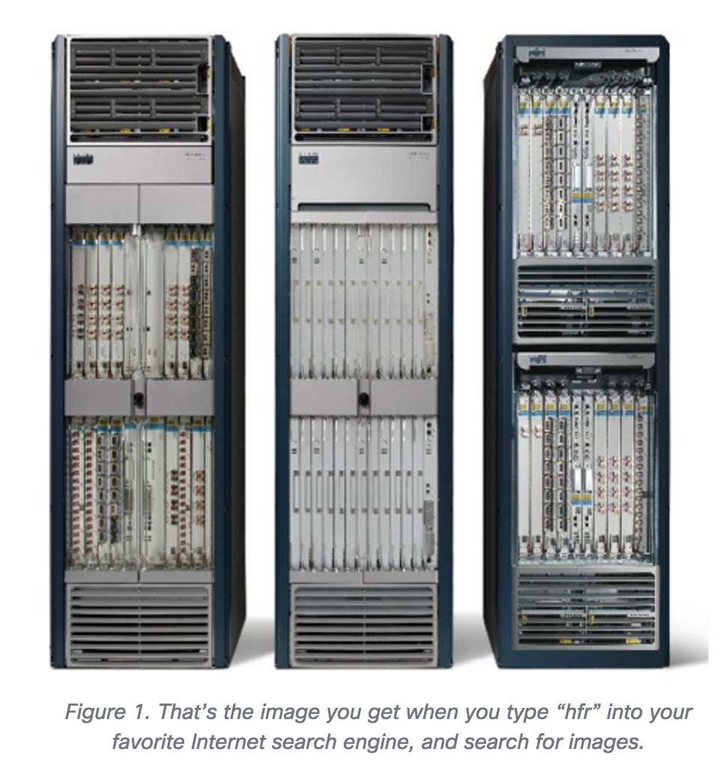
FD.io - Fast Data input/output – for Internet Packets and Services
What is it about – continuing the evolution of Computers and Networks:
Computers => Networks => Networks of Computers => Internet of Computers
Networks in Computers – Requires efficient packet processing in Computers
Enabling modular and scalable Internet packet services in the Cloud of Computers – routing, bridging, tunneling and servicing packets in CPUs
Making Computers be part of the Network, making Computers become a-bigger-helping-of-Internet
Internet
Services
FD.io: www.fd.io
Blog: blogs.cisco.com/sp/a-bigger-helping-of-internet-please

Slide 17
Introducing Vector Packet Processor - VPP
VPP is a rapid packet processing development platform for highly performing network applications.
It runs on commodity CPUs and leverages DPDK
It creates a vector of packet indices and processes them using a directed graph of nodes – resulting in a highly performant solution.
Runs as a Linux user-space application
Ships as part of both embedded & server products, in volume
Active development since 2002
Bare Metal/VM/Container
Data Plane Management Agent
Packet Processing
Network IO

Slide 18
What’s makes it fast – the secret…
Is actually not a secret at all – tricks of the trade well known e.g. see DPDK.
No-to-Minimal memory traffic per packet.
Ahead of packet of course memory needed! ☺
Core writes Rx descriptor in preparation for receiving a packet.
NIC reads Rx descriptor to get ctrl flags and buffer address.
NIC writes the packet.
NIC writes Rx descriptor.
Core reads Rx descriptor (polling or irq or coalesced irq).
Core reads packet header to determine action.
Core performs action on packet header.
Core writes packet header (MAC swap, TTL, tunnel, foobar..)
Core reads Tx descriptor.
Core writes Tx descriptor and writes Tx tail pointer.
NIC reads Tx descriptor.
NIC reads the packet.
NIC writes Tx descriptor.
CPU Socket
DDR SDRAM
CPU Cores
7
8
Memory Controller
6
1
5
9
10
Memory
Channels
rxd
LLC
packet
txd
Core operations
NIC packet operations
NIC descriptor operations
3
12
2
4
13
11
PCIe
NICs
Most of the hard work done by SW threads in CPU cores and local cache with smart algos and predictive prefetching, IOW shifted forward in time :)

Slide 19
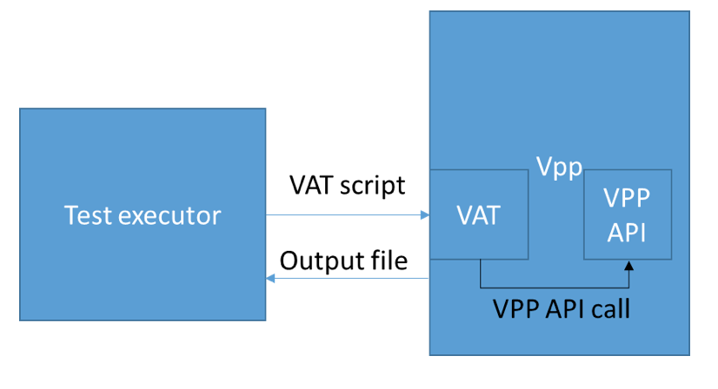
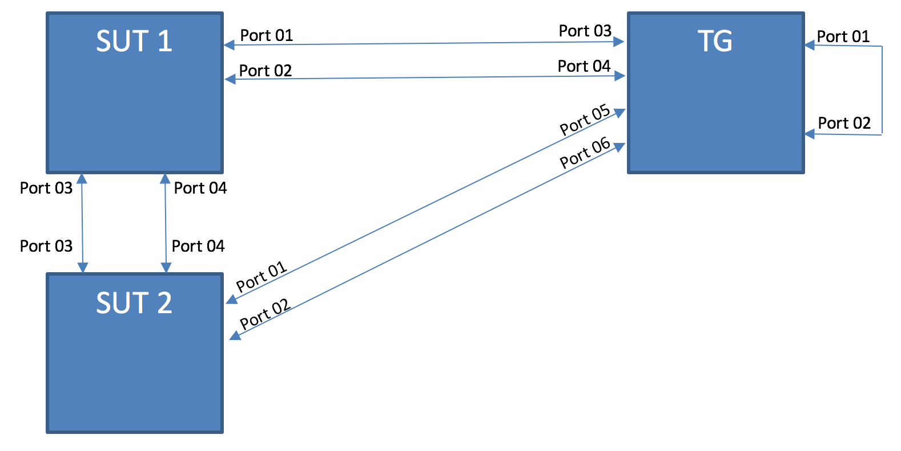
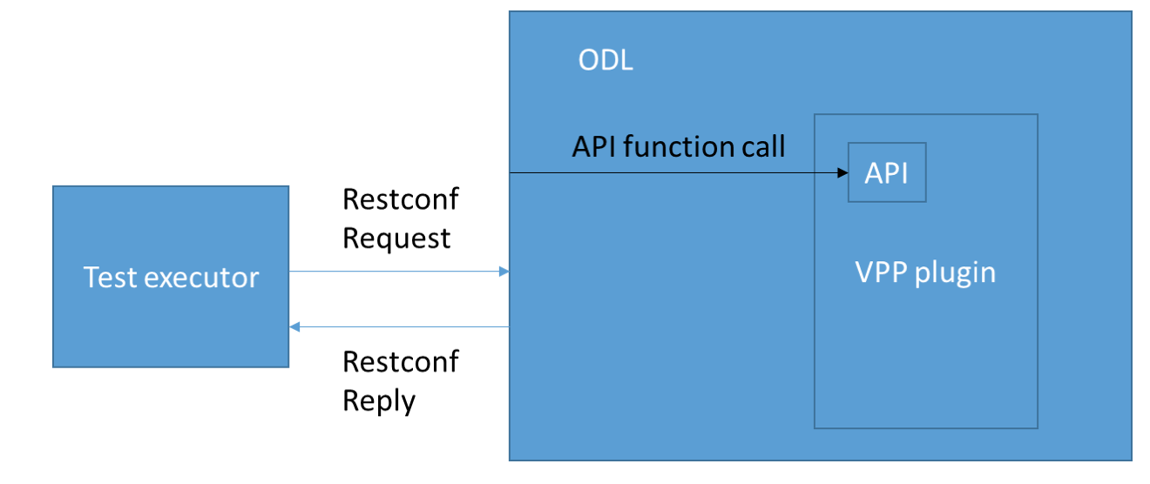
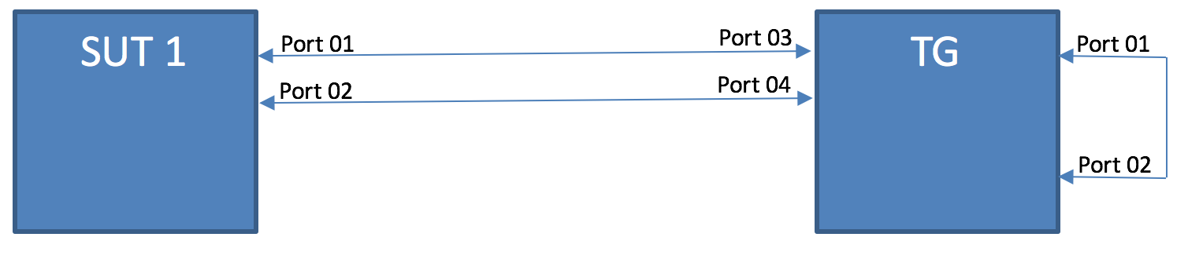
CSIT Platform System Design in a Nutshell
DUT1
VPP DUT
V
DUT2
CSIT 3-Node Topology
(implemented in VM and HW environments)
Honeycomb
DUT1
CSIT 2-Node Topology (planned)

Slide 20
CSIT Vagrant environment
https://wiki.fd.io/view/CSIT/Tutorials/Vagrant
Host-only network
DUT1
VM
DUT2
VM
dut1_dut2
DEV
VM
tg_dut2
tg_dut1
TG
VM
Internet (NAT)

Slide 21
CSIT Vagrant environment
https://wiki.fd.io/view/CSIT/Tutorials/Vagrant
vagrant up
Host-only network
DUT1
VM
DUT2
VM
dut1_dut2
DEV
VM
tg_dut2
tg_dut1
TG
VM
Internet (NAT)

Slide 22
Q&A

