Slide 1
Performance Considerations for Packet Processing on Intel® Architecture
Patrick Lu, Intel DCG/NPG/ASE
Acknowledgement: Roman Dementiev, John DiGiglio, Andi Kleen, Maciek Konstantynowicz, Sergio Gonzalez Monroy, Shrikant Shah, George Tkachuk, Vish Viswanathan, Jeremy Williamson

Slide 2
Agenda
Uncore Performance Monitoring with Hardware Counters
Measure PCIe Bandwidth
Measure Memory Bandwidth
Core Performance Monitoring
IPC revisit
Intel® Processor Trace for Performance Optimization

Slide 3
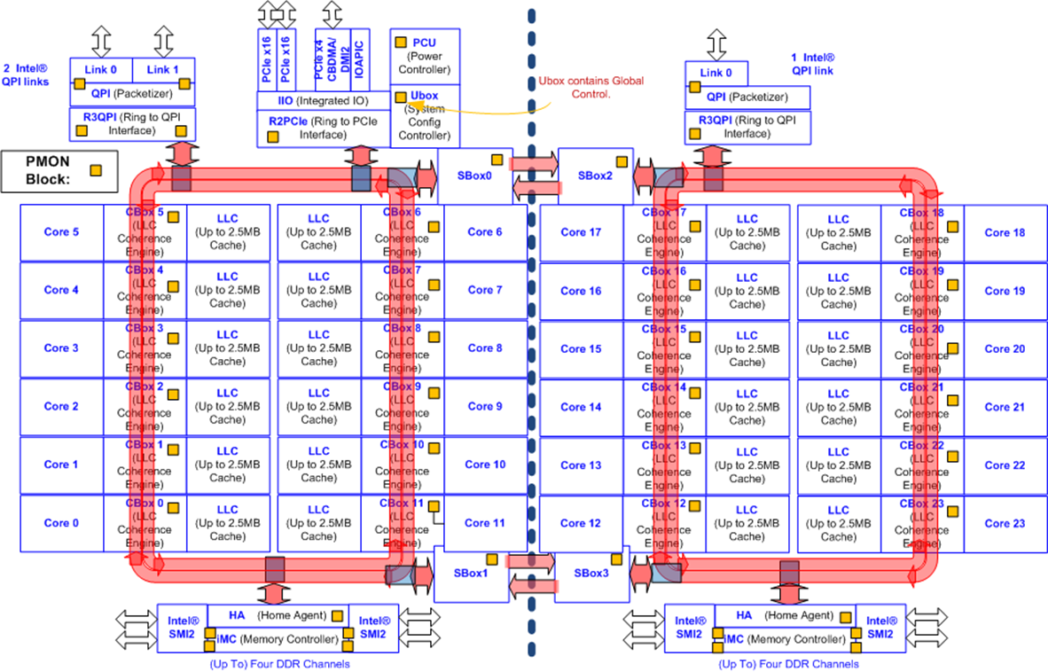
“un”core:
(everything not core)
LLC cache
Memory controller
IIO controller
QPI controller
and more!
Core:
ALU
L1 cache
L2 cache
Terminology sync:
Core = execution units (ALU) + L1 cache + L2 caches
Uncore = everything not core

Slide 4
Traditional performance analysis is core centric
We need new methodologies to analyze I/O centric workloads
Notes:
Network oriented workload analysis is very different than Computed oriented workload (like AI)
a lot of IO is involved and CPU + I/O interaction
addition to widely available CPU side tools (perf, Vtune) we need other tools to cover uncore

Slide 5
Uncore Side Performance Considerations
PCIe bandwidth
Memory bandwidth
QPI bandwidth (Backup)

Slide 6
Open Sourced Uncore Performance Tool Options
Processor Counter Monitoring (PCM) – in GitHub*
Linux* perf + pmu-tools – in Linux* kernel
real-time display on metrics, bandwidth
user space tools
cross platforms (Linux*, Windows*, Mac OSx*)
stand alone Linux* perf utility + wrapper

Slide 7
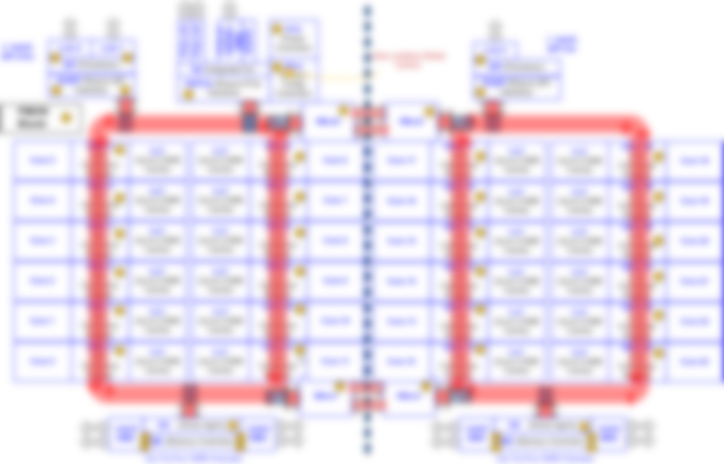
Measure PCIe Bandwidth

Slide 8
Measure PCIe Bandwidth
Processor Counter Monitoring (PCM): ./pcm-pcie.x -e
Network Rx (ItoM/RFO)
Inbound PCIe write
Network Tx (PCIeRdCur)
MMIO Read (PRd)
MMIO Write (WiL)
Inbound PCIe read
Outbound CPU read
Outbound CPU write
Match workload I/O throughput¹
Optimize batch size
Avoid DDIO miss
Avoid MMIO Rd
Reduce RFO
1. Results in number of cache lines (64 Bytes)
Notes:
Avoid DDIO miss
balance descriptor sizes (larger the span, more chance to collide cache sets)
Avoid RFO
disable CRC striping

Slide 9
Measure
Memory Bandwidth

Slide 10
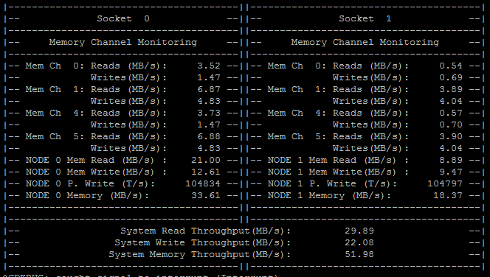
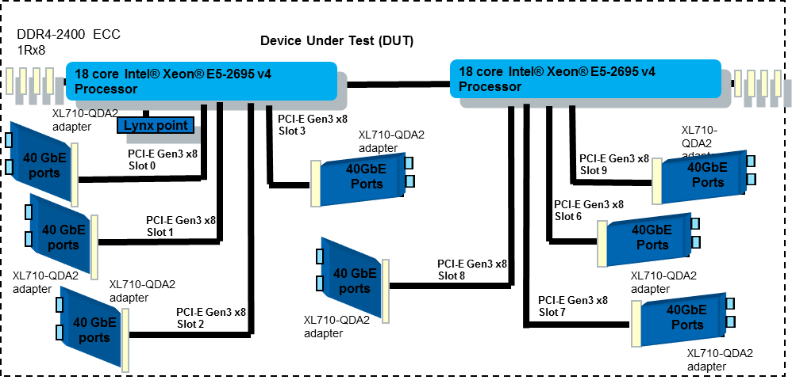
Measure Memory Bandwidth
Processor Counter Monitoring (PCM): ./pcm-memory.x
Reason with memory traffic:
Wrong NUMA allocation
DDIO Miss
CPU data structure
No memory traffic: Best
Fix it in the code!
Receive packets ASAP, descriptor ring sizes (needs tuning)
May be okay, but check for latency!
Notes:
Look for cross numa traffic
Check if DDIO is utilized optimally
Remember memory latency is x times LLC latency

Slide 11
Uncore Performance Takeaway
Calibrate I/O bandwidth with expected performance
Check for unexpected cross-NUMA traffic
Avoid MMIO Read
Batch MMIO Write
Optimize Software to make use of DDIO
Easy
Advance

Slide 12
Core Side Performance Consideration
IPC
Intel® Processor Trace

Slide 13
Which Workload Has Best Performance?
IPC
VPP A
2.63
VPP B
2.12
Notes:
We need visibility into performance, here is an example
code efficiency
compiler efficiency
IPC really very bad, TMAM L1
un-optimzed OpenSSL library

Slide 14
Workload Performance Reveal: A: Un-optimized VPP IPSec, B: Intel® AES-NI Accelerated VPP IPSec
IPC
Instructions/packet
Cycles/packet
VPP A
2.63
15733
VPP B
2.12
1865
5982
880
8x reduction in instructions
6x reduction in cycles
Notes:
We need visibility into performance, here is an example
code efficiency
compiler efficiency
IPC really very bad, TMAM L1
un-optimzed OpenSSL library

Slide 15
Performance is Determined by Two Factors Instruction per Cycle (IPC) Mystery
Instructions/pkt
Cycles/pkt
IPC
÷
=
Measured | Instructions / sec (M) | 5229
Measured | Cycles / sec (M) | 2103
Derived | IPC | 2.49
Measured | CPU freq. (MHz) | 2100
Measured | Packets / sec (M) | 9.7
Derived | Instructions / packet | 539
Derived | Cycles / packet | 217
Unless IPC is really poor, instructions/packet or cycles/packet is more realistic Core metrics.
Notes:
Understand composition of 539 instructions/pkt
Are we using optimal functions?
Can we avoid heavy generic processing?
Can we group the processing by type of works?

Slide 16
Intel® Processor Trace (Intel® PT) Components
Intel® Processor Trace (Intel® PT) packet log, binaries, and software runtime data are used to reconstruct the precise execution flow
Intel
CPU 0..n
Intel PT Software
Decoder
Intel PT HW
Intel PT packet log
(per logical processor)
Intel PT-enabled Tools
Configure &
enable Intel PT
Intel® Processor Trace can reveal exact execution path
Ring0 Agent
(OS, VMM, BIOS, Driver, …)
Runtime data, including:
Map linear-address to image files
Map CR3 value to application
Log module load/unload and JIT info
Binary
Image Files

Slide 17
Linux* perf and Intel® Processor Trace
Provides basic framework for trace collection, mining, and visualization
Kernel driver in 4.1, user tools in 4.2/4.3
Supports full trace and “snapshot” modes
Display tools support histograms, event lists, flame graphs, etc
Linux perf can capture finest detail with Intel® PT.
Post processing is required to reduce trace data.

Slide 18
Life Cycle of a Packet using Intel® PT
256 packets = 32-packet rx burst * 8 loops
256 packets = 16-packet tx burst * 16 loops
Tx
Dense packet processing functions
Rx
Processing
Not the most optimal driver path
Notes:
Explain the chart
Identify heavy duty functions
Offload methods
Burst / loop
Part of Linux perf (Intel upstream to kernel)
Code footprint (Coremark example)
Compiler comparison

Slide 19
Core Performance Takeaway
Use perfmon hardware to baseline workload performance.
PCM, Linux* Perf (pmu-tools/{toplev.py, ucevents.py}, intel_pt)
Reduce instruction counts per packet
Create more direct VPP path to process packets
Consider hardware offload
Reduce cycles per packet
Follow uncore performance takeaway to reduce latency
Measure CPU L1 cache miss latency and look for opportunity to prefetch it (not covered)

Slide 20
References
Xeon® E5-v4 Uncore Performance Monitor Unit (PMU) guide: https://software.intel.com/en-us/blogs/2014/07/11/documentation-for-uncore-performance-monitoring-units
Intel® 64 and IA-32 Architectures Optimization Reference Manual: http://www.intel.com/content/www/us/en/architecture-and-technology/64-ia-32-architectures-optimization-manual.html
Processor Counter Monitoring (PCM): https://github.com/opcm/pcm
pmu-tools: https://github.com/andikleen/pmu-tools
Intel® Processor Trace Linux* perf support: https://github.com/torvalds/linux/blob/master/tools/perf/Documentation/intel-pt.txt

Slide 22
Backup

Slide 23
Measure QPI
(Cross Sockets) Bandwidth

Slide 24
Measure QPI (cross sockets) Bandwidth
Processor Counter Monitoring (PCM): ./pcm.x -nc
Any QPI traffic will inevitably hurt latency, if not throughput.
QPI traffic is determined by placements of CPU, memory and I/O.
If unavoidable, watch for link utilization.

Slide 25
TMAM
Top-Down Analysis Methodology (TMAM)

Slide 26
Linux perf + pmu-tools
Perfmon device abstractions layers reside in /sys/devices
Measure Memory Bandwidth with Linux perf:
Measure PCIe Bandwidth with Linux perf (events pending upstream):
./ucevent.py --scale MEGA iMC.MEM_BW_READS iMC.MEM_BW_WRITES
#Event not upstreamed yet.
/ucevent.py --scale MEGA CBO.CPU_OUTBOUND_MMIO_READ \
CBO.CPU_OUTBOUND_MMIO_WRITE \
CBO.PCIE_INBOUND_READ_HIT_DDIO \
CBO.PCIE_INBOUND_READ_MISS_DDIO \
CBO.PCIE_INBOUND_WRITE_HIT_DDIO \
CBO.PCIE_INBOUND_WRITE_MISS_DDIO
Measure QPI Bandwidth with Linux perf:
./ucevent.py --scale MEGA QPI_LL.QPI_DATA_BW QPI_LL.QPI_LINK_BW
Notes:
Use –v to see the raw perf encoding.

