Slide 1
Software Network Data Planes:
Why code alone is no longer enough
FastData.io – CSIT-CPL Project
Maciek Konstantynowicz, lf-id/iirc: mackonstan, mkonstan [at] cisco.com
Ray Kinsella, lf-id/iirc: mdr78/mortderire, ray.kinsella [at] intel.com
CSIT-CPL – “Continuous System Integration and Testing” - Continuous Performance Lab
https://wiki.fd.io/view/CSIT

Slide 2
Agenda
Why code alone is no longer enough.
Introducing CSIT-CPL
Open Source Benchmarking, built on Open Source.
The Continuity Problem.
Catching performance regressions (and progressions) as they happen..
Digging Deeper.
Moving beyond the symptom.
Summary
Opportunities to contribute to CSIT-CPL.

Slide 3
















There has never been more choice
Lagopus
DPDK-ANS
Snabb
FD.io
XDP
and many more …

Slide 4

…. but how will it perform for me?
Is the test methodology trustworthy?
Are the
benchmarks repeatable?
Vendor reports.
Academic Papers.
Industry Publications.
Blogs.
Youtube.
Are the tests
applicable
for my use cases?
Are the tests platform and vendor neutral?
How do you evaluate ?

Slide 5
“Without data, you're just another person with an opinion.” ― W. Edwards Deming
Notes:
https://www.goodreads.com/author/quotes/10775.Edward_R_Tufte
https://www.goodreads.com/quotes/search?utf8=%E2%9C%93&q=W.+Edwards+Deming&commit=Search

Slide 6
Introducing CSIT-CPL
Open Source Benchmarking, built on Open Source.

Slide 7



FD.io CSIT-CPL
Open Source Benchmarking for evaluating data plane code
RFC2544, RFC1242, MEF
Range of pkt sizes
Open source tests and tools
  TRex Traffic Generation
  Test Robot Framework
  Jenkins CI
Multi-core scaling
NDR, PDR rates
Standard Industry Benchmarks and Tools
Open and fully documented test
environment
Open multi-vendor performance lab hosted by the Linux Foundation
Exhaustively documented and locally re-producible test environments
L2 switching
IPv4/v6 routing
ACLs, security groups
VXLAN, IPSec, GRE, GPE
NAT, LB, ..
Unit, Functional and Performance
Many popular network functions
L2, IP, security, tunnels
Multi platform and multi vendor
Intel x86 and ARM Architecture
CentOS, SUSE, Ubuntu and Fedora Operating Systems
Cloud Native and classic NFVi environments
Multiple NICs
Crypto Accelerators

Slide 8






FD.io CSIT-CPL
Open Source Benchmarking for evaluating data plane code
Set Goals
Drive good practice and engineering discipline into FD.io dev community
Drive innovative optimizations into the source code – verify they work
Provide conformance, performance and efficiency metrics
Prevent unnecessary code “harm”
Then Execute
Fully automated testing
  FD.io: VPP, DPDK L3fwd/Testpmd, Honeycomb.
  Functionality, performance, new features.
Functionality tests
  Network data, control and management planes.
  Conformance against IETF RFC specs.
Performance tests
  Data plane throughput and latency.
  Trending of data plane throughput limits.
Use case driven test definitions
  Uni-dimensional: data, control, management.
  Multi-dimensional tests: use case driven.
Test execution in LF FD.io environment
  Performance tests on physical servers in LF DCs.
  Functional tests on VMs hosted in LF DCs.
Integration with LF FD.io CI system
  LF FD.io Gerrit and Jenkins CI
  Test execution auto-triggered by FD.io jobs.

Slide 9
FD.io CSIT-CPL
Per release test and performance reports
Multi-Platform/-Vendor
  Intel & ARM (WiP)
Packet Throughput & Latency
  Non-Drop & Partial Drop Rates
Data Plane Workloads
  FD.io VPP
  DPDK L3fwd, Testpmd
Scaling
  Single-, Multi-Core
  MACs, IPs, Flows, ACLs etc.
Performance Test Suites (#s)
  L2: 58
  L3 (IPv4 / IPv6): 63
  VM vhostuser: 26
  Containers memif: 10
  Crypto: 13
  SRv6: 3
  Total: 173
FD.io VPP
DPDK
https://docs.fd.io/csit/rls1801/report/index.html
* Selection of testcases from the FD.io CSIT 18.01, 17.10 and 17.07 reports
Breath (# of test cases), depth (of measurement) and predictable (every release, repeatable locally)

Slide 10

The Continuity Problem
Catching performance regressions (progressions) as they happen.

Slide 11

The Continuity Problem
Catching performance regressions (progressions) as they happen
Finding performance regressions at release time is expensive.
  Time consuming to root cause.
  Time consuming to fix.
Userspace networking software is evolving rapidly!
  Many new software functions and features.
  New generations and types of hardware are showing up.
How do you maintain the best-in-class performance?
  Catch rogue patches causing regressions?
  Quantify HW and SW code optimizations?
Addressing the danger of “Creeping Normality” => Guaranteeing performance longevity.

Slide 12
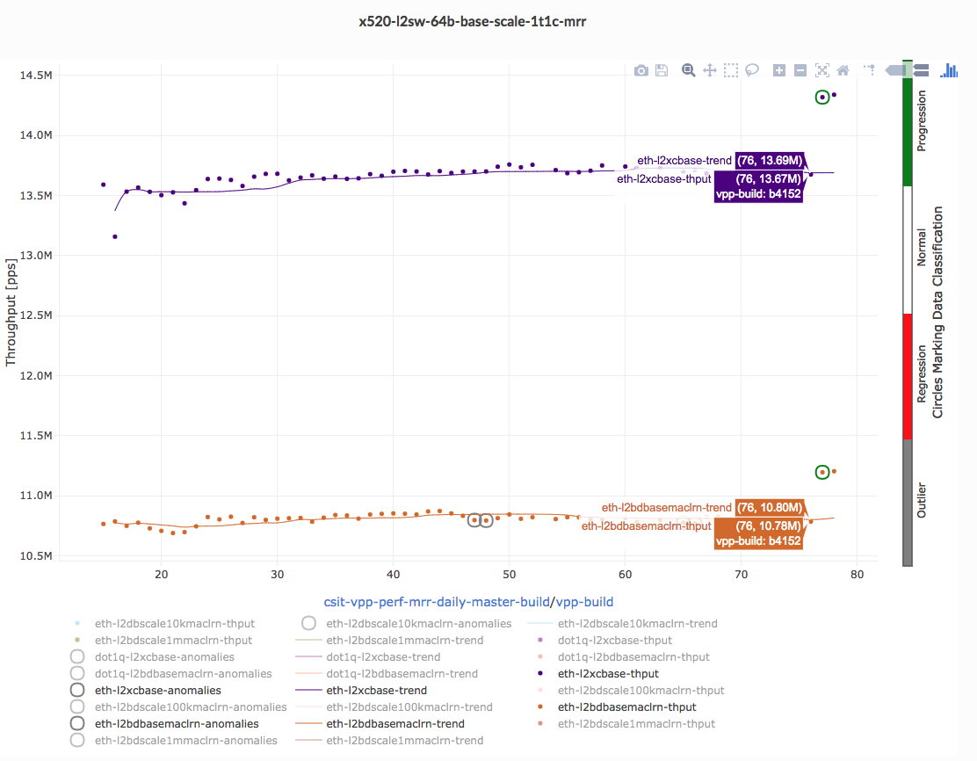
Performance Trending
A Spectrum of Data – Trendline Graphs
Performance Trendline Graphs:
MRR* throughput measurements
7-Day trendline based on moving median
Measurements classified:
  Progression anomaly
  Normal
  Regression anomaly
  Outlier anomaly
https://docs.fd.io/csit/master/trending/trending/index.html
* Maximum Receive Rate (MRR) - measured packet forwarding rate under the maximum load offered by traffic generator over a set trial duration, regardless of packet loss.
Data to analyse ..

Slide 13
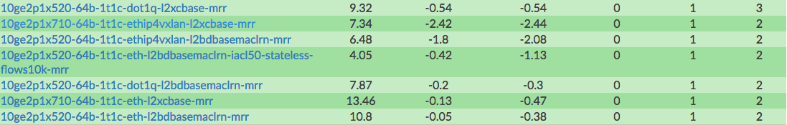
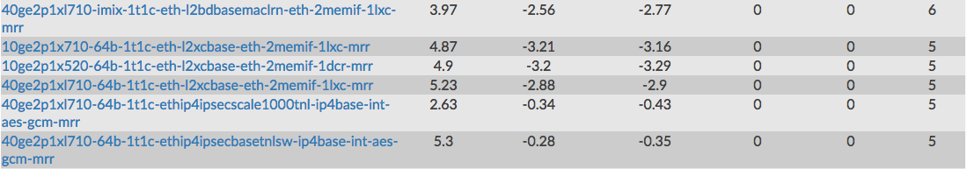
Performance Trending
A Spectrum of Data – Trend Dashboard
Legend to Performance Trend Dashboard:
Test Case : name of FD.io CSIT test case, naming convention here.
Trend [Mpps] : last value of performance trend.
Short-Term Change [%] : Relative change of last trend value vs. last week trend value.
Long-Term Change [%] : Relative change of last trend value vs. maximum of trend values over the last quarter except last week.
Regressions [#] : Number of regressions detected.
Progressions [#] : Number of progressions detected.
Outliers [#] : Number of outliers detected.
https://docs.fd.io/csit/master/trending/introduction/index.html
Data to analyse - Summary makes it easier!

Slide 14
CSIT-CPL - Getting “C” right in “CI/CD”..
CI Challenges
Physical Platform Contention.
  Lots of tests, many combinations, they take time.
  Physical resources, testbeds, servers are always in short supply!
Employ strategy to address scarce physical resources.
  Focus on efficiency and reducing execution time.
  Get smarter with test methodologies/algorithms, keep optimizing..
Next Steps
Every patch performance benchmarked
  Cause once it is merged, it is gone!
Maintain the continuous & virtuous feedback loop
  Results summarized, abstracted and distributed to…
    to contributors, committers, testers, users and downstream projects.
    to trending analytics for anomaly detection and notification.

Slide 15

Diving Deeper
Moving beyond the symptom.

Slide 16
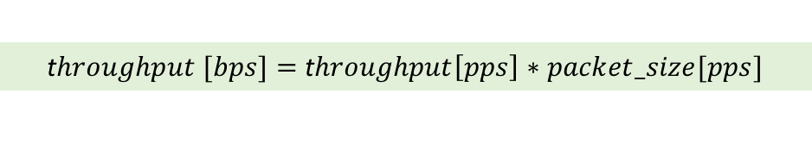

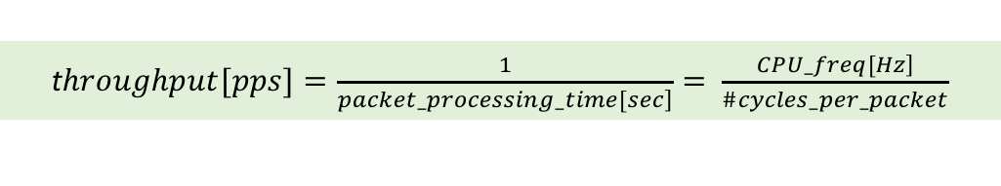
Data Plane Benchmarking Metrics
Diving Deeper
Treat software network Data Plane as one would any program, ..
$$program_unit_execution_time[sec]=\frac{\#instructions}{program_unit}∗\frac{\#cycles}{instruction}∗cycle_time$$
with the instructions per packet being the program unit, ..
$$packet_processing_time[sec]=\frac{\#instructions}{packet}∗\frac{\#cycles}{instruction}∗cycle_time$$
Internal
Metrics
#cycles_per_packet $=\frac{\#instructions}{packet}∗\frac{\#cycles}{instruction}$
and arrive to the main data plane benchmarking metrics.
CPP
IPP
CPI or 1/IPC
PPS
t$hroughput[pps]=\frac{1}{\left.packet_processing_time[sec\right]}= \frac{\left.CPU_freq[Hz\right]}{\#cycles_per_packet}$
External
Metrics
BPS
t$hroughput [bps]=$ t$hroughput\left[pps\right]∗packet_size[pps]$
CPP, PPS and BPS are foundational to our understanding of performance

Slide 17
Understanding platform resource utilization
Main critical resources used for software packet-processing:
Packet processing logic – How many CPU core cycles are required to process a packet?
Memory bandwidth – How many memory-read and write accesses are made per packet?
I/O bandwidth – How many bytes are transferred over PCIe link per packet?
Inter-socket transactions – How many bytes are accessed from the other socket or other core in the same socket per packet?
Co-relating resource utilization is key to understanding performance (CPP, PPS, BPS)

Slide 18
Open-source Performance Monitoring Tools
Number of tools and code libraries available for monitoring performance counters and their analysis e.g. Intel® VTuneTM, pmu-tools.
Three open-source tools have been in presented Benchmarking and Analysis methodology
Their applicability to each identified analysis area
Linux Perf
  a generic Linux kernel tool for basic performance events
  enables performance hot-spot analysis at source code level
PMU-Tools
  builds upon Linux Perf, provides richer analysis and enhanced monitoring events for a particular processor architecture
  includes Top-down Micro-Architecture Method (TMAM), powerful performance analysis tool based on the, as presented in this talk
PCM Tool Chain
  set of utilities focusing on specific parts of architecture including Core, Cache hierarchy, Memory, PCIe, NUMA
  easy to use and great for showing high-level statistics in real-time
Analysis Area | Performance Tools
CPU Cores | pmu-tools top-down analysis.
CPU cache Hierarchy | pmu-tools, pcm.x.
Memory bandwidth | pcm-memory.x, pmu-tools.
PCIe bandwidth | pcm-pcie.x
Inter-Socket transactions | pcm-numa.x, pmu-tools.
Open source performance analysis tools provide key insights.

Slide 19
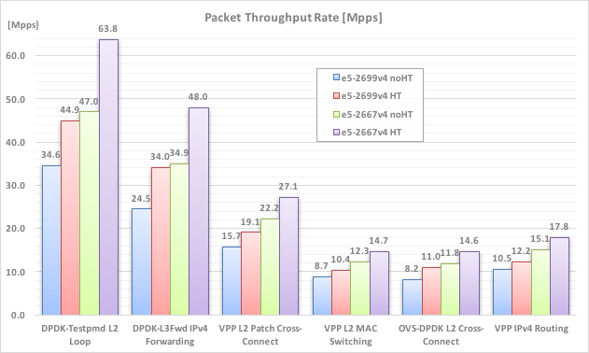
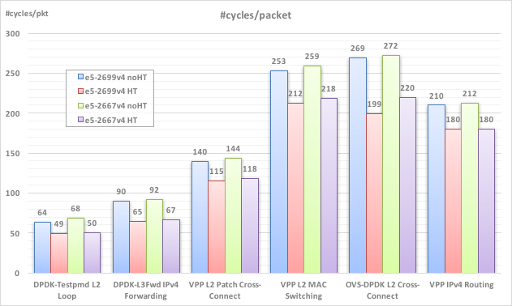
Future: Planned Summary Data Views
Results and Analysis – #cycles/packet (CPP) and Throughput (Mpps)
See Kubecon Dec-2017, Benchmarking and Analysis.., https://wiki.fd.io/view/File:Benchmarking-sw-data-planes-Dec5_2017.pdf
Packet Throughput Rate [Mpps]
#cycles/packet [CPP]
#cycles/packet = cpu_freq[MHz] / throughput[Mpps]
Putting it all together: co-relating CPP to PPS per workload..

Slide 20
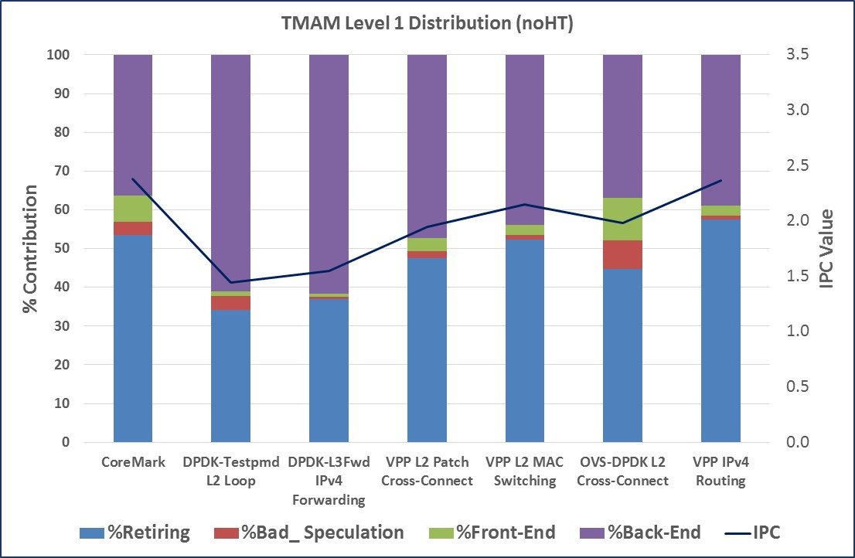
Future: Planned Summary Data Views
Xeon Telemetry Analytics - Top-Down Analysis
See Kubecon Dec-2017, Benchmarking and Analysis.., https://wiki.fd.io/view/File:Benchmarking-sw-data-planes-Dec5_2017.pdf
Sample Observations:
IPC | Good IPC for all Network workloads due to code optimization, HT makes it even better.
Retiring | Instructions retired, drives IPC.
Bad_Speculations | Minimal Bad branch speculations, Attributed to architecture logic, and software pragmas.
Backend Stalls | Major contributor causing low IPC in noHT cases, HT hides backend stalls.
Frontend Stalls | Becomes a factor in HT as more instructions are being executed by both logical cores.
And then further dissecting CPP into a set of internal compute efficiency metrics.

Slide 21
Why code alone is no longer enough - Summary
There are now lots of Open Source projects in the network software data plane ecosystem.
Benchmarking is a core activity for serious data plane software projects
FD.io CSIT-CPL is an industry leading collaborative effort in Open Benchmarking
  Open Benchmarks, Open Lab, Open Tools, Open Test Cases
  Tight Multi-Vendor Collaboration
Our next steps
  Keep addressing The Continuity Problem, catching regressions as they happen.
  Digging deeper, identifying the cause, as well as measuring the symptom.
For more information:
See our in-depth introduction on SW data plane performance benchmarking.
  White paper @ https://fd.io/resources/performance_analysis_sw_data_planes.pdf
  Kubecon Dec-2017, Benchmarking and Analysis @ https://wiki.fd.io/view/File:Benchmarking-sw-data-planes-Dec5_2017.pdf

Slide 22
THANK YOU !

Slide 23
Opportunities to Contribute
We invite you to Participate in FD.io
Get the Code, Build the Code, Run the Code
Try the vpp user demo
Install vpp from binary packages (yum/apt)
Read/Watch the Tutorials
Join the Mailing Lists
Join the IRC Channels
Explore the wiki
Join FD.io as a member
Container Integration
Firewall, IDS, DPI
Hardware Accelerators
Control plane – support your favorite SDN Protocol Agent
Telemetry and analytics tools
Test tools
Packaging
Testing
Thank you!

Slide 24
References
FD.io VPP, CSIT-CPL and related projects
VPP: https://wiki.fd.io/view/VPP
CSIT-CPL: https://wiki.fd.io/view/CSIT
pma_tools - https://wiki.fd.io/view/Pma_tools
Benchmarking Methodology
Kubecon Dec-2017, Benchmarking and Analysis.., https://wiki.fd.io/view/File:Benchmarking-sw-data-planes-Dec5_2017.pdf
“Benchmarking and Analysis of Software Network Data Planes” by M. Konstantynowicz, P. Lu, S.M. Shah, https://fd.io/resources/performance_analysis_sw_data_planes.pdf
Benchmarks
EEMBC CoreMark® - http://www.eembc.org/index.php
DPDK testpmd - http://dpdk.org/doc/guides/testpmd_app_ug/index.html
FDio VPP – Fast Data IO packet processing platform, docs: https://wiki.fd.io/view/VPP, code: https://git.fd.io/vpp/
Performance Analysis Tools
“Intel Optimization Manual” – Intel® 64 and IA-32 architectures optimization reference manual
Linux PMU-tools, https://github.com/andikleen/pmu-tools
TMAM
Intel Developer Zone, Tuning Applications Using a Top-down Microarchitecture Analysis Method, https://software.intel.com/en-us/top-down-microarchitecture-analysis-method-win
Technion presentation on TMAM , Software Optimizations Become Simple with Top-Down Analysis Methodology (TMAM) on Intel® Microarchitecture Code Name Skylake, Ahmad Yasin. Intel Developer Forum, IDF 2015. [Recording]
A Top-Down Method for Performance Analysis and Counters Architecture, Ahmad Yasin. In IEEE International Symposium on Performance Analysis of Systems and Software, ISPASS 2014, https://sites.google.com/site/analysismethods/yasin-pubs

