Slide 1
Enabling VPP IPsec Offload
September 2016
Tommy Long

Slide 2
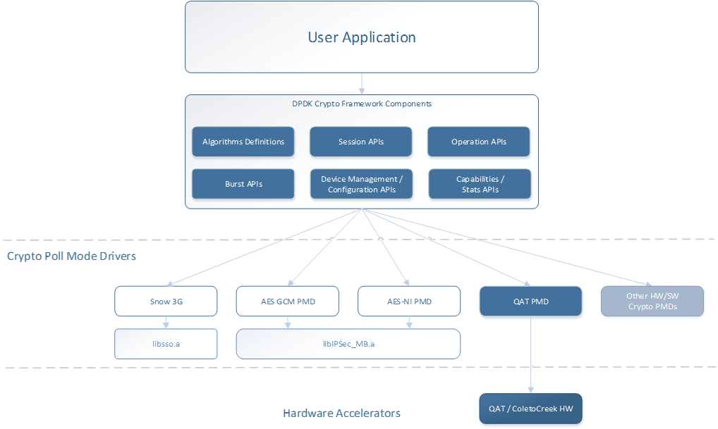
Cryptodev Overview
Crypto framework for processing symmetric crypto workloads in DPDK.
Defines a standard API which supports both hardware and software crypto processing.
  How the crypto operation is processed is transparent to user application, allowing migration of work from hardware to software dynamically.
Poll mode driver infrastructure for hardware and software crypto devices.
Cryptodev Components

Slide 3
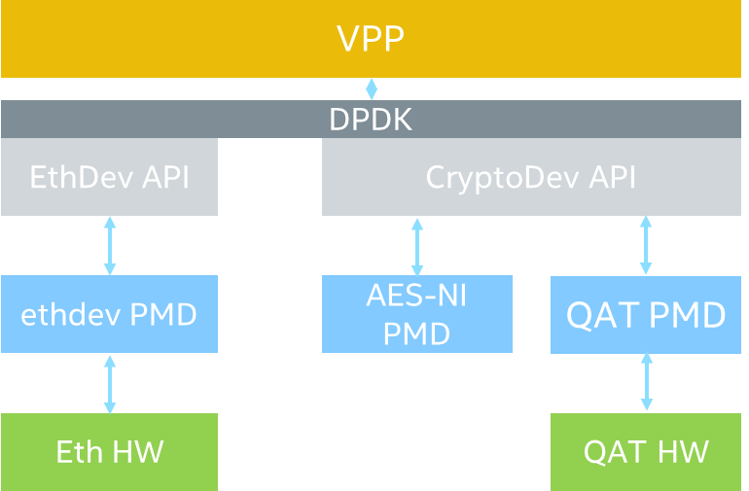
DPDK Current Crypto Acceleration
Supports software and hardware (offload) symmetric crypto.
  Cipher - AES CBC/CTR 128/192/256 bit, Snow3G (UEA2), KASUMI F8* , NULL*
  Authentication - MD5_HMAC*/SHA1/224*/256/384*/512, AES XCBC, Snow3G UIA2, KASUMI F9*, NULL*
  Combined - AES GCM 128/192**/256** bit

Slide 4
VPP IPsec Encryption Path
Default IPsec graph in VPP today

Slide 5
IPsec Cryptodev Encryption Path
Poll crypto devices (AES-NI, QAT etc.) for return packets
Configure Crypto operation and submit packet to offload for crypto processing
Complete processing for Crypto packet e.g. next header type after decryption

Slide 6
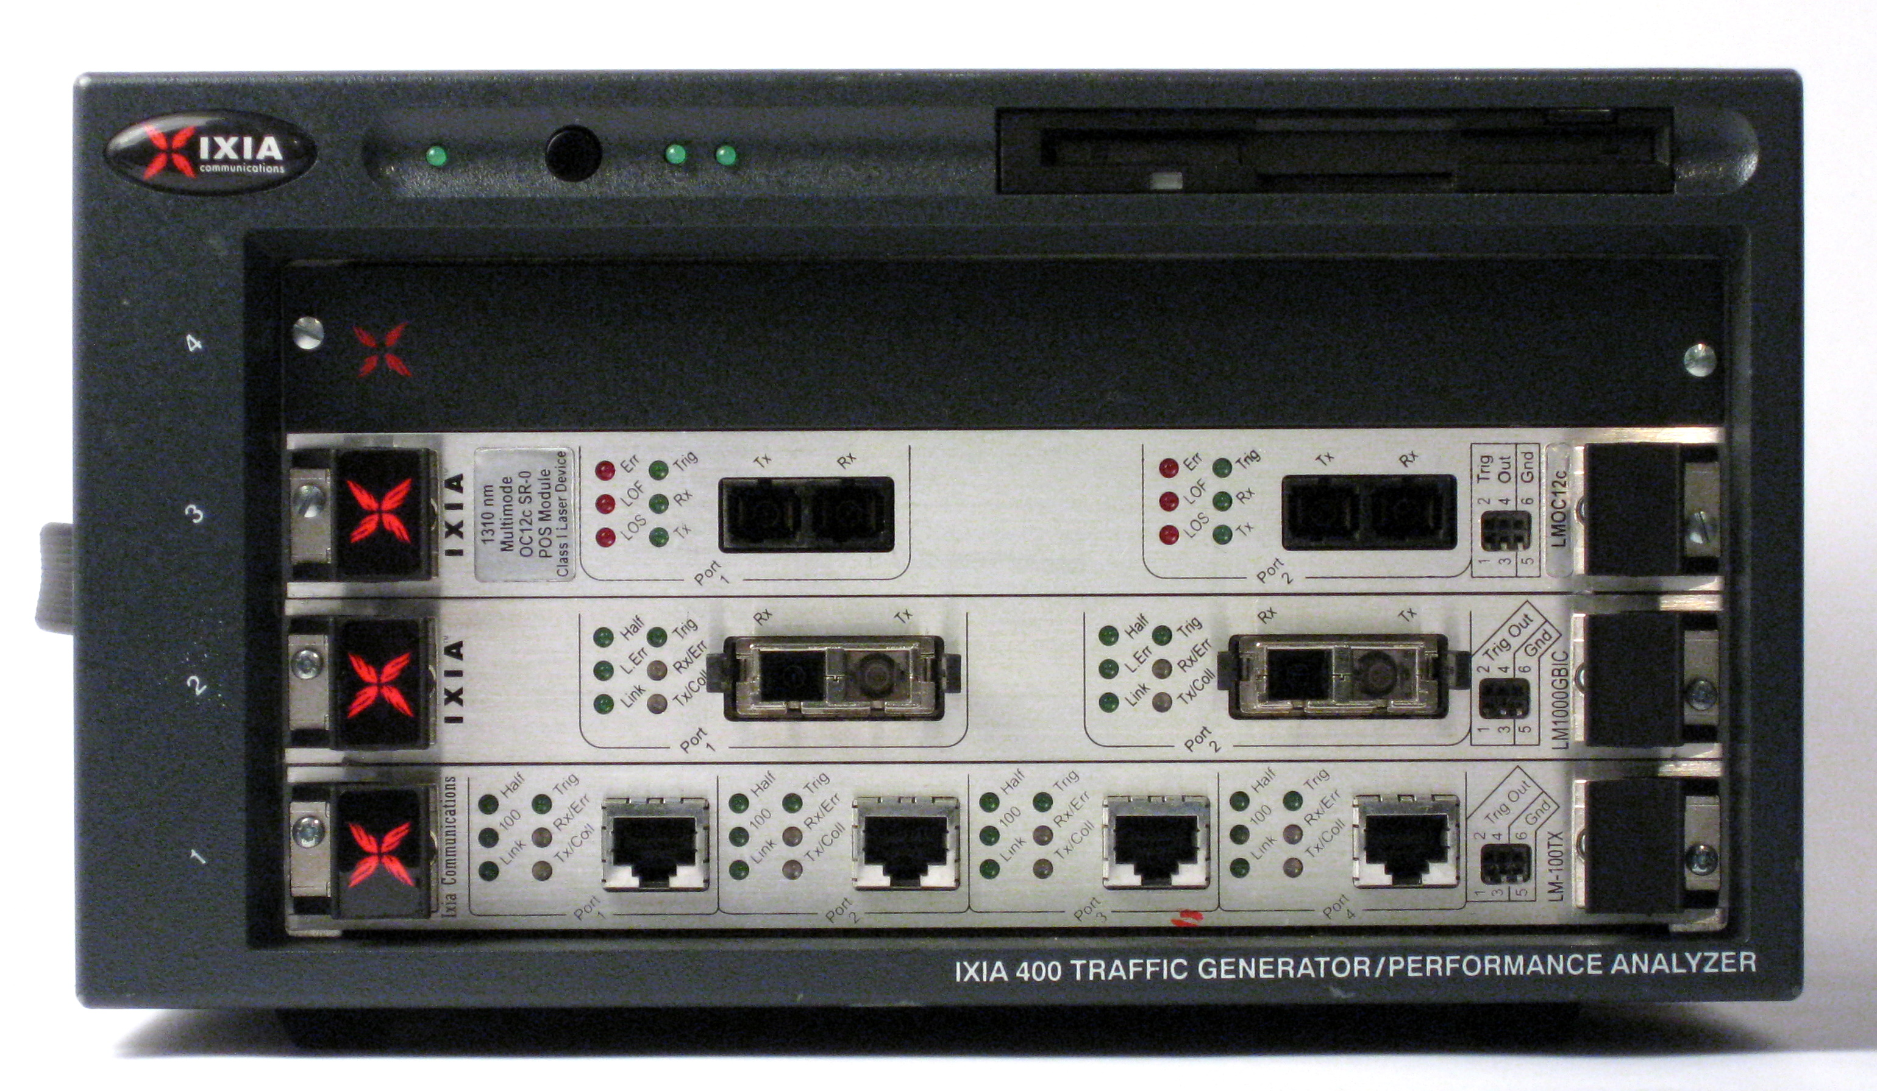
Test Setup
DUT
IXIA Traffic Generator
Cleartext Traffic
Patched VPP
Ciphertext Traffic
IPsec Encap

Slide 7
Platform Configuration
  Intel® Xeon® DP-based Server (2 CPU sockets).
  Intel(R) Xeon(R) CPU E5-2699 v3 @ 2.30GHz (Haswell)
  18 physical cores per CPU (i.e. per socket)
  128 GB DDR4 RDIMM Crucial Server capacity = 64 GB RAM (16 x 8 GB). Tested with 128 G
  1 x Intel® 82599 10 Gigabit Ethernet Controller
  1 x Intel Corporation DH895XCC Series QAT (Coletto Creek)
  Operating System: Ubuntu 16.04, Kernel version: 4.4.0-22-generic
  VPP commit ID: 154d445f7f8f1553d9bb00d1be42bf1b06eda9f1
  Intel(R) DPDK 16.04
  Single data processing core
  All hardware local to socket 1
BIOS Settings | Setting
Enhanced Intel SpeedStep® | DISABLED
Processor C3 | DISABLED
Processor C6 | DISABLED
Intel® Hyper-Threading Technology (HTT) | DISABLED
Intel® Virtualization Technology | ENABLED
Intel® Virtualization Technology for Directed I/O (VT-d) | DISABLED
MLC Streamer | ENABLED
MLC Spatial Prefetcher | ENABLED
DCU Data Prefetcher | ENABLED
DCU Instruction Prefetcher | ENABLED
Direct Cache Access (DCA) | ENABLED
CPU Power and Performance Policy | Performance
Memory Power Optimization | Performance Optimized
Intel® Turbo boost | OFF
Memory RAS and Performance Configuration -> NUMA Optimized | ENABLED
Results will vary depending on software, workloads and system configuration

Slide 8
VPP Configuration
set int ip address TenGigabitEthernet86/0/0 192.168.10.1/24
set int promiscuous on TenGigabitEthernet86/0/1
set int ip address TenGigabitEthernet86/0/1 192.168.1.1/24
set int promiscuous on TenGigabitEthernet86/0/1
create ipsec tunnel local-ip 192.168.1.1 local-spi 1111 remote-ip 192.168.1.2 remote-spi 2222
set interface ipsec key ipsec0 local crypto aes-cbc-128 2b7e151628aed2a6abf7158809cf4f3d
set interface ipsec key ipsec0 local integ sha1-96 6867666568676665686766656867666568676669
set interface ipsec key ipsec0 remote crypto aes-cbc-128 2b7e151628aed2a6abf7158809cf4f3d
set interface ipsec key ipsec0 remote integ sha1-96 6867666568676665686766656867666568676669
ip route add 192.168.20.2/32 via ipsec0
set ip arp TenGigabitEthernet86/0/0 192.168.1.2 90:e2:ba:b0:dc:69
set int state TenGigabitEthernet86/0/1 up
set int state TenGigabitEthernet86/0/0 up
set int state ipsec0 up

Slide 9
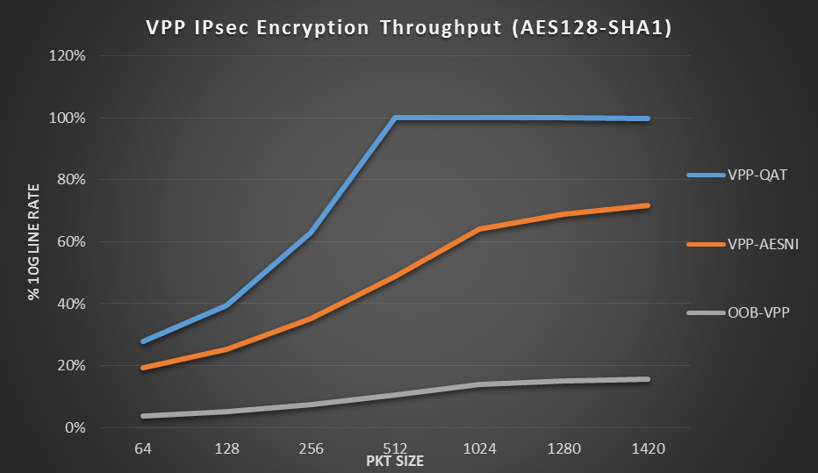
Early Development Performance Indicators
Test Setup Limitation
Preliminary POC Results
Results have been estimated or simulated using internal Intel analysis or architecture simulation or modeling, and provided to you for informational purposes. Any differences in your system hardware, software or configuration may affect your actual performance.
All information provided here is subject to change without notice. Contact your Intel representative to obtain the latest Intel product specifications and roadmaps.

Slide 10
Implementation Gaps that we know of
  Algorithm Support - Only AES-SHA is currently supported
  Re-keying on sequence overflow
  Anti-replay frame size limited to 64 packets
  Full multicore support – atomic sequence number updates
  SA lifetime (Time & Flow Data)
  No scatter gather support
  IKEv2 Initiator mode
Any other gaps ?

Slide 11
Initial Features we would like to add to VPP
  Close some of the implementation gaps
  Support for Cryptodev API
  Additional algorithm support – e.g. GCM
  Ability to configure and manage different devices
    Detection of supported devices
    Detection of supported algorithms on each devices
VPP Patch number 2858
https://gerrit.fd.io/r/#/c/2858/
Patch Overview and Setup details
https://jira.fd.io/browse/VPPSB-3

Slide 12
Call To Arms
Please review and provide feedback on the patch
What other contributions would the community like to see ?

Slide 13
Back Up

Slide 14
VPP
DPDK
EthDev API
CryptoDev API
ethdev PMD
AES-NI PMD
QAT PMD
Eth HW
QAT HW

Slide 15
DPDK Crypto PMDs
QAT (hw)
AESNI multi-buffer (sw)
AESNI GCM (sw)
NULL (sw)
Snow3G (sw)
Each PMD supports the full cryptodev API, but may only support a subset of all the possible algorithms/modes.

Slide 16
DPDK Crypto Software PMDs
aesni_mb – uses the intel multi-buffer library to provide symmetric crypto operations in SW, utilising the AES-NI CPU instruction set.
See http://dpdk.org/doc/guides/cryptodevs/aesni_mb.html
aesni_gcm – provides AES GCM operations in software. Also depends on the mb lib.
null – provides a pass-through service (for debug)
Snow3G – uses the intel Snow3G libsso library to provide Snow3G cipher and auth operations for wireless applications.
See http://dpdk.org/doc/guides/cryptodevs/snow3g.html

Slide 17
DPDK Crypto APIs
  Crypto Device Management APIs
  Crypto Stats and Capabilities APIs
  Symmetric Cipher / Hash Algorithm Definitions
  Session Management APIs
  Operation Management APIs
  Burst APIs

Slide 18
DPDK Crypto APIs - Burst
uint16_t rte_cryptodev_enqueue_burst(uint8_t dev_id, uint16_t qp_id,
struct rte_crypto_op **ops, uint16_t nb_bufs);
uint16_t rte_cryptodev_dequeue_brust(uint8_t dev_id, uint16_t qp_id,
struct rte_crypto_op **ops, uint16_t nb_bufs);
  The enqueue burst function will expect that each rte_crypto_op in the burst has a valid crypto operation data.
  Burst dequeue function will flag rte_crypto_op which have failed to be processed correctly (for example, incorrect digest) with an appropriate flag set, so that no packets can be dropped silently within the cryptodev.

Slide 19
DPDK Crypto APIs - Session Management
struct rte_crypto_auth_xform {
enum rte_crypto_auth_operation op;
enum rte_crypto_auth_algorithm algo;
struct rte_crypto_key key;
uint32_t digest_length;
uint32_t add_auth_data_length;
};
struct rte_crypto_cipher_xform {
enum rte_crypto_cipher_operation op; enum rte_crypto_cipher_algorithm algo; struct rte_crypto_key key;
};
struct rte_cryptodev_session *rte_cryptodev_session_create(uint8_t dev_id, struct rte_crypto_xform *xform);
void rte_cryptodev_free_session(struct rte_crypto_session *session);
struct rte_crypto_sym_xform {
struct rte_crypto_sym_xform *next;
enum rte_crypto_sym_xform_type type; union {
struct rte_crypto_auth_xform auth;
struct rte_crypto_cipher_xform cipher;
};
};
  Session creation function allocates and populates a device specific opaque session data structure.
  Session structures are crypto device specific to allow for formatting of key material in an optimal way for the underlying devices.

Slide 20
DPDK Crypto APIs - Operation Management
struct rte_crypto_op {
enum rte_crypto_op_type type;
// sym/future
enum rte_crypto_op_status status; //result
struct rte_mempool *mempool;
phys_addr_t phys_addr; //unused
void *opaque_data;
/* for user data */
union {
struct rte_crypto_sym_op *sym;
};
}
struct rte_crypto_sym_op
struct rte_mbuf *src;
struct rte_mbuf *dst;
enum rte_crypto_sym_op_sess_type type;
union {
struct rte_crypto_session *session;
struct rte_crypto_xform *xform; // Sessionless
}
struct {
struct {..} data; // Offsets/sizes of cipher data
struct {..} iv; // Parameters for the IV
} cipher;
struct {
struct {..} data; // Offsets/sizes of hash data
struct {..} digest; // Parameters for the digest
struct {..} aad_auth; // Parameters for the //Additional Auth Data
} auth;
};
  Crypto API also includes generic helper functions to allocate and free rte_crypto_ops from a mempool.

