Slide 1
Data Plane Development Kit (DPDK) Intro DPDK/FD.io Mini Summit
Tim O’Driscoll
21st June, 2016

Slide 2
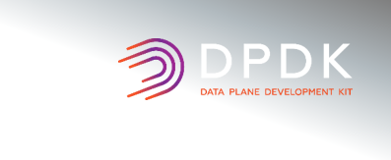
Legal Disclaimer
General Disclaimer:
© Copyright 2016 Intel Corporation. All rights reserved. Intel, the Intel logo, Intel Inside, the Intel Inside logo, Intel. Experience What’s Inside are trademarks of Intel. Corporation in the U.S. and/or other countries. *Other names and brands may be claimed as the property of others.
Technology Disclaimer:
Intel technologies’ features and benefits depend on system configuration and may require enabled hardware, software or service activation. Performance varies depending on system configuration. No computer system can be absolutely secure. Check with your system manufacturer or retailer or learn more at [intel.com].
Performance Disclaimers:
Cost reduction scenarios described are intended as examples of how a given Intel- based product, in the specified circumstances and configurations, may affect future costs and provide cost savings. Circumstances will vary. Intel does not guarantee any costs or cost reduction.
Results have been estimated or simulated using internal Intel analysis or architecture simulation or modeling, and provided to you for informational purposes. Any differences in your system hardware, software or configuration may affect your actual performance.

Slide 3
DPDK Overview

Slide 4
DPDK Framework
Network Functions (Cloud, Enterprise, Comms)
Classify
Extensions
QoS
Pkt Framework
LPM
DISTRIB
REORDER
IVSHMEM
POWER
METER
PORT
TABLE
HASH
JOBSTAT
KNI
VHOST
IP FRAG
SCHED
PIPELINE
ACL
Core
EAL
ETHDEV
CRYPTO
Future
MBUF
IGB
BNX2X
MPIPE
VMXNET3
BONDING
QAT
TBD
MEMPOOL
IXGBE
CXGBE
NFP
XENVIRT
PCAP
AESNI MB
RING
E1000
ENIC
SZEDATA2
VIRTIO
RING
AESNI GCM
I40E
MLX4
ENA
VHOST
AF_PKT
SNOW 3G
TIMER
FM10K
MLX5
NULL
NULL
PMDs: Native & Virtual
Accelerators
User Space
KNI
IGB_UIO
VFIO
UIO_PCI_GENERIC
Kernel
* Other names and brands may be claimed as the property of others.

Slide 5
Multi-Architecture/NIC Support
CPUs
X86
IA32
POWER 8
TILE-Gx
ARM v7/v8
Layerscape
1.8
2.0
2.1
2.2
16.04
16.07
ENIC
FM10K
BNX2X
NFP-6xxx
ENA
QEDE
IGB
IXGBE
E1000
I40E
SZEDATA2
MLX4
CXGBE
ThunderX
MLX5
NICs
* Other names and brands may be claimed as the property of others.

Slide 6
DPDK Generational Performance Gains
IPV4 L3 Forwarding Performance of 64Byte Packets
Broadwell EP System Configuration
Hardware
Platform | SuperMicro® - X10DRX
CPU | Intel® Xeon® Processor E5-2658 v4
Chipset | Intel® C612 chipset
Sockets | 2
Cores per Socket | 14 (28 threads)
LL CACHE | 30 MB
QPI/DMI | 9.6GT/s
PCIe | Gen3x8
MEMORY | DDR4 2400 MHz, 1Rx4 8GB (total 64GB), 4 Channel per Socket
NIC | 10 x Intel® Ethernet CNA XL710-QDA2PCI-Express Gen3 x8 Dual Port 40 GbE Ethernet NIC (1x40G/card)
NIC Mbps | 40,000
BIOS | BIOS version: 1.0c (02/12/2015)
Software
OS | Debian 8.0
Kernel version | 3.18.2
Other | DPDK2.2.0
233
Gbps
187.2
Gbps
171.4
Gbps
2010
(2S WMR)
2011
(1S SNB)
2012
(2S SNB)
2013
(2S IVB)
2014
(2S HSW)
2015
(2S BDW)
Disclaimer: Software and workloads used in performance tests may have been optimized for performance only on Intel microprocessors. Performance tests, such as SYSmark and MobileMark, are measured using specific computer systems, components, software, operations and functions. Any change to any of those factors may cause the results to vary. You should consult other information and performance tests to assist you in fully evaluating your contemplated purchases, including the performance of that product when combined with other products. For more complete information visit http://www.intel.com/performance.
* Other names and brands may be claimed as the property of others.

Slide 7
Open Source Stats
DPDK Release Stats
Major Contributors
A fully open source software project with a strong development community:
BSD licensed
Website: http://dpdk.org; Git: http://dpdk.org/browse/dpdk/
* Other names and brands may be claimed as the property of others.

Slide 8
DPDK In OPNFV

Slide 9
OPNFV Projects
Requirements
Collaborative Development
Integration and Testing
Documentation
Doctor
Multisite
Octopus
JOID
PolicyTest
KVM
OpenStack Fwd Graph
ENFV
FuncTest
Bottleneck
SFSQM
OPNFV
Doc
Copper
Escalator
BGS
Releng
CPERF
OVSNFV
Prediction
Models
Qtip
DoveTail
ONOSFW
Promise
Inspector
IPv6
Apex
FDS
OVNO
Resource Scheduler
Domino
Parser
ARMBand
Moon
Availability
Pinpoint
VSPERF
Compass
SDNVPN
Movie
NetReady
Yardstick
StorPerf
SFC
DPACC
Genesis
Pharos
Fuel

Slide 10
DPDK Involvement
Direct DPDK Involvement
Indirect DPDK Involvement
Doctor
Multisite
Octopus
JOID
PolicyTest
KVM
OpenStack Fwd Graph
ENFV
FuncTest
Bottleneck
SFSQM
OPNFV
Doc
Copper
Escalator
BGS
Releng
CPERF
OVSNFV
Prediction
Models
Qtip
DoveTail
ONOSFW
Promise
Inspector
IPv6
Apex
FDS
OVNO
Resource Scheduler
Domino
Parser
ARMBand
Moon
Availability
Pinpoint
VSPERF
Compass
SDNVPN
Movie
NetReady
Yardstick
StorPerf
SFC
DPACC
Genesis
Pharos
Fuel

Slide 11
DPDK Involvement
Direct DPDK Involvement
Indirect DPDK Involvement
Data Plane Acceleration (DPACC)
The goal of this project is to specify a general framework for VNF data plane acceleration (or DPA for short), including a common suite of abstract APIs at various OPNFV interfaces, to enable VNF portability and resource management across various underlying integrated SOCs that may include hardware accelerators or standard high volume (or SHV) server platforms that may include attached hardware accelerators.
DPDK Impacts:
Multi-architecture support, especially the addition of ARMv8 in DPDK 2.2.
External Mempool Manager in DPDK 16.07 to provide better inter-working with SoCs.
Addition of cryptodev API to support hardware and software crypto acceleration.
Future support for additional accelerator types.
Doctor
Multisite
Octopus
JOID
PolicyTest
KVM
OpenStack Fwd Graph
ENFV
FuncTest
Bottleneck
SFSQM
OPNFV
Doc
Copper
Escalator
BGS
Releng
CPERF
OVSNFV
Prediction
Models
Qtip
DoveTail
ONOSFW
Promise
Inspector
IPv6
Apex
FDS
OVNO
Resource Scheduler
Domino
Parser
ARMBand
Moon
Availability
Pinpoint
VSPERF
Compass
SDNVPN
Movie
NetReady
Yardstick
StorPerf
SFC
DPACC
Genesis
Pharos
Fuel

Slide 12
DPDK Involvement
Direct DPDK Involvement
Indirect DPDK Involvement
Doctor
Multisite
Octopus
JOID
PolicyTest
KVM
Software Fastpath Service Quality Metrics (SFQSM)
“Software Fastpath Service Quality Metrics" is focused on the development of utilities and libraries which supports low latency, high performance packet processing paths (fast path) through the NFVI such that VNFs can:
Measure Telco Traffic and Performance KPIs through that software fast path.
Detect and report violations that can be consumed by VNFs and higher level EMS/OSS systems.
DPDK Impacts:
Extended stats (xstats), which allows each PMD to expose a unique set of stats in the form of string-value pairs.
Keep Alive, which demonstrates how to detect ‘failed’ DPDK cores and notify a fault management entity of the failure.
OpenStack Fwd Graph
ENFV
FuncTest
Bottleneck
SFSQM
OPNFV
Doc
Copper
Escalator
BGS
Releng
CPERF
OVSNFV
Prediction
Models
Qtip
DoveTail
ONOSFW
Promise
Inspector
IPv6
Apex
FDS
OVNO
Resource Scheduler
Domino
Parser
ARMBand
Moon
Availability
Pinpoint
VSPERF
Compass
SDNVPN
Movie
NetReady
Yardstick
StorPerf
SFC
DPACC
Genesis
Pharos
Fuel

Slide 13
DPDK Involvement
Direct DPDK Involvement
Indirect DPDK Involvement
Open vSwitch for NFV (OVSNFV)
This project proposes:
Modifying the OPNFV build to include a deployment option for the software-accelerated userspace Open vSwitch build. This change will significantly improve the performance of the NFVI for network I/O.
Future work that will encompass collaborative development within the Open vSwitch project to improve the performance of the software-accelerated userspace Open vSwitch and increasing its suitability for Telco NFV deployments.
DPDK Impacts:
DPDK enablement of Open vSwitch.
Vhost-Virtio performance optimisations in DPDK which help to further improvement the performance of the DPDK-enables userspace OVS. These include: Vhost-User support (2.0), Vhost Multi-Queue Support (2.2), Virtio 1.0 support (16.04), Vhost-Virtio performance optimisations (2.2, 16.04).
Doctor
Multisite
Octopus
JOID
PolicyTest
KVM
OpenStack Fwd Graph
ENFV
FuncTest
Bottleneck
SFSQM
OPNFV
Doc
Copper
Escalator
BGS
Releng
CPERF
OVSNFV
Prediction
Models
Qtip
DoveTail
ONOSFW
Promise
Inspector
IPv6
Apex
FDS
OVNO
Resource Scheduler
Domino
Parser
ARMBand
Moon
Availability
Pinpoint
VSPERF
Compass
SDNVPN
Movie
NetReady
Yardstick
StorPerf
SFC
DPACC
Genesis
Pharos
Fuel

Slide 14
DPDK Involvement
Direct DPDK Involvement
Indirect DPDK Involvement
Doctor
Multisite
Octopus
JOID
PolicyTest
KVM
Fault Management (Doctor)
The goal of this project is to build a fault management and maintenance framework for high availability of Network Services on top of virtualized infrastructure. The key feature is immediate notification of unavailability of virtualized resources from VIM, to process recovery of VNFs on them.
DPDK Impacts:
The Extended Statistics and Keep Alive functionality from DPDK, along with the DPDK Ceilometer plugin developed as part of the SFSQM project address some of the requirements of the Doctor project. The SFSQM and Doctor teams are collaborating closely to ensure that these efforts are coordinated.
OPNFV
Doc
OpenStack Fwd Graph
ENFV
FuncTest
Bottleneck
SFSQM
Copper
Escalator
BGS
Releng
CPERF
OVSNFV
Prediction
Models
Qtip
DoveTail
ONOSFW
Promise
Inspector
IPv6
Apex
FDS
OVNO
Resource Scheduler
Domino
Parser
ARMBand
Moon
Availability
Pinpoint
VSPERF
Compass
SDNVPN
Movie
NetReady
Yardstick
StorPerf
SFC
DPACC
Genesis
Pharos
Fuel

Slide 15
DPDK Involvement
Direct DPDK Involvement
Indirect DPDK Involvement
Doctor
Multisite
Octopus
JOID
PolicyTest
KVM
Characterize vSwitch Performance for Telco NFV Use Cases (VSPERF)
“vSwitch Performance" will develop a generic and architecture agnostic vSwitch testing framework and associated tests, that will serve as a basis for validating the suitability of different vSwitch implementations in a Telco NFV deployment environment.
DPDK Impacts:
This project includes support for DPDK-enabled OVS, as well as MoonGen, which is a DPDK-enabled software traffic generator.
OpenStack Fwd Graph
ENFV
FuncTest
Bottleneck
SFSQM
OPNFV
Doc
Copper
Escalator
BGS
Releng
CPERF
OVSNFV
Prediction
Models
Qtip
DoveTail
ONOSFW
Promise
Inspector
IPv6
Apex
FDS
OVNO
Resource Scheduler
Domino
Parser
ARMBand
Moon
Availability
Pinpoint
VSPERF
Compass
SDNVPN
Movie
NetReady
Yardstick
StorPerf
SFC
DPACC
Genesis
Pharos
Fuel

Slide 16
DPDK Involvement
Direct DPDK Involvement
Indirect DPDK Involvement
Doctor
Multisite
Octopus
JOID
PolicyTest
KVM
FastDataStacks (FDS)
“FastDataStacks” creates and composes a set of scenarios which include the virtual forwarder supplied by the FD.IO project. The project also provides required enhancements to individual components such as SDN controllers or installers to allow for the scenario composition.
DPDK Impacts:
The focus of this project is on enhancements to FD.io and other components including SDN controllers and installers, but the core component of FD.io, VPP, is based on DPDK.
OpenStack Fwd Graph
ENFV
FuncTest
Bottleneck
SFSQM
OPNFV
Doc
Copper
Escalator
BGS
Releng
CPERF
OVSNFV
Prediction
Models
Qtip
DoveTail
ONOSFW
Promise
Inspector
IPv6
Apex
FDS
OVNO
Resource Scheduler
Domino
Parser
ARMBand
Moon
Availability
Pinpoint
VSPERF
Compass
SDNVPN
Movie
NetReady
Yardstick
StorPerf
SFC
DPACC
Genesis
Pharos
Fuel

Slide 18
FD.io Intro
Ed Warnicke

Slide 19
Evolution of Programmable Networking
CLOUD
NFV
SDN
Many industries are transitioning to a more dynamic model to deliver network services
The great unsolved problem is how to deliver network services in this more dynamic environment
Inordinate attention has been focused on the non-local network control plane (controllers)
Necessary, but insufficient
There is a giant gap in the capabilities that foster delivery of dynamic Data Plane Services
Programmable Data Plane

Slide 20
Introducing Fast Data: fd.io
fd.io Charter
New project in Linux Foundation
Multi-party
Multi-project
What does multi-party mean?
Multiple members - Open to all
What does multi-project mean?
Multiple subprojects
Subproject autonomy
Cross project synergy
Open to new subprojects
Anyone can propose a subproject
Allows for innovation
Create a Platform that enables Data Plane Services that are:
Highly performant
Modular and extensible
Open source
Interoperable
Multi-Vendor
Platform fosters innovation and synergistic interoperability between Data Plane Services
Source of Continuous Integration resources for Data Plane services based on the Consortium’s project/subprojects
Meet the functionality needs of developers, deployers, datacenter operators

Slide 21
Fast Data Scope
Bare Metal/VM/Container
Fast Data Scope:
IO
Hardware/vHardware <-> cores/threads
Processing
Classify
Transform
Prioritize
Forward
Terminate
Management Agents
Control/manage IO/Processing
Management Agent
Processing
IO

Slide 22
Fd.io Members

Slide 23
Fd.io Projects
Legend:
- New Projects
- Core Projects
Management Agent
Honeycomb
deb_dpdk
Packet Processing
Testing/Performance/Support
NSH_SFC
ONE
VPP Sandbox
TLDK
VPP
CSIT
Network IO

Slide 24
Governance – At a Glance
Anyone May Participate – Not just members
Anyone can contribute code
Anyone can rise to being a committer via meritocracy
Anyone can propose a subproject
Subprojects:
Composed of the committers to that subproject – those who can merge code
Responsible for sub project oversight and autonomous releases
Make technical decisions for that subproject by consensus, or failing that, majority vote.
Technical Steering Committee
Fosters collaboration among subprojects, but is not involved in day to day management of sub-projects
Approves new subprojects, sets development process guidelines for the community, sets release guidelines for multi-project or simultaneous releases, etc.
Initial TSC will be seeded with representatives from Platinum Membership and core project PTLs with the goal of replacing representatives with Project Leads after the first year
Governing Board will Oversee Business Decision Making
Set Scope and Policy of Consortium
Composed of Platinum member appointees, elected Gold, Silver, and Committer member representatives
Examples of business needs include: budgeting, planning for large meetings (e.g. a Summit, Hackfest), marketing, websites, developer infrastructure, test infrastructure, etc.

Slide 25
VPP: Vector Packet Processing

Slide 26
Introducing Vector Packet Processor - VPP
VPP is a rapid packet processing development platform for highly performing network applications.
It runs on commodity CPUs and leverages DPDK
It creates a vector of packet indices and processes them using a directed graph of nodes – resulting in a highly performant solution.
Runs as a Linux user-space application
Ships as part of both embedded & server products, in volume
Active development since 2002
Bare Metal/VM/Container
Data Plane Management Agent
Packet Processing
Network IO

Slide 27
VPP Architecture - Modularity Enabling Flexible Plugins
Packet vector
…
Plugins == Subprojects
Plugins can:
Introduce new graph nodes
Rearrange packet processing graph
Can be built independently of VPP source tree
Can be added at runtime (drop into plugin directory)
All in user space
Enabling:
Ability to take advantage of diverse hardware when present
Support for multiple processor architectures (x86, ARM, PPC)
Few dependencies on the OS (clib) allowing easier ports to other Oses/Env
ethernet-input
Plug-in to enable new HW input Nodes
mpls-ethernet-input
ip4input
llc-input
ip6-input
arp-input
…
ip6-lookup
Plug-in to create new nodes
ip6-rewrite-transmit
ip6-local
Custom-A
Custom-B

Slide 28
VPP Feature Summary
IPv4/IPv6
IPv4
L2
14+ MPPS, single core
Multimillion entry FIBs
Source RPF
Thousands of VRFs
Controlled cross-VRF lookups
Multipath – ECMP and Unequal Cost
Multiple million Classifiers –
Arbitrary N-tuple
VLAN Support – Single/Double tag
Counters for everything
Mandatory Input Checks:
TTL expiration
header checksum
L2 length < IP length
ARP resolution/snooping
ARP proxy
GRE, MPLS-GRE, NSH-GRE,
VXLAN
IPSEC
DHCP client/proxy
CG NAT
VLAN Support
Single/ Double tag
L2 forwarding with EFP/BridgeDomain concepts
VTR – push/pop/Translate (1:1,1:2, 2:1,2:2)
Mac Learning – default limit of 50k addresses
Bridging – Split-horizon group support/EFP Filtering
Proxy Arp
Arp termination
IRB – BVI Support with RouterMac assignment
Flooding
Input ACLs
Interface cross-connect
IPv6
Neighbor discovery
Router Advertisement
DHCPv6 Proxy
L2TPv3
Segment Routing
MAP/LW46 – IPv4aas
iOAM
MPLS
MPLS-o-Ethernet –
Deep label stacks supported
Notes:
The input checks included by VPP include mandatory networking checks.
Some solutions today either don’t perform these or don’t have them leading to questionable performance numbers

Slide 29
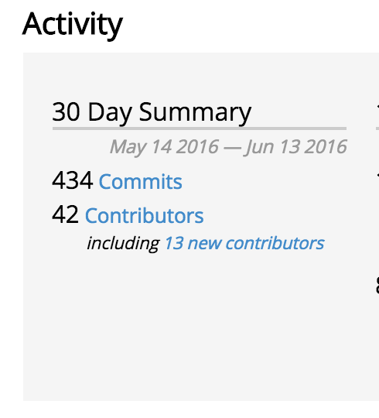
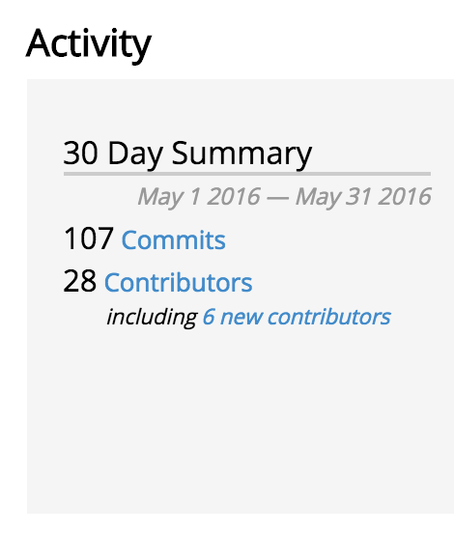
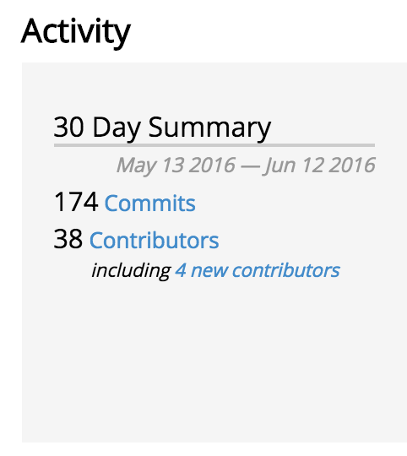
Code Activity
Fd.io has more code activities (commits, contributors) than other dataplane project (data from openhub)
Fd.io
ovs
dpdk

Slide 30
Contributor/Committer Diversity
Universitat Politècnica de Catalunya (UPC)

Slide 31
VPP 16.06 Release
Released 2016-06-17
Enhanced Switching & Routing
IPv6 Segment Routing multicast support
LISP xTR support
VXLAN over IPv6 underlay
per interface whitelists
shared adjacencies in FIB
New and improved interface support
jumbo frame support for vhost-user
Netmap interface support
AF_Packet interface support
Expanded and improved programmability
Python API bindings
Enhanced JVPP Java API bindings
Enhanced debugging cli
Expanded Hardware and Software Support
Support for ARM 32 targets
Support for Raspberry Pi
Support for DPDK 16.04

Slide 32
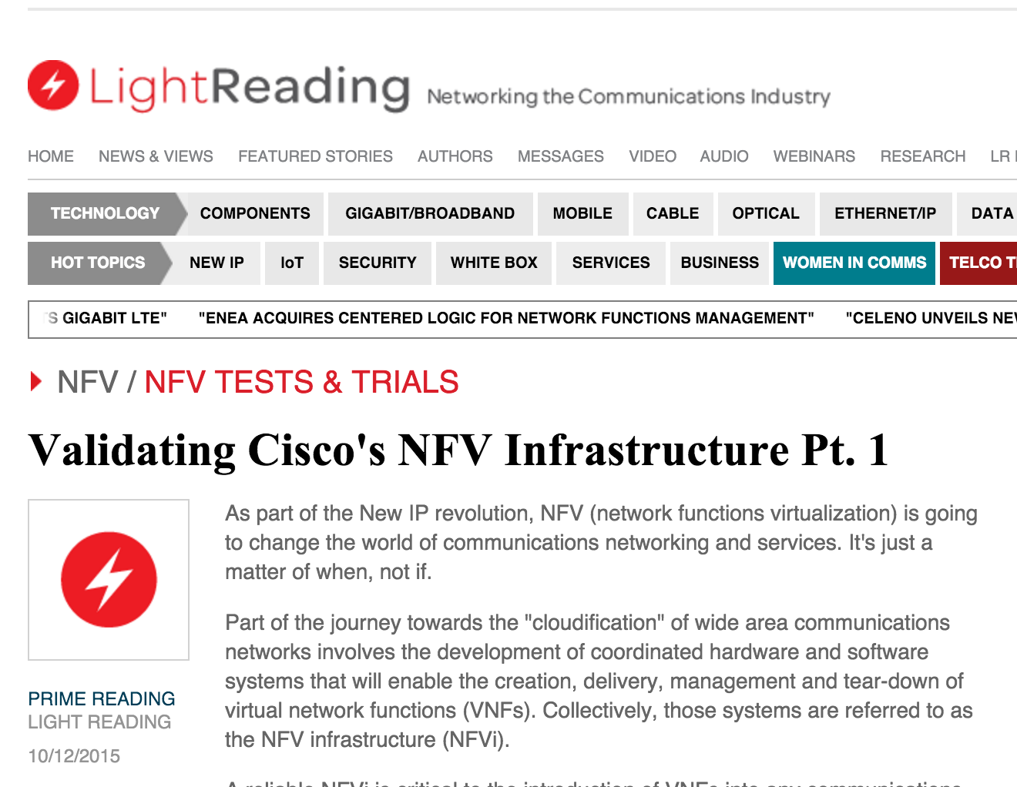
NDR rates for 2p10GE, 1 core, L2 NIC-to-NIC
[IMIX Gbps]
NDR rates for 12 port 10GE, 12 cores, IPv4
[IMIX Gbps]
VPP technology in a nutshell
VPP data plane throughput not impacted by large FIB size
OVSDPDK data plane throughput heavily impacted by FIB size
VPP and OVSDPDK tested on Haswell x86 platform with E5-2698v3 2x16C 2.3GHz (Ubuntu 14.04 trusty)
not tested

Slide 33
vNet-SLA benchmarking at scale: IPv6 VPP-based vSwitch
Phy-VS-Phy
Zero-packet-loss Throughput for 12 port 40GE, 24 cores, IPv6
Zero-packet-loss Throughput for 12 port 40GE, 24 cores, IPv6
[Gbps]
[Mpps]
FD.io VPP data plane throughput not impacted by large size of IPv6 FIB
VPP tested on UCS 4-CPU-socket server with 4 of Intel “Haswell" x86-64 processors E7-8890v3 18C 2.5GHz
24 Cores used – Another 48 cores can be used for other network services!
VPP vSwitch IPv4 routed forwarding FIB with 2 milion IPv6 entries 12x40GE (480GE) 64B frames
200Mpps zero frame loss
NIC and PCIe is the limit not VPP
VPP vSwitch IPv4 routed forwarding FIB with 2 milion IPv6 entries
12x40GE (480GE) IMIX frames
480Gbps zero frame loss
“Sky” is the limit not VPP

Slide 34
vNet benchmarking at scale: IPv4+SEcurity
Zero-Packet-Loss Throughput for 18 port 40GE, 36 cores, IPv4
[Gbps]
[Mpps]
That is Right – No Impact on IMIX and 1518B Performance
FD.io VPP data plane throughput not impacted by large size of IPv4 FIB
VPP tested on UCS 4-CPU server with 4x Intel E7-8890v3 (18C 2.5GHz)
36 Core used – NIC RSS=2 to drive NIC performance, VPP cores not busy!
Another 36 cores available for other services!
VPP vSwitch IPv4 rtd fwding, FIB up to 8M IPv4, 2k white-list
Zero Packet Loss Measurements
IMIX => 342 Gbps
1518B => 462 Gbps
“Sky” is the limit not VPP
64B => 238 Mpps
NIC and PCIe is the limit not VPP

Slide 35
VPP Cores Not Completely Busy
VPP Vectors Have Space For More Services and More Packets!!
PCIe 3.0 and NICs Are The Limit
And How Do We Know This?
Simples – A Well Engineered Telemetry
In Linux and VPP Tells Us So
========
TC5 120ge.vpp.24t24pc.ip4.cop
TC5.0 120ge.2pnic.6nic.rss2.vpp.24t24pc.ip4.cop
d. testcase-vpp-ip4-cop-scale
120ge.2pnic.6nic.rss2.vpp.24t24pc.ip4.2m.cop.2.copip4dst.2k.match.100
64B, 138.000Mpps, 92,736Gbps
IMIX, 40.124832Mpps, 120.000Gbps
1518, 9.752925Mpps, 120.000Gbps
---------------
Thread 1 vpp_wk_0 (lcore 2)
Time 45.1, average vectors/node 23.44, last 128 main loops 1.44 per node 23.00
vector rates in 4.6791e6, out 4.6791e6, drop 0.0000e0, punt 0.0000e0
Name State Calls Vectors Suspends Clocks Vectors/Call
TenGigabitEtherneta/0/1-output active 9003498 211054648 0 1.63e1 23.44
TenGigabitEtherneta/0/1-tx active 9003498 211054648 0 7.94e1 23.44
cop-input active 9003498 211054648 0 2.23e1 23.44
dpdk-input polling 45658750 211054648 0 1.52e2 4.62
ip4-cop-whitelist active 9003498 211054648 0 4.34e1 23.44
ip4-input active 9003498 211054648 0 4.98e1 23.44
ip4-lookup active 9003498 211054648 0 6.25e1 23.44
ip4-rewrite-transit active 9003498 211054648 0 3.43e1 23.44
---------------
Thread 24 vpp_wk_23 (lcore 29)
Time 45.1, average vectors/node 27.04, last 128 main loops 1.75 per node 28.00
vector rates in 4.6791e6, out 4.6791e6, drop 0.0000e0, punt 0.0000e0
Name State Calls Vectors Suspends Clocks Vectors/Call
TenGigabitEthernet88/0/0-outpu active 7805705 211055503 0 1.54e1 27.04
TenGigabitEthernet88/0/0-tx active 7805705 211055503 0 7.75e1 27.04
cop-input active 7805705 211055503 0 2.12e1 27.04
dpdk-input polling 46628961 211055503 0 1.60e2 4.53
ip4-cop-whitelist active 7805705 211055503 0 4.35e1 27.04
ip4-input active 7805705 211055503 0 4.86e1 27.04
ip4-lookup active 7805705 211055503 0 6.02e1 27.04
ip4-rewrite-transit active 7805705 211055503 0 3.36e1 27.04

Slide 36
VPP Cores Not Completely Busy
VPP Vectors Have Space For More Services and More Packets!!
PCIe 3.0 and NICs Are The Limit
And How Do We Know This?
Simple – A Well Engineered Telemetry
In Linux and VPP Tells Us So
========
TC5 120ge.vpp.24t24pc.ip4.cop
TC5.0 120ge.2pnic.6nic.rss2.vpp.24t24pc.ip4.cop
d. testcase-vpp-ip4-cop-scale
120ge.2pnic.6nic.rss2.vpp.24t24pc.ip4.2m.cop.2.copip4dst.2k.match.100
64B, 138.000Mpps, 92,736Gbps
IMIX, 40.124832Mpps, 120.000Gbps
1518, 9.752925Mpps, 120.000Gbps
---------------
Thread 1 vpp_wk_0 (lcore 2)
Time 45.1, average vectors/node 23.44, last 128 main loops 1.44 per node 23.00
vector rates in 4.6791e6, out 4.6791e6, drop 0.0000e0, punt 0.0000e0
Name State Calls Vectors Suspends Clocks Vectors/Call
TenGigabitEtherneta/0/1-output active 9003498 211054648 0 1.63e1 23.44
TenGigabitEtherneta/0/1-tx active 9003498 211054648 0 7.94e1 23.44
cop-input active 9003498 211054648 0 2.23e1 23.44
dpdk-input polling 45658750 211054648 0 1.52e2 4.62
ip4-cop-whitelist active 9003498 211054648 0 4.34e1 23.44
ip4-input active 9003498 211054648 0 4.98e1 23.44
ip4-lookup active 9003498 211054648 0 6.25e1 23.44
ip4-rewrite-transit active 9003498 211054648 0 3.43e1 23.44
---------------
Thread 24 vpp_wk_23 (lcore 29)
Time 45.1, average vectors/node 27.04, last 128 main loops 1.75 per node 28.00
vector rates in 4.6791e6, out 4.6791e6, drop 0.0000e0, punt 0.0000e0
Name State Calls Vectors Suspends Clocks Vectors/Call
TenGigabitEthernet88/0/0-outpu active 7805705 211055503 0 1.54e1 27.04
TenGigabitEthernet88/0/0-tx active 7805705 211055503 0 7.75e1 27.04
cop-input active 7805705 211055503 0 2.12e1 27.04
dpdk-input polling 46628961 211055503 0 1.60e2 4.53
ip4-cop-whitelist active 7805705 211055503 0 4.35e1 27.04
ip4-input active 7805705 211055503 0 4.86e1 27.04
ip4-lookup active 7805705 211055503 0 6.02e1 27.04
ip4-rewrite-transit active 7805705 211055503 0 3.36e1 27.04
VPP average vector size below shows 23-to-27
This indicates VPP program worker threads are not busy
Busy VPP worker threads should be showing 255
This means that VPP worker threads operate at 10% capacity
It’s like driving 1,000hp car at 100hp power – lots of space
for adding (service) acceleration and (sevice) speed.

Slide 37
VPP Cores Not Completely Busy
VPP Vectors Have Space For More Services and More Packets!!
PCIe 3.0 and NICs Are The Limit
And How Do We Know This?
Simples – A Well Engineered Telemetry
In Linux and VPP Tells Us So
========
TC5 120ge.vpp.24t24pc.ip4.cop
TC5.0 120ge.2pnic.6nic.rss2.vpp.24t24pc.ip4.cop
d. testcase-vpp-ip4-cop-scale
120ge.2pnic.6nic.rss2.vpp.24t24pc.ip4.2m.cop.2.copip4dst.2k.match.100
64B, 138.000Mpps, 92,736Gbps
IMIX, 40.124832Mpps, 120.000Gbps
1518, 9.752925Mpps, 120.000Gbps
---------------
Thread 1 vpp_wk_0 (lcore 2)
Time 45.1, average vectors/node 23.44, last 128 main loops 1.44 per node 23.00
vector rates in 4.6791e6, out 4.6791e6, drop 0.0000e0, punt 0.0000e0
Name State Calls Vectors Suspends Clocks Vectors/Call
TenGigabitEtherneta/0/1-output active 9003498 211054648 0 1.63e1 23.44
TenGigabitEtherneta/0/1-tx active 9003498 211054648 0 7.94e1 23.44
cop-input active 9003498 211054648 0 2.23e1 23.44
dpdk-input polling 45658750 211054648 0 1.52e2 4.62
ip4-cop-whitelist active 9003498 211054648 0 4.34e1 23.44
ip4-input active 9003498 211054648 0 4.98e1 23.44
ip4-lookup active 9003498 211054648 0 6.25e1 23.44
ip4-rewrite-transit active 9003498 211054648 0 3.43e1 23.44
---------------
Thread 24 vpp_wk_23 (lcore 29)
Time 45.1, average vectors/node 27.04, last 128 main loops 1.75 per node 28.00
vector rates in 4.6791e6, out 4.6791e6, drop 0.0000e0, punt 0.0000e0
Name State Calls Vectors Suspends Clocks Vectors/Call
TenGigabitEthernet88/0/0-outpu active 7805705 211055503 0 1.54e1 27.04
TenGigabitEthernet88/0/0-tx active 7805705 211055503 0 7.75e1 27.04
cop-input active 7805705 211055503 0 2.12e1 27.04
dpdk-input polling 46628961 211055503 0 1.60e2 4.53
ip4-cop-whitelist active 7805705 211055503 0 4.35e1 27.04
ip4-input active 7805705 211055503 0 4.86e1 27.04
ip4-lookup active 7805705 211055503 0 6.02e1 27.04
ip4-rewrite-transit active 7805705 211055503 0 3.36e1 27.04
VPP average vector size below shows 23-to-27
This indicates VPP program worker threads are not busy
Busy VPP worker threads should be showing 255
This means that VPP worker threads operate at 10% capacity
It’s like driving 1,000bhp car at 100bhp power – lots of space
for adding (service) acceleration and (sevice) speed.
VPP is also counting the cycles-per-packet (CPP)
We know exactly what feature, service, packet processing activity is using the CPU cores
We can engineer, we can capacity plan, we can automate service placement
We can scale across many many CPU cores and computers
And AUTOMATE it easily – as it is after all just SOFTWARE

Slide 38
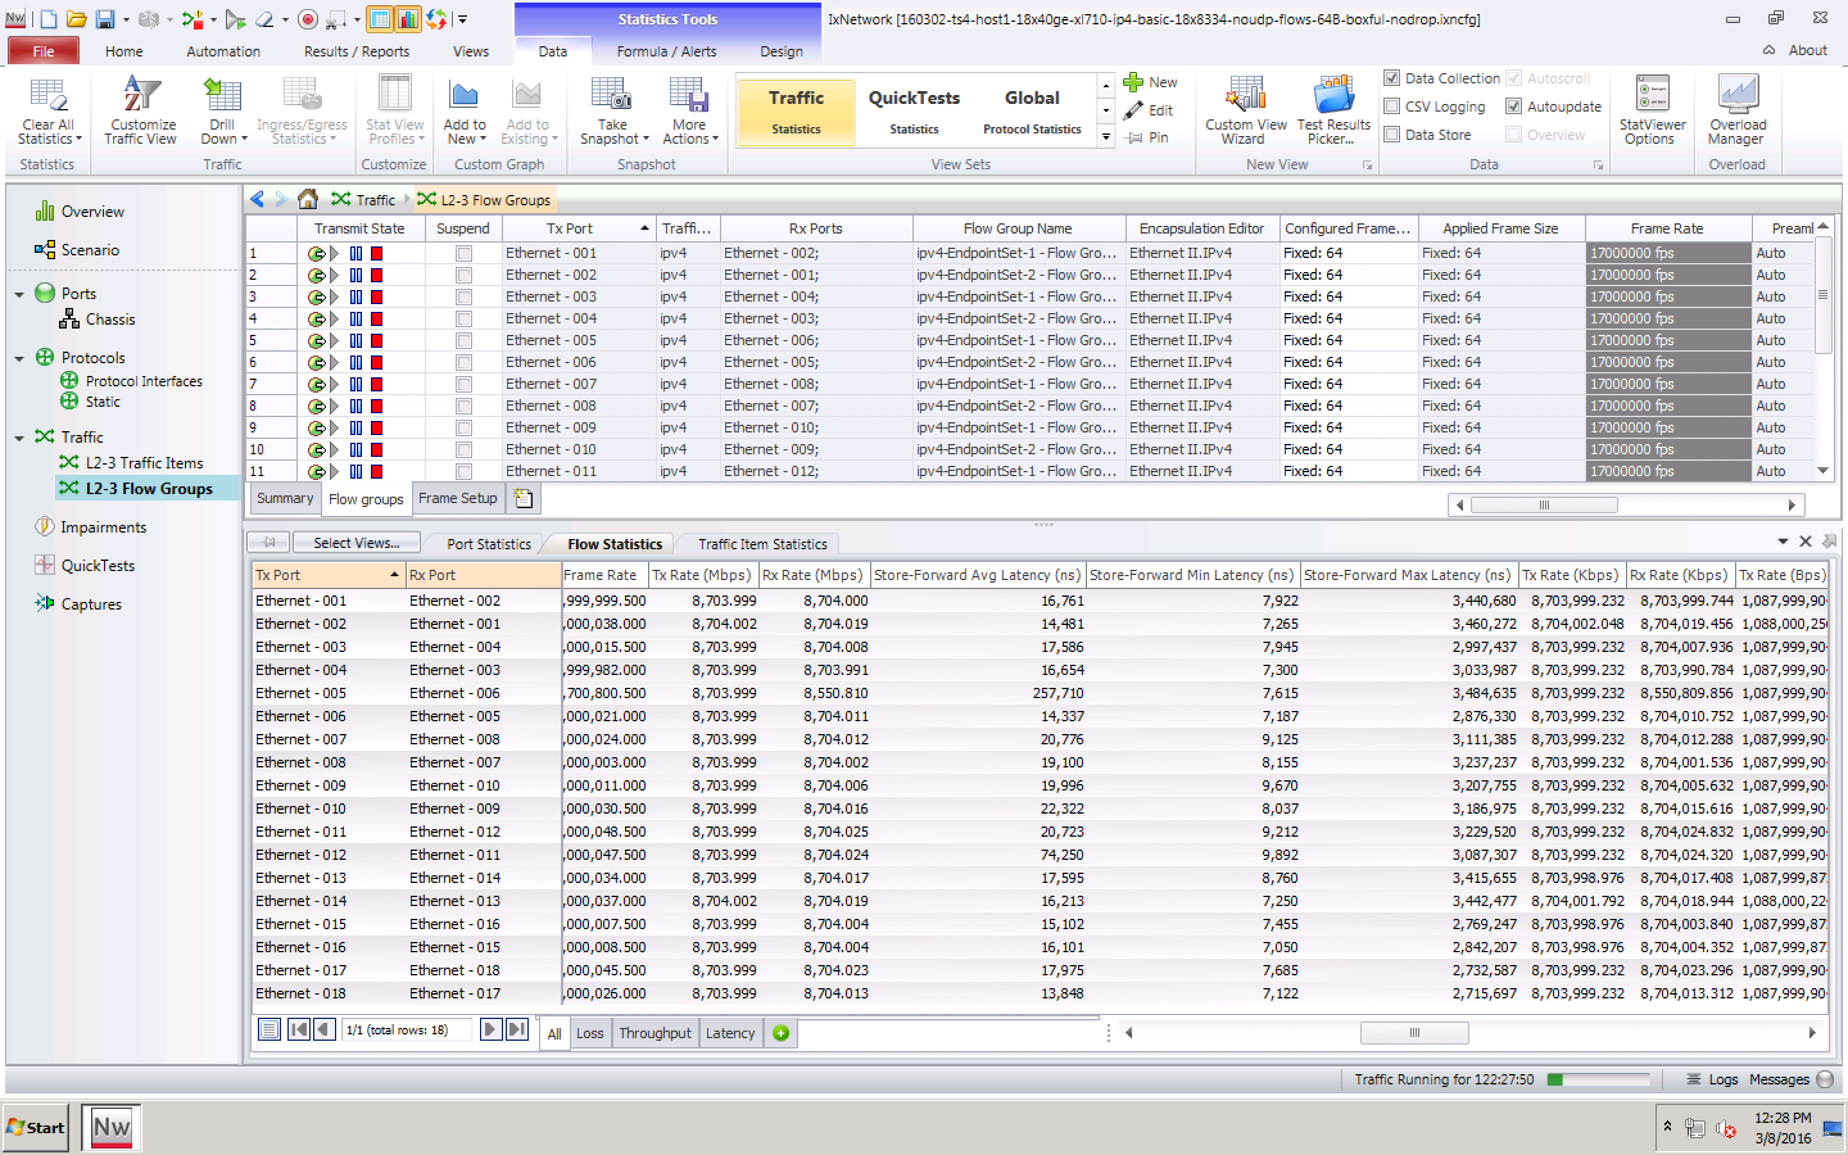
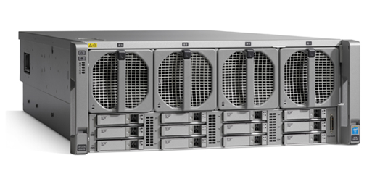
ONE MORE THING – THE LONG TERM MAX DELAY
The Fast Data Project (FD.io)
Low long-term max packet delay with FD.io VPP
>>120 msec long-term max packet delay measured by others for other vSwitches
But it is just not not there with VPP and stock Ubuntu 14.04 (no Linux tuning!)
The Soak Test Proof:
18 x 7.7trillion packets forwarded.
Max Packet Delay <3.5 msec incl. the outliers!!
Min Packet Delay 7..10 usec, Avg Packet Delay <23 usec.
Compute Node Software | Version
Host Operating System | Ubuntu 14.04.3 LTS Kernel version: 3.13.0-63-generic
DPDK | DPDK 2.2.0
FD.io VPP | vpp v1.0.0-174~g57a90e5
Compute Node Hardware | Cisco UCS C460 M4
Chipset | Intel® C610 series chipset
CPU | 4 x Intel® Xeon® Processor E7-8890 v3 (18 cores, 2.5GHz, 45MB Cache)
Memory | 2133 MHz, 512 GB Total
NICs | 9 x 2p40GE Intel XL710 18 x 40GE = 720GE !!
Avg
Delay
Min
Delay
Max
Delay

Slide 39
Implementation Example: VPP as a vRouter/vSwitch
Out of the box vSwitch/vRouter
Including CLI
Switching
Can Create
Bridge Domains
Ports (including tunnel ports)
Connect ports to bridge domains
Program ARP termination
etc
Routing
Can Create
VRFs - thousands
Routes - millions
Linux Host
VPP App
Switch-1
VRF-1
Switch-2
VRF-2
DPDK
Kernel

Slide 40
VPP vRouter/vSwitch: Local Programmability
Low Level API
Complete
Feature Rich
High Performance
Example: 900k routes/s
Shared memory/message queue
Box local
All CLI tasks can be done via API
Generated Low Level Bindings - existing today
C clients
Java clients
Others can be done
Linux Host
External App
VPP App
DPDK
Kernel

Slide 41
VPP vRouter/vSwitch: Remote Programmability
High Level API: An approach
Data Plane Management Agent
Speaks low level API to VPP
Box (or VM or container) local
Exposes higher level API via some binding
Flexibility:
VPP does not force a particular Data Plane Management Agent
VPP does not force only *one* High Level API
Anybody can bring a Data Plane Management Agent
High Level API/Data Plane Management Agent
Match VPP app needs
netconf/yang
REST
Other (BGP)
Linux Host
Data Plane Management Agent
VPP App
DPDK
Kernel

Slide 42
Broader Ecosystem

Slide 43
OpenDaylight Virtual Bridge Domain
Working on installer changes needed to add ODL & VPP as the networking stack for Openstack
Provides a programmable interface to include ‘edge’ network programming into a virtual environment
Allows for multiple data plane forwarders to be active
Integration happening in OpNFV “Fast Data Stacks” project
Control Plane
VBD app
HC
Data Plane
OVS
VPP

Slide 44
OpNFV FDS: Integrating OpenStack/ODL/fdio
Working on installer changes needed to add ODL & VPP as the networking stack for Openstack
Provides a programmable interface to include ‘edge’ network programming into a virtual environment
Allows for multiple data plane forwarders to be active
Integration happening in OpNFV “Fast Data Stacks” project
Openstack
Neutron
ODL
Plugin
Control Plane
HC
Data Plane
OVS
VPP

Slide 45
Next Steps – Get Involved
We invite you to Participate in fd.io
Get the Code, Build the Code, Run the Code
Read/Watch the Tutorials
Join the Mailing Lists
Join the IRC Channels
Explore the wiki
Join fd.io as a member
Come to fd.io breakout session at 5pm in Bellevue

