Slide 1
uCPE Reference Solution on FD.io
Hongjun Ni, Xuekun Hu @ Intel

Slide 2
Acknowledgement
  VPP Community
  John DiGiglio @ Intel
  Sarabjit Gosal @ Intel
  Dirk Blevins @ Intel
  Frank Liu @ Intel
  Xuekun Hu @ Intel
  Jerry Zhang @ Intel
  Sweetcomb Community
  Ray Kinsella @ Intel
  Jokul Li @ Intel
  Yu Liu @ Intel
  Ping Yu @ Intel
  Zhiyong Yang @ Intel
  Yuwei Zhang @ Intel
*Other names and brands may be claimed as the property of others.

Slide 3
Agenda
  Problem Statement
  Reference Solution Overview
  Hardware Architecture
  uCPE Software Reference
  uCPE POC
  Key Takeaway
*Other names and brands may be claimed as the property of others.

Slide 4







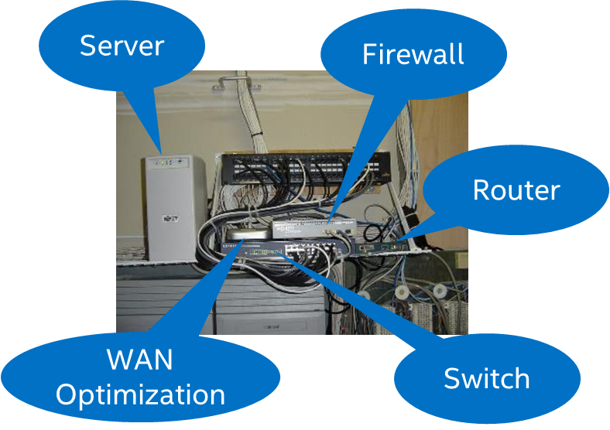
Avg. 6-12 hardware appliances/branch
Problem Statement
Public Cloud
SaaS
SECaaS, IaaS…
Internet
Network
MPLS
Data Center
Complex Customer
Premise
Increasing
Bandwidth Demand/Cost
Manual service provisioning and no centralized control
*Other names and brands may be claimed as the property of others.

Slide 5
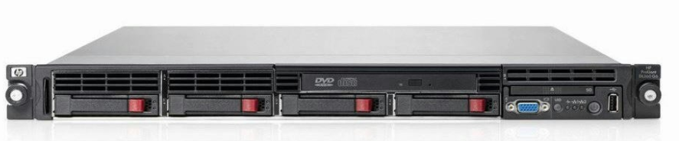


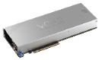

Transformation to SD-Branch
Public Cloud
SaaS
SECaaS, IaaS…
Wireless
Internet
SD-WAN
uCPE
MPLS
Simplified
SD-Branch
Data Center
Highly scalable
SDN network
Centralized control and
Automated provisioning of services
Enterprise
Edge
Network
Cloud
uCPE/SD-WAN play a key role as Cloud Edge Platform
*Other names and brands may be claimed as the property of others.

Slide 6



uCPE/SD-WAN Open Framework & Reference Solution
Open Source/3rd party commercial
Controller
（ONOS/ODL)
3
Leaf DPI
VM1
Firewall
VM2
VPN
VM3
Other VNFs
Intel + ISV
Intel Xeon
VNF Operation& Management Framework
5
2
cloud
Sweetcomb Management Engine
Netconf (YANG/XML)
uCPE Reference
Open Source Network Fabric
DPDK + VPP (19.01)
Management, Operation, Orchestration
CentOS 7.5 and KVM
uCPE White-Box Reference Design
vCPE/
Cloud Gateway
Eth/WiFi/VoIP
1
4
WAN
BIOS/Firmware/Driver
WAN
(MPLS/INET/4G/FTTH)
vCPE
Intel ATOM Based uCPE
VPP
Enterprise
LAN
Spine DPI
uCPE (IO) Interfaces
LAN
Intel Xeon/Xeon-D
*Other names and brands may be claimed as the property of others.

Slide 7
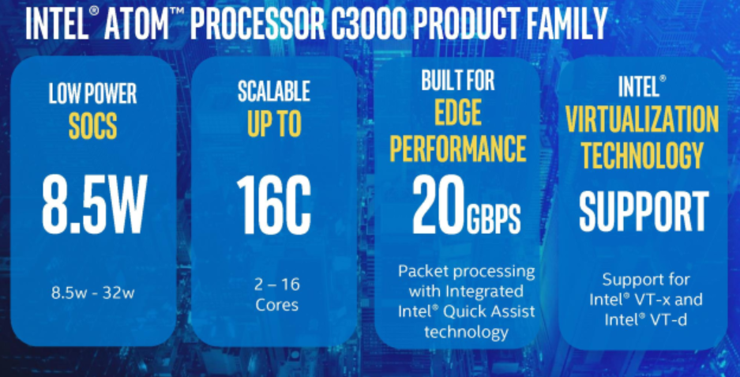
ATOM Product Family
*Other names and brands may be claimed as the property of others.

Slide 8

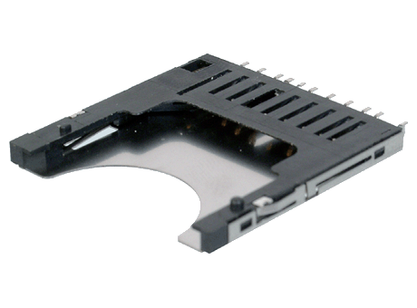



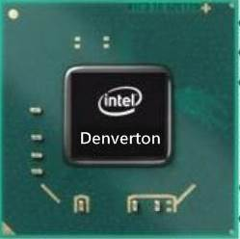
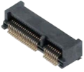

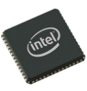



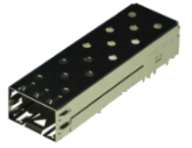


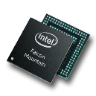
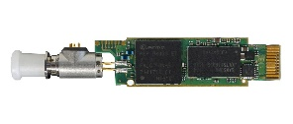
uCPE White-Box Reference Design
eMMC
(8/16GB)
Adapter
SIM Slot
2x DDR4 SO-DIMM (ECC Support)
Power IC
1/2x DDR4
1x USB3.0
1x M.2 Connector
(LTE)
Single/Dual Channel
SATA 3.0
1x PCIe
1x USB
1x Mini-PCIe Connector
(Wi-Fi)
mSATA
/SATA
SATA 3.0
2 x USB 2.0
USB Host
2xSGMII
ETH PHY
PCIe x4
VoIP Expansion
4x PCIe G3
LPC
GPON/GbE SFP
I350 AM4
I211
1x RJ-45 Console
SIO
LED
Button
GPIO
2 x GbE Combo
4 x GbE RJ-45
*Other names and brands may be claimed as the property of others.

Slide 9

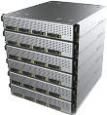





Scalability in Enterprise SD-Branch
VNFs @
POP/Data Center
Routing, VPN, FW, CGNAT, WiFi CTRL, SD-WAN CTRL
Routing, VPN, FW, IPS, SBC, CGNAT, WiFi CTRL, SD-WAN CTRL
FW, IPS, CGNAT, SBC, WiFi CTRL, SD-WAN CTRL
WAN Accel, SD-WAN CTRL
Network
Network
Network
Network
Service Provider
Enterprise
SOHO
Small Branch
Medium Branch
Large Branch
VNFs @ CPE
SD-WAN, VPN
Routing, SD-WAN, VPN
Routing, VPN, WAN Accel, SD-WAN, vRAN
Routing, VPN, WiFi CTRL, WAN Accel, FW, IPS, SD-WAN, vRAN
VNF
1-2
VNFs
VNF
VNF
1-2
VNFs
VNF
VNF
2-4
VNFs
VNF
VNF
6+
VNFs
VNF
Intel SoC Positioning
Atom 2C
Atom 2-4C
Atom 12-16C-> Xeon-D
Xeon D -> Xeon Scalable Series
Intel technologies to drive performance, scale and security
DPDK, VPP, Intel ® QuickAssist, Hyperscan, Intel® VT, AESNI
*Other names and brands may be claimed as the property of others.

Slide 10


uCPE Software Reference Overview
Linux BSP
toolkit
Network stack
CentOS 7.x
Device Drivers (QAT, Wireless, I/O)
Footprint Optimization
Configuration Optimization
CPU Core Usage Profiling
Developer Environment
Cross-compiling
Build server and deployment
Installer, Packaging
Documentation
DPDK + VPP
IPSec VPN (IKE), VxLAN, NAT
QoS, ACL
Real-time Traffic Analytics
Tapv2(Kernel-Bridge), DHCP, DNS
SW-defined I/O
management
PoC
VoIP
DSP + SLIC, up to 16x POTS
GPON
SFP Module (1G, 2.5G, 10G)
WAN/LAN
Management Engine (Sweetcomb)
YANG Model & Plug-ins
Local Management
Gateway/Router
VPN, Wireless, VoIP
E2E SD-WAN W/ Open Framework
Performance Showcase
Intel® Architecture-Based
Platforms Support
*Other names and brands may be claimed as the property of others.

Slide 11
uCPE Software Reference Diagram
vDPI
vFW
Value Added
Service
Validation/Benchmark Tools
3rd-party VNF
Local/Remote Management
VPP
vSwitch
Netconf
NAT/NAT-T
PPPoE
IGMP
DHCP
DDNS
VoIP
NPT/SNPT
MP-BGP
SW Reference
IP Frag/Reassembly
L2/L3 Stack
IPsec/SSL
Tunneling
Qos/ACL
DPDK
Tapv2/AF_Packet/KNI
User Mode
Kernel Mode
Hypervisor/KVM
Container
Kernel Driver
WIFI
LTE
PON
Voice
Optimized Linux
BIOS/Firmware
Intel SOC
QAT
ETH
External I/F Module
WIFI
LTE
PON
Voice
*Other names and brands may be claimed as the property of others.

Slide 12
Multi-Core Usage Profiling for SD-WAN
Intel Atom® C3000 Processor 4C and More
SD –WAN (2C default)
Core 0
Core 1
Core 2
Core 3
Management Engine
VPP Master/CLI
DHCP/DNS/NTP/IxMP/...
Local Portal/APP
Network Stack - DP
IPSec, VxLAN, NAT
L2/L3 FWD w/ QoS, ACL
DPDK + VPP
Option#1: SD-WAN/Host
VAS/Edge Service
VM/Docker
Option#2: VAS/Edge Service
VM/Docker
uCPE SW Reference (Dev tool, BSP, DPDK, VPP, Patch, configurations, Samples, Docs)
CentOS 7.5
DNV/RGY
QAT
AES-NI
ETH
WiFi
GPON
LTE
*Other names and brands may be claimed as the property of others.

Slide 13
uCPE POC
Postman
Software BOM
CentOS 7.5
VPP 18.10
Local management
Sweetcomb
Sysrepo 0.7.7
Netopeer2-server 0.7.0
Netopeer2-cli 2.0.49
REST
SIP Server
Netconf
uCPE 1
uCPE 2
PC
WAN
Phone
Voice Module
LAN/WiFi
Soft phone
Local Mgmt.
LAN
LAN
IPSec (with IKE)
VxLAN
QoS, ACL
Traffic Analytics
VoIP
Pkt-Gen
*Other names and brands may be claimed as the property of others.

Slide 14
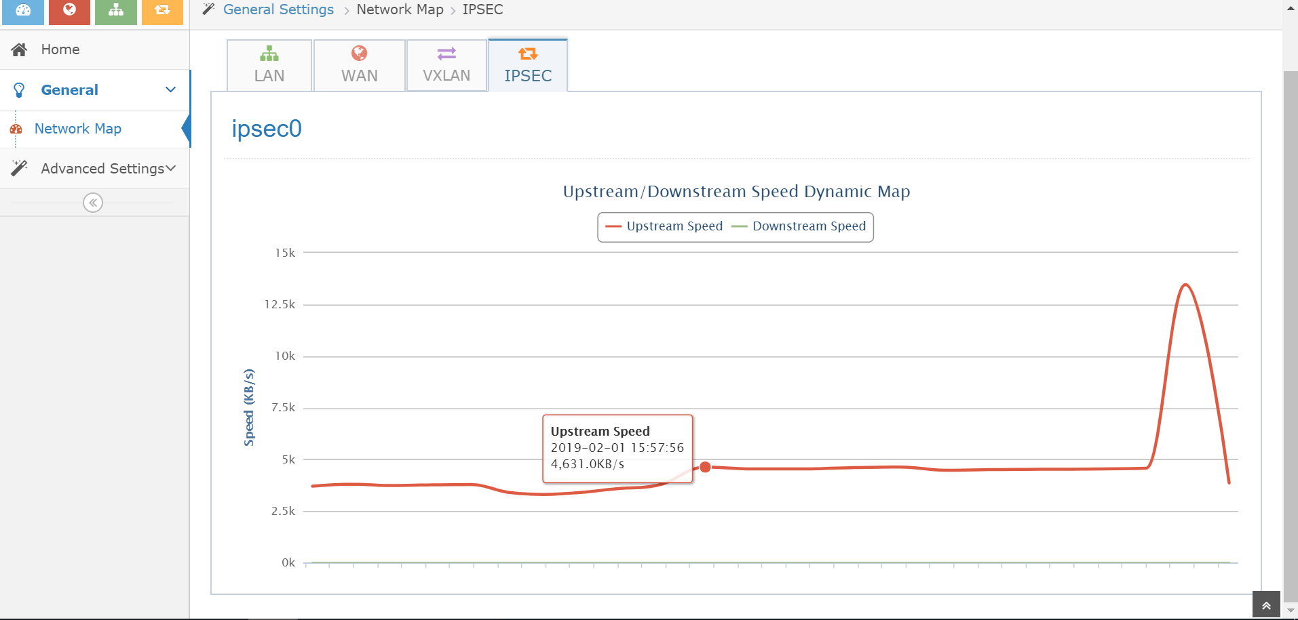
IPSec GUI
*Other names and brands may be claimed as the property of others.

Slide 15
Key Takeaway
uCPE helps to transform to SD-Branch as Edge Cloud Platform.
uCPE Solution contains uCPE SW Reference and White-box HW Reference.
White-box Reference provides fully scalable HW design.
uCPE Software Reference built on VPP provides rich features and Toolkits.
*Other names and brands may be claimed as the property of others.

Slide 16

Thank you !
Q & A
Email : hongjun.ni@intel.com
xuekun.hu@intel.com

