Slide 1
fd.io Intro
Ed Warnicke

Slide 2
Evolution of Programmable Networking
CLOUD
NFV
SDN
Many industries are transitioning to a more dynamic model to deliver network services
The great unsolved problem is how to deliver network services in this more dynamic environment
Inordinate attention has been focused on the non-local network control plane (controllers)
  Necessary, but insufficient
There is a giant gap in the capabilities that foster delivery of dynamic Data Plane Services
Programmable Data Plane

Slide 3
Issues/Limitations with Existing Data Plane Solutions
Known issues with Performance, Scalability & Stability
Overly Complex Architectures
  Hard to evolve
  Slow rate of innovation
  Steep learning curve
Hard to deploy/upgrade/operate
  slow cycles, too many kernel dependencies
Lack of :
  automated end-to-end system testing frameworks
    leads to unpredictable system behavior
  support for diverse/custom hardware
  portability across compute platforms
  optimal use of compute microarchitectures
  network level instrumentation
    Few debugability features
    Few if any Statistics/Counters exposed

Slide 4

Introducing Fast Data: fd.io
fd.io Charter
New project in Linux Foundation
  Multi-party
  Multi-project
What does multi-party mean?
  Multiple members - Open to all
What does multi-project mean?
  Multiple subprojects
  Subproject autonomy
  Cross project synergy
  Open to new subprojects
  Anyone can propose a subproject
  Allows for innovation
Create a Platform that enables Data Plane Services that are:
  Highly performant
  Modular and extensible
  Open source
  Interoperable
  Multi-Vendor
Platform fosters innovation and synergistic interoperability between Data Plane Services
Source of Continuous Integration resources for Data Plane services based on the Consortium’s project/subprojects
Meet the functionality needs of developers, deployers, datacenter operators

Slide 5














Fd.io Members

Slide 6
Fd.io Projects
Legend:
- New Projects
- Core Projects
Management Agent
Honeycomb
Packet Processing
Testing/Performance
NSH_SFC
ONE
VPP Sandbox
TLDK
VPP
CSIT
Network IO

Slide 7
Fast Data Scope
Bare Metal/VM/Container
Fast Data Scope:
    IO
      Hardware/vHardware <-> cores/threads
  Processing
    Classify
    Transform
    Prioritize
    Forward
    Terminate
  Management Agents
    Control/manage IO/Processing
Management Agent
Processing
IO

Slide 8
Governance – At a Glance
Anyone May Participate – Not just members
  Anyone can contribute code
  Anyone can rise to being a committer via meritocracy
  Anyone can propose a subproject
Subprojects:
  Composed of the committers to that subproject – those who can merge code
  Responsible for sub project oversight and autonomous releases
  Make technical decisions for that subproject by consensus, or failing that, majority vote.
Technical Steering Committee
  Fosters collaboration among subprojects, but is not involved in day to day management of sub-projects
  Approves new subprojects, sets development process guidelines for the community, sets release guidelines for multi-project or simultaneous releases, etc.
  Initial TSC will be seeded with representatives from Platinum Membership and core project PTLs with the goal of replacing representatives with Project Leads after the first year
Governing Board will Oversee Business Decision Making
  Set Scope and Policy of Consortium
  Composed of Platinum member appointees, elected Gold, Silver, and Committer member representatives
  Examples of business needs include: budgeting, planning for large meetings (e.g. a Summit, Hackfest), marketing, websites, developer infrastructure, test infrastructure, etc.

Slide 9
VPP:
Vector Packet Processing

Slide 10
Introducing Vector Packet Processor - VPP
VPP is a rapid packet processing development platform for highly performing network applications.
It runs on commodity CPUs and leverages DPDK
It creates a vector of packet indices and processes them using a directed graph of nodes – resulting in a highly performant solution.
Runs as a Linux user-space application
Ships as part of both embedded & server products, in volume
Active development since 2002
Bare Metal/VM/Container
Data Plane Management Agent
Packet Processing
Network IO

Slide 11

VPP in the Overall Stack
Application Layer / App Server
VM/VIM Management Systems
Orchestration
Network Controller
Operating Systems
Data Plane Services
VPP
Packet Processing
Network IO
Hardware

Slide 12
VPP Architecture -
Modularity Enabling Flexible Plugins
Packet vector
…
Plugins == Subprojects
Plugins can:
  Introduce new graph nodes
  Rearrange packet processing graph
  Can be built independently of VPP source tree
  Can be added at runtime (drop into plugin directory)
  All in user space
Enabling:
  Ability to take advantage of diverse hardware when present
  Support for multiple processor architectures (x86, ARM, PPC)
  Few dependencies on the OS (clib) allowing easier ports to other Oses/Env
ethernet-input
Plug-in to enable new HW input Nodes
mpls-ethernet-input
ip4input
llc-input
ip6-input
arp-input
…
ip6-lookup
Plug-in to create new nodes
ip6-rewrite-transmit
ip6-local
Custom-A
Custom-B

Slide 13
VPP Feature Summary
  IPv4/IPv6
  IPv4
  L2
  14+ MPPS, single core
  Multimillion entry FIBs
  Source RPF
  Thousands of VRFs
  Controlled cross-VRF lookups
  Multipath – ECMP and Unequal Cost
  Multiple million Classifiers –
  Arbitrary N-tuple
  VLAN Support – Single/Double tag
  Counters for everything
  Mandatory Input Checks:
  TTL expiration
  header checksum
  L2 length < IP length
  ARP resolution/snooping
  ARP proxy
  GRE, MPLS-GRE, NSH-GRE,
  VXLAN
  IPSEC
  DHCP client/proxy
  CG NAT
  VLAN Support
  Single/ Double tag
  L2 forwarding with EFP/BridgeDomain concepts
  VTR – push/pop/Translate (1:1,1:2, 2:1,2:2)
  Mac Learning – default limit of 50k addresses
  Bridging – Split-horizon group support/EFP Filtering
  Proxy Arp
  Arp termination
  IRB – BVI Support with RouterMac assignment
  Flooding
  Input ACLs
  Interface cross-connect
  IPv6
  Neighbor discovery
  Router Advertisement
  DHCPv6 Proxy
  L2TPv3
  Segment Routing
  MAP/LW46 – IPv4aas
  iOAM
  MPLS
  MPLS-o-Ethernet –
  Deep label stacks supported
Notes:
The input checks included by VPP include mandatory networking checks.
Some solutions today either don’t perform these or don’t have them leading to questionable performance numbers

Slide 14
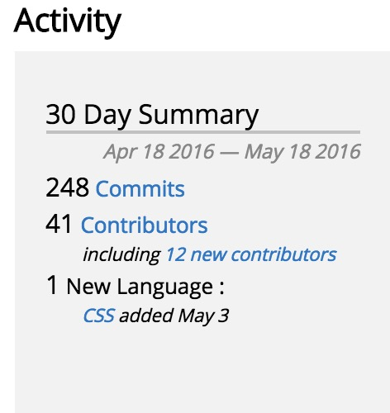
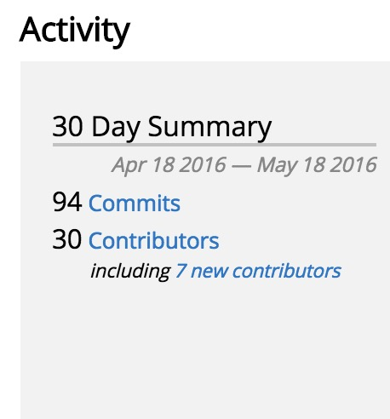
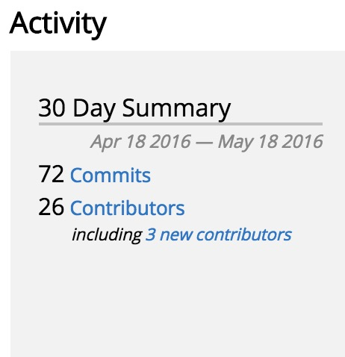
Code Activity
Fd.io continues to have more code activities (commits, contributors) than either ovs or dpdk (data from openhub)
Fd.io
ovs
dpdk

Slide 15
Upcoming VPP Release
Vpp project committers approved Release Plan
  Targeting 2016-06-17 Release (16.06)
  stable/1606 throttle branch has been cut
New features:
Uses dpdk 16.04
IP fib cleanups
Packaging/Consumability
Testing (CSIT/CPL/Performance)
lisp xtr support
ip6 SR multicast support
vxlan over v6 underlay
gre over v6 underlay
Arm 32 support
Works on raspberry pi
Per interface whitelists
Jumbo frame support for vhost-user
Shared adjacencies in fib
netmap interface support
af_packet interface support
python api bindings
reworked jvpp java api bindings
centos7/ubuntu1404/ubuntu1604 packaging support
Vpp_lite
Multi-vpp support

Slide 16
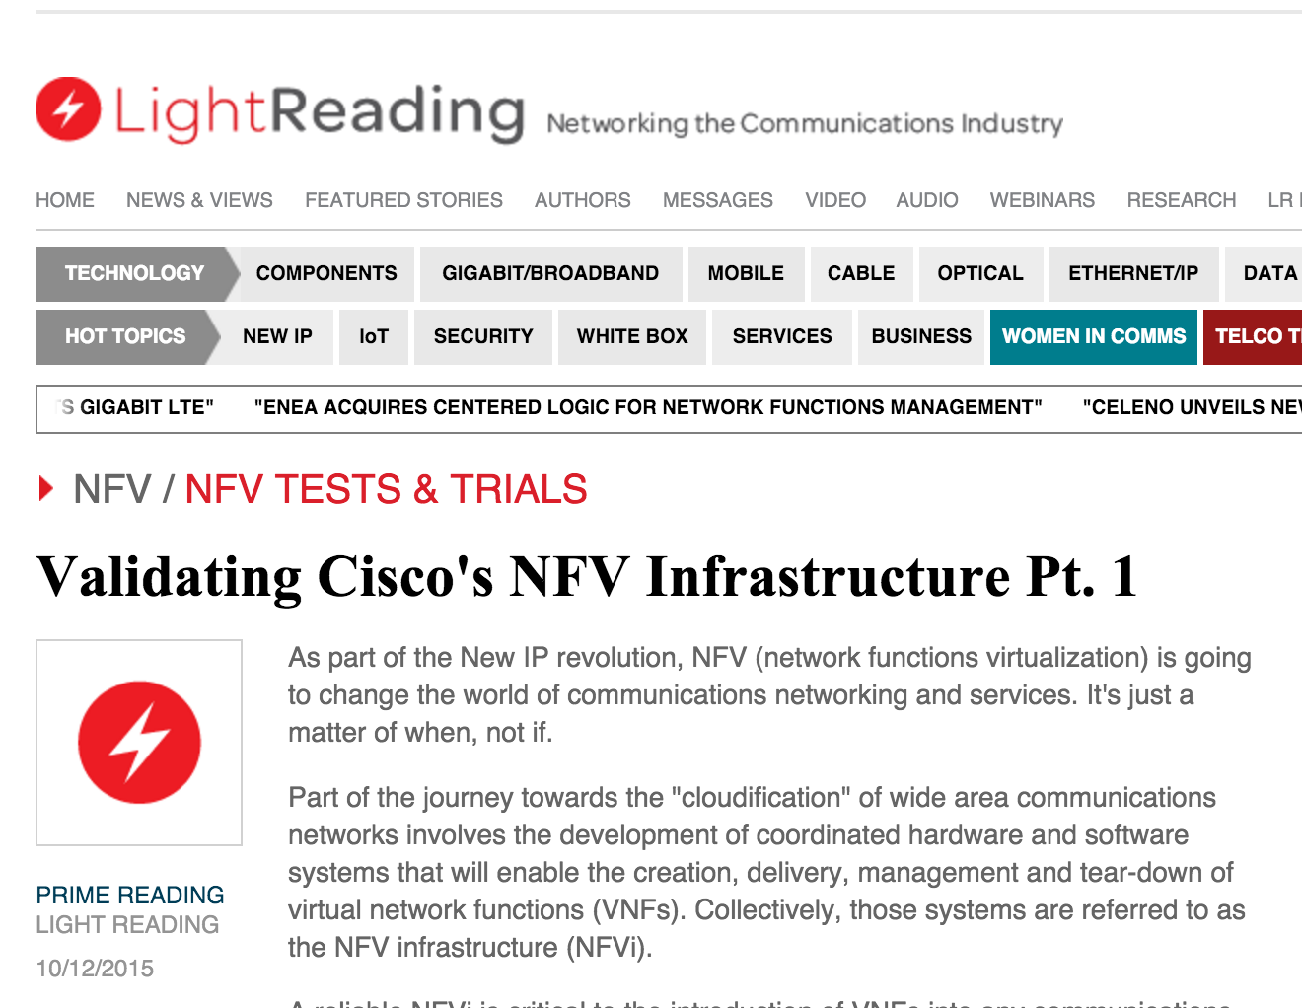

NDR rates for 2p10GE, 1 core, L2 NIC-to-NIC
[IMIX Gbps]
NDR rates for 12 port 10GE, 12 cores, IPv4
[IMIX Gbps]
VPP technology in a nutshell
VPP data plane throughput not impacted by large FIB size
OVSDPDK data plane throughput heavily impacted by FIB size
VPP and OVSDPDK tested on Haswell x86 platform with E5-2698v3 2x16C 2.3GHz (Ubuntu 14.04 trusty)
not tested

Slide 17
vNet-SLA benchmarking at scale: IPv6
VPP-based vSwitch
Phy-VS-Phy
Zero-packet-loss Throughput for 12 port 40GE, 24 cores, IPv6
Zero-packet-loss Throughput for 12 port 40GE, 24 cores, IPv6
[Gbps]
[Mpps]
FD.io VPP data plane throughput not impacted by large size of IPv6 FIB
VPP tested on UCS 4-CPU-socket server with 4 of Intel “Haswell" x86-64 processors E7-8890v3 18C 2.5GHz
24 Cores used – Another 48 cores can be used for other network services!
VPP vSwitch IPv4 routed forwarding FIB with 2 milion IPv6 entries 12x40GE (480GE) 64B frames
200Mpps zero frame loss
NIC and PCIe is the limit not VPP
VPP vSwitch IPv4 routed forwarding FIB with 2 milion IPv6 entries
12x40GE (480GE) IMIX frames
480Gbps zero frame loss
“Sky” is the limit not VPP

Slide 18
vNet benchmarking at scale: IPv4+SEcurity
Zero-Packet-Loss Throughput for 18 port 40GE, 36 cores, IPv4
[Gbps]
[Mpps]
That is Right – No Impact on IMIX and 1518B Performance
FD.io VPP data plane throughput not impacted by large size of IPv4 FIB
VPP tested on UCS 4-CPU server with 4x Intel E7-8890v3 (18C 2.5GHz)
36 Core used – NIC RSS=2 to drive NIC performance, VPP cores not busy!
Another 36 cores available for other services!
VPP vSwitch IPv4 rtd fwding, FIB up to 8M IPv4, 2k white-list
Zero Packet Loss Measurements
IMIX => 342 Gbps
1518B => 462 Gbps
“Sky” is the limit not VPP
64B => 238 Mpps
NIC and PCIe is the limit not VPP

Slide 19
VPP Cores Not Completely Busy
VPP Vectors Have Space For More Services and More Packets!!
PCIe 3.0 and NICs Are The Limit
And How Do We Know This?
Simples – A Well Engineered Telemetry
In Linux and VPP Tells Us So
========
TC5 120ge.vpp.24t24pc.ip4.cop
TC5.0 120ge.2pnic.6nic.rss2.vpp.24t24pc.ip4.cop
d. testcase-vpp-ip4-cop-scale
120ge.2pnic.6nic.rss2.vpp.24t24pc.ip4.2m.cop.2.copip4dst.2k.match.100
64B, 138.000Mpps, 92,736Gbps
IMIX, 40.124832Mpps, 120.000Gbps
1518, 9.752925Mpps, 120.000Gbps
---------------
Thread 1 vpp_wk_0 (lcore 2)
Time 45.1, average vectors/node 23.44, last 128 main loops 1.44 per node 23.00
vector rates in 4.6791e6, out 4.6791e6, drop 0.0000e0, punt 0.0000e0
Name State Calls Vectors Suspends Clocks Vectors/Call
TenGigabitEtherneta/0/1-output active 9003498 211054648 0 1.63e1 23.44
TenGigabitEtherneta/0/1-tx active 9003498 211054648 0 7.94e1 23.44
cop-input active 9003498 211054648 0 2.23e1 23.44
dpdk-input polling 45658750 211054648 0 1.52e2 4.62
ip4-cop-whitelist active 9003498 211054648 0 4.34e1 23.44
ip4-input active 9003498 211054648 0 4.98e1 23.44
ip4-lookup active 9003498 211054648 0 6.25e1 23.44
ip4-rewrite-transit active 9003498 211054648 0 3.43e1 23.44
---------------
Thread 24 vpp_wk_23 (lcore 29)
Time 45.1, average vectors/node 27.04, last 128 main loops 1.75 per node 28.00
vector rates in 4.6791e6, out 4.6791e6, drop 0.0000e0, punt 0.0000e0
Name State Calls Vectors Suspends Clocks Vectors/Call
TenGigabitEthernet88/0/0-outpu active 7805705 211055503 0 1.54e1 27.04
TenGigabitEthernet88/0/0-tx active 7805705 211055503 0 7.75e1 27.04
cop-input active 7805705 211055503 0 2.12e1 27.04
dpdk-input polling 46628961 211055503 0 1.60e2 4.53
ip4-cop-whitelist active 7805705 211055503 0 4.35e1 27.04
ip4-input active 7805705 211055503 0 4.86e1 27.04
ip4-lookup active 7805705 211055503 0 6.02e1 27.04
ip4-rewrite-transit active 7805705 211055503 0 3.36e1 27.04

Slide 20
VPP Cores Not Completely Busy
VPP Vectors Have Space For More Services and More Packets!!
PCIe 3.0 and NICs Are The Limit
And How Do We Know This?
Simple – A Well Engineered Telemetry
In Linux and VPP Tells Us So
VPP average vector size below shows 23-to-27
This indicates VPP program worker threads are not busy
Busy VPP worker threads should be showing 255
This means that VPP worker threads operate at 10% capacity
It’s like driving 1,000hp car at 100hp power – lots of space
for adding (service) acceleration and (sevice) speed.
========
TC5 120ge.vpp.24t24pc.ip4.cop
TC5.0 120ge.2pnic.6nic.rss2.vpp.24t24pc.ip4.cop
d. testcase-vpp-ip4-cop-scale
120ge.2pnic.6nic.rss2.vpp.24t24pc.ip4.2m.cop.2.copip4dst.2k.match.100
64B, 138.000Mpps, 92,736Gbps
IMIX, 40.124832Mpps, 120.000Gbps
1518, 9.752925Mpps, 120.000Gbps
---------------
Thread 1 vpp_wk_0 (lcore 2)
Time 45.1, average vectors/node 23.44, last 128 main loops 1.44 per node 23.00
vector rates in 4.6791e6, out 4.6791e6, drop 0.0000e0, punt 0.0000e0
Name State Calls Vectors Suspends Clocks Vectors/Call
TenGigabitEtherneta/0/1-output active 9003498 211054648 0 1.63e1 23.44
TenGigabitEtherneta/0/1-tx active 9003498 211054648 0 7.94e1 23.44
cop-input active 9003498 211054648 0 2.23e1 23.44
dpdk-input polling 45658750 211054648 0 1.52e2 4.62
ip4-cop-whitelist active 9003498 211054648 0 4.34e1 23.44
ip4-input active 9003498 211054648 0 4.98e1 23.44
ip4-lookup active 9003498 211054648 0 6.25e1 23.44
ip4-rewrite-transit active 9003498 211054648 0 3.43e1 23.44
---------------
Thread 24 vpp_wk_23 (lcore 29)
Time 45.1, average vectors/node 27.04, last 128 main loops 1.75 per node 28.00
vector rates in 4.6791e6, out 4.6791e6, drop 0.0000e0, punt 0.0000e0
Name State Calls Vectors Suspends Clocks Vectors/Call
TenGigabitEthernet88/0/0-outpu active 7805705 211055503 0 1.54e1 27.04
TenGigabitEthernet88/0/0-tx active 7805705 211055503 0 7.75e1 27.04
cop-input active 7805705 211055503 0 2.12e1 27.04
dpdk-input polling 46628961 211055503 0 1.60e2 4.53
ip4-cop-whitelist active 7805705 211055503 0 4.35e1 27.04
ip4-input active 7805705 211055503 0 4.86e1 27.04
ip4-lookup active 7805705 211055503 0 6.02e1 27.04
ip4-rewrite-transit active 7805705 211055503 0 3.36e1 27.04

Slide 21
VPP Cores Not Completely Busy
VPP Vectors Have Space For More Services and More Packets!!
PCIe 3.0 and NICs Are The Limit
And How Do We Know This?
Simples – A Well Engineered Telemetry
In Linux and VPP Tells Us So
VPP average vector size below shows 23-to-27
This indicates VPP program worker threads are not busy
Busy VPP worker threads should be showing 255
This means that VPP worker threads operate at 10% capacity
It’s like driving 1,000bhp car at 100bhp power – lots of space
for adding (service) acceleration and (sevice) speed.
========
TC5 120ge.vpp.24t24pc.ip4.cop
TC5.0 120ge.2pnic.6nic.rss2.vpp.24t24pc.ip4.cop
d. testcase-vpp-ip4-cop-scale
120ge.2pnic.6nic.rss2.vpp.24t24pc.ip4.2m.cop.2.copip4dst.2k.match.100
64B, 138.000Mpps, 92,736Gbps
IMIX, 40.124832Mpps, 120.000Gbps
1518, 9.752925Mpps, 120.000Gbps
---------------
Thread 1 vpp_wk_0 (lcore 2)
Time 45.1, average vectors/node 23.44, last 128 main loops 1.44 per node 23.00
vector rates in 4.6791e6, out 4.6791e6, drop 0.0000e0, punt 0.0000e0
Name State Calls Vectors Suspends Clocks Vectors/Call
TenGigabitEtherneta/0/1-output active 9003498 211054648 0 1.63e1 23.44
TenGigabitEtherneta/0/1-tx active 9003498 211054648 0 7.94e1 23.44
cop-input active 9003498 211054648 0 2.23e1 23.44
dpdk-input polling 45658750 211054648 0 1.52e2 4.62
ip4-cop-whitelist active 9003498 211054648 0 4.34e1 23.44
ip4-input active 9003498 211054648 0 4.98e1 23.44
ip4-lookup active 9003498 211054648 0 6.25e1 23.44
ip4-rewrite-transit active 9003498 211054648 0 3.43e1 23.44
---------------
Thread 24 vpp_wk_23 (lcore 29)
Time 45.1, average vectors/node 27.04, last 128 main loops 1.75 per node 28.00
vector rates in 4.6791e6, out 4.6791e6, drop 0.0000e0, punt 0.0000e0
Name State Calls Vectors Suspends Clocks Vectors/Call
TenGigabitEthernet88/0/0-outpu active 7805705 211055503 0 1.54e1 27.04
TenGigabitEthernet88/0/0-tx active 7805705 211055503 0 7.75e1 27.04
cop-input active 7805705 211055503 0 2.12e1 27.04
dpdk-input polling 46628961 211055503 0 1.60e2 4.53
ip4-cop-whitelist active 7805705 211055503 0 4.35e1 27.04
ip4-input active 7805705 211055503 0 4.86e1 27.04
ip4-lookup active 7805705 211055503 0 6.02e1 27.04
ip4-rewrite-transit active 7805705 211055503 0 3.36e1 27.04
VPP is also counting the cycles-per-packet (CPP)
We know exactly what feature, service, packet processing activity is using the CPU cores
We can engineer, we can capacity plan, we can automate service placement
We can scale across many many CPU cores and computers
And AUTOMATE it easily – as it is after all just SOFTWARE

Slide 22
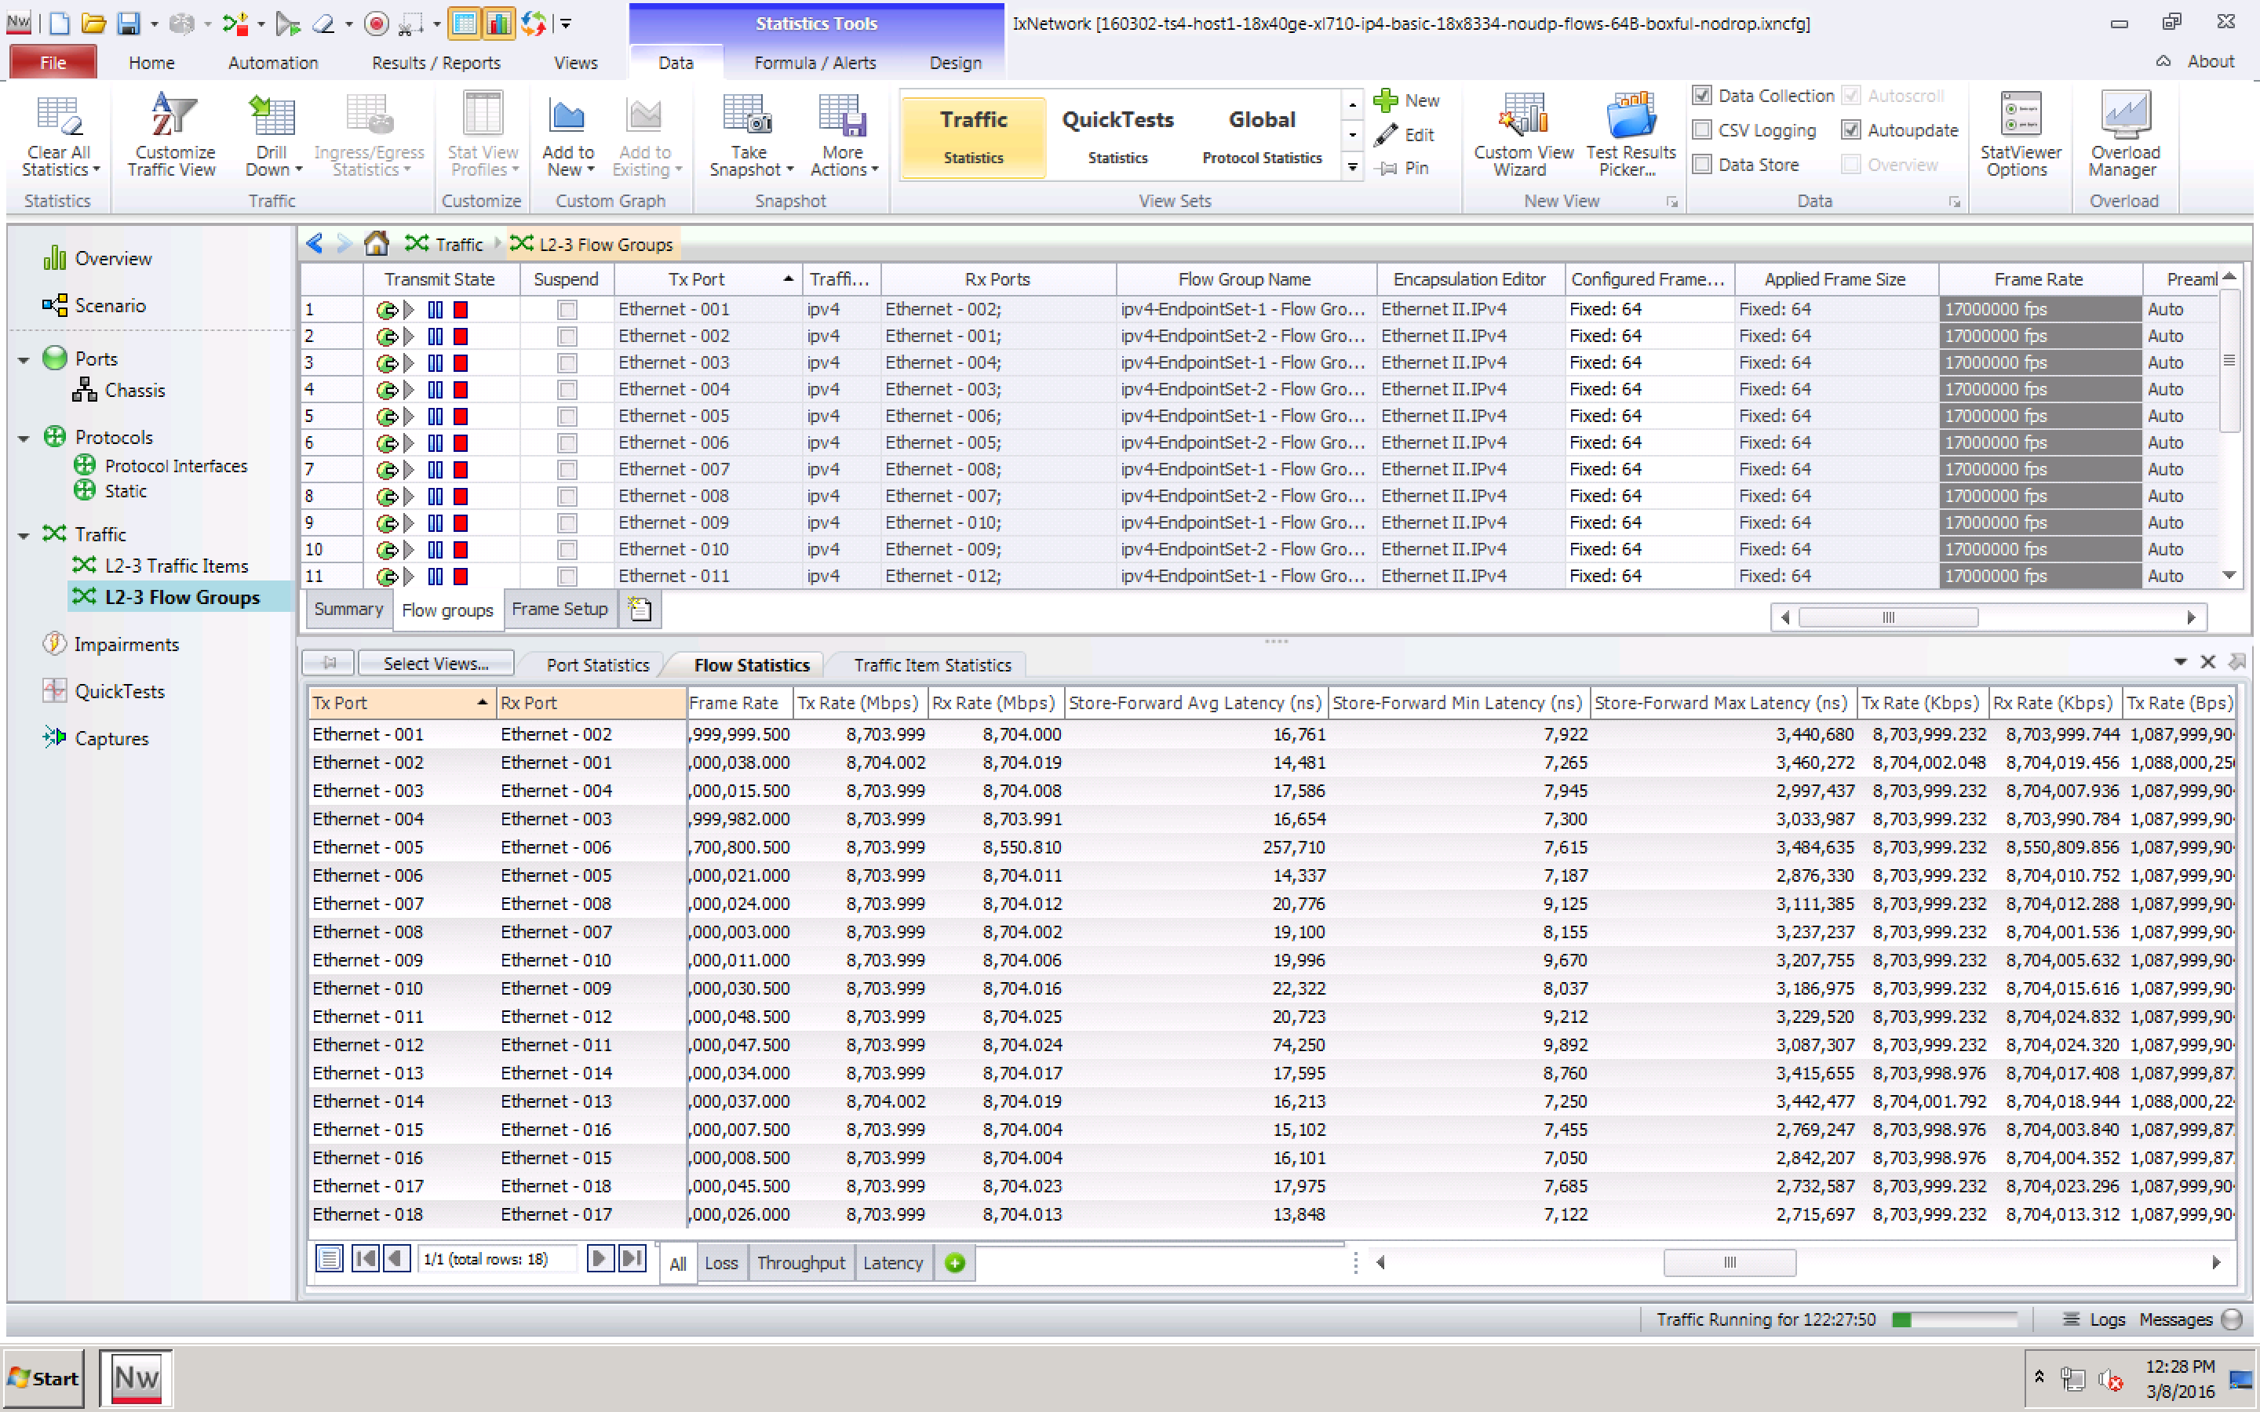
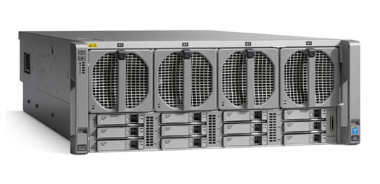
ONE MORE THING – THE LONG TERM MAX DELAY
The Fast Data Project (FD.io)
Low long-term max packet delay with FD.io VPP
>>120 msec long-term max packet delay measured by others for other vSwitches
But it is just not not there with VPP and stock Ubuntu 14.04 (no Linux tuning!)
The Soak Test Proof:
18 x 7.7trillion packets forwarded.
Max Packet Delay <3.5 msec incl. the outliers!!
Min Packet Delay 7..10 usec, Avg Packet Delay <23 usec.
Compute Node Software | Version
Host Operating System | Ubuntu 14.04.3 LTS Kernel version: 3.13.0-63-generic
DPDK | DPDK 2.2.0
FD.io VPP | vpp v1.0.0-174~g57a90e5
Compute Node Hardware | Cisco UCS C460 M4
Chipset | Intel® C610 series chipset
CPU | 4 x Intel® Xeon® Processor E7-8890 v3 (18 cores, 2.5GHz, 45MB Cache)
Memory | 2133 MHz, 512 GB Total
NICs | 9 x 2p40GE Intel XL710 18 x 40GE = 720GE !!
Avg
Delay
Min
Delay
Max
Delay

Slide 23
Implementation Example: VPP as a vRouter/vSwitch
Out of the box vSwitch/vRouter
  Including CLI
Switching
  Can Create
  Bridge Domains
  Ports (including tunnel ports)
  Connect ports to bridge domains
  Program ARP termination
  etc
Routing
  Can Create
  VRFs - thousands
  Routes - millions
Linux Host
VPP App
Switch-1
VRF-1
Switch-2
VRF-2
DPDK
Kernel

Slide 24
VPP vRouter/vSwitch: Local Programmability
Low Level API
  Complete
  Feature Rich
  High Performance
    Example: 900k routes/s
  Shared memory/message queue
  Box local
  All CLI tasks can be done via API
Generated Low Level Bindings - existing today
  C clients
  Java clients
  Others can be done
Linux Host
External App
VPP App
DPDK
Kernel

Slide 25
VPP vRouter/vSwitch: Remote Programmability
High Level API: An approach
  Data Plane Management Agent
  Speaks low level API to VPP
  Box (or VM or container) local
  Exposes higher level API via some binding
Flexibility:
  VPP does not force a particular Data Plane Management Agent
  VPP does not force only *one* High Level API
  Anybody can bring a Data Plane Management Agent
  High Level API/Data Plane Management Agent
  Match VPP app needs
netconf/yang
REST
Other (BGP)
Linux Host
Data Plane Management Agent
VPP App
DPDK
Kernel

Slide 26
Honeycomb

Slide 27
Fd.io Projects
Legend:
- New Projects
- Core Projects
Dataplane Management Agents
Honeycomb
Packet Processing
Testing/Performance
NSH_SFC
ONE
VPP Sandbox
TLDK
VPP
CSIT
Network IO

Slide 28
Honeycomb Data Plane Management Agent
High Level API: An Approach
  Yang Models via netconf/restconf
  Box local ODL instance (Honeycomb) using low level API over generated Java Bindings to talk to VPP App, and exposing yang models over netconf/restconf NB
  Initial example: Bridge Domains
netconf/yang
REST
Other (BGP)
Linux Host
ODL Honeycomb Agent
VPP App
DPDK
Kernel

Slide 29
ONE:
Overlay Network Engine

Slide 30
Fd.io Projects
Legend:
- New Projects
- Core Projects
Dataplane Management Agents
Honeycomb
Packet Processing
Testing/Performance
NSH_SFC
ONE
VPP Sandbox
TLDK
VPP
CSIT
Network IO

Slide 31


Overlay Control Plane
Mapping System
VPP
VPP
overlay
underlay
overlay

Slide 32
Mapping System
Retrieve destination
mapping
VPP
VPP

Slide 33
Map-Cache
Mapping System
b->B
c->{D, E}
[a, f]->G
VPP
VPP
B
b

Slide 34
Mapping System
VPP
VPP
Encapsulate and forward packets over underlay

Slide 35
Mapping System
VPP
VPP
Use multiple paths if possible

Slide 36
Mapping System
VPP
VPP
Decap and forward to destination

Slide 37
SDN Controller
Mapping System
Reprogram forwarding
VPP

Slide 38
NSH SFC

Slide 39
Fd.io Projects
Legend:
- New Projects
- Core Projects
Dataplane Management Agents
Honeycomb
Packet Processing
Testing/Performance
NSH_SFC
ONE
VPP Sandbox
TLDK
VPP
CSIT
Network IO

Slide 40
NSH_SFC project in SFC Architecture
NSH_SFC is a VPP plugin
  NSH encap/decap
  NSH forwarding
  NSH proxy
Available roles:
    VPP+NSH_SFC for classifier
  SFF
  VPP+NSH_SFC as SF framework
Service Chaining Orchestration
Control Plane
Policy Plane
VPP
VPP
SF
(Physical)
SF
(VM)
SF
(Physical)
SF
(VM)
Service
Service
Service
Service
(v)switch
Service Header
(v)switch
Service^{1 VLAN}
VPP
Service^{1 VLAN}
VPP
Service Function Forwarder (SFF)
Service Function Forwarder (SFF)
VPP
VPP
Network Overlay + Service Header
Service Classifier
Forwarding
Forwarding
Service Classifier

Slide 41
TLDK:
Transport Layer Development Kit

Slide 42
TLDK: Host Stack
Linux Host
TLDK has just started
  Building transport layer libraries
    TCP/UDP/etc
  Building VPP plugin to provide user space host stack
  Building Netlink Agent+LDPRELOAD
    Allows Linux Process to use userspace hoststack instead of kernel host stack without modifying the app
  Any process or group of processes could get their own v6 address
  Bypass Kernel Network Stack
Linux Process 1
Linux Process 2
Linux Process 3
Userspace interface 1
Userspace interface 2
NetlinkAgent+LDPRELOAD
VPP
Host Stack Plugin
DPDK
Kernel

Slide 43
CSIT:
Continuous System & Integration Testing

Slide 44
Fd.io Projects
Legend:
- New Projects
- Core Projects
Dataplane Management Agents
Honeycomb
Packet Processing
Testing/Performance
NSH_SFC
ONE
VPP Sandbox
TLDK
VPP
CSIT
Network IO

Slide 45

FD.io Continuous Performance Lab a.k.a. The CSIT Project (Continuous System Integration and Testing)
Submit Patch
Automated Testing
Deploy
Develop
What it is all about – CSIT aspirations
  FD.io VPP benchmarking
    VPP functionality per specifications (RFCs¹)
    VPP performance and efficiency (PPS², CPP³) – Throughput Non-Drop Rate (Bandwidth, PPS), Delay
      Network Data plane, Network Control Plane, Management Plane Interactions (memory leaks!)
    Performance baseline references for HW + SW stack (PPS², CPP³)
    Range of deterministic operation for HW + SW stack (SLA⁴)
  Provide testing platform and tools to FD.io VPP dev and usr community
    Automated functional and performance tests
    Automated telemetry feedback with conformance, performance and efficiency metrics
  Help to drive good practice and engineering discipline into FD.io VPP dev community
    Drive innovative optimizations into the source code – verify they work
    Enable innovative functional, performance and efficiency additions & extensions
    Make progress faster
    Prevent unnecessary code “harm”
Legend:
¹ RFC – Request For Comments – IETF Specs basically
² PPS – Packets Per Second
³ CPP – Cycles Per Packet (metric of packet processing efficiency)
⁴ SLA – Service Level Agreement

Slide 46
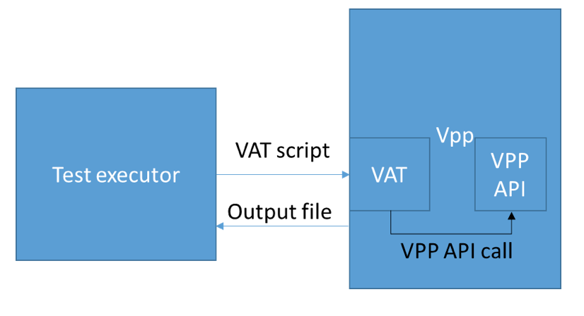
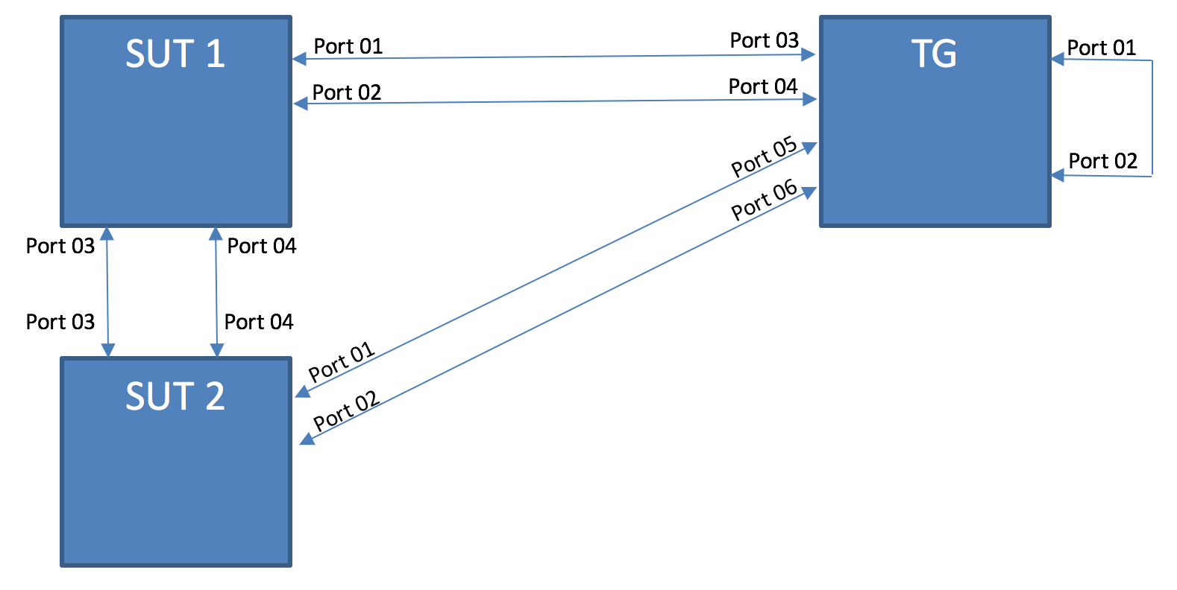
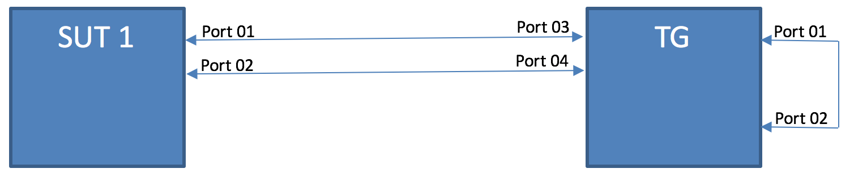
CSIT Platform System Design in a Nutshell

Slide 47
Broader Ecosystem

Slide 48
OpenDaylight Virtual Bridge Domain
Working on installer changes needed to add ODL & VPP as the networking stack for Openstack
Provides a programmable interface to include ‘edge’ network programming into a virtual environment
Allows for multiple data plane forwarders to be active
Integration happening in OpNFV “Fast Data Stacks” project
Control Plane
VBD app
HC
Data Plane
OVS
VPP

Slide 49
OpNFV FDS: Integrating OpenStack/ODL/fdio
Working on installer changes needed to add ODL & VPP as the networking stack for Openstack
Provides a programmable interface to include ‘edge’ network programming into a virtual environment
Allows for multiple data plane forwarders to be active
Integration happening in OpNFV “Fast Data Stacks” project
Openstack
Neutron
ODL
Plugin
Control Plane
HC
Data Plane
OVS
VPP

Slide 50
Next Steps – Get Involved
We invite you to Participate in fd.io
Get the Code, Build the Code, Run the Code
Read/Watch the Tutorials
Join the Mailing Lists
Join the IRC Channels
Explore the wiki
Join fd.io as a member

