Slide 1
Fd.io DPDK vSwitch
mini-summit
Discussion of vSwitches, VSwitch requirements and how this fits into the cloud
Christopher Price (Ericsson), Mark D Gray (Intel), Thomas F Herbert (Red Hat)

Slide 2
Chris Price -- Introduction
Mark D. Gray vSwitch Requirements
Thomas F. Herbert -- OVS and fd.io

Slide 3
Fd.io why another vswitch?

Slide 4
Other vswitches
Competition is good, so it’s good we have an alternative to OVS right?
http://www.openswitch.net/
http://www.opendataplane.org/
http://www.projectfloodlight.org/indigo/
https://opennetlinux.org
https://azure.github.io/SONiC/
…

Slide 5
So… Let’s start another one!
But Why?
The best in breed vSwitches:
Already have fast-path processing
Already have advanced classification
Already have multithreading
Are monolithic purpose built…
Have sequential packet pipelines...
Are feature constrained...

Slide 6
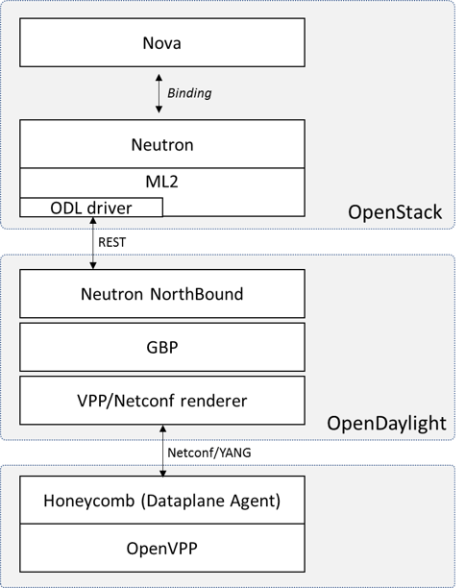
Comes integrated in opnfv
FDS – fast data stacks
Delivers an integrated openstack deployment using fd.io
Provides an “in context” apples to apples comparison with other solutions
Establishes a VNFi platform for advanced VPP application development and deployment
Available in the Colorado release this Autumn
https://wiki.opnfv.org/display/fds

Slide 7
Other requirements
multiqueue vhost
Performance
vhost reconnect
Stateful ACL
Tunnelling
SFC/NSH
OTHERS?
Service Assurance
Notes:
Openstack, the cloud and NFV impose a number of requirements on virtual switches used in the NFVI

Slide 8
Other requirements
multiqueue vhost
Performance
vhost reconnect
Stateful ACL
Tunnelling
SFC/NSH
OTHERS?
Service Assurance
Notes:
Openstack, the cloud and NFV impose a number of requirements on virtual switches used in the NFVI

Slide 9
Service Function Chaining
Service Path 1
Client
A
SF A
SF B
Server A
SFC
Client
B
SF C
SF D
Server B
Notes:
Service Function Chaining provides the ability to define an ordered list of a network services (e.g. firewalls, NAT, QoS). These service are then "stitched" together in the network to create a service chain.

Slide 10
Service Function Chaining
Service Path 2
Client
A
SF A
SF B
Server A
SFC
Client
B
SF C
SF D
Server B

Slide 11
Service Function Chaining
Service Path 3
Client
A
SF A
SF B
Server A
SFC
Client
B
SF C
SF D
Server B

Slide 12
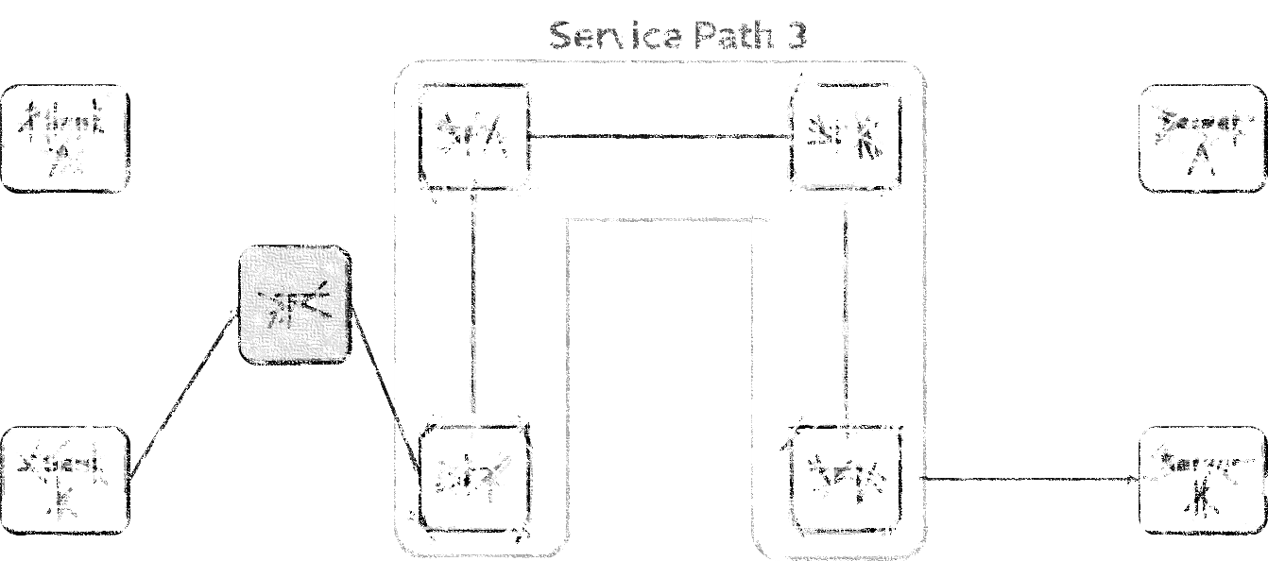
Network Service Header (NSH)
Header Format
Reduces lookup cost by avoiding costly classifications
Requires transport protocol
VxLAN-GPE
Ethernet
May require tunnel termination inside the virtual machine
Can provide a mechanism to share of metadata between service functions using “Type 2 metadata “
SF A
SF B
Inner Frame
Inner Frame
NSH
NSH
VxLAN-GPE
VxLAN-GPE
SFF/Virtual Switch
Notes:
NSH is a header that can be inserted into packets to realise service function paths.

Slide 13
Stateful ACL
VM Instance
Security groups and security group rules allows administrators and tenants the ability to specify the type of traffic and direction (ingress/egress) that is allowed to pass through a port.
Security groups require stateful ACLs which allow related flows for allowed flows
Security Group
direction = ingress
protocol = tcp
remote ip = 1.2.3.4
remote port = 80
PORT
Allow Flow
protocol = tcp
dest IP = 1.2.3.4
dest port = 80
source IP = 5.5.5.5
source port = 12345
Allow
Related Flow
protocol = tcp
dest IP = 5.5.5.5
dest port = 12345
source IP = 1.2.3.4
source port = 80
Network
Notes:
Stateful classification is required in order to implement security groups

Slide 14
Multiqueue Vhost
VM
vNic
Q0
Q1
Q2
Q3
Rx
Tx
Rx
Tx
Rx
Tx
Rx
Tx
Guest
Improves the throughput into virtual machines by providing way to scale out performance when using vhost ports.
vSwitch
PMD 0
PMD 1
PMD 2
PMD 3
Host
NIC
Hardware
Q0
Q1
Q2
Q3
Rx
Tx
Rx
Tx
Rx
Tx
Rx
Tx
Notes:
Multiqueue vhost is required in order to get better performance into a virtual machine

Slide 15
Vhost reconnect
Qemu
vNic
Guest
OS
Rx
Tx
Reconnect
vSwitch
Unix Domain Socket
vHost
User
Ensures virtual machine network connectivity is maintained even across restarts of the virtual switch.
Notes:
Connectivity between VM and Vswitch must be maintained between reboots of the virtual machine and the vswitch.

Slide 16
Network Service Assurance
Qemu
Guest Operating System
Provide differentiated classes of service for high priority dataflows ensuring end-to-end Quality of Service SLAs are met. One example shown here.
Performance monitoring at the network level.
Reactive and Proactive responses to faults
Application
vNic
vNic
Q
vSwitch
Classify
High Priority Traffic (e.g. voice)
Low Priority
Traffic (e.g. bulk
data transfer)
Q

Slide 17
Open vSwitch dataplane FD.IO/VPP
Open Flow Protocol matches and actions
Fast Path -- Linux Kernel Module
or
Accelerated
Fast Path Exact Match Cache -- Fastest
About 8K matches using linear search
Misses go to Slower MiniFlow Match -- Slower
Misses go to OFP Match Slowest
VPP fd.io
Graph based vector Processing Engine
Extensible via plugins
Includes complete IPv4 and IPv6 stack
Uses DPDK as packet engine
Being extended for vxLAN VTEP
DPDK

Slide 18
Open vSwitch control plane differences FD.IO/VPP
Management via OFP and OVSDB
Management via Netconf/REST ODL Honecomb Agent
Based on Open Flow
System of matches and tables with actions
Supports common packet header fields
Actions
Change fields with some pushes and pops
Generally ODL/Netvirt/OVSDB
Open Stack - Neutron
VPP Plugin API
Restconf
ODL HoneyComb Agent
NetConf
Open Stack Neutron ML2

Slide 19
OVS and FD.IO similarities
DPDK based
Both are virtualized switch fabrics
Implemented in Software on Commodity Processors
Deployable in Compute node
Host to VM uses vhost-user
Container Support is through kernel via TAP

Slide 20
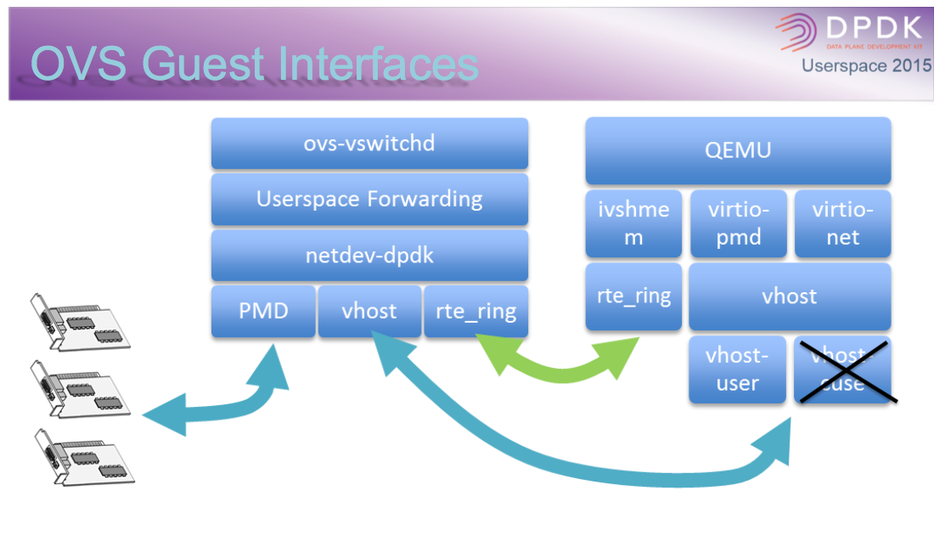
Open vSwitch Architecture
DPDK User Space Summit 2015 Dublin

Slide 21
Open vSwitch Architecture
DPDK User Space Summit 2015 Dublin

Slide 22
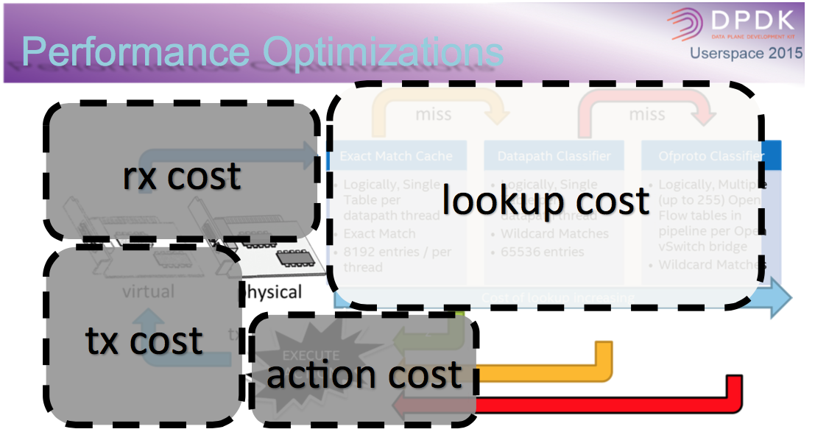
Open vSwitch Architecture
DPDK User Space Summit 2015 Dublin

Slide 23
How VPP Works
Packet Vector is Input to DPDK
Nodes on Graph Pipeline Process Packets According to Registered Dependencies
Additional Plugins can be Introduced to Create New Nodes
Examples of Plugins
NSH and VTEP
Parallelism -- determism in throughput and latency.

Slide 24
Backup

Slide 25
What does Fd.io offer?
IPv4/IPv6
IPv4
L2
14+ MPPS, single core
Multimillion entry FIBs
Source RPF
Thousands of VRFs
Controlled cross-VRF lookups
Multipath – ECMP and Unequal Cost
Multiple million Classifiers –
Arbitrary N-tuple
VLAN Support – Single/Double tag
Counters for everything
Mandatory Input Checks:
TTL expiration
header checksum
L2 length < IP length
ARP resolution/snooping
ARP proxy
GRE, MPLS-GRE, NSH-GRE,
VXLAN
IPSEC
DHCP client/proxy
CG NAT
VLAN Support
Single/ Double tag
L2 forwarding with EFP/BridgeDomain concepts
VTR – push/pop/Translate (1:1,1:2, 2:1,2:2)
Mac Learning – default limit of 50k addresses
Bridging – Split-horizon group support/EFP Filtering
Proxy Arp
Arp termination
IRB – BVI Support with RouterMac assignment
Flooding
Input ACLs
Interface cross-connect
IPv6
Neighbor discovery
Router Advertisement
DHCPv6 Proxy
L2TPv3
Segment Routing
MAP/LW46 – IPv4aas
iOAM
MPLS
MPLS-o-Ethernet –
Deep label stacks supported

Slide 26
What does fd.io offer?
Packet vector
Modularity
…
Plugins == Subprojects
Plugins can:
Introduce new graph nodes
Rearrange packet processing graph
Can be built independently of VPP source tree
Can be added at runtime (drop into plugin directory)
All in user space
Enabling:
Ability to take advantage of diverse hardware when present
Support for multiple processor architectures (x86, ARM, PPC)
Few dependencies on the OS (clib) allowing easier ports to other Oses/Env
ethernet-input
Plug-in to enable new HW input Nodes
mpls-ethernet-input
ip4input
llc-input
ip6-input
arp-input
…
ip6-lookup
Plug-in to create new nodes
ip6-rewrite-transmit
ip6-local
Custom-A
Custom-B

Slide 27
Continuous performance lab
Develop
Deploy
Submit Patch
Continuous Functional Testing
VM based virtual testbeds (3-node/3-VM topologies)
Continuous verification of feature conformance
Highly parallel test execution
Membership dues can donate VMs …. to the CPL
Continuous Benchmark Testing
Server based hardware testbeds (3-node/3-server topologies)
Continuous integration process with real hardware verification
Server models, CPU models, NIC models
Platinum Members can donate hardware to the CPL
Automated Testing

Slide 28
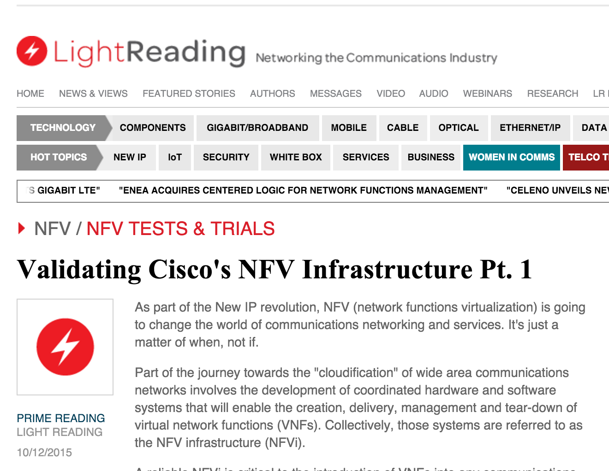
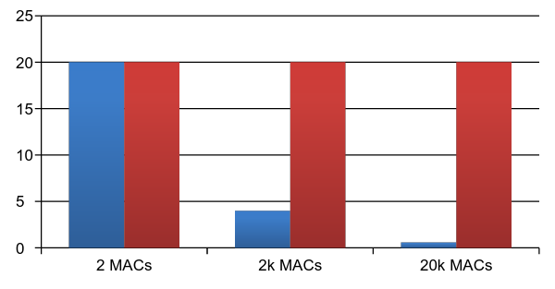
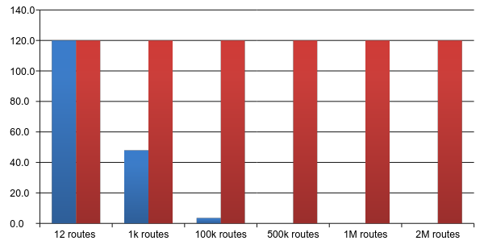
Looks pretty good!
NDR rates for 2p10GE, 1 core, L2 NIC-to-NIC
[IMIX Gbps]
NDR rates for 12 port 10GE, 12 cores, IPv4
[IMIX Gbps]
VPP technology in a nutshell
VPP data plane throughput not impacted by large FIB size
OVSDPDK data plane throughput heavily impacted by FIB size
VPP and OVSDPDK tested on Haswell x86 platform with E5-2698v3 2x16C 2.3GHz (Ubuntu 14.04 trusty)
not tested

Slide 29
Not just another vswitch
fd.io Charter
Create a Platform that enables Data Plane Services that are:
Highly performant
Modular and extensible
Open source
Interoperable
Multi-Vendor
Platform fosters innovation and synergistic interoperability between Data Plane Services
Source of Continuous Integration resources for Data Plane services based on the Consortium’s project/subprojects
Meet the functionality needs of developers, deployers, datacenter operators
VPP is a rapid packet processing development platform for highly performing network applications.
Bare Metal/VM/Container
Data Plane Management Agent
Packet Processing
Network IO

