Slide 1
memif - shared memory packet interface for container networking
FastData.io – VPP
Damjan Marion, lf-id/iirc: damarion, damarion@cisco.com
Maciek Konstantynowicz, lf-id/iirc: mackonstan, mkonstan@cisco.com

Slide 2
Agenda
Context
  SDN/NFV Evolution
  Bare-metal performance limits
  Moving “virtualization” to native
Memif
  Motivation
  Security
  Control channel
  Share memory layout
  Connection lifecycle
Performance

Slide 3
SDN NFV Evolution to Cloud-native
Moving on from VMs to Pods/Containers
  Network function workloads moving from VMs to Containers
    Native code execution on compute nodes, much less execution overhead
    Lighter workloads, many more of them, much more dynamic environment
Orchestration moving from OpenStack VMs to K8s Pods/Containers
  Pod/Container networking being addressed: Multus, Ligato, “Network Services Mesh”
Pressing need for optimized user-mode packet virtual interface
  Equivalent of “virtio-vhostuser” for Containers, but much faster
  Must be compatible with Container orchestration stack
  Opportunity to do it right!
Should allow us to get closer to the native bare-metal limits ..

Slide 4


Baremetal Data Plane Performance Limit
FD.io benefits from increased Processor I/O
YESTERDAY
PCle Packet Forwarding Rate [Gbps]
TODAY
1,120*
Gbps
Server
2x [2 Sockets]
+75%
640
Server
[2 Sockets]
+75%
560
320
Network I/O: 160 Gbps
Core ALU: 4-wide parallel µops
Memory: 4-channels 2400 MHz
Max power: 145W (TDP)
FD.io Takes Full Advantage of Faster Intel® Xeon® Scalable Processors
No Code Change Required
Network I/O: 280 Gbps
Core ALU: 5-wide parallel µops
Memory: 6-channels 2666 MHz
Max power: 205W (TDP)
1
1
2
Server
[1 Socket]
+75%
280
2
3
160
3
4
4
Intel® Xeon® E5-2699v4
22 Cores, 2.2 GHz, 55MB Cache
Intel® Xeon® Platinum 8168
24 Cores, 2.7 GHz, 33MB Cache
0 200 400 600 800 1000 1200
Intel® Xeon® v3, v4 Processors
Intel® Xeon® Platinum 8180 Processors
* On compute platforms with all PCIe lanes from the Processors routed to PCIe slots.
    https://goo.gl/UtbaHy
Breaking the Barrier of Software Defined Network Services
1 Terabit Services on a Single Intel® Xeon® Server !

Slide 5
Cloud-network Services within a Compute Node
Diving Deeper
Bare-metal
Virtual Machines
virtio
vhost
Moving “virtualization” to native compute node execution
Containers
Get closer to bare-metal speeds ..
memif
!

Slide 6
memif – Motivation
  Create packet based shared memory interface for user-mode application
  Be container friendly (no privileged containers needed)
  Support both polling and interrupt mode operation
    Interrupts simulated with linux eventfd infrastructure
    Support for interrupt masking in polling mode
  Support vpp-to-vpp, vpp-to-3rd-party and 3rd-party-to-3rd-party operation
  Support for multiple queues (incl. asymmetric configurations)
  Jumbo frames support (chained buffers)
  Take security seriously
  Multiple operation mode: ethernet, ip, punt/inject
  Lightweight library for apps - allows easy creation of applications which communicate over memif
It needs to be fast, but performance is not a number 1 priority.

Slide 7
memif – Security
  Point-to-point Master/Slave concept:
    Master - Never exposes memory to slave
    Slave - Responsible for allocation and sharing memory region(s) to Master
    Slave can decide if it will expose internal buffers to master or copy data into separate shared memory buffer
  Shared memory data structures (rings, descriptors) are pointer-free
  Interfaces are always point-to-point, between master-slave pair
  Shared memory is initialized on connect and freed on disconnect
  Interface is uniquely identified by unix socket filename and interface id pair
  There is optional shared secret support per interface
  Optionally master can get PID, UID, GID for each connection to socket listener
Memory copy is a MUST for security.

Slide 8
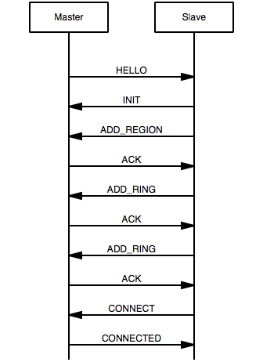
memif – Control Channel
  Implemented as Unix Socket connection (AF_UNIX)
  Master is socket listener (allows multiple connections on single listener)
  Slave connects to socket
  Communication is done with fixed size messages (128 bytes):
    HELLO (m2s): announce info about Master
    INIT (s2m): starts interface initialization
    ADD_REGION (s2m): shares memory region with master (FD passed in ancillary data)
    ADD_RING (s2m): shares ring information with master (size, offset in mem region, interrupt eventfd)
    CONNECT (s2m): request interface state to be changed to connected
    CONNECTED (m2s): notify slave that interface is connected
    DISCONNECT (m2s, s2m): disconnect interface
    ACK (m2s, s2m): Acknowledge

Slide 9
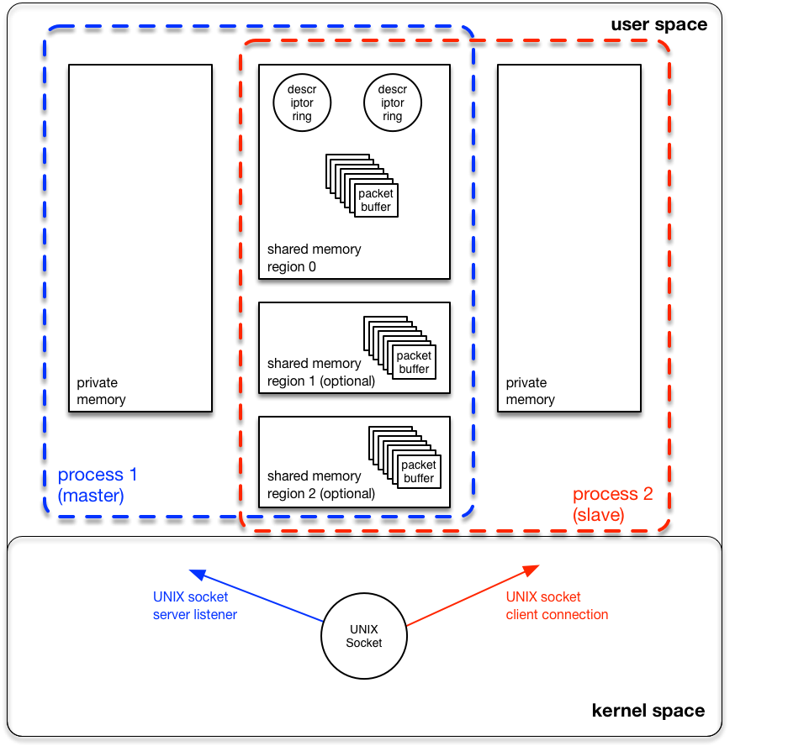
memif – Shared Memory layout

Slide 10
memif – Shared Memory layout
  Rings and buffers in shared memory are referenced with (region_index, offset) pair
    Much easier to deal with SEGFAULTS caused by eventual memory corruption
  Slave shares one or more memory regions with master by passing mmap() file descriptor and region size information (ADD_REGION message)
  Slave initializes rings and descriptors and shares their location (region_index, offset), size, direction and efd with master (ADD_RING) message
  Each ring contains header and array of buffer descriptors
    number of descriptors is always power-of-2 for performance reasons (1024 as default)
  Buffer descriptor is 16 byte data structure which contains:
    flags (2byte) – space for various flags, currently only used for buffer chaining
    region_index (2 byte) – memory region where buffer is located
    offset (4 bytes) – buffer start offset in particular memory region
    length (4 byte) – length of actual data in the buffer
    metadata (4 byte) – custom use space

Slide 11
Memif Performance – L2
memif
DUT
Note: packets are passing “vswitch, vrouter” DUT twice per direction, so the external throughput numbers reported in the table should be doubled to get per CPU core throughput.
* Maximum Receive Rate (MRR) Throughput - measured packet forwarding rate under the maximum load offered by traffic generator over a set trial duration, regardless of packet loss.
Hsw – Intel Xeon® Haswell, E5-2699v3, 2.3GHz, noHT. Results scaled up to 2.5GHz and HT eanbled.
Skx – Intel Xeon® Skylake, Platinum 8180, 2.5GHz, HT enabled.
TB – TurboBoost enabled.
noTB – TurboBoost disabled

Slide 12
Memif Performance – IPv4
memif
DUT
Note: packets are passing “vswitch, vrouter” DUT twice per direction, so the external throughput numbers reported in the table should be doubled to get per CPU core throughput.
* Maximum Receive Rate (MRR) Throughput - measured packet forwarding rate under the maximum load offered by traffic generator over a set trial duration, regardless of packet loss.
Hsw – Intel Xeon® Haswell, E5-2699v3, 2.3GHz, noHT. Results scaled up to 2.5GHz and HT eanbled.
Skx – Intel Xeon® Skylake, Platinum 8§80, 2.5GHz, HT enabled.
TB – TurboBoost enabled.
noTB – TurboBoost disabled

Slide 13
Summary
FD.io memif is a cleanslate virtual packet interface for containers
  Safe and Secure
  Zero memory copy on Slave side
  Optimized for performance (Mpps, Gbps, CPP* and IPC**)
Implementation in VPP shows good performance
  Getting closer to bare-metal limits..
Memif library for apps available
  Allows easy integration into cloud-native apps for communicating over memif
  Potential to become de facto standard based on adoption..
* CPP, Cycles Per Packet
** IPC, Instructions per Cycle

Slide 14
THANK YOU !

