Slide 1
High Speed Solutions in VPP to Accelerate Container Networking:
-Howto and Deep Dive
Tan,Jianfeng (jianfeng.tan@intel.com)
Xu,qian (qian.q.xu@intel.com)

Slide 2
Agenda
Motivations
Solutions introduction – what and howto
  SSVM, Vhost/virtio, Netmap pipes
Solutions comparison
  Performance
  Features…
Summary and next step

Slide 3
Motivations
Packet Vector
dpdk-input
Pkt-1
Pkt-2
…
Pkt-n
  Challenges in container networking
    High performance packet processing
    Linearly scalability
    Flexibility
  Discussions in VPP community
  VPP thread model
    Now, multi threads share the nodes graph
    How to run 3rd party plugins securely?
      Spread nodes into containers
ethernet-input
arp-input
Container
ip4-input
mpls-ethernet-input
ip6-input
Cross container IPC.
Container
Plugin Node

Slide 4




What’s SSVM
Shared memory
  SSVM: Structured Shared Virtual memory
    Specified for VPP project
    Shared memory based
Only one process
can get the lock
queue
Container1
(master)
Element
pool
Container2
(slave)

Slide 5

SSVM Ring Layout and Memory access (1)
This lock can be avoided!
Queue
Queue metadata
elt_idx_0
elts pool
elt
elt_idx_1
type
…
ssvm_elt_0
…
head
(tx side r, rx side w)
elt_idx_a
ssvm_elt_1
total_len
Metadata
(16 B)
…
…
cursize
(race)
len
elt_idx_b
ssvm_elt_i
next_idx
…
…
data
tail
(tx side r, rx side w)
elt_idx_c
ssvm_elt_m
(2048 + 128 B)
…
pad
elt_idx_n

Slide 6

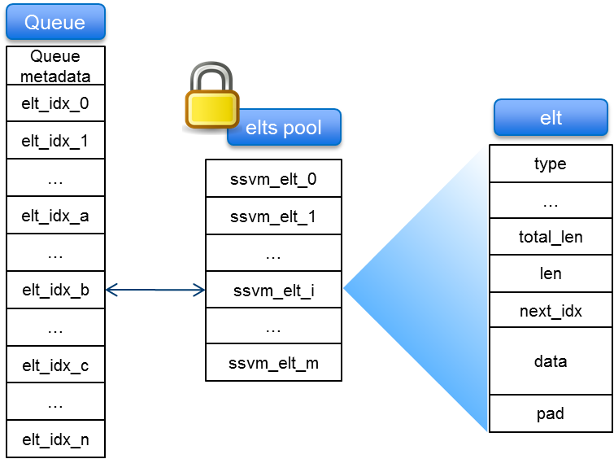
SSVM Ring Layout and Memory access (2)
  Tx
    SpinLock elt pool to get one elt
    Fill metadata of elt
    Copy data from clib_buf -> elt
    SpinLock Tx queue to set idx
  Rx
    SpinLock Rx queue to get idx
    Copy data from elt -> clib_buf
    Fill metadata of clib_buf
    SpinLock elt pool to return elt
Batching

Slide 7
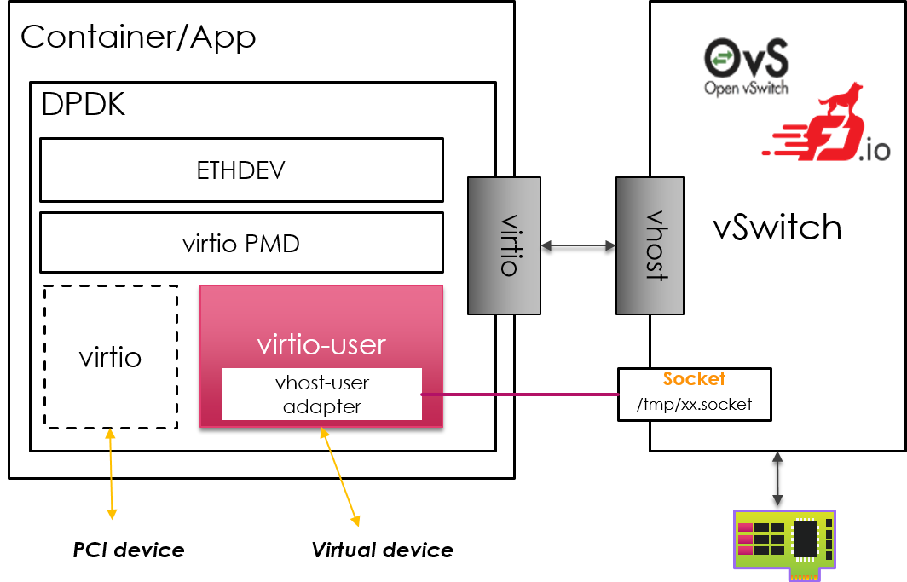
What’s Vhost/virtio-user
  As a DPDK virtual device
  Talk to backend by embedded adapter w/o device emulation
  Share PMD with virtio (PCI)
  Single consistent vhost PMD on the backend
  Frontend shares mem with backend

Slide 8
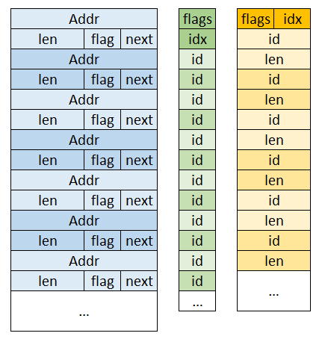
Vhost/Virtio Ring Layout and Memory Access
  Prepare at virtio side
    Prepare desc table entry
    update avail ring
  Tx at vhost side
    Get avail ring idx and entry
    Locate buf in desc table
    Copy data: vlib_buf (of vhost) -> vlib_buf (of virtio)
    Update used ring entry and idx
  Rx at virtio side
    Get used ring idx and entry
Batching

Slide 9
What’s Netmap pipes
  A framework for high speed packet I/O
    Netmap
    Netmap/VALE (switch)
    Netmap pipes (p2p communication)

Slide 10
Netmap Ring Layout and Memory access
  Tx
    Get some slots (tail -> head)
    Copy data: vlib_buf -> netmap_buf
    Update head, cur
    Syscall: tx_sync
  Rx
    Get some slots to consume
    Copy data: from netmap_buf -> vlib_buf
    Syscall: rx_sync
    Update head, cur
SWAP

Slide 11

An inaccurate summary

Slide 12
Performance: Test Setup
1. Create Docker images and run containers:
$ docker pull fedora
$ (For netmap, insert netmap kernel module)
$ docker run –v /dev/netmap:/dev/netmap … -v /dev/uio0:/dev/uio0 --privileged --cap-add SYS_ADMIN
$ docker run –v /dev/shm/ssvmtest1:/dev/shm/ssvmtest1 …
$ docker run –v /unix_sock_dir:/unix_sock_dir …
2. Start VPP instance in each container
$ vpp unix {…} ssvm_eth {…} dpdk {…} cpu {…} &
$ vpp unix {…} dpdk {… --extra “--vdev=eth_vhost0,path=…”} cpu {…} &
$ vpp unix {…} dpdk {… --extra “--vdev=virtio_user0,path=…”} cpu {…} &
3. Create devices
$ vppctl create netmap name vale00:vpp0 hw-addr 02:FE:3F:34:15:9B pipe master
4. Start the devices and send the traffic
$ set int state xxx up
$ set int ip address xxx [ip_addr]
$ set interface l2 xconnect xxx yyy
Patches not
upstreamed yet !!!

Slide 13
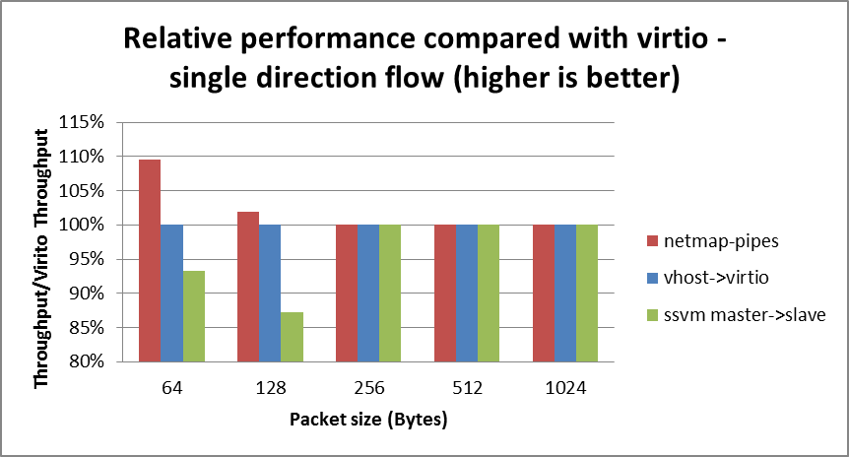
Performance
  No difference after pkt size >= 256
  For small pkts, there is room for improvement in ssvm and virtio
Ssvm is not stable.

Slide 14
Features
 | Offloading | Coupling | Compatibility (w/ container) | Notification/Lock
ssvm | N/A | High coupled with VPP | VPP app | Polling mode; spinlock
Vhost/virtio | TSO, checksum | Decoupled with VPP with Standard spec | DPDK app | Polling mode; lockless
Netmap pipes | N/A | Decoupled with VPP | Pcap app Netmap app | Syscall w/ POSIX poll; Lockless

Slide 15
Summary and next step
Summary
A survey on running VPP in containers
Analysis on ssvm, virtio_user and netmap pipes
Next step
Continue virtio evolution for containers
Support notification of virtio_user
Virtio 1.1, virtio 1.1, virtio 1.1
Bring best I/O engine for VPP

