Slide 1

F-Stack - a full user-space network service with DMM
Based on DPDK, FreeBSD TCP/IP stack
Hailong Wang

Slide 2
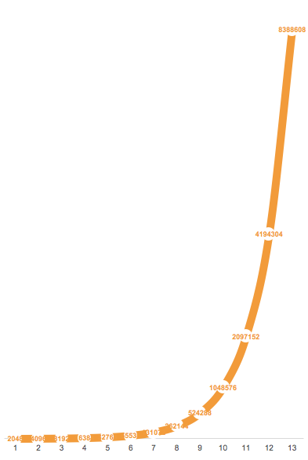
Explosive growth of data services
Challenges
service traffic:CDN,live streaming(RTMP),etc.
DDoS, CC
Solution
NIC: 25GbE→40GbE→100GbE
CPU: 24Cores→48Cores→56Cores
L2/L3: Kernel bapass(DPDK)
L4/L7: ？

Slide 3

The problem - Kernel
Thread0
Thread1
Thread2
Thread3
Thread4
Thread5
User space
Kernel space
CPU cores(NUMA)
NIC queues

Slide 4
The solution - Kernel Bypass
Kernel space
Process0
Process1
Process2
Process3
User space
Control plane
Data plane

Slide 5
What does F-Stack do？
APP
SDK
Posix-like API
FreeBSD TCP/IP stack
DPDK

Slide 6
The characteristics of F-Stack
Full user-space
No context switch
Zero copy
No hirqs and sirqs
Shared-nothing architecture
Linear scalability
No schedule
No lock
No cache locality miss
APP
……
……
SDK
……
……
Posix-like API
……
……
FreeBSD TCP/IP stack
……
……
DPDK
……
……

Slide 7
Why FreeBSD
Why full TCP/IP stack？
Advantageous functional, production ready stack.
Stable.
Network tools.
Why not Linux ?
Complicated logic.
GPL.

Slide 8
TCP/IP stack on Linux
read
recv
send
write
sock_recvmsg
sock_sendmsg
ip_output
tcp_sendmsg
tcp_recestablished
tcp_recvmsg
ip_finish_output
tcp_push
tcp_v4_recv
tcp_v4_do_recv
tcp_write_xmit
dev_queue_xmit
ip_local_deliver
ip_recv
tcp_transmit_skb
netif_rx
netif_recv_skb
ip_queue_xmit

Slide 9
TCP/IP stack on FreeBSD
read
readv
recvmsg
recvfrom
write
writev
soreceive
sendto
sendmsg
sosend
tcp_input
tcp_outpt
ip_input
ip_output
ether_demux
ether_input
ether_output

Slide 10
User space FreeBSD TCP/IP stack
timecounter
ticks
hz
timer
timecounter
ticks
hz
timer
kernel,irq threading
sched
wakeup
sleep
phymem
uma_page_slab
uma
kmem_malloc malloc
kernel,irq threading
sched
wakeup
sleep
phymem
uma_page_slab
uma
kmem_malloc malloc
mtx
rw
rm
sx
cond
remove & replace
hijack
replace
remove
mmap/malloc
(rte_mempool/rte_malloc)
rte_timer
ticks
timecounter
polling
empty macro
memory
clock
schedule
locks

Slide 11
Posix-like api and network tools
ff_init(argc, argv)
ff_socket
ff_read
ff_write
……
ff_kqueue
ff_kevent
ff_epoll_ctl
ff_epoll_wait
sysctl
ifconfig
route
ipfw
arp
top
etc..
ff_run(loop, arg);
F-Stack Lib

Slide 12
Application Cases
Load Balance
4 layer: ipfw/nat
7 layer: nginx
Web Server
epoll-based http server: httpdns
nginx: live streaming(rtmp).
WAF
nginx+lua/openresty
SCTP

Slide 13
Limitations
Multi-process architecture, not suitable for multi-thread.
Should modify the application's source code.
Can not be used for multiple apps
Not suitable for heavy logic.

Slide 14
Integrate with DMM
Plug-in interface
module init
Multiple deploy type
run-to-completion
pipe-line
F-Stack with DMM
more easier to use
more scenarios

Slide 15
F-Stack with DMM
app1
app2
app3
app..n
DMM socket compatible layer
F-Stack
dpdk-if-interface
freebsd-stack
freebsd-stack
stack1
stack.n
DMM hardware adapter layer

Slide 16
Resources
https://github.com/f-stack

Slide 17
Thanks!

