Slide 1
Get the best out of VPP and inter-VM communications.
Pierre Pfister

Slide 2
Taming the penguins !
Linux scheduler and CPU are your friends, except when they are not.
VPP
Qemu
VM
KVM
Linux
CPU
FD.io on top of Linux
Scheduler/CPU Jitter shall die !
Lossless virtual routing is possible !

Slide 3
The game we play today
Challenged by RedHat
1 worker CPU (2 threads)
Non-DPDK vhost driver
3 CPUs
VM
DPDK-testpmd
VPP
How many PPS on one core ?
Linux 4.4.0-generic
Qemu 2.7
2x10Gb Ethernet
Intel 82599ES 10-Gigabit SFI/SFP+
Intel E5-2643 v3 @ 3.40GHz
2 NUMA Nodes
6 CPUs per Node
2 Hyper-Thread per CPU
DPDK-pktgen

Slide 4
Disclaimer
Performance may differ on other setups.
Disable Intel’s processor turbo-boost
sudo wrmsr -p <cpu> 0x1a0 0x4000850089
I am using the Non-DPDK driver.
VPP Vhost is changing:
- VPP’s driver improvement
- DPDK’s driver might step-up and replace VPP’s

Slide 5
Vhost-User without CPU scheduler jitter elimination
Max throughput
Output = Input
Loss due to jitter
lossless
Note: Each packet is forwarded twice (PHY => VM & VM => PHY)

Slide 6
VPP CPU pinning
Vhost-user
Vhost-user
VPP
DPDK’s tools/cpu_layout.sh:
cores = [0, 1, 2, 3, 4, 5]
sockets = [0, 1]
Socket 0 Socket 1
-------- --------
Core 0 [0, 12] [6, 18]
Core 1 [1, 13] [7, 19]
Core 2 [2, 14] [8, 20]
Core 3 [3, 15] [9, 21]
Core 4 [4, 16] [10, 22]
Core 5 [5, 17] [11, 23]
lcore 2
lcore 14
core 0 (CLI…)
DPDK
DPDK
VPP cmdline:
cpu { corelist-workers 2,14 }
dpdk { dev 0000:84:00.0 { workers 0 } dev 0000:84:00.1 { workers 1 } }
Upcoming VPP hange will make vhost-user CPU pinning configurable at runtime.

Slide 7
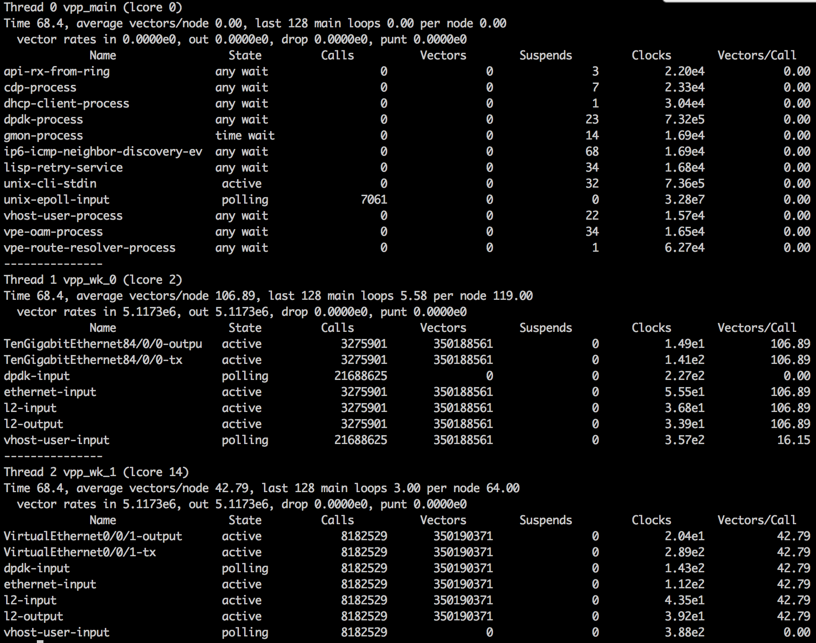
VPP CPU pinning
show runtime
Thread 0 (lcore 0)
Non-polling
CLI, API, …
Thread 1 (lcore 2)
RX on vhost
TX on DPDK PHY
Thread 2 (lcore 14)
RX on DPDK PHY
TX on vhost

Slide 8
VM CPU pinning – STEP 1
VM (testpmd) gets 3 CPUs (3, 4 & 5)
QEMU will use 3 cores: ‘-smp 3’
testpmd can cross-connect 20Mpps on single core.
chrt -r 1 taskset -c 3,4,5 qemu-system-x86_64 …
PIN Qemu to cores 3,4,5
Without this, the VM runs on a single core…
Without ‘chrt –r 1’
With ‘chrt –r 1’
(cpu #3 is VPP)

Slide 9
VM CPU pinning – STEP 2
When pinned to a set of CPUs,
Linux sometimes move processes around: e.g.
Once the VM is running:
rePIN each individual working VM process to individual CPU
Find working qemu threads (better way is welcome):
ps -eLf | grep qemu-system-x86_64 | awk '{ print $4" "$5; }’
26296 1
26297 0
26300 3
26301 94
26302 94
26304 0
[...]
These are our workers
sudo taskset -pc 3 26301
sudo taskset -pc 4 26302

Slide 10
Tick-Less Linux Kernel
https://www.kernel.org/doc/Documentation/timers/NO_HZ.txt
https://www.kernel.org/doc/Documentation/kernel-per-CPU-kthreads.txt
CPU 0 will get (almost) all interrupts
1. Kernel boot parameters
nohz_full=1-17
isolcpus=1-17
rcu_nocbs=1-17
No kernel interrupt
Only taskset & co. will assign a process to this core
Offload rcu callbacks
2. Disable IRQs on the CPUs we care about (Not all IRQs can be disabled)
for i in $(ls /proc/irq/ | grep [0-9]); do
echo 1 > /proc/irq/$i/smp_affinity ;
done
3. Disable watchdog (and other kthreads – but all cannot be)
echo "0,18-23" > /proc/sys/kernel/watchdog_cpumask
All this on both host and guest !

Slide 11
Scheduler and process priorities
Despite previous tricks. Scheduler jitter still causes packet loss.
chrt’s SCHED_RR (-r) and SHED_FIFO (-f) provide better real-time properties.
Do:
chrt -r -p 1 <pid>
For VPP and VM worker threads.

Slide 12
CPU jitter elimination: Lossless 5Mpps
Small Perf. Improvement
lossless
Grey (1) : Without jitter reduction
Red (2) : With jitter reduction
Note: Each packet is forwarded twice (PHY => VM & VM => PHY)

Slide 13
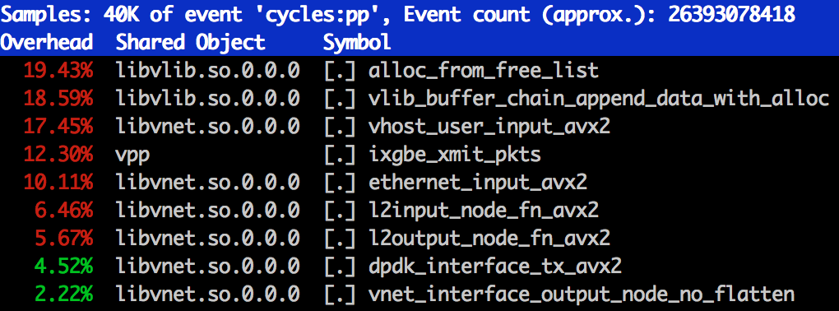
Troubleshooting
Hunt wild interrupts
cat /proc/interrupts
(developer) Troubleshoot software
perf top –C <core>
Hunt processes scheduled on your working cores
cat /proc/sched_debug (look for runnable tasks)

Slide 14
Unidirectional Vs Bidirectional traffic
lossless
Both with jitter optimization
Note: Each packet is forwarded twice (PHY => VM & VM => PHY)

Slide 15
VIRTIO 1.0 and Vhost-User
Feature negotiation (Vhost <–> Qemu <-> virtio)
- Depends on version
- Tells you what may happen, but not what will happen.
- Feels a bit like a ‘ménage à trois’ …
Virtio defines 3 ways to transmit buffers
vring
1
2
3
Chained descriptors
ptr
1
Indirect descriptors
2
3
1
Mergeable descriptors
2
3

Slide 16
Between VPP and DPDK’s testpmd
Hdr + Packet(76B)
indirect_desc=on
VPP
testpmd
ptr
Virtio net hdr (12B)
Uses a level of indirection.
Packet(64B)
Hdr + Packet(76B)
VPP
testpmd
indirect_desc=off
Uses twice as many descriptors
-> Only 128 packets fit in the queue.
Virtio net hdr (12B)
Packet(64B)
Hdr + Packet(76B)
What we would like…
VPP
testpmd
…but I couldn’t convince
Qemu and/or testpmd yet
Hdr + Packet(76B)

Slide 17
Negative impact of chained descriptors
Indirect Descriptors
Chained Descriptors
lossless
Both with jitter optimization
Note: Each packet is forwarded twice (PHY => VM & VM => PHY)

Slide 18
Virtio queue length
Qemu hard-codes virtio-net queue length to 256
Indirect descriptors: 256 packets
Chained descriptors: 128 or 256 (packet layout)
Mergeable desc. : 256 packets
Lossless at 5Mpps
256/5M = 51us max jitter
1024/5M = 204us max jitter

Slide 19
Impact of virtio queue size
256
1024
512
lossless
With jitter optimization
Note: Each packet is forwarded twice (PHY => VM & VM => PHY)

Slide 20
VPP’s vhost-user multi-queue support
Ready to merge (or merged already)
https://gerrit.fd.io/r/#/c/2922/

Slide 21
With 2 Queues (VPP on 2 CPUs – 4 hyperthreads)
The Goal
(2x single queue)
Zero Loss
Yet-to-be-explained
losses
lossless

Slide 22
Thank You !
All this and even better will be in VPP 17.01
Prepare a better future with virtio 1.1

Slide 23
Impact of chrt
lossless
Grey (1) : No Jitter elimintation
Green (3) : With jitter reduction but no chrt for VPP
Red (2) : With jitter reduction

