Slide 1
European FD.io event proposal

Slide 2
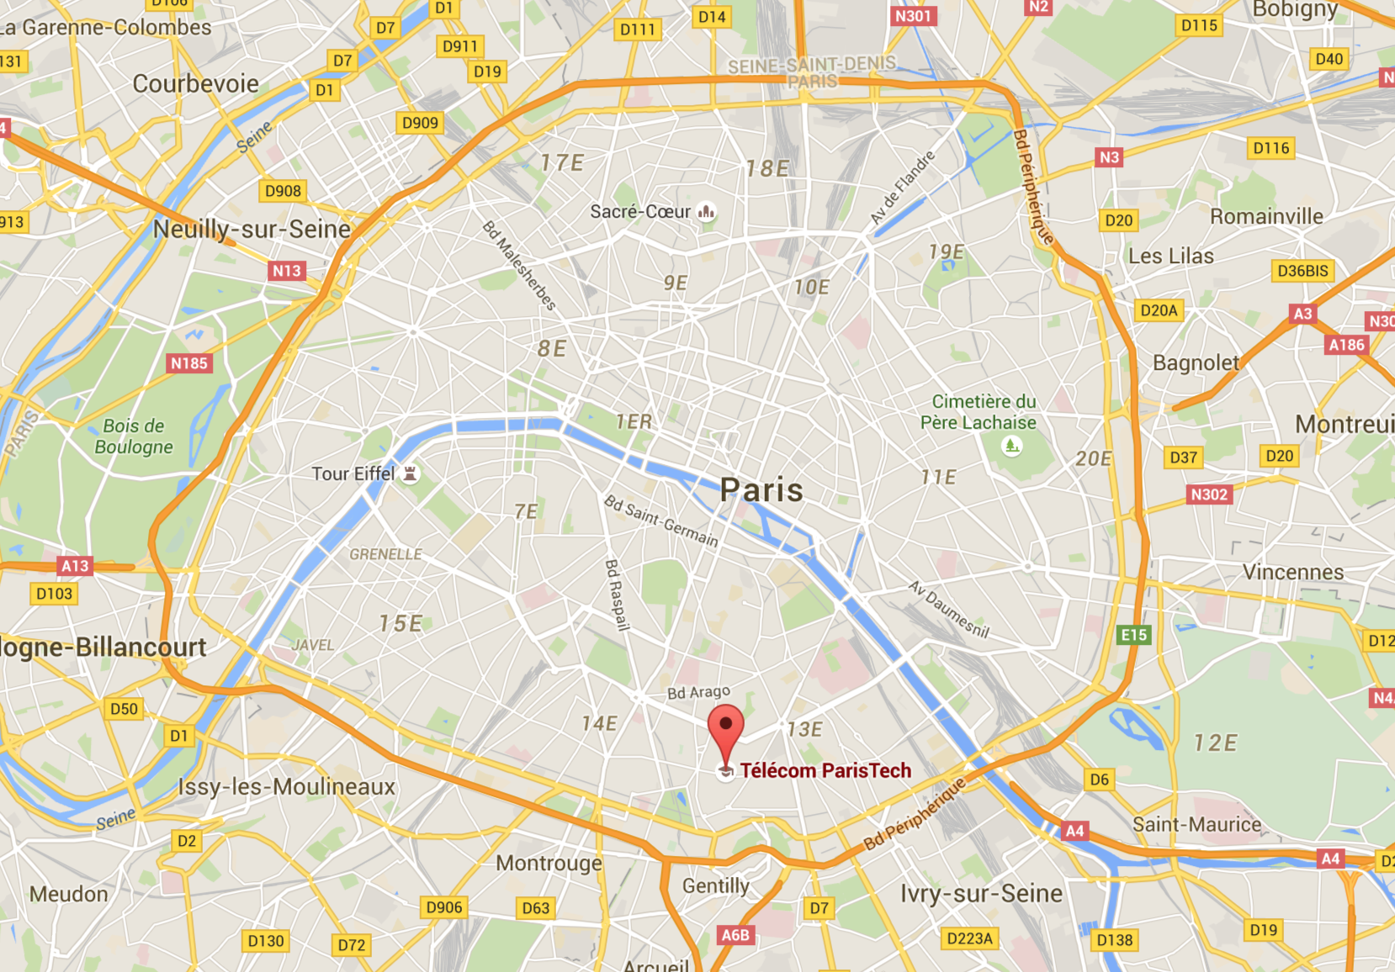
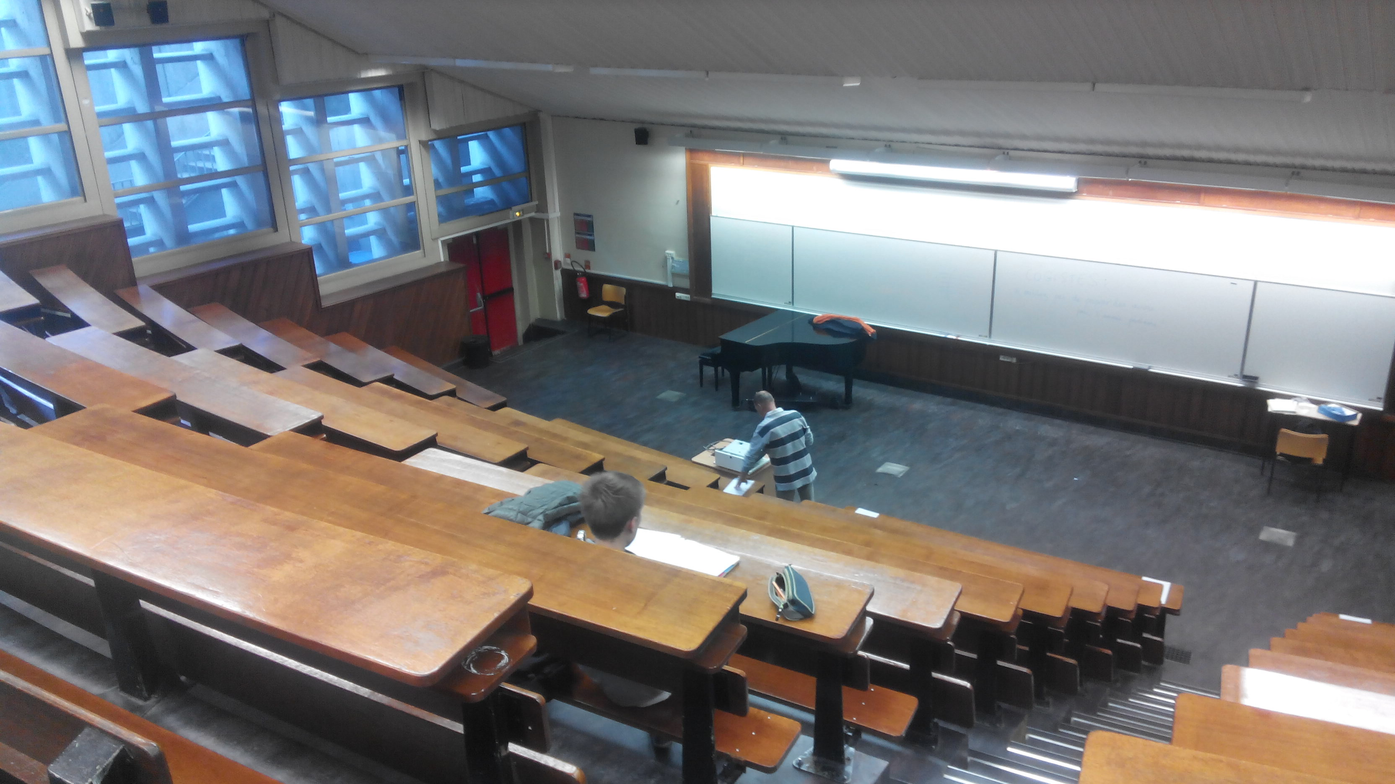
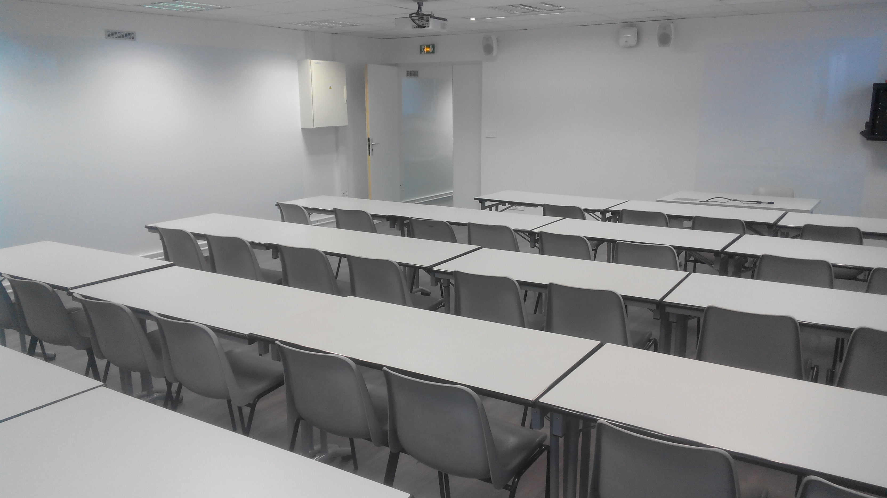
Date and Place
When: 4 days – From Tuesday 31st May to Friday 3rd June (morning only)
Where: École Télécom ParisTech – Center of Paris
Facilities:
Day 1 – 130p amphi
Day 2,3,4 – 2x30p adjacent rooms

Slide 3
Feedbacks
Emphasis that attendees should setup their environment -> Will have a pre-setup on Day 1
Deal with vagrant issues -> Plan B will be a pre-installed VM file.
Difficulties to follow hands-on sessions -> Step-by-step will be available online
Prepare better walkthrough presentation -> ‘More like Damjan’s presentation’
Architectural and Overview before deep-dive -> Will be progressive from day to day
…

Slide 4
Tentative Agenda
DAY 1:
Pre-Launch like
FD.io presentation
Governance
FD.io ecosystem
Highlevel VPP presentation
Performances highlights
FD.io business governance
FD.io tech. contribution mechanism
Vagrant install helpdesk session (prep. for day 2).
On site social event ?
DAY 2:
User experience
CLI, APIs, Doc, Packaging
Install party and basic hands-on
Memory Management and threading model
Macswap plugin and packet trace
VPP and OpenStack integration
Event Logger
DAY 3:
Code deep-dive
Source tree overview and building
Software Optimization
DPDK
Where to plug your code (IP Fib, L2/L3 features)
Macswap code walkthrough
Macswap CSIT
DAY 4:
Specific projects
MAP ?
LISP ?
Honeycomb demo ?
?
**Open to proposals**
Hackfest ?
Stops at 12:30PM
Feedback is welcome (But we may not satisfy everyone…)

Slide 5
Budget
The rooms are provided for free !
Catering (Breakfast + Lunch + Drinks)
On site social event end of Day 1 ?
Audio/Video setup
Post-event communication (Video Clip) ?
Free for attendees

Slide 6
Invite schedule
Wiki page to be created April 29th (tomorrow)
Subscribe link to be open April 29th (tomorrow)
Time to broadcast

