Slide 1
High Speed Solutions in VPP to Accelerate Container Networking: -Howto and Deep Dive
Tan,Jianfeng(Jianfeng.tan@intel.com)
Xu,qian(qian.q.xu@intel.com)

Slide 2
Agenda
Motivations
Solutions introduction – what and howto
SSVM
Vhost/virtio
Netmap pipes
Test setup and performance
Solutions comparison
Summary and next step

Slide 3
Motivations
Packet Vector
dpdk-input
Pkt-1
Pkt-2
…
Pkt-n
Challenges in container networking
High performance packet processing
Linearly scalability
Flexibility
VPP running model
Now, multi threads share the nodes graph
How to run 3rd party plugins securely?
Discussions in VPP community go on
ethernet-input
arp-input
ip4-input
mpls-ethernet-input
ip6-input
Container
Plugin Node

Slide 4
What’s SSVM
SSVM stands for Structured Shared Virtual memory, specified for VPP project.
Shared memory solution based on Linux IPC shared memory, master process first creates the shared memory and share with slave process. It uses spin-lock to ensure only one process write at the same time.

Slide 5
SSVM Ring Layout and Memory access
head
cursize
tail
elt_idx_0
elt_idx_1
…
elt_idx_a
…
elt_idx_b
…
elt_idx_c
…
elt_idx_n
type
ssvm_elt_0
…
ssvm_elt_1
total_len
Metadata
(16 Bytes)
…
len
ssvm_elt_i
next_idx
…
data
ssvm_elt
(2048 + 128 B)
pad

Slide 6
SSVM Ring Layout and Memory access
Memcpy times: same as netmap
Spin lock: element
Spin lock: queue index
Ring layout: Queue, elements 2
Indirect ndex, element
Similar as virtio

Slide 7
What’s Vhost/virtio-user
As a DPDK virtual device
Talk to backend by embedded adapter w/o device emulation
Share PMD with virtio (PCI)
Single consistent vhost PMD on the backend

Slide 8
Vhost/Virtio Ring Layout and Memory Access
Vhost → Virtio
Vhost enqueue + virtio RX
1 time for memcpy from vhost mem to virtio mem
6 times
Vhost 4times
Virtio 2times
Vhost avail ring Index, avail Ring entry, descriptor table, update used ring(4 cache misses)
Virtio used ring index, used ring entry(2 cache misses)

Slide 9
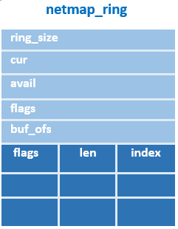
What’s Netmap pipes
Tiwei can help here.

Slide 10
Netmap Ring Layout and Memory access
buf_idx
Netmap website ring layout
2 memcpy for complete packet + 1 time for 16B copy no matter packet
RX ring:
1 times at RX side, 1 times at TX side
2 syscall, 256 packets per time
len
flags
ptr

Slide 11
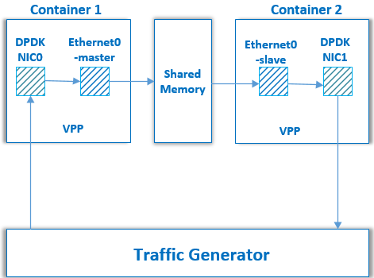
Test Setup
1. Create Docker images and run containers:
$ docker pull fedora
$ (For netmap, insert netmap kernel module)
$ docker run –v /dev/netmap:/dev/netmap … -v /dev/uio0:/dev/uio0 --privileged --cap-add SYS_ADMIN
$ docker run –v /dev/shm/ssvmtest1:/dev/shm/ssvmtest1 …
$ docker run –v /unix_sock_dir:/unix_sock_dir …
2. Install VPP packages for containers
3. Start VPP instance in each container
$ vpp unix {…} ssvm_eth {…} dpdk {…} cpu {…} &
$ vpp unix {…} dpdk {… --extra “--vdev=eth_vhost0,path=…”} cpu {…} &
$ vpp unix {…} dpdk {… --extra “--vdev=virtio_user0,path=…”} cpu {…} &
4. Create devices
$ vppctl create netmap name vale00:vpp0 hw-addr 02:FE:3F:34:15:9B pipe master
5. Start the devices and send the traffic
$ set int state xxx up
$ set int ip address xxx [ip_addr]
$ set interface l2 xconnect xxx yyy

Slide 12
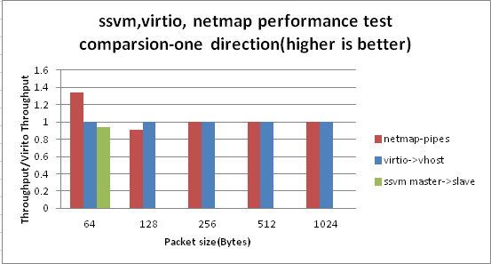
Performance Comparison

Slide 13
3 Solutions Comparison
 | Offloading | Coupling | Compatibility | Notification/Lock
ssvm | N/A | High coupled with VPP | VPP app | Polling mode; spinlock
Vhost/virtio | TSO, checksum | Decoupled with VPP with Standard spec | DPDK app | Polling mode; lockless
Netmap pipes | N/A | Decoupled with VPP | Pcap app Netmap app | Syscall w/ POSIX poll; Lockless

Slide 14
Summary and Next step
Summary
A survey on running VPP in containers
Analysis on ssvm, virtio_user and netmap pipes
Next step
Continue virtio evolution for containers
Support notification of virtio_user
Bring best I/O engine for VPP

