Slide 1
/csit
CSIT Readout to FD.io Board
08 February 2017
Maciek Konstantynowicz | Project Lead
FD.io CSIT Project

Slide 2
FD.io CSIT Readout
CSIT Background, Scope and Aspirations
Where We Got So Far
Where We Want to Drive It
Challenges
Agenda

Slide 3
FD.io Continuous Performance Lab (CPL)
Submit Patch
Automated Testing
Deploy
Develop
Fully automated testing infrastructure
Covers both programmability and data planes
Continuous verification of code/feature
Functionality and performance
Code breakage and performance degradations identified before patch review
Review, commit and release resource protected
Fully open sourced test framework to be included at launch
Slide from Linux Foundation FD.io Pre-Launch Event
Presented by DWard on 12th January 2016 In San Jose, CA, US.

Slide 4
CSIT⁽⁴⁾ Project Scope
Fully automated testing of LF⁽¹⁾ FD.io⁽²⁾ systems
FD.io VPP⁽³⁾ and related sub-systems (e.g. DPDK⁽⁵⁾ Testpmd⁽⁶⁾, Honeycomb⁽⁷⁾, ...)
Functionality, performance, regression and new functions.
Functionality tests - against functional specifications
VPP data plane, network control plane, management plane.
Performance tests - limits discovery and benchmark against established reference
VPP data plane packet throughput and latency with TRex⁽¹⁰⁾ traffic generator.
Network control plane, management plane.
Test definitions driven by FD.io VPP functionality, interfaces and performance
Uni-dimensional tests: data plane, network control plane, management plane.
Multi-dimensional tests: Use case driven.
Integration with LF VPP test execution environment
Performance tests execute in physical compute environment hosted by LF.
Functional tests execute in virtualized VM VIRL⁽⁹⁾ environment hosted by LF.
Integration with LF FD.io CI⁽⁸⁾ system including FD.io Gerrit and Jenkins
Test auto-execution triggered by VPP verify jobs, periodic CSIT jobs, and other FD.io jobs.
(1) LF - Linux Foundation.
(2) FD.io - Fast Data I/O - project in LF.
(3) VPP - Vector Packet Processing - sub-project in FD.io.
(4) CSIT – Continuous System Integration and Testing - sub-project in FD.io.
(5) DPDK - Data Plane Development Kit.
(6) Testpmd - DPDK example application for baseline DPDK testing.
(7) Honeycomb - Model-driven management agent for VPP - project in FD.io.
(8) CI - Continuous Integration.
(9) VIRL - Virtual Internet Routing Lab, SW platform donated by Cisco.
(10) TRex – SW-based packet traffic generator, LF FD.io project.

Slide 5
CSIT - Continuous System Integration and Testing
Project aspirations ..
FD.io VPP benchmarking
VPP functionality per specifications (RFCs¹)
VPP performance and efficiency (PPS², CPP³)
Network data plane - throughput Non-Drop Rate, bandwidth, PPS, packet delay
Network Control Plane, Management Plane Interactions (memory leaks!)
Performance baseline references for HW + SW stack (PPS², CPP³)
Range of deterministic operation for HW + SW stack (SLA⁴)
Provide testing platform and tools to FD.io VPP dev and usr community
Automated functional and performance tests
Automated telemetry feedback with conformance, performance and efficiency metrics
Help to drive good practice and engineering discipline into FD.io dev community
Drive innovative optimizations into the source code – verify they work
Enable innovative functional, performance and efficiency additions & extensions
Make progress faster
Prevent unnecessary code “harm”
Legend:
¹ RFC – Request For Comments – IETF Specs basically
² PPS – Packets Per Second
³ CPP – Cycles Per Packet (metric of packet processing efficiency)
⁴ SLA – Service Level Agreement

Slide 6
CSIT - Continuous System Integration and Testing
Project aspirations ..
FD.io VPP benchmarking
VPP functionality per specifications (RFCs¹)
VPP performance and efficiency (PPS², CPP³)
Network data plane - throughput Non-Drop Rate, bandwidth, PPS, packet delay
Network Control Plane, Management Plane Interactions (memory leaks!)
Performance baseline references for HW + SW stack (PPS², CPP³)
Range of deterministic operation for HW + SW stack (SLA⁴)
Provide testing platform and tools to FD.io VPP dev and usr community
Automated functional and performance tests
Automated telemetry feedback with conformance, performance and efficiency metrics
Help to drive good practice and engineering discipline into FD.io dev community
Drive innovative optimizations into the source code – verify they work
Enable innovative functional, performance and efficiency additions & extensions
Make progress faster
Prevent unnecessary code “harm”
Help to drive FD.io VPP community acceptance and usability.
Focus on use case requirements and deployments.
Drive towards a reference open-source NF benchmarking project.
Legend:
¹ RFC – Request For Comments – IETF Specs basically
² PPS – Packets Per Second
³ CPP – Cycles Per Packet (metric of packet processing efficiency)
⁴ SLA – Service Level Agreement

Slide 7
CSIT Project wiki
https://wiki.fd.io/view/CSIT

Slide 8
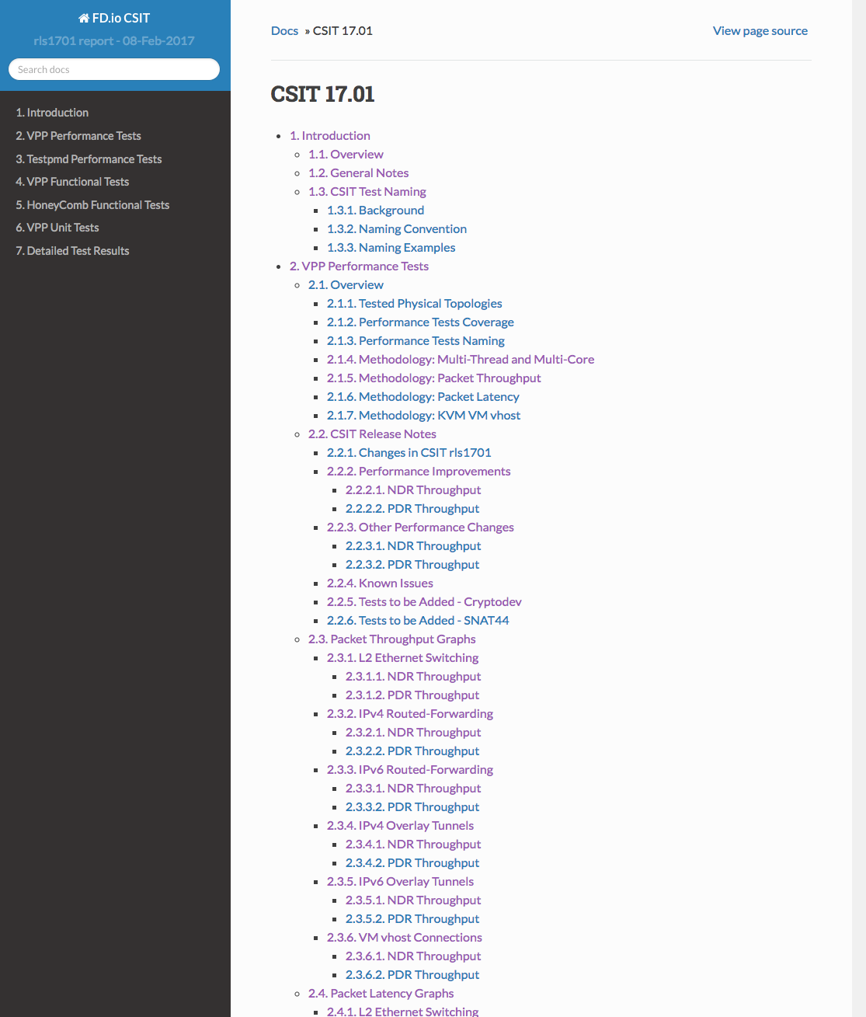
CSIT - Where We Got So Far …
CSIT rls1701 - CSIT latest report
https://docs.fd.io/csit/rls1701/report/
Content – browsable and dynamic
Performance results for FD.io VPP and DPDK Testpmd.
Functional results for FD.io VPP and Honeycomb.
Documents all environment and SUT+DUT settings for replicability and inspection.
Result graphs and tables auto-generated from FD.io jenkins test verify jobs.
Demonstrates functional reachness of FD.io VPP.

Slide 9
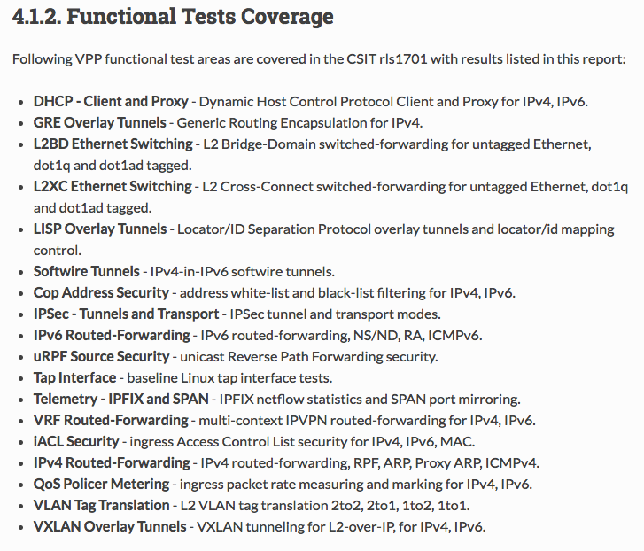
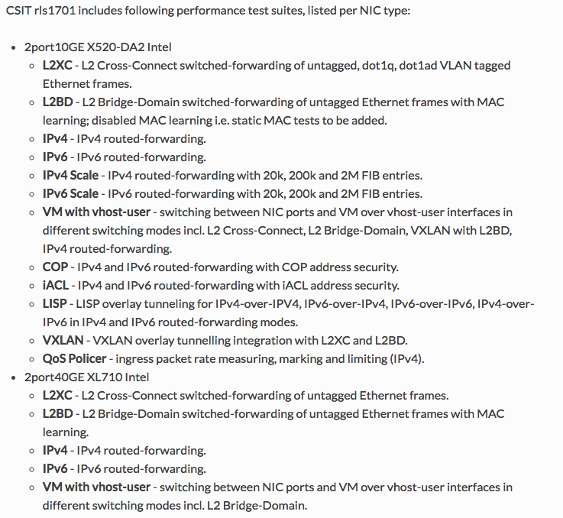
CSIT - Where We Got So Far … VPP Tests Summary List – We think we are “maturing"
https://docs.fd.io/csit/rls1701/report/vpp_functional_tests/overview.html
https://docs.fd.io/csit/rls1701/report/vpp_performance_tests/overview.html

Slide 10
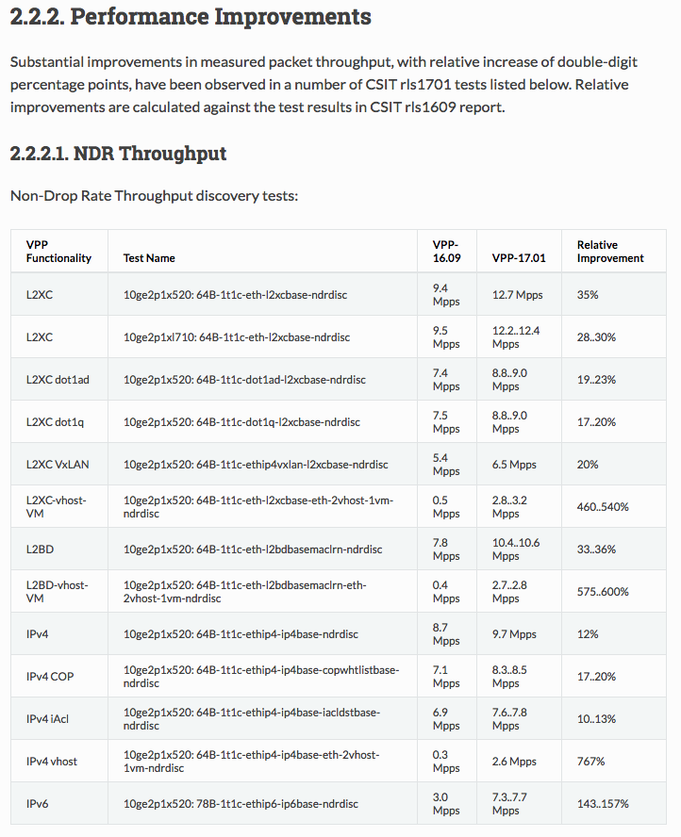
FD.io collaboration works – results speak for themselves …
Substantial performance improvements reported in csit rls1701 for vpp1701 release
L2 forwarding modes
VM vhost performance
IPv4 routed-forwarding
IPv6 routed-forwarding

Slide 11
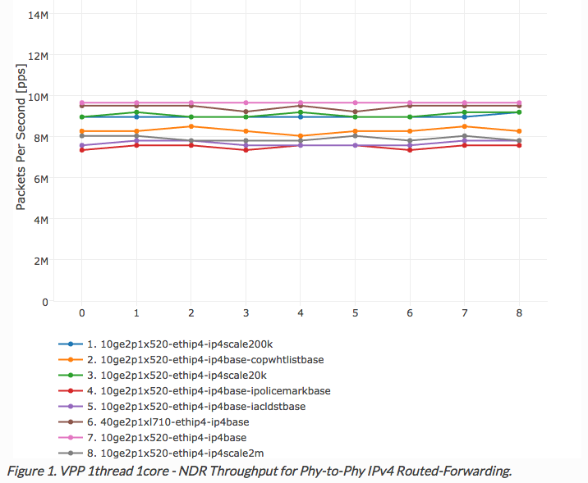
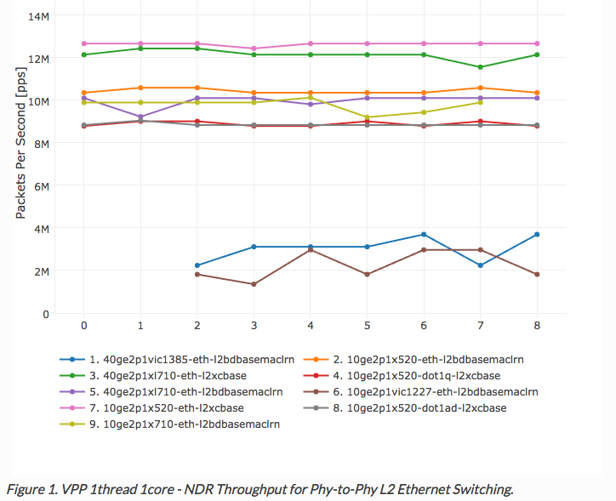
FD.io collaboration works – results speak for themselves …
Best practice environment settings and testing methodology applied by LF FD.io community.
Repeatible performance test results you can trust.
VPP L2 Ethernet Switching
VPP IPv4 Routed-Forwarding
https://docs.fd.io/csit/rls1701/report/vpp_performance_tests/packet_throughput_graphs/l2.html
https://docs.fd.io/csit/rls1701/report/vpp_performance_tests/packet_throughput_graphs/ipv4.html

Slide 12
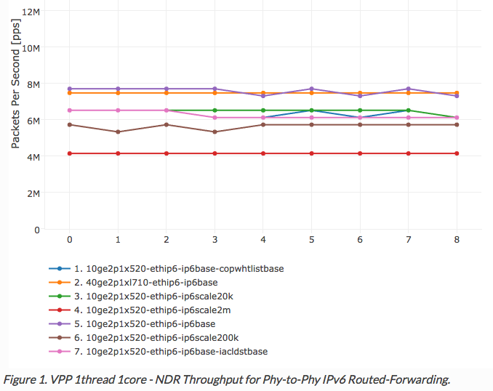
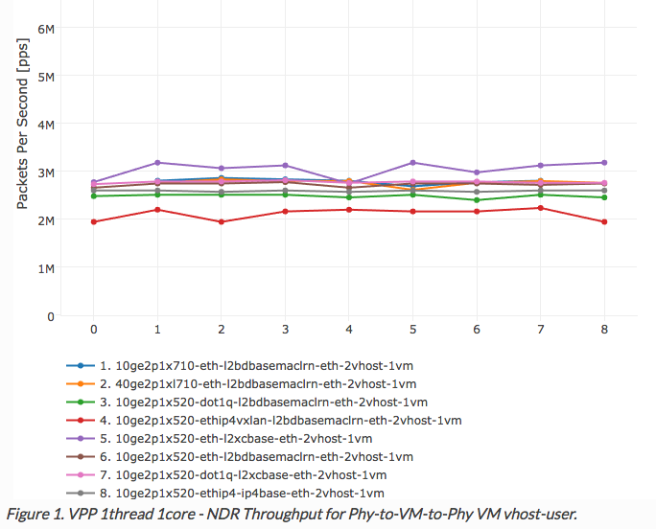
FD.io collaboration works – results speak for themselves …
Best practice environment settings and testing methodology applied by LF FD.io community.
Repeatible performance test results you can trust.
VM vhost-user Throughput
VPP IPv6 Routed-Forwarding
https://docs.fd.io/csit/rls1701/report/vpp_performance_tests/packet_throughput_graphs/vm_vhost.html
https://docs.fd.io/csit/rls1701/report/vpp_performance_tests/packet_throughput_graphs/ipv6.html

Slide 13
CSIT - Where We Want To Drive It… (1/2)
System-level improvements
Goal: Easier replicability, consumability, extensibility
Model-driven test definitions and analytics
More telemetry
Know exactly what's happening on machines: collectd
Periodic HW system baselinining: pcm, mlc, sys_info
CPU uarch: pmu-tools, CPU jitter measurement tools
Baseline instruction/cycle efficiency: Skylake packet trace
Continue to automate analytics
Better exception handling
More coding discipline :)
More HW for performance tests
More testbeds to do scale and parallelize execution
Add SMT⁽¹⁾/ HT⁽²⁾
Add multi-port multi-thread tests
More HW offload
Latest XEONs in 1- and 2-socket servers
100GE NICs, SmartNICs
Focus on use cases
VPP as vSwitch, vRouter – continue
VM vhost virtual interfaces
LXC shared-memory virtual interfaces
VPP as NF - new
Baremetal, VM, LXC
Atomic NF nodes - within one VPP
Service function chaining – across many VPPs
(1) SMT – Simultaneous Multi-Threading
(2) HT – Intel Hyper-Threading

Slide 14
CSIT - Where We Want To Drive It… (2/2)
Providing feedback to other LF projects
FD.io VPP
FD.io Honeycomb
DPDK
OPNFV
Making Test-Verified Use Recommendations for FD.io
Providing feedback to technology stack owners:
HW CPU: CPU technologies e.g. Intel
HW NICs: HW offload, driver costs, ...
OS: kernel related e.g. CFS
Virtualization: QEMU, libvirt, ...
Orchestration integration: OpenStack, ...
Asking technology stack owners for optimizations

Slide 15
CSIT – Challenges ..
Sandboxing performance tests – physical testbed capacity shortage.
FD.io Jenkins execution system reliability.
ci-management project dependencies.

Slide 16
Network system performance – reference network device benchmarking specs
IETF
RFC 2544, https://tools.ietf.org/html/rfc2544
RFC 1242, https://tools.ietf.org/html/rfc1242
opnfv/vsperf – vsperf.ltd
draft-vsperf-bmwg-vswitch-opnfv-01
https://tools.ietf.org/html/draft-vsperf-bmwg-vswitch-opnfv-01
Derivatives
vnet-sla, http://events.linuxfoundation.org/sites/events/files/slides/OPNFV_VSPERF_v10.pdf

Slide 17
Q&A

